Slide 2
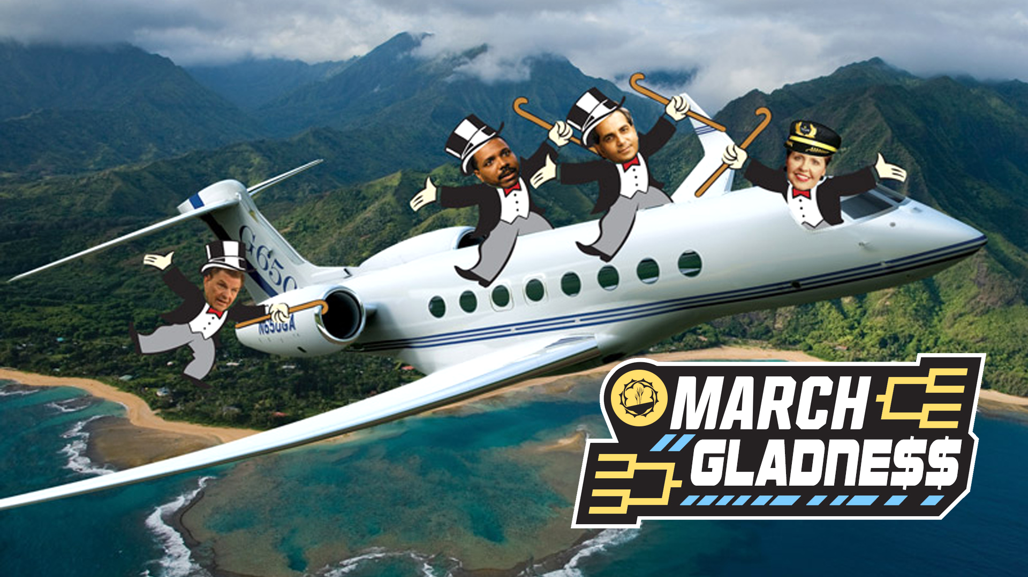

Slide 4
WHY DO WE GIVE?
We give to worship God

Slide 5
WHY DO WE GIVE?
We give to worship God
No one can serve two masters. Either you will hate the one and love the other, or you will be devoted to the one and despise the other. You cannot serve both God and money. Matthew 6:24

Slide 6
WHY DO WE GIVE?
We give to worship God
We give to care for others

Slide 7
WHY DO WE GIVE?
We give to worship God
We give to care for others
We give to care for ourselves

Slide 8
WHY DO WE GIVE?
We give to worship God
We give to care for others
We give to care for ourselves
…the Lord Jesus himself said: ‘It is more blessed to give than to receive.’ Acts 20:35

Slide 9
GIVING MAKES YOU HAPPIER
In a 2008 study, subjects were asked to rate their happiness and given an envelope containing either $5 or $20. The participants were randomly assigned to either spend the money on themselves or on someone else by the end of the day.¹ Those who spent the money on someone else reported happier moods than those who spent the money on themselves.
Elizabeth W. Dunn, Lara B. Akin, Michael I. Norton (2008). Spending Money on Others Promotes Happiness. Science 21 March 2008: Vol. 319, Issue 5870, pp. 1687-1688.
Elizabeth W. Dunn, Lara B. Akin, Michael I. Norton (2014). Prosocial Spending and Happiness: Using Money to Benefit Others Pays Off. Current Directions in Psychological Science 2014 23:41.

Slide 10
GIVING MAKES YOU HAPPIER
A separate group was asked to predict outcomes of the experiment and most believed those who spent money on themselves would be happier. Not only were they wrong, they were significantly wrong. The research suggests “thinking about money may propel individuals toward using their financial resources to benefit themselves, but spending money on others can provide a more effective route in increasing one’s own happiness.” ²
Elizabeth W. Dunn, Lara B. Akin, Michael I. Norton (2008). Spending Money on Others Promotes Happiness. Science 21 March 2008: Vol. 319, Issue 5870, pp. 1687-1688.
Elizabeth W. Dunn, Lara B. Akin, Michael I. Norton (2014). Prosocial Spending and Happiness: Using Money to Benefit Others Pays Off. Current Directions in Psychological Science 2014 23:41.

Slide 11
ETERNAL REWARDS
¹⁹ Do not store up for yourselves treasures on earth, where moths and vermin destroy, and where thieves break in and steal. ²⁰ But store up for yourselves treasures in heaven, where moths and vermin do not destroy, and where thieves do not break in and steal. ²¹ For where your treasure is, there your heart will be also. Matthew 6:19-21

Slide 12
ETERNAL REWARDS
¹⁷As for the rich in this present age, charge them not to be haughty, nor to set their hopes on the uncertainty of riches, but on God, who richly provides us with everything to enjoy. ¹⁸They are to do good, to be rich in good works, to be generous and ready to share, ¹⁹thus storing up treasure for themselves as a good foundation for the future, so that they may take hold of that which is truly life.
1 Timothy 6:17-19

Slide 13
RANDY ALCORN: MONEY, POSSESSIONS, and ETERNITY
Imagine you’re alive at the end of the Civil War. You’re living in the South, but you’re a Northerner. You plan to move home as soon as the war’s over. While in the South you’ve accumulated lots of Confederate currency. Now, suppose you know for a fact the North’s going to win the war, and the end is imminent. What will you do with your Confederate money? If you’re smart, there’s only one answer. You should immediately cash in your Confederate currency for U.S. currency—the only money that will have value once the war’s over. Keep only enough Confederate currency to meet your short-term needs.

Slide 15
NEXT STEPS
Become a child of the King

Slide 16
NEXT STEPS
Become a child of the King
Give 10% back to God through your church

Slide 17
NEXT STEPS
Become a child of the King
Give 10% back to God through your church
Give above and beyond to others

Slide 18
NEXT STEPS
Become a child of the King
Give 10% back to God through your church
Give above and beyond to others
Talk to others about your giving journey

