Slide 2
PRAYER & SOLITUDE
FASTING
SCRIPTURE
SHARING GOOD NEWS
SERVING
WORSHIP

Slide 3
SUBMISSION

Slide 5
HEBREWS 13:17 ^{NIV}
Have confidence in your leaders and submit to their authority, because they keep watch over you as those who must give an account. Do this so that their work will be a joy, not a burden, for that would be of no benefit to you.

Slide 6
HEBREWS 13:17 ^{NIV}
Have confidence in your leaders and submit to their authority, because they keep watch over you as those who must give an account. Do this so that their work will be a joy, not a burden, for that would be of no benefit to you.

Slide 7
Richard foster, celebration of discipline
"Of all the Spiritual Disciplines none has been more abused than the Discipline of submission. Somehow the human species has an extraordinary knack for taking the best teaching and turning it to the worst ends. Nothing can put people into bondage like religion, and nothing in religion has done more to manipulate and destroy people than a deficient teaching on submission. Therefore, we must work our way through this Discipline with great care and discernment in order to ensure that we are the minister of life, not death."

Slide 8
Mark 1:9-11 ^{NIV}
⁹ At that time Jesus came from Nazareth in Galilee
and was baptized by John in the Jordan.
¹⁰ Just as Jesus was coming up out of the water,
he saw heaven being torn open and
the Spirit descending on him like a dove.
¹¹ And a voice came from heaven:
“You are my Son, whom I love; with you I am well pleased.”
¹² At once the Spirit sent him out into the wilderness...

Slide 9
Mark 14:35-36 ^{NIV}
³⁵ Going a little farther, he fell to the ground and prayed that if possible the hour might pass from him. ³⁶ “Abba, Father,” he said, “everything is possible for you. Take this cup from me...”

Slide 10
Mark 14:35-36 ^{NIV}
³⁵ Going a little farther, he fell to the ground and prayed that if possible the hour might pass from him. ³⁶ “Abba, Father,” he said, “everything is possible for you. Take this cup from me... Yet not what I will, but what you will.”

Slide 11
Mark 14:35-36 ^{NIV}
³⁵ Going a little farther, he fell to the ground and prayed that if possible the hour might pass from him. ³⁶ “Abba, Father,” he said, “everything is possible for you. Take this cup from me... Yet not what I will, but what you will.”
For the joy set before him he endured the cross… Heb 12:2b

Slide 12
Mark 15:33-34, 37 ^{NIV}
³³ At noon, darkness came over the whole land until three in the afternoon. ³⁴ And at three in the afternoon Jesus cried out in a loud voice, “Eloi, Eloi, lema sabachthani?” (which means “My God, my God, why have you forsaken me?”).
³⁷ With a loud cry, Jesus breathed his last.

Slide 13
Mark 15:33-34, 37 ^{NIV}
³³ At noon, darkness came over the whole land until three in the afternoon. ³⁴ And at three in the afternoon Jesus cried out in a loud voice, “Eloi, Eloi, lema sabachthani?” (which means “My God, my God, why have you forsaken me?”).
³⁷ With a loud cry, Jesus breathed his last.
…gave/yielded up his spirit. Matt 27:50 & Jn 19:30

Slide 14
Mark 15:33-34, 37 ^{NIV}
³³ At noon, darkness came over the whole land until three in the afternoon. ³⁴ And at three in the afternoon Jesus cried out in a loud voice, “Eloi, Eloi, lema sabachthani?” (which means “My God, my God, why have you forsaken me?”).
³⁷ With a loud cry, Jesus breathed his last.
This is how we know what love is: Jesus Christ laid down his life for us. And we ought to lay down our lives for our brothers and sisters. 1 Jn 3:16

Slide 15
Mark 15:33-34, 37 ^{NIV}
³³ At noon, darkness came over the whole land until three in the afternoon. ³⁴ And at three in the afternoon Jesus cried out in a loud voice, “Eloi, Eloi, lema sabachthani?” (which means “My God, my God, why have you forsaken me?”).
³⁷ With a loud cry, Jesus breathed his last.
“Whoever wants to be my disciple must deny themselves and take up their cross and follow me.“ Mk 8:34

Slide 17
Ephesians 5:21-25 ^{NIV}
²¹ Submit to one another out of reverence for Christ. ²² Wives, submit yourselves to your own husbands as you do to the Lord. ²³ For the husband is the head of the wife as Christ is the head of the church, his body, of which he is the Savior. ²⁴ Now as the church submits to Christ, so also wives should submit to their husbands in everything. ²⁵ Husbands, love your wives, just as Christ loved the church and gave himself up for her...

Slide 18
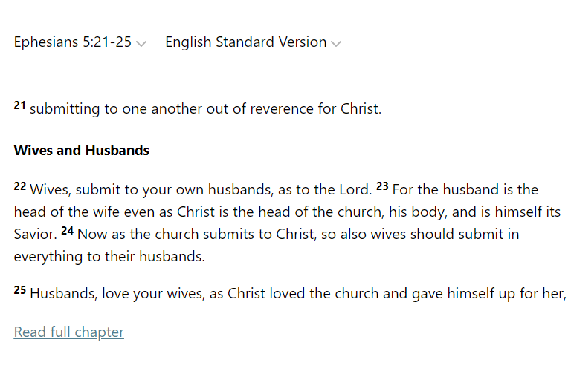
Ephesians 5:21-25 ^{NIV}

Slide 19
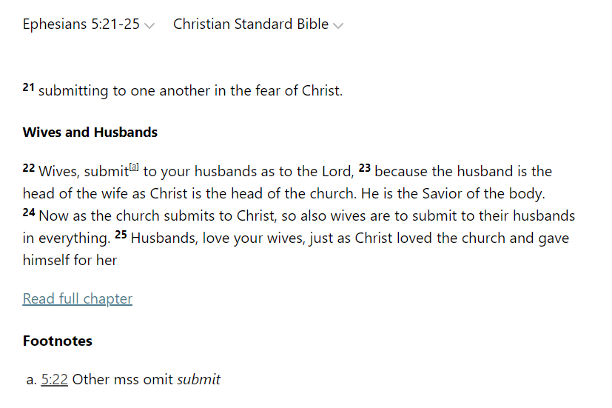
Ephesians 5:21-25 ^{NIV}

Slide 20
Ephesians 5:21-25 ^{NIV}

Slide 21
Josephus, Against apion
"It (laws about marriage) commands us also, when we marry, not to have regard to a portion; nor to take a woman by violence; nor to persuade her deceitfully and knavishly: but to demand her in marriage of him who hath power to dispose of her, and is fit to give her away by the nearness of his kindred. For, says the scripture, *A woman is inferior to her husband in all things. Let her therefore be obedient to him."
*This text is no where in our present copies of the Old Testament.

Slide 22
aristotle, politics
"Of household management... A husband and father, we saw, rules over wife and children, both free, but the rule differs, the rule over his children being a royal, over his wife a constitutional rule. For although there may be exceptions to the order of nature, the male is by nature fitter for command than the female, just as the elder and full-grown is superior to the younger and more immature."

Slide 23
Ben Witherington Iii, the paul quest
"Even if beginning in verse 22 Paul is taking over a traditional household code, the connecting of verse 22 to 21 means that whatever submit means in the relationship of all Christians to each other, including males to females ('submit to one another'), is also what it means for a Christian wife in relationship to her husband."

Slide 24
Ben Witherington Iii, the paul quest
"Put another way, the submission of wives to husbands is simply a particular example of how all Christians should submit to one another out of respect. When the text goes on to say, 'Husbands, love your wives...' and then describes Christ's self-sacrificial act, even submitting to death, as the model of this love, we see that the husband also is submitting to the wife... Thus in fact verse 22-33 serve as one large explication of how husband and wife submit to each other and serve each other."

Slide 25
Richard foster, celebration of discipline
"The call for Christians to live the cross-life is rooted in the cross-life of Jesus himself. The Discipline of submission has been terribly misconstrued and abused from failure to see this wider context. Submission is an ethical theme that runs the gamut of the New Testament. It is a posture obligatory upon all Christians: men as well as women, fathers as well as children, masters as well as slaves.”

Slide 26
Richard foster, celebration of discipline
“We are commanded to live a life of submission because Jesus lived a life of submission, not because we are in a particular place or station in life. Self-denial is a posture fitting for all those who follow the crucified Lord. Everywhere in the Hausetafel (house-table, a table of rules for the Christian household) the one and only compelling reason for submission is the example of Jesus."

Slide 27
1 Corinthians 7:4-5a ^{NIV}
⁴ The wife does not have authority over her own body
but yields it to her husband.

Slide 28
1 Corinthians 7:4-5a ^{NIV}
⁴ The wife does not have authority over her own body
but yields it to her husband.
In the same way,
the husband does not have authority over his own body
but yields it to his wife.

Slide 29
1 Corinthians 7:4-5a ^{NIV}
⁴ The wife does not have authority over her own body
but yields it to her husband.
In the same way,
the husband does not have authority over his own body
but yields it to his wife.
^{5a} Do not deprive each other except perhaps
by mutual consent and for a time…

Slide 30
Richard foster, celebration of discipline
"This singular rationale for submission is staggering when we compare it to other first-century writings. In them there was a constant appeal to submission because that was the way the gods had created things; it was one's station in life. Not a single New Testament writer appeals to submission on that basis. The teaching is revolutionary. They completely ignored all the contemporary customs of superordinate and subordinate and called everyone to 'count others better than yourselves’
(Phil. 2:3)."

Slide 31
Philippians 2:3-11 ^{NIV}
³ Do nothing out of selfish ambition or vain conceit.
Rather, in humility value others above yourselves,
⁴ not looking to your own interests
but each of you to the interests of the others.
⁵ In your relationships with one another,
have the same mindset as Christ Jesus:
⁶ Who, being in very nature God,
did not consider equality with God
something to be used to his own advantage;

Slide 32
Philippians 2:3-11 ^{NIV}
⁷ rather, he made himself nothing
by taking the very nature of a servant,
being made in human likeness.
⁸ And being found in appearance as a man,
he humbled himself
by becoming obedient to death—
even death on a cross!

Slide 33
Philippians 2:3-11 ^{NIV}
⁹ Therefore God exalted him to the highest place
and gave him the name that is above every name,
¹⁰ that at the name of Jesus every knee should bow,
in heaven and on earth and under the earth,
¹¹ and every tongue acknowledge that Jesus Christ is Lord,
to the glory of God the Father.

Slide 34
Submit to the Father, the Son, and the Holy Spirit

Slide 35
Submit to the Father, the Son, and the Holy Spirit
Submit to one another

Slide 36
PRACTICING SUBMISSION
Beginning: Practice submission in small ways
Baseline: Ask the Father where you need to yield to Him during Lent (starts March 2nd)
Stretch: Cultivate a lifestyle of sacrificial submission

