Slide 1
RADICAL JESUS

Slide 2
RADICAL JESUS
Young vs. Old Earth
Vaccines
Refugees
Women in the Church

Slide 3
RADICAL JESUS
Young vs. Old Earth
Vaccines
Refugees
Women in the Church Money & Possessions

Slide 4
Money, Possessions, & THE WAY OF JESUS

Slide 5
Money, Possessions, & THE WAY OF JESUS
NOISE IN THE ROOM:
CYNICISM & CONSUMERISM

Slide 6
Money, Possessions, & THE WAY OF JESUS
NOISE IN THE ROOM:
CYNICISM & CONSUMERISM

Slide 7
The grass withers, the flower fades, but the word of our God will stand forever.
ISAIAH 40:8

Slide 8
Money, Possessions, & THE WAY OF JESUS

Slide 9
…the Lord Jesus himself said: ‘It is more blessed to give than to receive.’
ACTS 20:35

Slide 10
…the Lord Jesus himself said: ‘It is more blessed to give than to receive.’
HAPPY!
ACTS 20:35

Slide 11
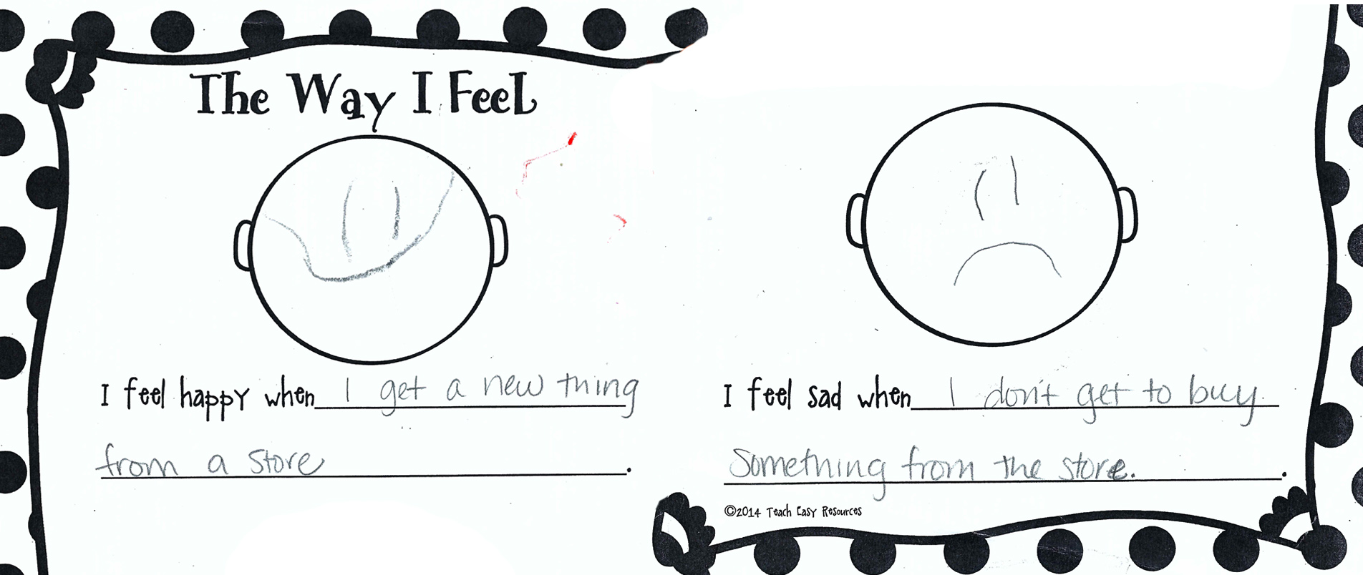
…the Lord Jesus himself said: ‘It is more blessed to give than to receive.’
HAPPY!
ACTS 20:35

Slide 12
…the Lord Jesus himself said: ‘It is more blessed to give than to receive.’
HAPPY!
ACTS 20:35

Slide 13
PARABLE OF THE RICH FARMER
¹³ Someone in the crowd said to him, “Teacher, tell my brother to divide the inheritance with me.” ¹⁴ But he said to him, “Man, who made me a judge or arbitrator over you?” ¹⁵ And he said to them, “Take care, and be on your guard against all types of greed, for one's life does not consist in the abundance of his possessions.” ¹⁶ And he told them a parable, saying, “The land of a rich man produced plentifully, ¹⁷ and he thought to himself, ‘What shall I do, for I have nowhere to store my crops?’ ¹⁸ And he said, ‘I will do this: I will tear down my barns and build larger ones, and there I will store all my grain and my goods. ¹⁹ And I will say to my soul, “Soul, you have ample goods laid up for many years; relax, eat, drink, be merry.”’ ²⁰ But God said to him, ‘Fool! This night your soul is required of you, and the things you have prepared, whose will they be?’ ²¹ So is the one who lays up treasure for himself and is not rich toward God.”
LUKE 12:13-21

Slide 14
PARABLE OF THE RICH FARMER
¹³ Someone in the crowd said to him, “Teacher, tell my brother to divide the inheritance with me.” ¹⁴ But he said to him, “Man, who made me a judge or arbitrator over you?” ¹⁵ And he said to them, “Take care, and be on your guard against all types of greed, for one's life does not consist in the abundance of his possessions.” ¹⁶ And he told them a parable, saying, “The land of a rich man produced plentifully, ¹⁷ and he thought to himself, ‘What shall I do, for I have nowhere to store my crops?’ ¹⁸ And he said, ‘I will do this: I will tear down my barns and build larger ones, and there I will store all my grain and my goods. ¹⁹ And I will say to my soul, “Soul, you have ample goods laid up for many years; relax, eat, drink, be merry.”’ ²⁰ But God said to him, ‘Fool! This night your soul is required of you, and the things you have prepared, whose will they be?’ ²¹ So is the one who lays up treasure for himself and is not rich toward God.”
LUKE 12:13-21

Slide 15
PARABLE OF THE RICH FARMER
¹³ Someone in the crowd said to him, “Teacher, tell my brother to divide the inheritance with me.” ¹⁴ But he said to him, “Man, who made me a judge or arbitrator over you?” ¹⁵ And he said to them, “Take care, and be on your guard against all types of greed, for one's life does not consist in the abundance of his possessions.” ¹⁶ And he told them a parable, saying, “The land of a rich man produced plentifully, ¹⁷ and he thought to himself, ‘What shall I do, for I have nowhere to store my crops?’ ¹⁸ And he said, ‘I will do this: I will tear down my barns and build larger ones, and there I will store all my grain and my goods. ¹⁹ And I will say to my soul, “Soul, you have ample goods laid up for many years; relax, eat, drink, be merry.”’ ²⁰ But God said to him, ‘Fool! This night your soul is required of you, and the things you have prepared, whose will they be?’ ²¹ So is the one who lays up treasure for himself and is not rich toward God.”
LUKE 12:13-21

Slide 16
PARABLE OF THE RICH FARMER
¹³ Someone in the crowd said to him, “Teacher, tell my brother to divide the inheritance with me.” ¹⁴ But he said to him, “Man, who made me a judge or arbitrator over you?” ¹⁵ And he said to them, “Take care, and be on your guard against all types of greed, for one's life does not consist in the abundance of his possessions.” ¹⁶ And he told them a parable, saying, “The land of a rich man produced plentifully, ¹⁷ and he thought to himself, ‘What shall I do, for I have nowhere to store my crops?’ ¹⁸ And he said, ‘I will do this: I will tear down my barns and build larger ones, and there I will store all my grain and my goods. ¹⁹ And I will say to my soul, “Soul, you have ample goods laid up for many years; relax, eat, drink, be merry.”’ ²⁰ But God said to him, ‘Fool! This night your soul is required of you, and the things you have prepared, whose will they be?’ ²¹ So is the one who lays up treasure for himself and is not rich toward God.”
LUKE 12:13-21

Slide 17
PARABLE OF THE RICH FARMER
¹³ Someone in the crowd said to him, “Teacher, tell my brother to divide the inheritance with me.” ¹⁴ But he said to him, “Man, who made me a judge or arbitrator over you?” ¹⁵ And he said to them, “Take care, and be on your guard against all types of greed, for one's life does not consist in the abundance of his possessions.” ¹⁶ And he told them a parable, saying, “The land of a rich man produced plentifully, ¹⁷ and he thought to himself, ‘What shall I do, for I have nowhere to store my crops?’ ¹⁸ And he said, ‘I will do this: I will tear down my barns and build larger ones, and there I will store all my grain and my goods. ¹⁹ And I will say to my soul, “Soul, you have ample goods laid up for many years; relax, eat, drink, be merry.”’ ²⁰ But God said to him, ‘Fool! This night your soul is required of you, and the things you have prepared, whose will they be?’ ²¹ So is the one who lays up treasure for himself and is not rich toward God.”
LUKE 12:13-21

Slide 18
FOUR FOOLISH ASSUMPTIONS
I’ll live a long time.
This is all my stuff.
I’m supposed to spend it on myself.
This world is my real home.
LUKE 12:13-21

Slide 19
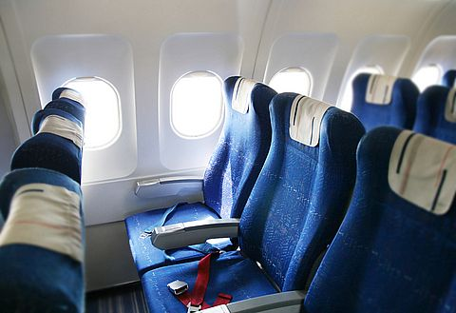
FOUR FOOLISH ASSUMPTIONS
LUKE 12:13-21

Slide 20
FOUR FOOLISH ASSUMPTIONS
LUKE 12:13-21

Slide 21
FOUR FOOLISH ASSUMPTIONS
LUKE 12:13-21

Slide 22
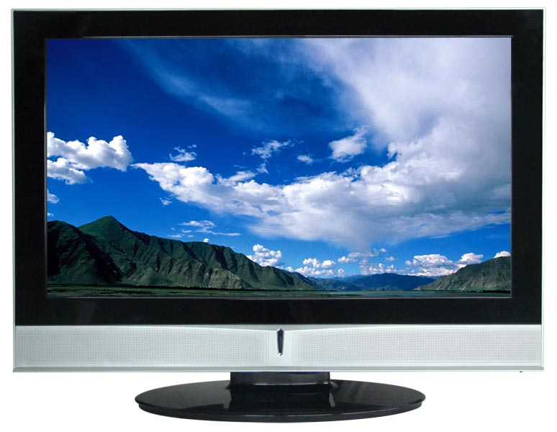
FOUR FOOLISH ASSUMPTIONS
LUKE 12:13-21

Slide 23
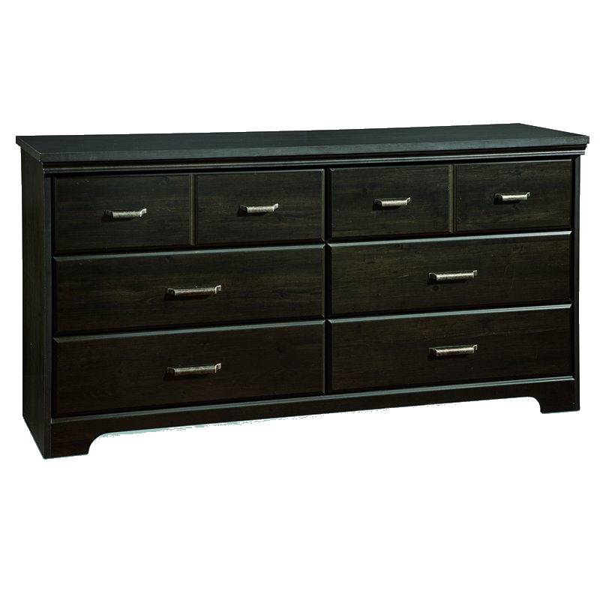
FOUR FOOLISH ASSUMPTIONS
LUKE 12:13-21

Slide 24
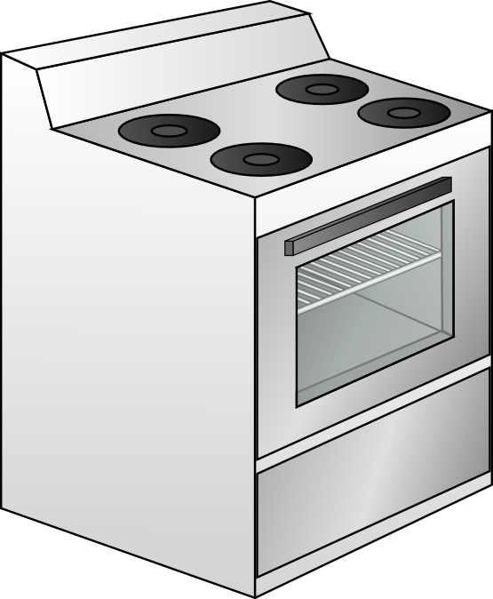
FOUR FOOLISH ASSUMPTIONS
LUKE 12:13-21

Slide 25
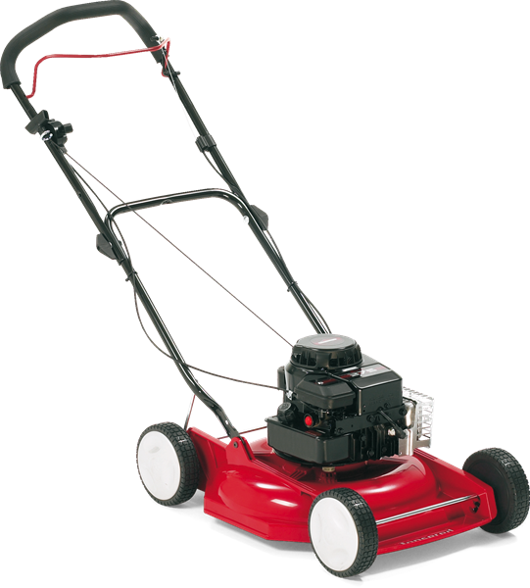
FOUR FOOLISH ASSUMPTIONS
LUKE 12:13-21

Slide 26
FOUR FOOLISH ASSUMPTIONS
LUKE 12:13-21

Slide 27
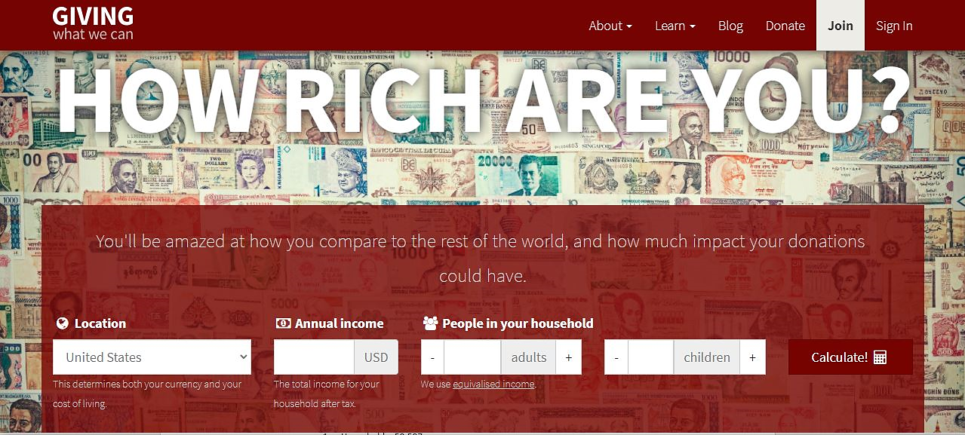
AM I RICH?
GIVINGWHATWECAN.ORG

Slide 28
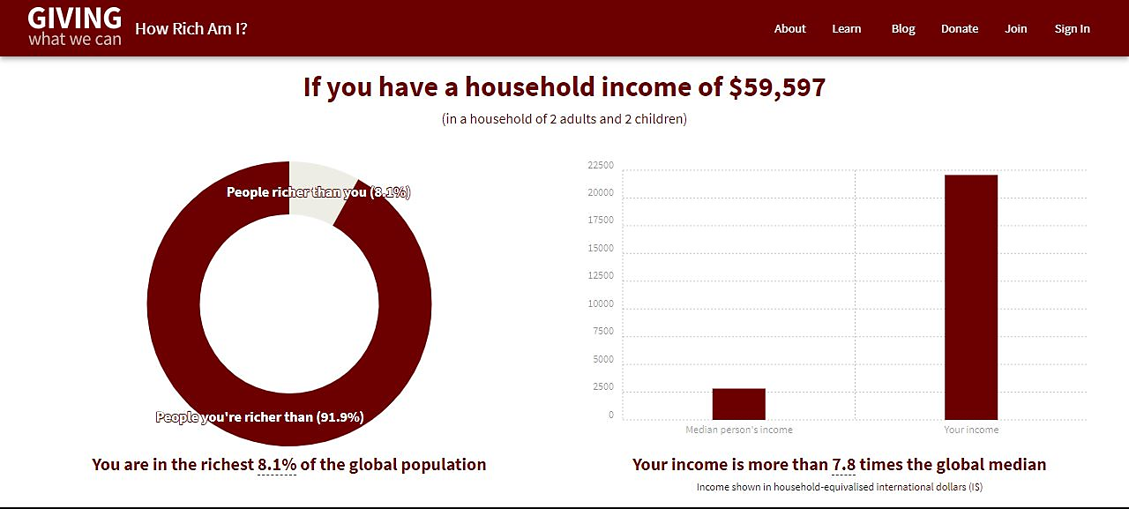
AM I RICH?
GIVINGWHATWECAN.ORG

Slide 29
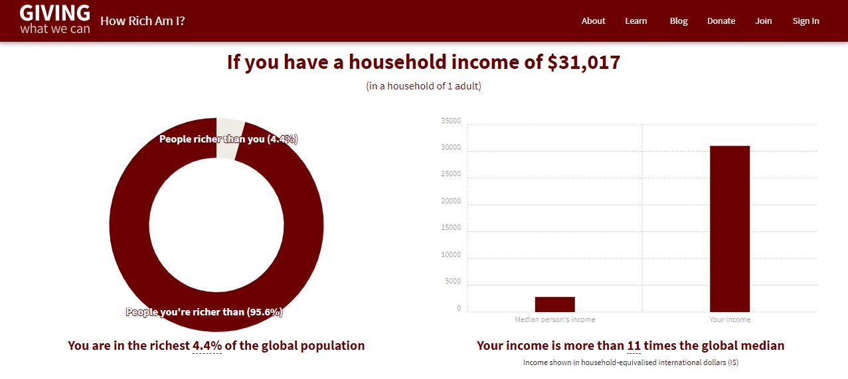
AM I RICH?
GIVINGWHATWECAN.ORG

Slide 30
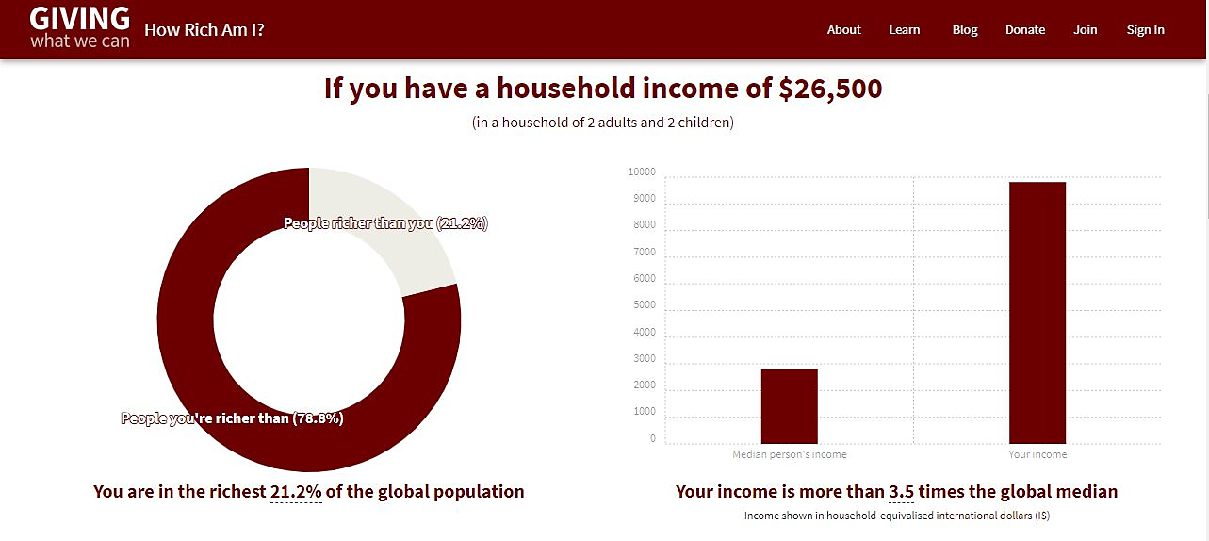
AM I RICH?
GIVINGWHATWECAN.ORG

Slide 31
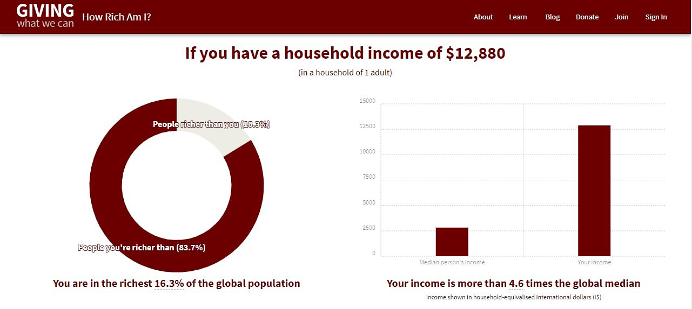
AM I RICH?
GIVINGWHATWECAN.ORG

Slide 32
THE SPECTRUM OF GREED
SPENDERS
Happiness : Consuming Stuff
Pleasure
SAVERS
Happiness : Keeping Safety

Slide 33
THE ANTIDOTE TO GREED

Slide 34
THE ANTIDOTE TO GREED
RADICAL GENEROSITY
GOSPEL STEWARDSHIP

Slide 35
APPLICATION
RADICAL GENEROSITY

Slide 36
APPLICATION
1) Accept the free gift of Jesus.
RADICAL GENEROSITY

Slide 37
APPLICATION
1) Accept the free gift of Jesus.
2) Give generously!
RADICAL GENEROSITY

Slide 38
APPLICATION
1) Accept the free gift of Jesus.
2) Give generously!
1 TIMOTHY 6:17-19
¹⁷ Command those who are rich in this present world not to be arrogant nor to put their hope in wealth, which is so uncertain, but to put their hope in God, who richly provides us with everything for our enjoyment. ¹⁸ Command them to do good, to be rich in good deeds, and to be generous and willing to share. ¹⁹ In this way they will lay up treasure for themselves as a firm foundation for the coming age, so that they may take hold of the life that is truly life.
RADICAL GENEROSITY

Slide 39
APPLICATION
1) Accept the free gift of Jesus.
2) Give generously!
→ To our church family tallgrass.church/give choose “Better Together Fund”
RADICAL GENEROSITY

Slide 40
APPLICATION
1) Accept the free gift of Jesus.
2) Give generously!
What’s your next step in response to this teaching?
RADICAL GENEROSITY

Slide 41
THE APOSTLES’ CREED
I believe in Jesus Christ, his only Son, our Lord,
who was conceived by the Holy Spirit,
born of the Virgin Mary,
suffered under Pontius Pilate,
was crucified, died, and was buried;

Slide 42
THE APOSTLES’ CREED
On the third day he rose again;
he ascended into heaven,
he is seated at the right hand of the Father,
and he will come to judge the living and the dead.

Slide 43
THE APOSTLES’ CREED
I believe in the Holy Spirit,
the holy *catholic Church,
the communion of saints,
the forgiveness of sins,
the resurrection of the body,
and the life everlasting.
Amen.
*the whole church in all times and places

Slide 44
CELEBRATION

