Slide 1
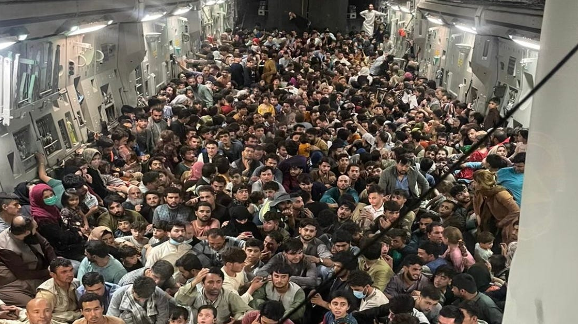

Slide 2
RADICAL JESUS

Slide 3
The grass withers, the flower fades, but the word of our God will stand forever.
ISAIAH 40:8

Slide 4
³³ “When a stranger sojourns with you in your land, you shall not do him wrong. ³⁴ You shall treat the stranger who sojourns with you as the native among you, and you shall love him as yourself, for you were strangers in the land of Egypt: I am the LORD your God.
LEVITICUS 19:33-34

Slide 5
REFUGEES &
YOUR STORY

Slide 6
THEREFORE, LOVE REFUGEES!
³³ “When a stranger sojourns with you in your land, you shall not do him wrong. ³⁴ You shall treat the stranger who sojourns with you as the native among you, and you shall love him as yourself, for you were strangers in the land of Egypt: I am the LORD your God.
LEVITICUS 19:33-34

Slide 7
SIGN THE PRINCIPLES
Our national immigration laws have created a moral, economic and political crisis in America. Initiatives to remedy this crisis have led to polarization and name calling in which opponents have misrepresented each other’s positions as open borders and amnesty versus deportations of millions. This false choice has led to an unacceptable political stalemate at the federal level at a tragic human cost. We urge our nation’s leaders to work together with the American people to pass immigration reform that embodies these key principles and that will make our nation proud.

Slide 8
SIGN THE PRINCIPLES
As evangelical Christian leaders, we call for a bipartisan solution on immigration that:
Respects the God-given dignity of every person
Protects the unity of the immediate family
Respects the rule of law
Guarantees secure national borders
Ensures fairness to taxpayers
Establishes a path toward legal status and/or citizenship for those who qualify and who wish to become permanent residents

Slide 9
THEREFORE, LOVE REFUGEES!
³³ “When a stranger sojourns with you in your land, you shall not do him wrong. ³⁴ You shall treat the stranger who sojourns with you as the native among you, and you shall love him as yourself, for you were strangers in the land of Egypt: I am the LORD your God.
LEVITICUS 19:33-34

Slide 10
THEREFORE, LOVE REFUGEES!
Therefore welcome one another as Christ has welcomed you, for the glory of God.
ROMANS 15:7

Slide 11
THEREFORE, LOVE REFUGEES!
² Therefore an overseer must be above reproach, the husband of one wife, sober-minded, self-controlled, respectable, hospitable, able to teach, ³ not a drunkard, not violent but gentle, not quarrelsome, not a lover of money.
1 TIMOTHY 2:2-3

Slide 12
THEREFORE, LOVE REFUGEES!
² Therefore an overseer must be above reproach, the husband of one wife, sober-minded, self-controlled, respectable, Φιλόξενον (philoxenon), able to teach, ³ not a drunkard, not violent but gentle, not quarrelsome, not a lover of money.
1 TIMOTHY 2:2-3

Slide 13
THEREFORE, LOVE REFUGEES!
² Continue steadfastly in prayer, being watchful in it with thanksgiving. ³ At the same time, pray also for us, that God may open to us a door for the word, to declare the mystery of Christ, on account of which I am in prison—
COLOSSIANS 4:2-3

Slide 14
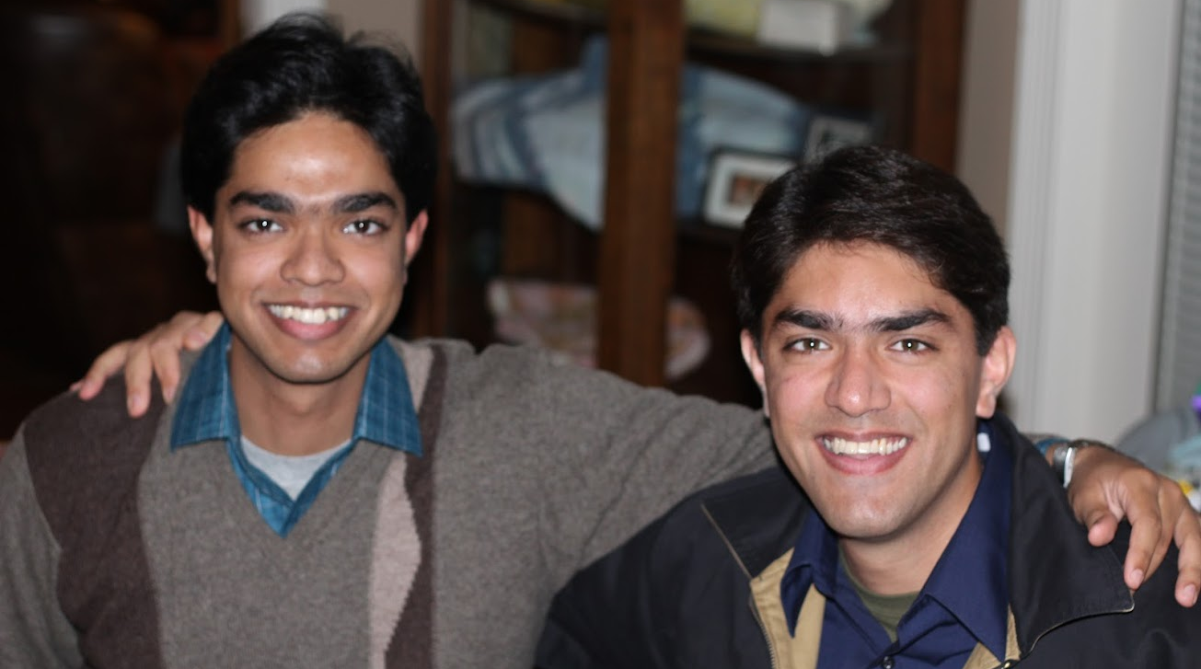
SAAD VISITS THE CRUSADERS

Slide 15
SAAD VISITS THE CRUSADERS
SUNDAY SCHOOL CLASS

Slide 16
SAAD VISITS THE CRUSADERS
SUNDAY SCHOOL CLASS

Slide 17
THEREFORE, LOVE REFUGEES!
And let our people learn to devote themselves to good works, so as to help cases of urgent need, and not be unfruitful.
TITUS 3:14

Slide 18
THEREFORE, LOVE REFUGEES!
⁹ And let us not grow weary of doing good, for in due season we will reap, if we do not give up. ¹⁰ So then, as we have opportunity, let us do good to everyone, and especially to those who are of the household of faith.
GALATIANS 6:9-10

Slide 20
RON GOODMAN
You shall stand up before the gray head and honor the face of an old man… Leviticus 19:32a

Slide 21
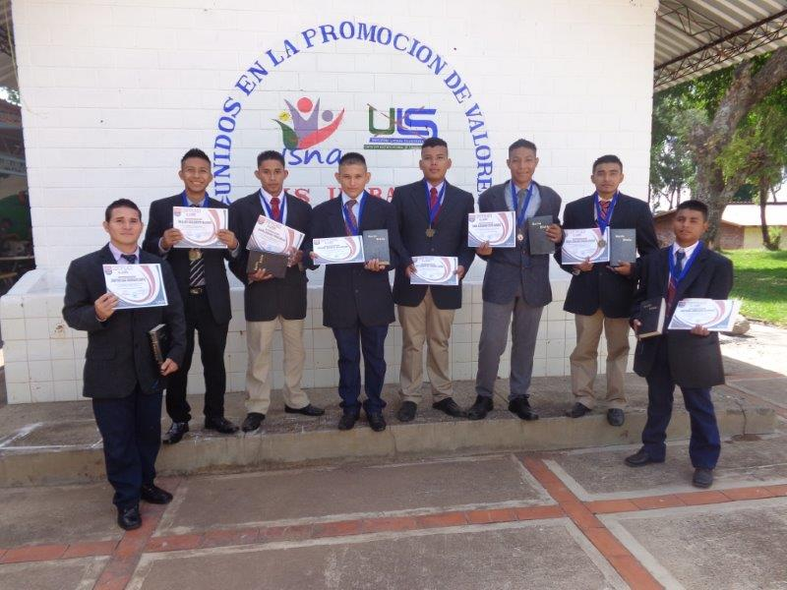
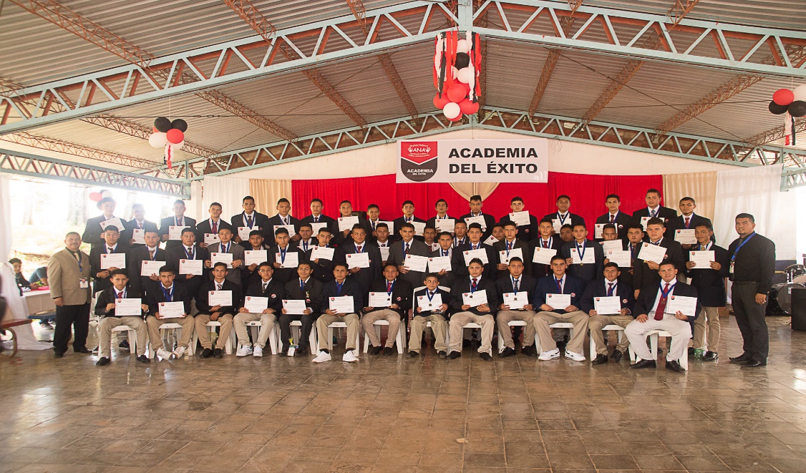
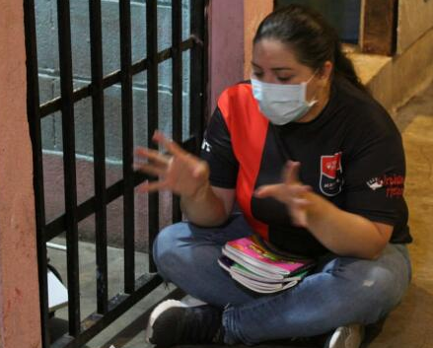
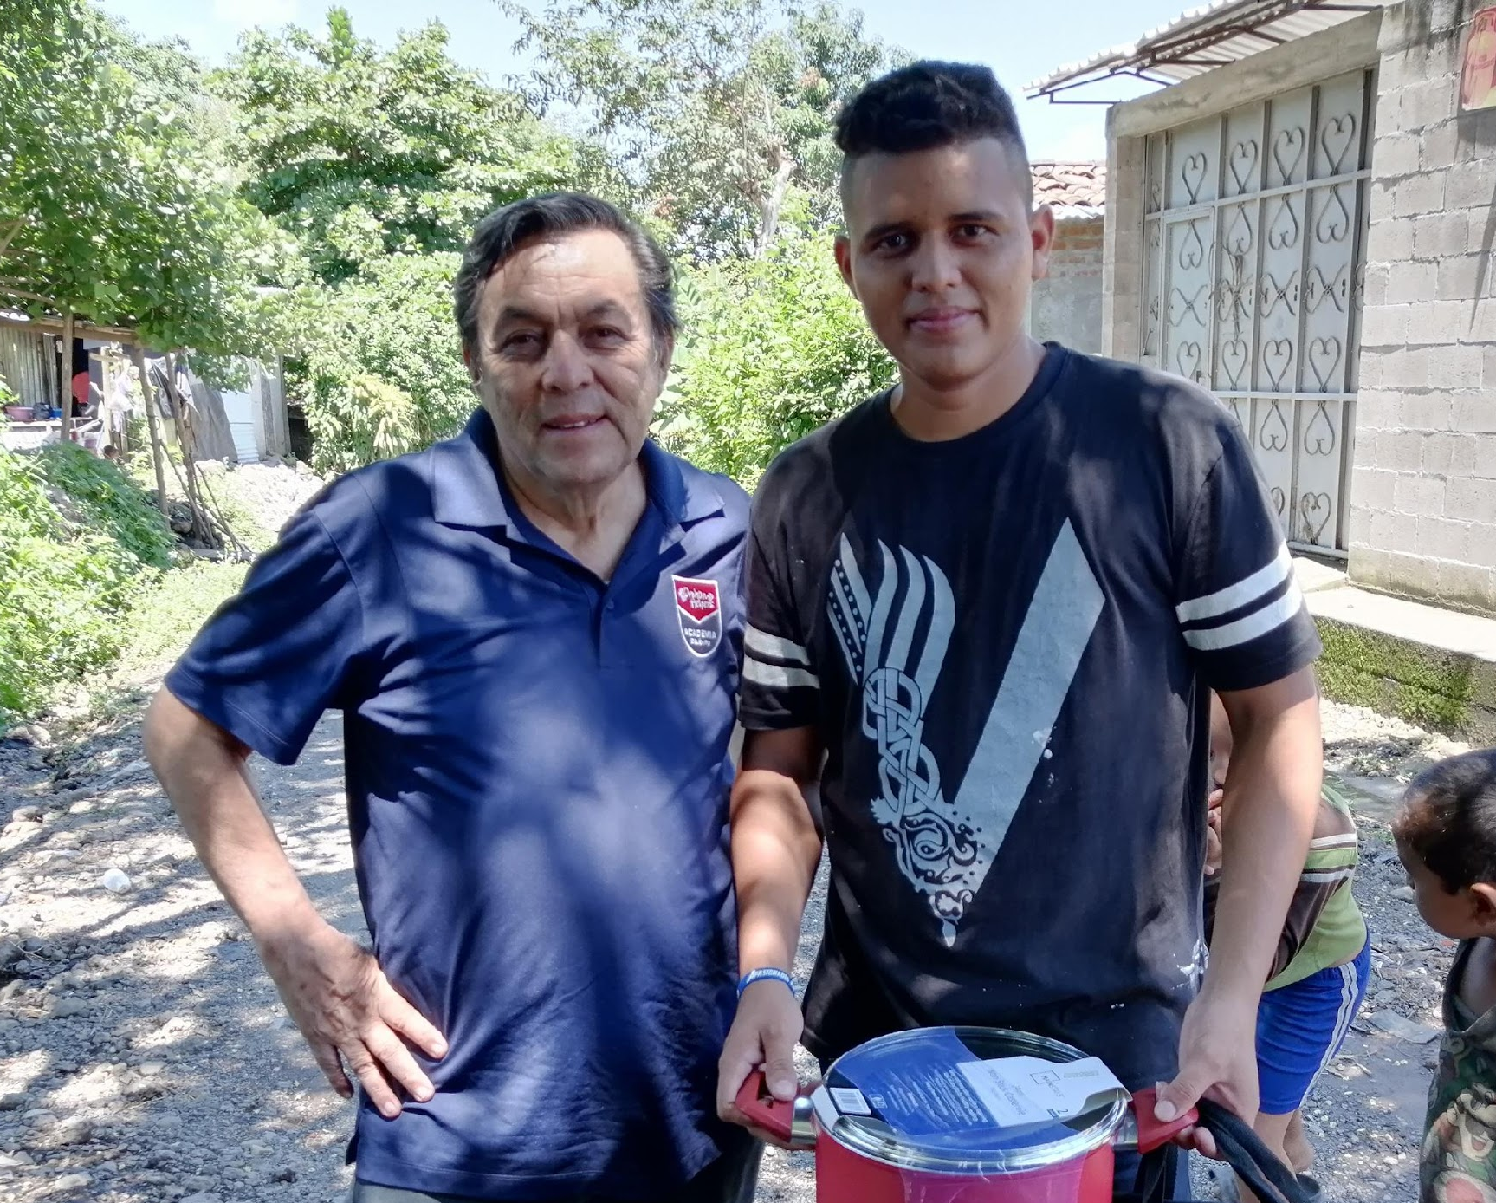
SUCCESS ACADEMY
REACHING YOUTH SINCE 2000

Slide 22
WHAT WE DO
Go inside youth prisons
Provide support after release

Slide 23
WHERE WE SERVE
El Salvador
3 Detention Centers for Boys
1 Detention Center for Girls
1 Protection Center for Boys
Expand soon to center for 900 youth, ages 18-25
Honduras
4 Detention Centers for Boys
1 Detention Center for Girls
Guatemala coming soon!

Slide 24
OUR “WHY”
We believe every youth has a future worth fighting for!

Slide 25
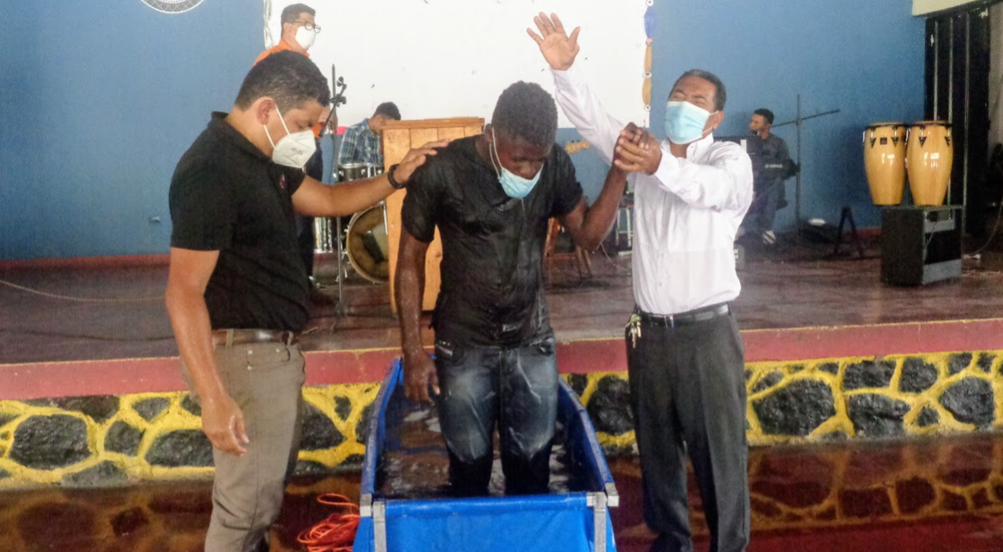
OUR “WHY”
Hope to the hopeless – found in Christ!

Slide 26
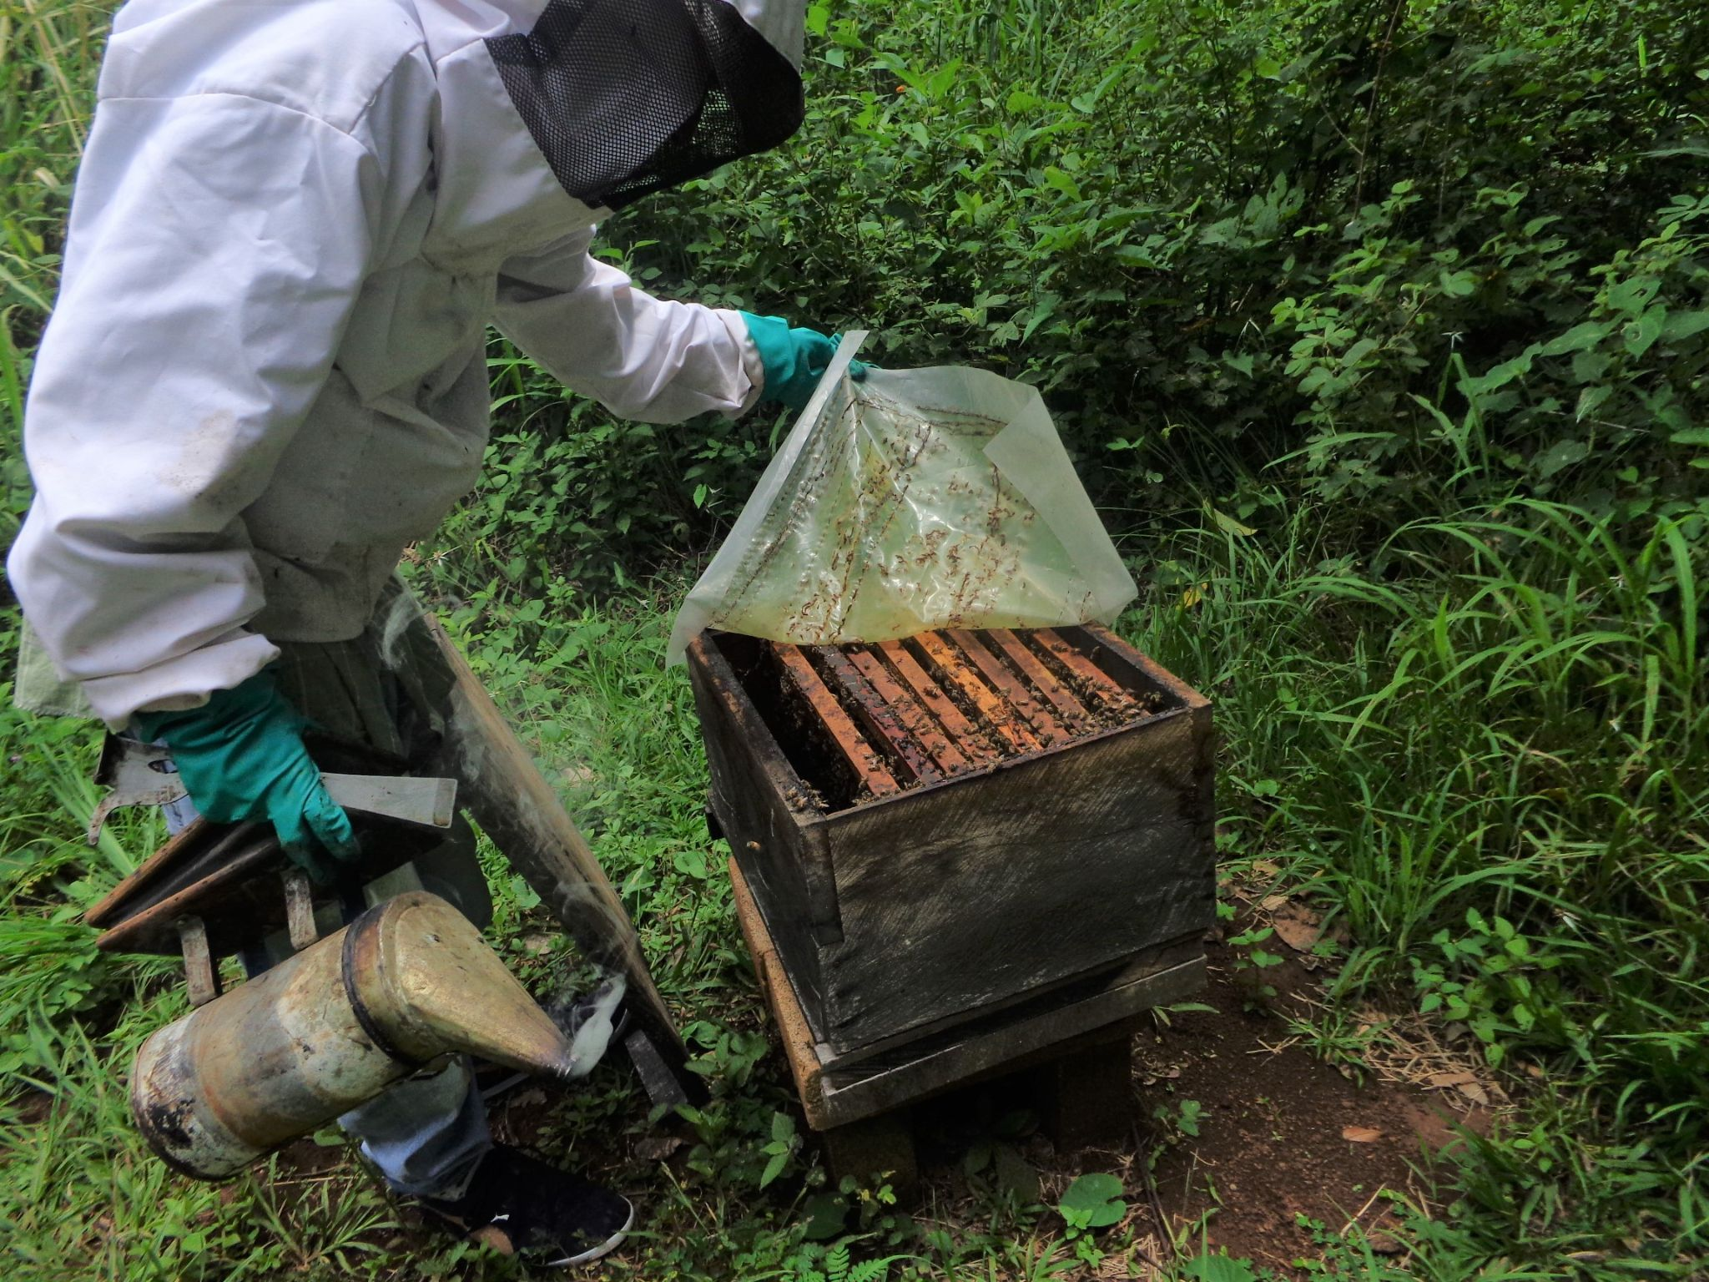
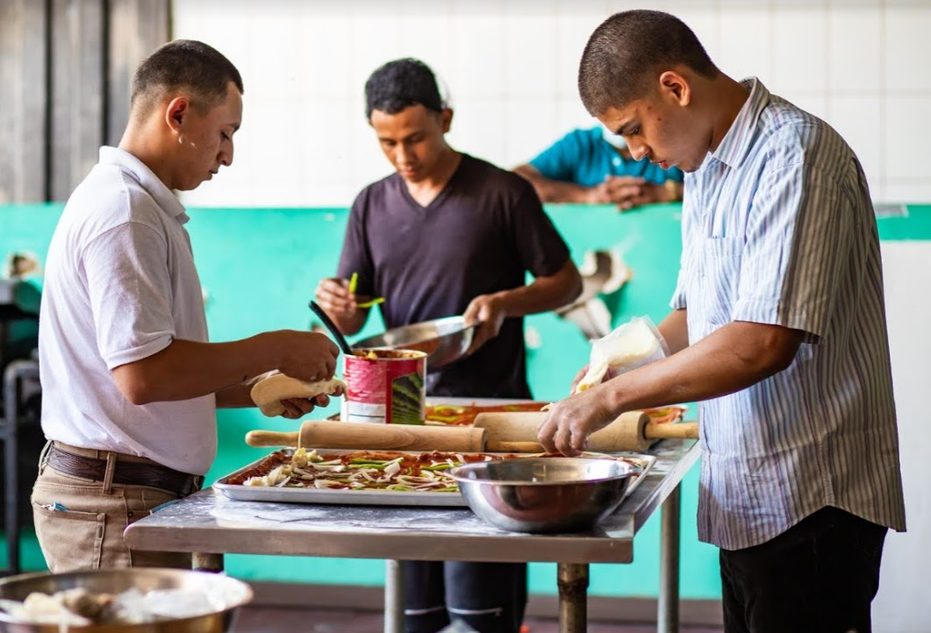
OUR “WHY”
Dignity and purpose through life skills

Slide 27
THE CALL TO SERVE
THE FATHERLESS Defend the weak and the fatherless. Psalm 82:3
THE PRISONER I was in prison and you came to me. Matthew 25:36
THE POOR The angel answered, “Your prayers and gifts to the poor have come up as a memorial offering before God.” Acts 10:4
THE HURTING He's the one who comforts us in all our trouble so that we can comfort other people who are in every kind of trouble. 2 Corinthians 1:4

Slide 28
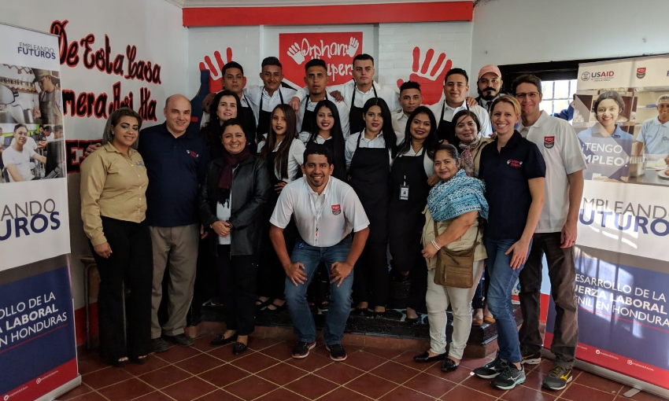
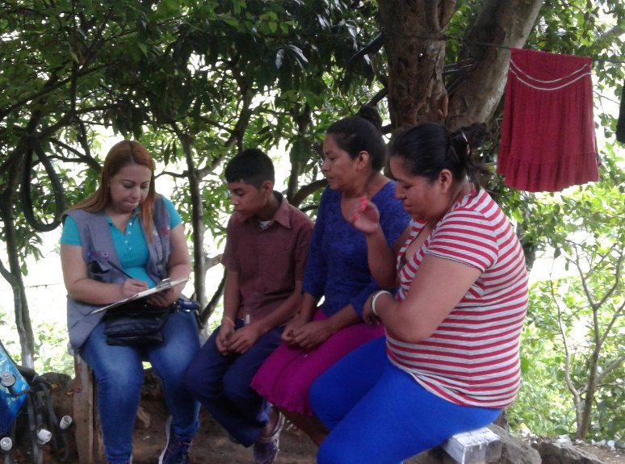
WHAT’S BEEN DONE?
Job training
Family counseling

Slide 29
SUCCESS ACADEMY SINCE 2016
801 Graduates
269 Baptisms

Slide 30
SUCCESS COACHES
Johanna
A TRUE CALLING

Slide 31
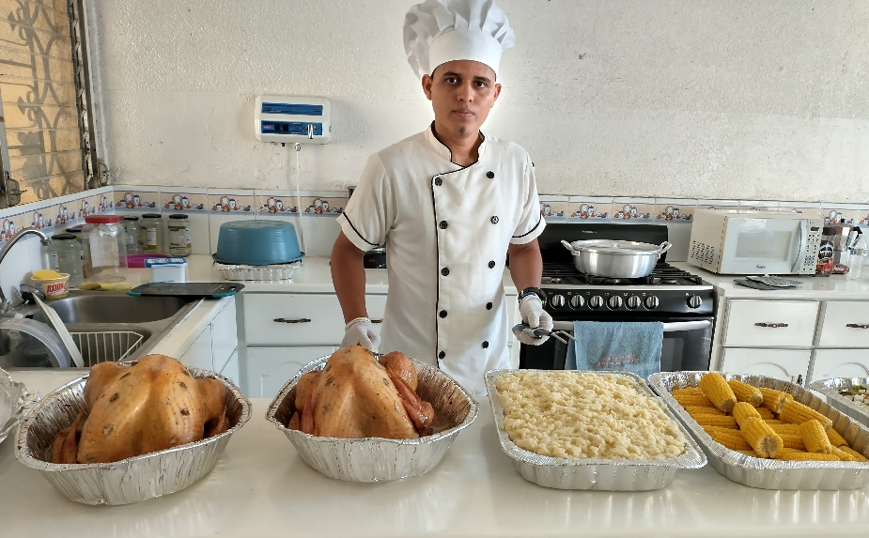
A LIFE TRANSFORMED
Andy
CHEF

Slide 32
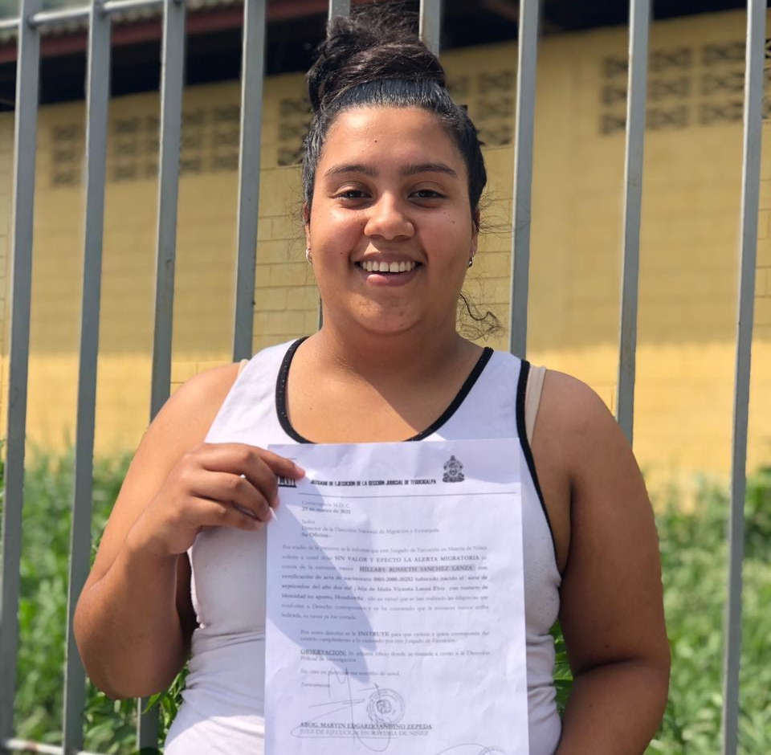
A LIFE TRANSFORMED
Hillary
LAW STUDENT

Slide 33
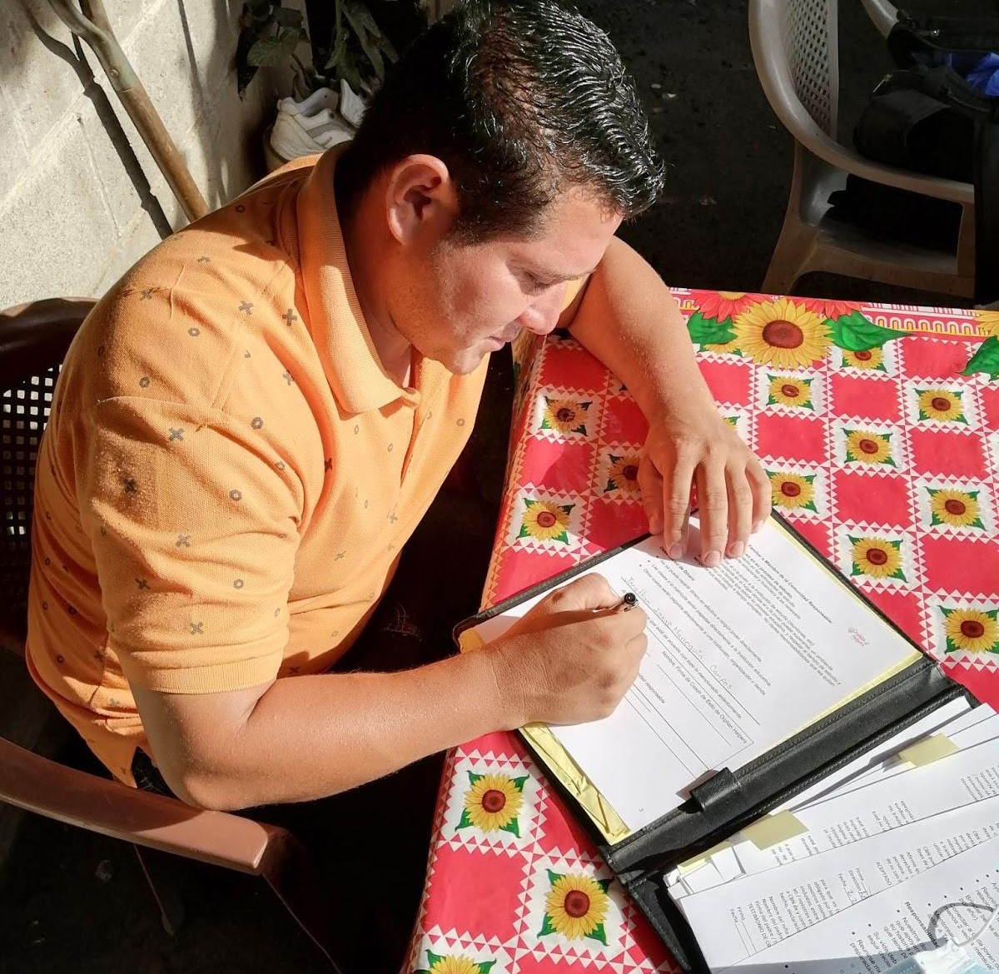
A LIFE TRANSFORMED
Jonathan
SOCIAL WORK STUDENT

Slide 34
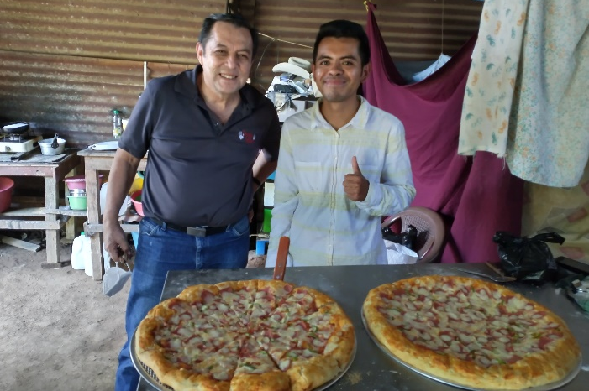
A LIFE TRANSFORMED
Nilson
PIZZA RESTAURANT

Slide 35
OUR “WHY”
We believe every youth has a future worth fighting for!

Slide 36
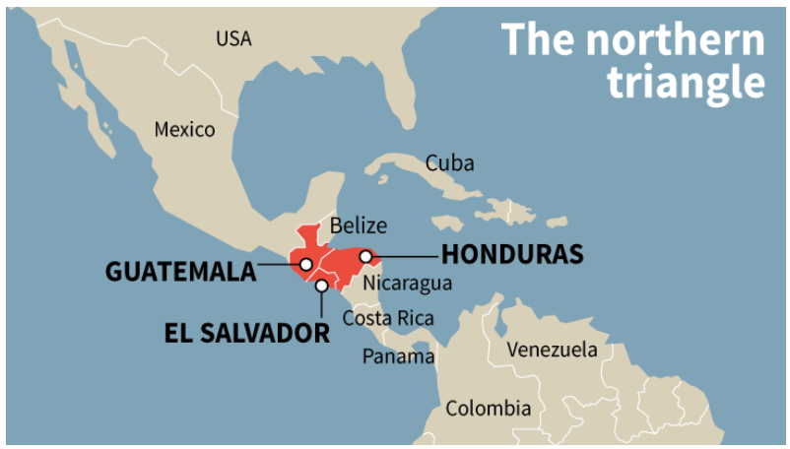

Slide 38
OPERATION WELCOME AFGHAN ALLIES
Manhattan has an Afghan population that has been woven into our community fabric over the last decade.

Slide 39
OPERATION WELCOME AFGHAN ALLIES
Manhattan has an Afghan population that has been woven into our community fabric over the last decade.
In less than two weeks over 30 organizations and 45 civic leaders have stepped up to form a coalition in Manhattan named the Afghan Resettlement Team.

Slide 40
OPERATION WELCOME AFGHAN ALLIES
Manhattan has an Afghan population that has been woven into our community fabric over the last decade.
In less than two weeks over 30 organizations and 45 civic leaders have stepped up to form a coalition in Manhattan named the Afghan Resettlement Team.
Manhattan stands ready to receive and resettle Afghan Allies.

Slide 41
OPERATION WELCOME AFGHAN ALLIES
Manhattan has an Afghan population that has been woven into our community fabric over the last decade.
In less than two weeks over 30 organizations and 45 civic leaders have stepped up to form a coalition in Manhattan named the Afghan Resettlement Team.
Manhattan stands ready to receive and resettle Afghan Allies.
K-State leadership, including President Myers, have important ties the American University in Kabul and female leaders in Afghanistan.

Slide 42
OPERATION WELCOME AFGHAN ALLIES
Manhattan has an Afghan population that has been woven into our community fabric over the last decade.
In less than two weeks over 30 organizations and 45 civic leaders have stepped up to form a coalition in Manhattan named the Afghan Resettlement Team.
Manhattan stands ready to receive and resettle Afghan Allies.
K-State leadership, including President Myers, have important ties the American University in Kabul and female leaders in Afghanistan.
Manhattan’s approach to receiving Afghan Allies serves as an example of living up to the ideals of America.

Slide 43
RADICAL JESUS
Next Week: Women in the Church

Slide 44
THE APOSTLES’ CREED
I believe in Jesus Christ, his only Son, our Lord,
who was conceived by the Holy Spirit,
born of the Virgin Mary,
suffered under Pontius Pilate,
was crucified, died, and was buried;

Slide 45
THE APOSTLES’ CREED
On the third day he rose again;
he ascended into heaven,
he is seated at the right hand of the Father,
and he will come to judge the living and the dead.

Slide 46
THE APOSTLES’ CREED
I believe in the Holy Spirit,
the holy *catholic Church,
the communion of saints,
the forgiveness of sins,
the resurrection of the body,
and the life everlasting.
Amen.
*the whole church in all times and places

