Slide 1
WELCOME
yall!

Slide 2
WELCOME TO SPRING! AND TALLGRASS CHURCH’S CENTRAL GATHERING IN BOYS & GIRLS CLUB!

Slide 3
TG guys, join us THIS TUESDAY, APRIL 27, 7:30-9PM for the 2nd to last Guys Group of the semester at Chris Swanson's place: 12820 Hillside Dr. Bonfire! Dilan Oglesby will be leading us through the story of Jesus' interaction with the demoniac. Bring your camp chair and a beverage or snack to share. Guests welcome.

Slide 4
CHURCHWIDE SUMMER BOOK STUDY
Tuesday evenings 6:30-7:30pm starting May 18
Long’s Park, kids can play.
You’re invited!
Get the book and read along or just come and audit.
Order $16 discounted books via Ben Deaver through today.

Slide 5
OUR NEW TEACHING SERIES CATCH UP AT TALLGRASS.CHURCH

Slide 6
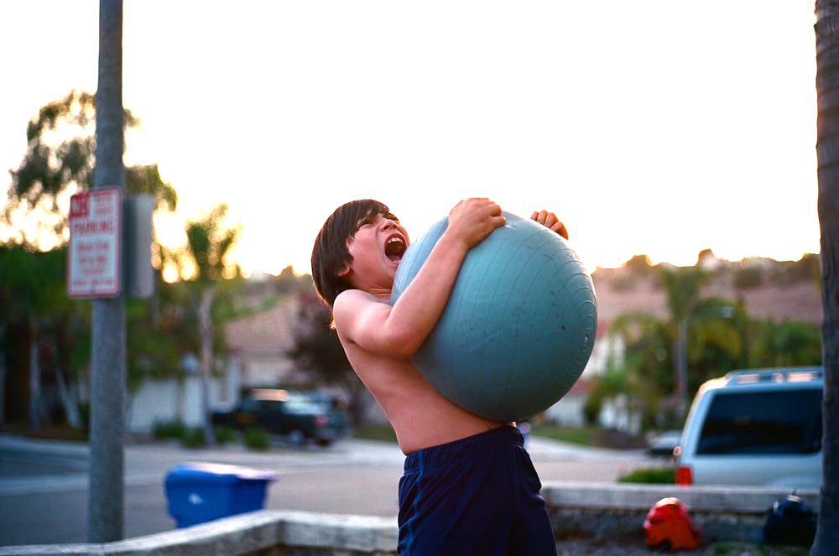

Slide 8
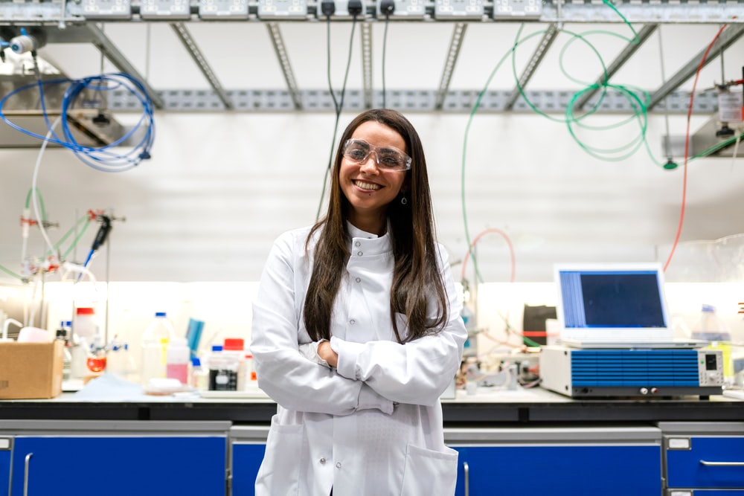

Slide 10
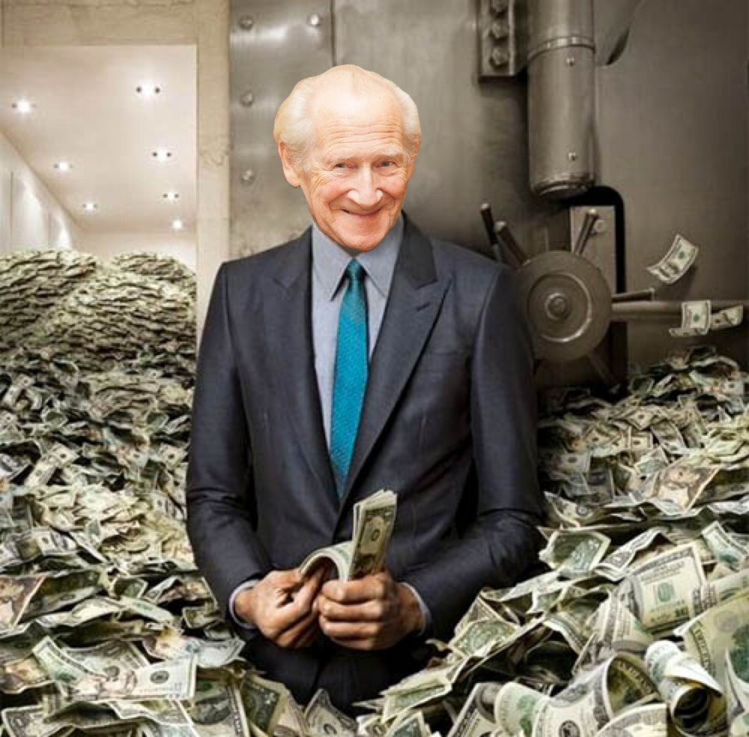

Slide 12
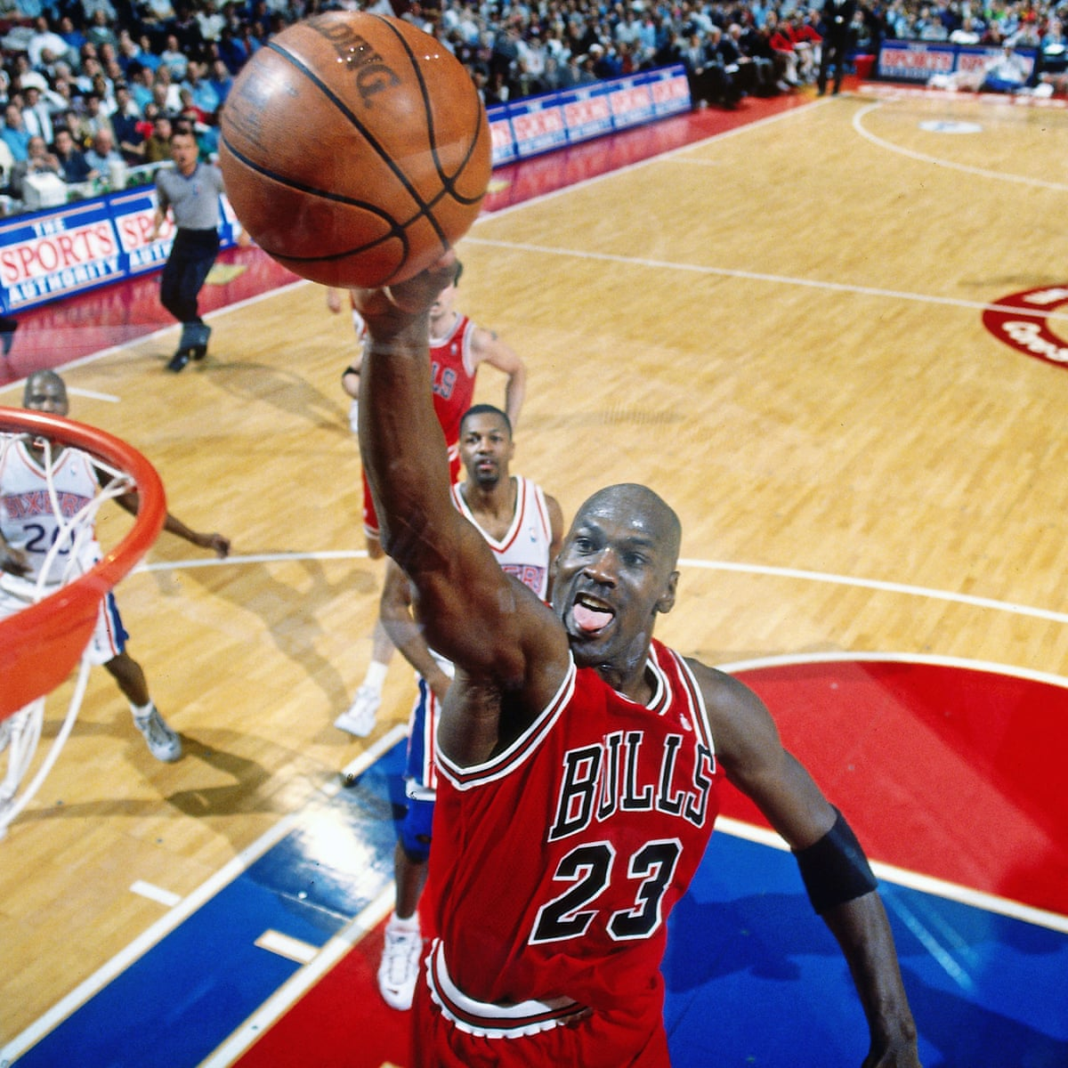
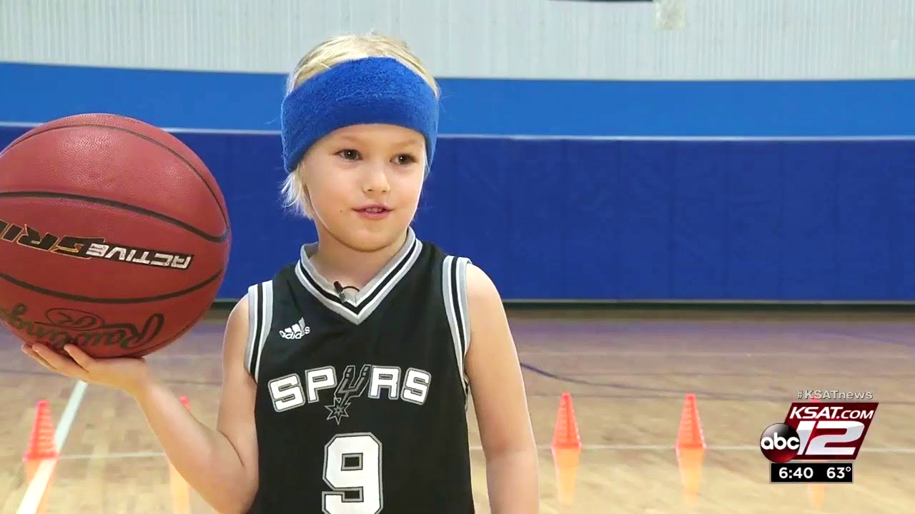

Slide 13
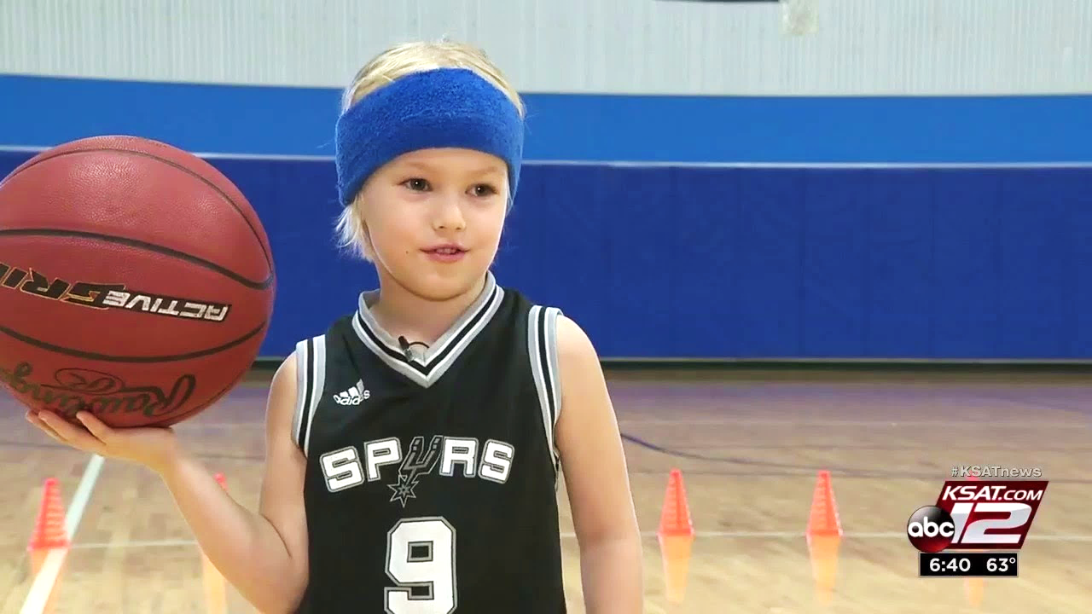

Slide 14
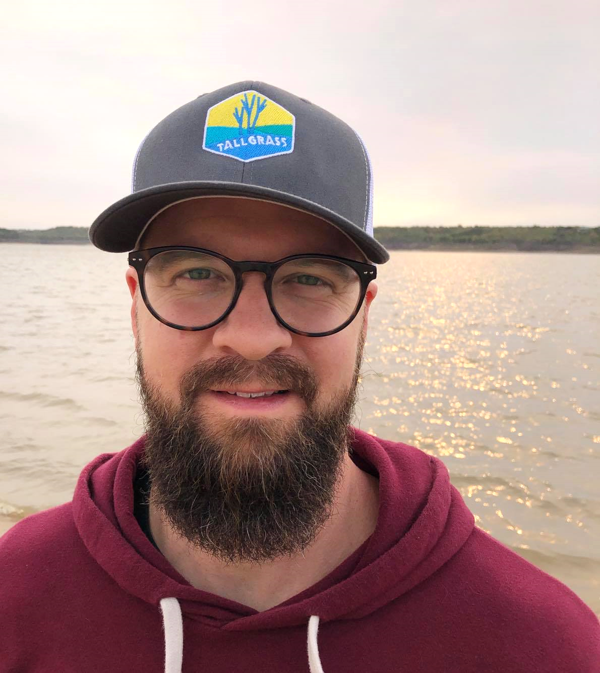

Slide 16
Matthew 18:1-6

Slide 17
Matthew 18:1-6
¹ At that time the disciples came to Jesus, saying, “Who is the greatest in the kingdom of heaven?”

Slide 18
Matthew 18:1-6
¹ At that time the disciples came to Jesus, saying, “Who is the greatest in the kingdom of heaven?”

Slide 19
Matthew 18:1-6
¹ At that time the disciples came to Jesus, saying, “Who is the greatest in the kingdom of heaven?” ² And calling to him a child, he put him in the midst of them ³ and said, “Truly, I say to you, unless you turn and become like children, you will never enter the kingdom of heaven. ⁴ Whoever humbles himself like this child is the greatest in the kingdom of heaven. ⁵ “Whoever receives one such a child in my name receives me, ⁶ but whoever causes one of these little ones who believe in me to sin, it would be better for him to have a great millstone fastened around his neck and to be drowned in the depth of the sea.

Slide 20
Matthew 18:1-6
¹ At that time the disciples came to Jesus, saying, “Who is the greatest in the kingdom of heaven?” ² And calling to him a child, he put him in the midst of them ³ and said, “Truly, I say to you, unless you turn and become like children, you will never enter the kingdom of heaven. ⁴ Whoever humbles himself like this child is the greatest in the kingdom of heaven. ⁵ “Whoever receives one such child in my name receives me, ⁶ but whoever causes one of these little ones who believe in me to sin, it would be better for him to have a great millstone fastened around his neck and to be drowned in the depth of the sea.
1 Corinthians 1:27-29 ²⁷ But God chose the foolish things of the world to shame the wise; God chose the weak things of the world to shame the strong. ²⁸ God chose the lowly things of this world and the despised things—and the things that are not—to nullify the things that are, ²⁹ so that no one may boast before him.

Slide 21
Matthew 19:13-15
¹³ Then children were brought to him [Jesus] that he might lay his hands on them and pray.

Slide 22
Matthew 19:13-15
¹³ Then children were brought to him [Jesus] that he might lay his hands on them and pray. The disciples rebuked the people, ¹⁴ but Jesus said, “Let the little children come to me and do not hinder them, for to such belongs the kingdom of heaven.” ¹⁵ And he laid his hands on them and went away.

Slide 23
Matthew 19:13-15
¹³ Then children were brought to him [Jesus] that he might lay his hands on them and pray. The disciples rebuked the people, ¹⁴ but Jesus said, “Let the little children come to me and do not hinder them, for to such belongs the kingdom of heaven.” ¹⁵ And he laid his hands on them and went away.
“when Jesus saw it, he was indignant”
(Mark 10)

Slide 24
Matthew 19:13-15
¹³ Then children were brought to him [Jesus] that he might lay his hands on them and pray. The disciples rebuked the people, ¹⁴ but Jesus said, “Let the little children come to me and do not hinder them, for to such belongs the kingdom of heaven.” ¹⁵ And he laid his hands on them and went away.
“when Jesus saw it, he was indignant”
(Mark 10)

Slide 25
Matthew 19:13-15
¹³ Then children were brought to him [Jesus] that he might lay his hands on them and pray. The disciples rebuked the people, ¹⁴ but Jesus said, “Let the little children come to me and do not hinder them, for to such belongs the kingdom of heaven.” ¹⁵ And he laid his hands on them and went away.
“when Jesus saw it, he was indignant”
(Mark 10)

Slide 26
Matthew 19:13-15
¹³ Then children were brought to him [Jesus] that he might lay his hands on them and pray. The disciples rebuked the people, ¹⁴ but Jesus said, “Let the little children come to me and do not hinder them, for to such belongs the kingdom of heaven.” ¹⁵ And he laid his hands on them and went away.
“when Jesus saw it, he was indignant”
(Mark 10)

Slide 27
Matthew 19:13-15
¹³ Then children were brought to him [Jesus] that he might lay his hands on them and pray. The disciples rebuked the people, ¹⁴ but Jesus said, “Let the little children come to me and do not hinder them, for to such belongs the kingdom of heaven.” ¹⁵ And he laid his hands on them and went away.
“took the children in his arms and”
(Mark 10)

Slide 28
Stats from Barna Group ²⁰⁰⁹
Barna 2009. https://www.barna.com/research/evangelism-is-most-effective-among-kids

Slide 29
Stats from Barna Group ²⁰⁰⁹
43% of all Americans who accept Jesus Christ do so before age 13
21% of born again Christians commit to Christ between age 13 and 18
13% make their profession of faith between age 18 to 21
Only 23% embrace Christ after their 21st birthday
Barna 2009. https://www.barna.com/research/evangelism-is-most-effective-among-kids

Slide 30
Stats from Barna Group ²⁰⁰⁹
43% of all Americans who accept Jesus Christ do so before age 13
21% of born again Christians commit to Christ between age 13 and 18
13% make their profession of faith between age 18 to 21
Only 23% embrace Christ after their 21st birthday
Barna 2009. https://www.barna.com/research/evangelism-is-most-effective-among-kids

Slide 31
Stats from Barna Group ²⁰⁰⁹
43% of all Americans who accept Jesus Christ do so before age 13
21% of born again Christians commit to Christ between age 13 and 18
13% make their profession of faith between age 18 to 21
Only 23% embrace Christ after their 21st birthday
“People who become Christian before their teen years are more likely than those who are converted when older to remain “absolutely committed” to Christianity through their lifetime.”
Barna 2009. https://www.barna.com/research/evangelism-is-most-effective-among-kids

Slide 32
Stats from Barna Group ²⁰⁰⁹
43% of all Americans who accept Jesus Christ do so before age 13
21% of born again Christians commit to Christ between age 13 and 18
13% make their profession of faith between age 18 to 21
Only 23% embrace Christ after their 21st birthday
“Americans who embraced Christ during…ages 13 through 21 are less likely than other believers to describe themselves as “deeply spiritual.” They donate substantially less money to churches than do other Christians…and are less likely to engage in lifestyle evangelism.”
Barna 2009. https://www.barna.com/research/evangelism-is-most-effective-among-kids

Slide 33
Stats from Barna Group ²⁰⁰⁹
43% of all Americans who accept Jesus Christ do so before age 13
“Families, churches and parachurch ministries must recognize that the primary window of opportunity for effectively reaching people with the good news of Jesus’ death and resurrection is during the pre-teen years. It is during those years that people develop their frames of reference for the remainder of their life – especially theologically and morally. Consistently explaining and modeling truth principles for young people is the most critical factor in their spiritual development.”
Barna 2009. https://www.barna.com/research/evangelism-is-most-effective-among-kids

Slide 34
STRETCH BREAK!

Slide 36
with Elisha Hillegeist

Slide 37
Application Questions
1) What does the way you interact with Tallgrass children show them about God?
2) What’s one thing you can do to better engage personally with children in our church?
3) Are you willing to serve in perhaps our church’s most strategic ministry, Sprouts, in this new season?

Slide 38
Matthias Bieber

Slide 39
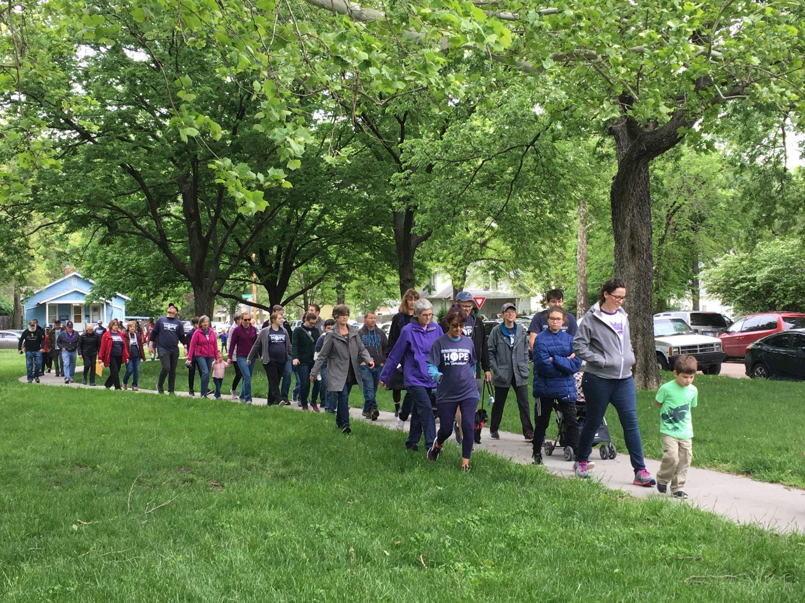
Walk for Life 2021 “Worth the Walk”
Saturday, June 26, 2021 at 9 a.m.
At Long’s Park (17th & Yuma)
Registration deadline: June 1, 2021.

Slide 40
You can
still get
involved!
Sponsor a walker from your church today!

