Slide 1
WELCOME
yall!

Slide 2
WELCOME TO SPRING! AND TALLGRASS CHURCH’S CENTRAL GATHERING IN BOYS & GIRLS CLUB!

Slide 3
TG LADIES' NIGHT
THIS TUESDAY 7PM__
@ Morgan Jones’ Home: 4814 Nature Ave
LADIES NIGHT THIS TUESDAY (April 6, 730-9pm)
We’re hoping to meet in person outside if the weather is nice! Stay tuned for more deets closer to time or contact Edie Doane: ediedoane@gmail.com

Slide 4
A MEN’S SEXUAL RECOVERY GROUP
For any man struggling with sexually unwanted behaviors including pornography addiction. This 10 month, high-commitment group will meet weekly on Thursday evenings, 7:30-9:30pm on Zoom. 3 spots left! Participation in this group will be kept confidential. If you're interested in more information or would like to register, let Dave Geldart know ASAP at davegeldart@tallgrass.church. #realfreedomispossible!

Slide 5
BRAND NEW TEACHING SERIES! CATCH UP AT TALLGRASS.CHURCH

Slide 7
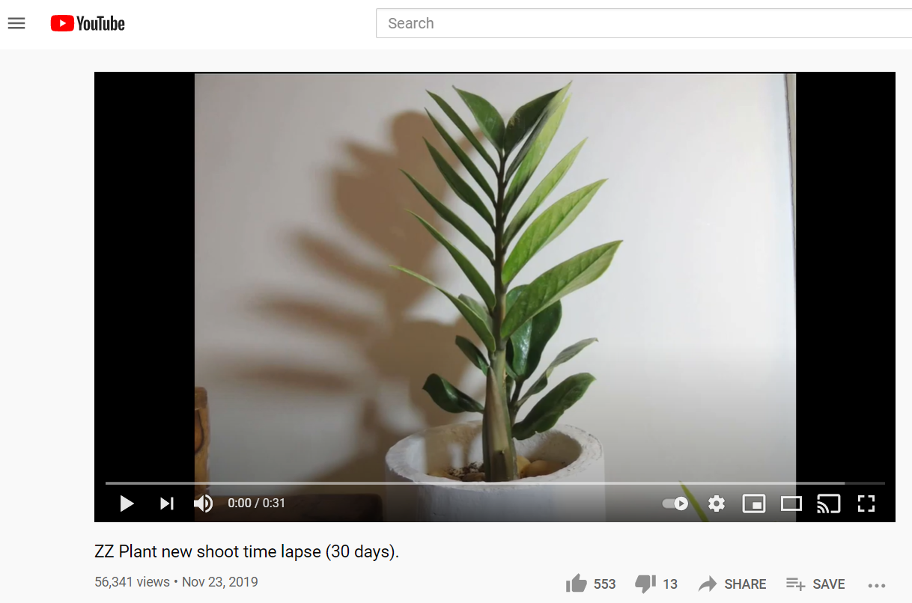

Slide 8
Patient Planting
So let’s not allow ourselves to get fatigued doing good.
At the right time we will harvest a good crop
if we don’t give up, or quit.
Galatians 6:9 ^{The Message}

Slide 9
Patient Planting
Don’t be misled: No one makes a fool of God.
What a person plants, he will harvest.
Galatians 6:7 ^{The Message}

Slide 10
Patient Planting
⁶ The Lord passed before him (Moses) and proclaimed,
“The Lord, the Lord, a God merciful and gracious, slow to anger,
and abounding in steadfast love and faithfulness, ⁷ keeping steadfast love for thousands, forgiving iniquity and transgression and sin,
but who will by no means clear the guilty, visiting the iniquity
of the fathers on the children and the children's children,
to the third and the fourth generation.”
Exodus 34:6-7 ^{ESV}

Slide 11
Patient Planting
The person who plants selfishness, ignoring the needs of others—ignoring God!—harvests a crop of weeds. All he’ll have to show for his life is weeds!
But the one who plants in response to God,
letting God’s Spirit do the growth work in him,
harvests a crop of real life, eternal life.
Galatians 6:8 ^{The Message}

Slide 12
Patient Planting
²¹ For as by a man came death,
by a man has come also the resurrection of the dead.
²² For as in Adam all die,
so also in Christ shall all be made alive.
²³ But each in his own order: Christ the firstfruits,
then at his coming those who belong to Christ.
1 Corinthians 15:22-23 ^{ESV}

Slide 13
Patient Planting
²¹ For as by a man came death,
by a man has come also the resurrection of the dead.
²² For as in Adam all die, (Galatians 5:19-21)
so also in Christ shall all be made alive. (Galatians 5:22-25)
²³ But each in his own order: Christ the firstfruits,
then at his coming those who belong to Christ.
1 Corinthians 15:22-23 ^{ESV}

Slide 14
Patient Planting
The person who plants selfishness, ignoring the needs of others—ignoring God!—harvests a crop of weeds. All he’ll have to show for his life is weeds!
But the one who plants in response to God,
letting God’s Spirit do the growth work in him,
harvests a crop of real life, eternal life.
Galatians 6:8 ^{The Message}

Slide 15
Patient Planting
Neighboring
Fund

Slide 16
Patient Planting
Neighboring
Fund

Slide 17
Patient Planting
Neighboring
Fund

Slide 18
Patient Planting
Neighboring
Fund

Slide 19
Patient Planting
Neighboring
Fund

Slide 20
Patient Planting
Neighboring
Fund

Slide 21
Patient Planting
Neighboring
Fund

Slide 22
Patient Planting

Slide 23
Patient Planting

Slide 24
Patient Planting

Slide 25
Patient Planting

Slide 26
Patient Planting

Slide 27
Patient Planting
this summer

Slide 28
Patient Planting
this summer
Develop a plan for LIFE Groups in the fall

Slide 29
Patient Planting
this summer
Develop a plan for LIFE Groups in the fall
Develop a plan for a Fall Launch

Slide 30
Patient Planting
this summer
Develop a plan for LIFE Groups in the fall
Develop a plan for a Fall Launch
Have a Welcome to Tallgrass Church Zoom Meeting

Slide 31
Patient Planting
this summer
Develop a plan for LIFE Groups in the fall
Develop a plan for a Fall Launch
Have a Welcome to Tallgrass Church Zoom Meeting
Leadership training with Emotionally Healthy Discipleship on Tuesday evenings

Slide 32
A SPECIAL CHURCHWIDE SUMMER BOOK STUDY
Tuesday evenings 6:30-7:30pm starting May 18
Long’s Park, kids can play.
You’re invited!
Get the book and read along or just come and audit.

Slide 33
Emotionally Healthy
discipleship

Slide 34
Emotionally Healthy
discipleship
Be Before You Do

Slide 35
Emotionally Healthy
discipleship
Be Before You Do
Follow the Crucified, Not the Americanized Jesus

Slide 36
Emotionally Healthy
discipleship
Be Before You Do
Follow the Crucified, Not the Americanized Jesus
Embrace God’s Gift of Limits

Slide 37
Emotionally Healthy
discipleship
Be Before You Do
Follow the Crucified, Not the Americanized Jesus
Embrace God’s Gift of Limits
Discover the Treasures Buried in Grief and Loss

Slide 38
Emotionally Healthy
discipleship
Be Before You Do
Follow the Crucified, Not the Americanized Jesus
Embrace God’s Gift of Limits
Discover the Treasures Buried in Grief and Loss
Make Love the Measure of Maturity

Slide 39
Emotionally Healthy
discipleship
Be Before You Do
Follow the Crucified, Not the Americanized Jesus
Embrace God’s Gift of Limits
Discover the Treasures Buried in Grief and Loss
Make Love the Measure of Maturity
Break the Power of the Past
Lead Out of Weakness and Vulnerability

Slide 40
Emotionally Healthy
discipleship
Be Before You Do
Follow the Crucified, Not the Americanized Jesus
Embrace God’s Gift of Limits
Discover the Treasures Buried in Grief and Loss
Make Love the Measure of Maturity
Break the Power of the Past

Slide 41
Patient Planting
Right now, therefore, every time we get the chance,
let us work for the benefit of all,
starting with the people closest to
us in the community of faith.
Galatians 6:10 ^{The Message}

