Slide 1
WELCOME!

Slide 2
WELCOME TO TALLGRASS CHURCH’S CENTRAL GATHERING IN BOYS & GIRLS CLUB!

Slide 3
an annual women’s virtual conference founded by Jennie Allen
“there is a God who has a plan in the middle of the ‘even if’”

Slide 4
THIS TUESDAY March 9, 7:30pm
TALLGRASS LADIES NIGHT
HOPEFULLY OUTSIDE IN PERSON!
Stay tuned to the GroupMe for deets closer to time. Or contact Edie at ediedoane@gmail.com.

Slide 5
A FRIENDLY COMPETITION OF GENEROSITY
organized by Thrivent Financial Ministries!
Tallgrass will be focusing on raising our full March budget of $14,907 AND RAISING FUNDS FOR A MUCH-NEEDED EQUIPMENT TRAILER! #Let’sMakeItFun! #Gladness #Generosity

Slide 6
HOW TO GIVE
Tallgrass literally operates on generosity!
ONLINE at tallgrass.church/give with your Bank Account or Credit Card
CHECK/CASH in the black box by the doors or by snail mail to: PO BOX 1795, MHK, 66505

Slide 8
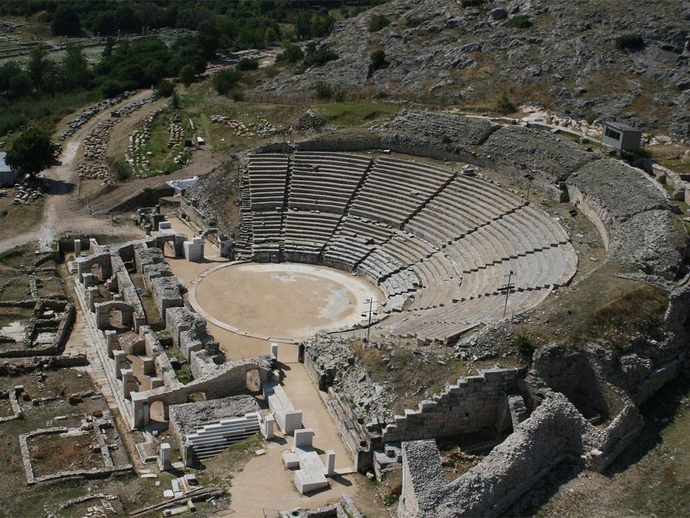

Slide 9
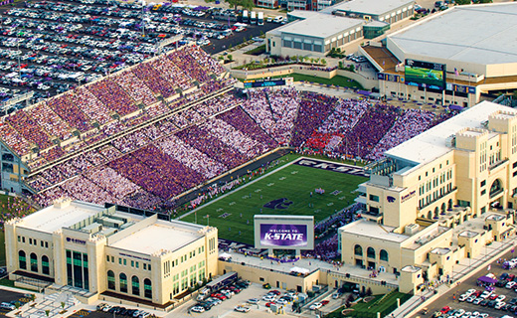

Slide 10
LET ME RETHINK THAT
Finally, brothers and sisters, whatever is true, whatever is honorable, whatever is just, whatever is pure, whatever is lovely, whatever is commendable, if there is any excellence, if there is anything worthy of praise, think about these things.
Philippians 4:8

Slide 12
PHILIPPIANS 4:8
“Our brain is changing moment by moment as we are thinking. By our thinking and choosing we are redesigning the landscape of our brains.”

Slide 13
PHILIPPIANS 4:8
“Our brain is changing moment by moment as we are thinking. By our thinking and choosing we are redesigning the landscape of our brains.”
“Our brain generates more electrical impulses in one day than all the cell phones on the planet.”

Slide 15
LET ME RETHINK THAT
¹ I appeal to you therefore, brothers and sisters, by the mercies of God, to present your bodies as a living sacrifice, holy and acceptable to God, which is your spiritual worship. ² Do not be conformed to this world, but be transformed by the renewal of your mind, that by testing you may discern what is the will of God, what is good and acceptable and perfect.
Romans 12:1-2

Slide 16
LET ME RETHINK THAT
Proverbs 23:7a NASB For as he thinks within himself, so he is.

Slide 17
LET ME RETHINK THAT
Proverbs 23:7a NASB For as he thinks within himself, so he is.
Colossians 3:2 Set your minds on things that are above, not on things that are on earth.

Slide 18
LET ME RETHINK THAT
Proverbs 23:7a NASB For as he thinks within himself, so he is.
Colossians 3:2 Set your minds on things that are above, not on things that are on earth.
1 Peter 1:13 Therefore, preparing your minds for action (girding up the loins of your mind), and being sober-minded, set your hope fully on the grace that will be brought to you at the revelation of Jesus Christ.

Slide 19
LET ME RETHINK THAT
2 Corinthians 10:3-6 ³ For though we walk in the flesh, we are not waging war according to the flesh. ⁴ For the weapons of our warfare are not of the flesh but have divine power to destroy strongholds. ⁵ We destroy arguments and every lofty opinion raised against the knowledge of God, and take every thought captive to obey Christ, ⁶ being ready to punish every disobedience, when your obedience is complete.

Slide 21
PHILIPPIANS 4:8
“Besides meditating on specific biblical texts, there are two scriptural strands of meditation sometimes overlooked. In the first scriptural strand, we are also urged to meditate on general abstract themes in Scripture, for example, on agape love, on justice, on hope, and so forth.”

Slide 22
PHILIPPIANS 4:8
“Thus, the apostle Paul wisely urges that ‘whatever is true, whatever is noble, whatever is right, whatever is pure, whatever is lovely, whatever is admirable—if anything is excellent or praiseworthy—think about such things’ (Philippians 4:8).”

Slide 23
PHILIPPIANS 4:8
“Certainly, we would want to remember and meditate on God’s wonderful acts toward us and those we care about. Remembering the times we received or gave of ourselves in love or extended forgiveness, times when the presence of God was especially precious, and answers to prayer—these are also proper objects for meditation.”

Slide 24
PHILIPPIANS 4:8
“Along these same lines, we could meditate on anything that is edifying and encourages us toward a life of Christian maturity and gratitude toward God, whether grand or small. And God’s creation is a vast repository of objects to ponder and to offer thanks to God about, such as attending to the sound of rain, to ducks swimming in a pond, or even to the wonderful tastes of what we eat.”

Slide 25
PHILIPPIANS 4:8
“When one is anxious and depressed, the so-called grand things of life may be difficult to hold one’s attention. But anyone can start by being thankful for the taste of one’s morning coffee or a glass of orange juice. How wonderful of God to create a world with such gratuitous pleasures!”

Slide 27
MAN OF YOUR WORD
All things are possible
When we believe
All chains are breakable
When we receieve
Yahweh, you keep your promises

Slide 28
MAN OF YOUR WORD
If you said it, we believe it, If you said it

Slide 29
MAN OF YOUR WORD
If you said it we believe it
If you said it we believe it
Cause you're a man of your word
If you said it we believe it
If you said it we believe it
Cause you're a man of your word

Slide 30
MAN OF YOUR WORD
We have this confidence, You'll finish what you started
God you have never failed, You won't start with me
You're present in every step, Patient in every heartache
God you have never failed,
You won't start with me

Slide 31
MAN OF YOUR WORD
If you said it, we believe it, If you said it

Slide 32
MAN OF YOUR WORD
If you said it we believe it
If you said it we believe it
Cause you're a man of your word
If you said it we believe it
If you said it we believe it
Cause you're a man of your word

Slide 34
PROPHETIC PROMISES
The Encounter with God | The Passage | The Lie | The Prophetic Promise

Slide 35
Psalm 23 & Prophetic Promise:
Maris Deaver

Slide 37
HOMEWORK:
Think deeply about something new that fits Philippians 4:8 this week.

Slide 38
LET ME RETHINK THAT
⁸ Finally, brothers and sisters, whatever is true, whatever is honorable, whatever is just, whatever is pure, whatever is lovely, whatever is commendable, if there is any excellence, if there is anything worthy of praise, think about these things. ⁹ What you have learned and received and heard and seen in me—practice these things, and the God of peace will be with you. Philippians 4:8-9

