Slide 1
WELCOME!

Slide 2
WELCOME TO TALLGRASS CHURCH’S CENTRAL GATHERING IN BOYS & GIRLS CLUB!

Slide 3
Bring non-perishable food and hygiene items today or drop them off yourself at our Blessing Box located at 1231 Poyntz Avenue (in cooperation with First Free Methodist).

Slide 4
LEADERSHIP
ELDER NOMINATIONS
You’re invited to send nominations for the Elder Team this week to:
elders@tallgrass.church
Make sure to review our elder qualifications first online at tallgrass.church/elder-qualifications

Slide 5
STARTS THIS THURSDAY FEB 11
A FREE ZOOM EQUIPPING COURSE FOR ALL TALLGRASS ADULTS REGISTER BY THIS TUESDAY TO DAVEGELDART@TALLGRASS.CHURCH

Slide 6
“LADIES NIGHT” -- ENJOYING JESUS STUDY -- THIS TUESDAY FEB 9, 730-9PM ON ZOOM contact Edie Doane for the link: ediedoane@gmail.com

Slide 7
FEB. 15, 630pm
Tallgrass women, celebrate women and friendship with us on Monday, February 15. We'll enjoy dinner, exchange small gifts and grow in our connection to one another. Bring money for dinner and a wrapped gift valued at $15 or less. Funds available to cover expenses for those in financial difficulty.

Slide 8
an annual women’s virtual conference founded by Jennie Allen
“there is a God who has a plan in the middle of the ‘even if’”

Slide 10
LAST WEEK’S HOMEWORK:
First, who do you need to seek relational harmony with? And what’s the first step you’ll take today?

Slide 11
LAST WEEK’S HOMEWORK:
First, who do you need to seek relational harmony with? And what’s the first step you’ll take today?
Second, what will you surrender to the King?

Slide 12
Approval and affirmation from men
Fear
Self-protection
Valuing my appearance
My electronics
My need to have control—accept grace and have patience
Anxiety
My desire to constantly be entertained/distracted instead of being content with silence
Clarity

Slide 13
Hurt and resentment
America in my image
My need for information
Wasting time watching TV, videos, and Facebook
Timidness/Control
Letting fear be the biggest factor driving my decisions
All
Everything
My doubt of your presence. May you give me the strength to put my faith and trust in You, Lord.

Slide 14
My need to control the future to protect myself
Physical pain, anxiety
Fear of failing school, Fear of letting others down
Overthinking!
Control and ownership over what is God’s
Jealousy, status quo
Lingering anger and bitterness and resentment
Stress over things to be as I know I don’t want these before You

Slide 15
Being on my phone
Excuses (with a big list)
Time and self
Bitterness and perfection
My insecurities
Being judgmental and not an active listener
Control, judgment
Time and self
What others think of me in favor of vulnerability

Slide 16
RELATIONAL HARMONY
¹ Therefore, my brothers and sisters, whom I love and long for, my joy and crown, stand firm thus in the Lord, my beloved. ² I entreat Euodia and I entreat Syntyche to live in harmony in the Lord. ³ Yes, I ask you also, true companion, help these women, who have labored side by side with me in the gospel together with Clement and the rest of my fellow workers, whose names are in the book of life.
Philippians 4:1-3

Slide 17
WAYS TO DIVIDE THE CHURCH
How should we take the Lord’s Supper? How often and who can?
Who should be baptized and when?
Can women teach and lead in the church?
Should the church care about social justice issues? If so, how?
What does the Bible teach about human sexuality?
How should parents parent? What kind of school should we send our kids to?
How should we vote? Can I relate to someone votes differently?
To mask or not to mask? To vaccinate or not to vaccinate?
What am I missing?

Slide 18
LOVE YOUR ENEMY
Matthew 5:43-44a ⁴³ “You have heard that it was said, ‘You shall love your neighbor and hate your enemy.’ ^{44a} But I say to you, Love your enemies…

Slide 19
LOVE ONE ANOTHER
John 13:34-35 ³⁴ A new commandment I give to you, that you love one another: just as I have loved you, you also are to love one another. ³⁵ By this all people will know that you are my disciples, if you have love for one another.”

Slide 20
LOVE ONE ANOTHER
Hebrews 12:14-15 ¹⁴ Strive for peace with everyone, and for the holiness without which no one will see the Lord. ¹⁵ See to it that no one fails to obtain the grace of God; that no “root of bitterness” springs up and causes trouble, and by it many become defiled…

Slide 21
LOVE ONE ANOTHER
Hebrews 12:14-15 ¹⁴ Strive for peace with everyone, and for the holiness without which no one will see the Lord. ¹⁵ See to it that no one fails to obtain the grace of God; that no “root of bitterness” springs up and causes trouble, and by it many become defiled…
Use A Peacemaker’s Checklist resource.

Slide 22
LOVE ONE ANOTHER
Galatians 5:13-15 ¹³ For you were called to freedom, brothers and sisters. Only do not use your freedom as an opportunity for the flesh, but through love serve one another. ¹⁴ For the whole law is fulfilled in one word: “You shall love your neighbor as yourself.” ¹⁵ But if you bite and devour one another, watch out that you are not consumed by one another.

Slide 23
LAUNCH TEAM NOTES:
Intimacy. Tallgrassians want a grace-centered place to grow in relationship with Christ and others! We want a safe place where leaders speak truth in love, where there is close-knit community, a family, meaningful relationships. Where people can come and be known. Desire for intimacy.
February 18, 2018

Slide 24
LAUNCH TEAM NOTES:
Intimacy. Tallgrassians want a grace-centered place to grow in relationship with Christ and others! We want a safe place where leaders speak truth in love, where there is close-knit community, a family, meaningful relationships. Where people can come and be known. Desire for intimacy.
Comfort zone! At the same time, we want to get out of our comfort zones! We want disruption, a growth mindset, to be a part of something bigger than ourselves, to be a part of God’s thing, see the Holy Spirit move, high commitment, freedom to fail, messiness. Desire for growth.
February 18, 2018

Slide 25
LAUNCH TEAM NOTES:
Intimacy. Tallgrassians want a grace-centered place to grow in relationship with Christ and others! We want a safe place where leaders speak truth in love, where there is close-knit community, a family, meaningful relationships. Where people can come and be known. Desire for intimacy.
Comfort zone! At the same time, we want to get out of our comfort zones! We want disruption, a growth mindset, to be a part of something bigger than ourselves, to be a part of God’s thing, see the Holy Spirit move, high commitment, freedom to fail, messiness. Desire for growth.
Neighboring. Reach communities, neighborhoods, multiplication at all levels, diversity, generations
February 18, 2018

Slide 26
LOVE THE OTHER
Colossians 4:5-6 ⁵ Walk in wisdom toward outsiders, making the best use of the time. ⁶ Let your speech always be gracious, seasoned with salt, so that you may know how you ought to answer each person.

Slide 27
LOVE THE OTHER
Colossians 4:5-6 ⁵ Walk in wisdom toward outsiders, making the best use of the time. ⁶ Let your speech always be gracious, seasoned with salt, so that you may know how you ought to answer each person.
2 Timothy 1:6-7 ⁶ For this reason I remind you to fan into flame the gift of God, which is in you through the laying on of my hands, ⁷ for God gave us a spirit not of fear but of power and love and self-control.

Slide 28
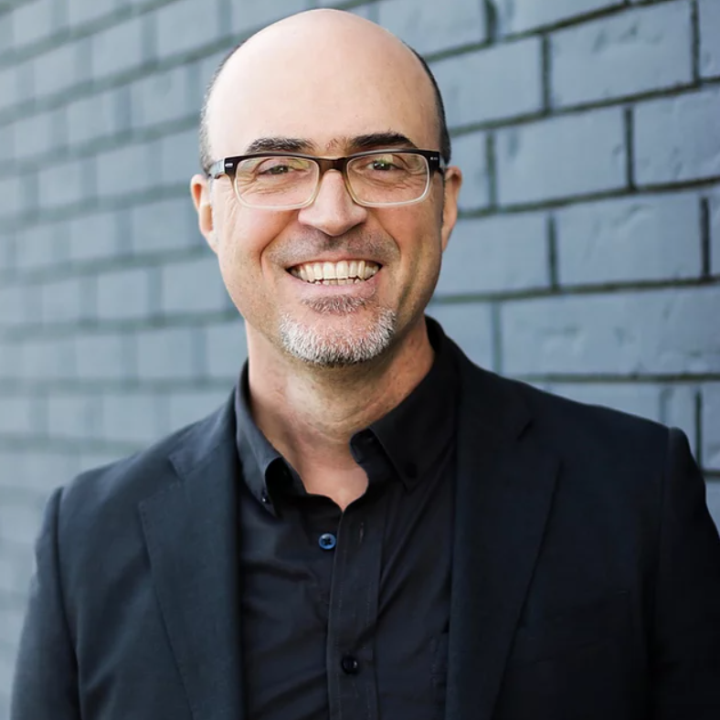
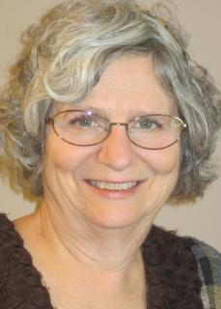
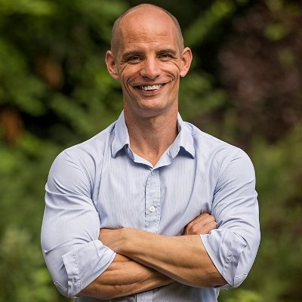
LOVE THE OTHER

Slide 29
LOVE THE OTHER
Colossians 4:2-4 ² Continue steadfastly in prayer, being watchful in it with thanksgiving. ³ At the same time, pray also for us, that God may open to us a door for the word, to declare the mystery of Christ, on account of which I am in prison— ⁴ that I may make it clear, which is how I ought to speak.

Slide 30
HOMEWORK:
Take on the Love the Other challenge!

Slide 31
HOMEWORK:
Take on the Love the Other challenge!
Let’s practice…now!

Slide 32
HOMEWORK:
Take on the Love the Other challenge!
Let’s practice…now!
Find someone in this room who you don’t know and is the same gender as you.

Slide 33
HOMEWORK:
Take on the Love the Other challenge!
Let’s practice…now!
Find someone in this room who you don’t know and is the same gender as you.
Spend 10 minutes answering a few of the questions on the Love the Other sheet.

Slide 34
HOMEWORK:
Take on the Love the Other challenge!
Let’s practice…now!
Find someone in this room who you don’t know and is the same gender as you.
Spend 10 minutes answering a few of the questions on the Love the Other sheet.
Consider who you’ll connect with next!

