Slide 1
WELCOME!

Slide 2
WELCOME TO TALLGRASS CHURCH’S CENTRAL GATHERING IN BOYS & GIRLS CLUB!

Slide 3
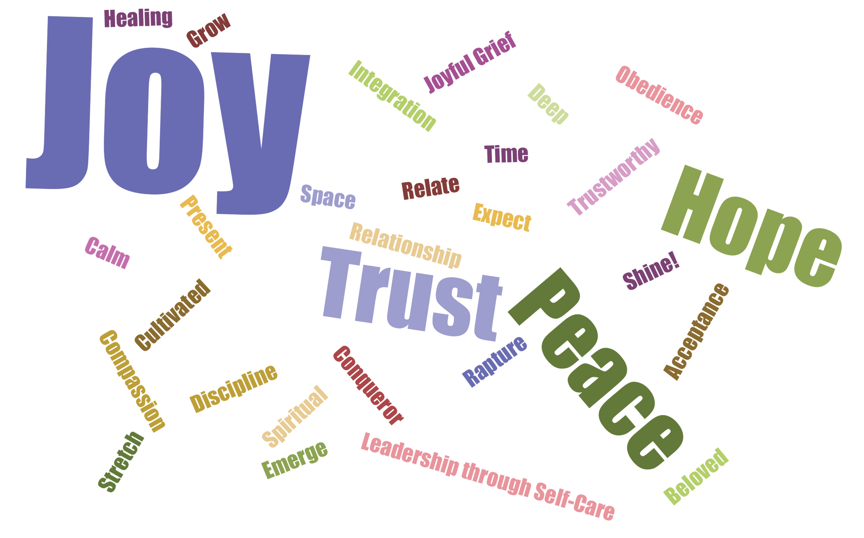
WHAT’S YOUR 2021 WOTY?
Here’s our current Tallgrass 2021 WOTY word cloud! Share yours at tallgrass.church/woty

Slide 4
STARTING FEBRUARY 11
A FREE ZOOM EQUIPPING COURSE FOR ALL TALLGRASS ADULTS FROM PURE DESIRE MINISTRIES

Slide 5
GRAB A BOOK AND GUIDE ON THE RESOURCE TABLE

Slide 6
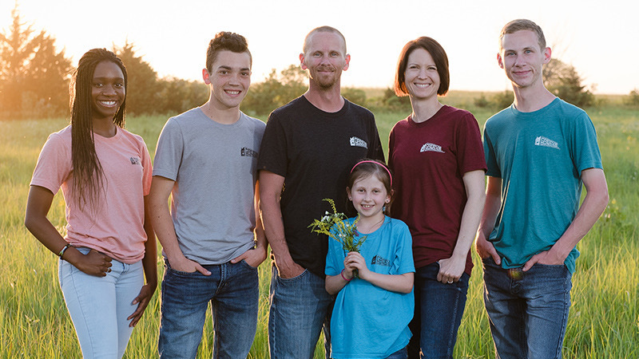
Ricky Greeve and family

Slide 7
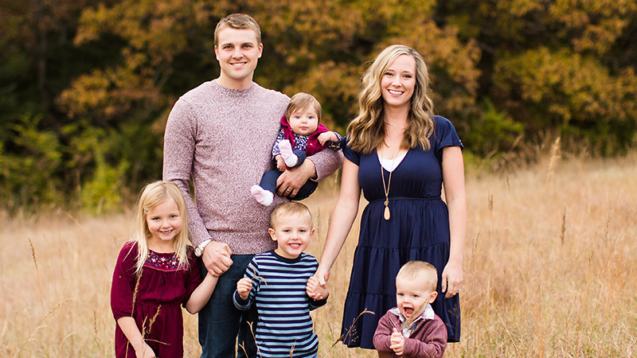
David Renberg and family

Slide 8
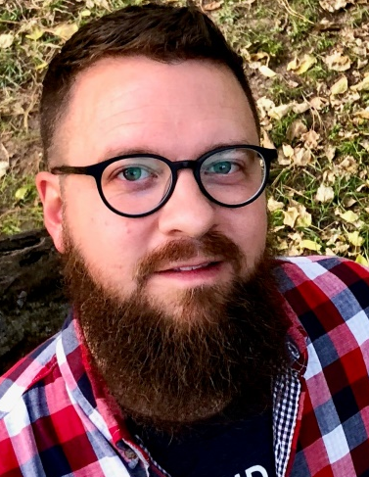
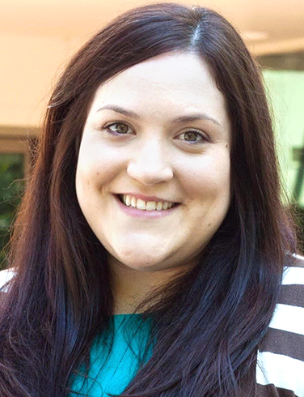
TALLGRASS LEADERSHIP
Ben Deaver Lead Pastor, Elder
Dave Geldart Associate Pastor, Elder
ELISHA HILLEGEIST Sprouts Coordinator, Elder
Dilan oglesby Youth Pastor
RON GOODMAN Elder
RICKY GREEVE
Elder
DAVID RENBERG Elder
EDIE DOANE Women’s Ministry

Slide 10
ENCOUNTERING ^{3 KINDS OF} DOUBT
Intellectual Doubt
Emotional Doubt
Volitional Doubt

Slide 11
ENCOUNTERING ^{3 KINDS OF} DOUBT
Intellectual Doubt
Emotional Doubt
Volitional Doubt
Modern “Faith” = belief despite evidence “Take a blind leap of faith.”
Biblical Faith = reasoned response based on evidence “Take a step of faith where the evidence leads.”

Slide 12
RELATIONAL HARMONY
¹ Therefore, my brothers and sisters, whom I love and long for, my joy and crown, stand firm thus in the Lord, my beloved. ² I entreat Euodia and I entreat Syntyche to agree in the Lord. ³ Yes, I ask you also, true companion, help these women, who have labored side by side with me in the gospel together with Clement and the rest of my fellow workers, whose names are in the book of life.
Philippians 4:1-3

Slide 13
RELATIONAL HARMONY
¹ Therefore, my brothers and sisters, whom I love and long for, my joy and crown, stand firm thus in the Lord, my beloved. ² I entreat Euodia and I entreat Syntyche to live in harmony in the Lord. ³ Yes, I ask you also, true companion, help these women, who have labored side by side with me in the gospel together with Clement and the rest of my fellow workers, whose names are in the book of life.
Philippians 4:1-3

Slide 14
RELATIONAL HARMONY
¹ Therefore, my brothers and sisters, whom I love and long for, my joy and crown, stand firm thus in the Lord, my beloved. ² I entreat Euodia and I entreat Syntyche to live in harmony in the Lord. ³ Yes, I ask you also, true companion, help these women, who have labored side by side with me in the gospel together with Clement and the rest of my fellow workers, whose names are in the book of life.
Philippians 4:1-3

Slide 15
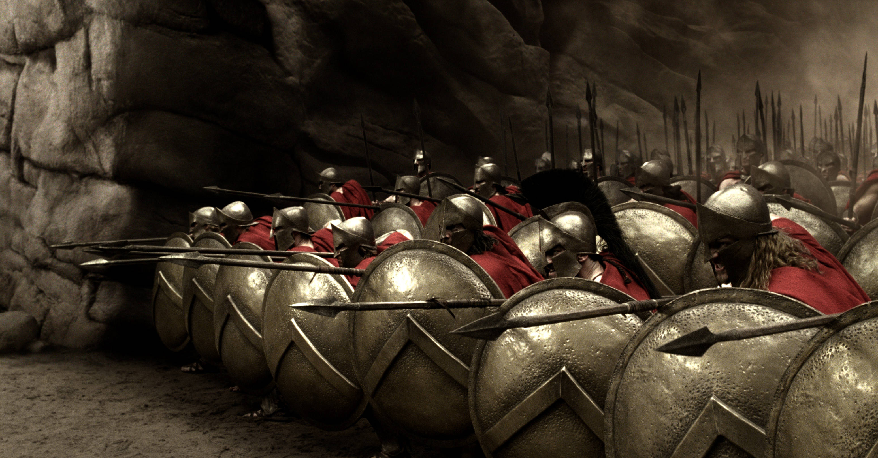
THE PHALANX

Slide 16
HOMEWORK:
First, who do you need to seek relational harmony with? And what’s the first step you’ll take today?

Slide 17
HOMEWORK:
First, who do you need to seek relational harmony with? And what’s the first step you’ll take today?
Four Steps towards Relational Harmony:
Glorify God
Get the log out
Gently restore
Go and be reconciled
From A Peacemaker’s Checklist, Appendix A in “The Peacemaker” by Ken Sande

Slide 18
HOMEWORK:
Glorify God: How can I please and honor the Lord in this situation?
From A Peacemaker’s Checklist, Appendix A in “The Peacemaker” by Ken Sande

Slide 19
HOMEWORK:
Glorify God: How can I please and honor the Lord in this situation?
Get the log out of your eye: How can I show Jesus’ work in me by taking responsibility for my contribution to this conflict?
From A Peacemaker’s Checklist, Appendix A in “The Peacemaker” by Ken Sande

Slide 20
HOMEWORK:
Glorify God: How can I please and honor the Lord in this situation?
Get the log out of your eye: How can I show Jesus’ work in me by taking responsibility for my contribution to this conflict?
Gently restore: How can I lovingly serve others by helping them take responsibility for their contribution to this conflict?
From A Peacemaker’s Checklist, Appendix A in “The Peacemaker” by Ken Sande

Slide 21
HOMEWORK:
Glorify God: How can I please and honor the Lord in this situation?
Get the log out of your eye: How can I show Jesus’ work in me by taking responsibility for my contribution to this conflict?
Gently restore: How can I lovingly serve others by helping them take responsibility for their contribution to this conflict?
Go and be reconciled: How can I demonstrate forgiveness of God and encourage a reasonable solution to this conflict?
From A Peacemaker’s Checklist, Appendix A in “The Peacemaker” by Ken Sande

Slide 22
HOMEWORK:
First, who do you need to seek relational harmony with? And what’s the first step you’ll take today?

Slide 23
HOMEWORK:
First, who do you need to seek relational harmony with? And what’s the first step you’ll take today?
Second, what will you surrender to the King this morning?

Slide 24
HOMEWORK:
First, who do you need to seek relational harmony with? And what’s the first step you’ll take today?
Second, what will you surrender to the King this morning?
I Surrender…

Slide 25
I Surrender…

Slide 26
^{The} Lord’s Supper

