Slide 1
WELCOME!

Slide 2
WELCOME TO TALLGRASS CHURCH’S CENTRAL GATHERING IN BOYS & GIRLS CLUB!

Slide 3
All Glory Be
to Christ
“All Glory be to Christ” By Dustin Kensrue. (CC) 2012 Mars Hill Music

Slide 4
Should nothing of our efforts stand,
no legacy survive
unless the Lord does raise the house,
in vain its builders strive.
“All Glory be to Christ” By Dustin Kensrue. (CC) 2012 Mars Hill Music

Slide 5
To you who boast tomorrow’s gain,
tell me what is your life?
A mist that vanishes at dawn,
all glory be to Christ!
“All Glory be to Christ” By Dustin Kensrue. (CC) 2012 Mars Hill Music

Slide 6
All glory be to Christ our king!
All glory be to Christ!
His rule and reign we’ll ever sing,
all glory be to Christ!
“All Glory be to Christ” By Dustin Kensrue. (CC) 2012 Mars Hill Music

Slide 7
His will be done, His kingdom come,
on earth as is above
Who is Himself our daily bread,
praise Him the Lord of love
“All Glory be to Christ” By Dustin Kensrue. (CC) 2012 Mars Hill Music

Slide 8
Let living water satisfy
the thirsty without price
We’ll take a cup of kindness yet,
all glory be to Christ!
“All Glory be to Christ” By Dustin Kensrue. (CC) 2012 Mars Hill Music

Slide 9
All glory be to Christ our king!
All glory be to Christ!
His rule and reign we’ll ever sing,
all glory be to Christ!
“All Glory be to Christ” By Dustin Kensrue. (CC) 2012 Mars Hill Music

Slide 10
When on the day the great I Am,
the faithful and the true
The Lamb who was for sinners slain,
is making all things new.
“All Glory be to Christ” By Dustin Kensrue. (CC) 2012 Mars Hill Music

Slide 11
Behold our God shall live with us
and be our steadfast light
And we shall e’er his people be,
all glory be to Christ!
“All Glory be to Christ” By Dustin Kensrue. (CC) 2012 Mars Hill Music

Slide 12
All glory be to Christ our king!
All glory be to Christ!
His rule and reign we’ll ever sing,
all glory be to Christ!
(repeat)
“All Glory be to Christ” By Dustin Kensrue. (CC) 2012 Mars Hill Music

Slide 14
Canvas and
the Clay
“Canvas and the Clay” By Pat Barrett, Ben Smith, Chris Tomlin. CCLI# 7133880.

Slide 15
In my mother’s womb
You formed me with Your hands
Known and loved by You
Before I took a breath
“Canvas and the Clay” By Pat Barrett, Ben Smith, Chris Tomlin. CCLI# 7133880.

Slide 16
When I doubt it, Lord, remind me
I’m wonderfully made
You’re an artist and a potter
I’m the canvas and the clay
“Canvas and the Clay” By Pat Barrett, Ben Smith, Chris Tomlin. CCLI# 7133880.

Slide 17
You make all things work together
For my future and for my good
You make all things work together
For Your glory and for Your name
“Canvas and the Clay” By Pat Barrett, Ben Smith, Chris Tomlin. CCLI# 7133880.

Slide 18
There's a healing light
Just beyond the clouds
Though I've walked through fire
I see clearly now
“Canvas and the Clay” By Pat Barrett, Ben Smith, Chris Tomlin. CCLI# 7133880.

Slide 19
I know nothing has been wasted
No failure or mistake
You’re an artist and a potter
I’m the canvas and the clay
“Canvas and the Clay” By Pat Barrett, Ben Smith, Chris Tomlin. CCLI# 7133880.

Slide 20
You make all things work together
For my future and for my good
You make all things work together
For Your glory and for Your name
(Repeat)
“Canvas and the Clay” By Pat Barrett, Ben Smith, Chris Tomlin. CCLI# 7133880.

Slide 21
When I doubt it, Lord, remind me
I’m wonderfully made
You’re an artist and a potter
I’m the canvas and the clay
“Canvas and the Clay” By Pat Barrett, Ben Smith, Chris Tomlin. CCLI# 7133880.

Slide 22
I know nothing has been wasted
No failure or mistake
You’re an artist and a potter
I’m the canvas and the clay
“Canvas and the Clay” By Pat Barrett, Ben Smith, Chris Tomlin. CCLI# 7133880.

Slide 23
You make all things work together
For my future and for my good
You make all things work together
For Your glory and for Your name
“Canvas and the Clay” By Pat Barrett, Ben Smith, Chris Tomlin. CCLI# 7133880.

Slide 24
When I doubt it, Lord, remind me
I’m wonderfully made
You’re an artist and a potter
I’m the canvas and the clay
“Canvas and the Clay” By Pat Barrett, Ben Smith, Chris Tomlin. CCLI# 7133880.

Slide 25
I know nothing has been wasted
No failure or mistake
You’re an artist and a potter
I’m the canvas and the clay
“Canvas and the Clay” By Pat Barrett, Ben Smith, Chris Tomlin. CCLI# 7133880.

Slide 26
You're not finished with me
You're not finished with me yet
(Repeat)
“Canvas and the Clay” By Pat Barrett, Ben Smith, Chris Tomlin. CCLI# 7133880.

Slide 28
WELCOME!

Slide 29
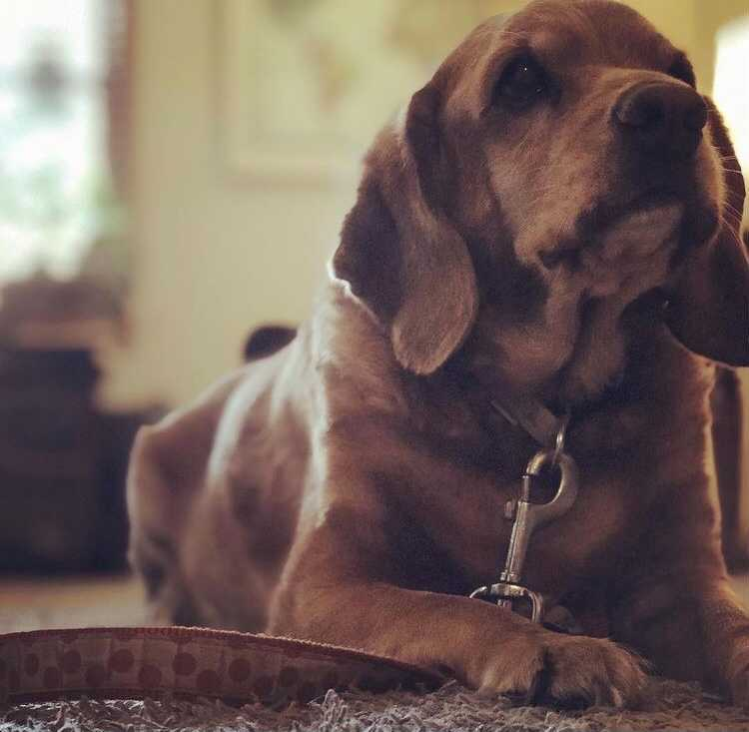
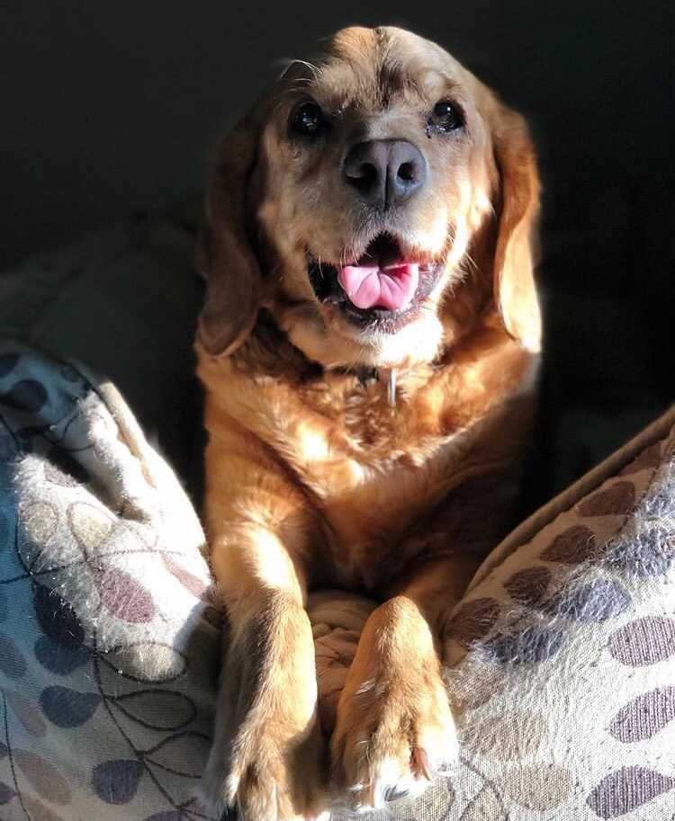

Slide 30
Like a dog that returns to his vomit is a fool who repeats his folly.
Proverbs 26:11

Slide 32
CONFIDENCE IN CRAP OR CHRIST?
¹ Finally, my brothers and sisters, rejoice in the Lord. To write the same things to you is no trouble to me and is safe for you. ² Look out for the dogs, look out for the evildoers, look out for those who mutilate the flesh.
Philippians 3:1-2

Slide 33
CONFIDENCE IN CRAP OR CHRIST?
³ For we are the circumcision, who worship by the Spirit of God and glory in Christ Jesus and put no confidence in the flesh— ^{4a} though I myself have reason for confidence in the flesh also.
Philippians 3:3-4a

Slide 34
PAUL’S IMPRESSIVE RESUME
^{4b} If anyone else thinks he has reason for confidence in the flesh, I have more: ⁵ circumcised on the eighth day, of the people of Israel, of the tribe of Benjamin, a Hebrew of Hebrews; as to the law, a Pharisee; ⁶ as to zeal, a persecutor of the church; as to righteousness under the law, blameless.
Philippians 3:4b-6

Slide 35
PAUL’S IMPRESSIVE RESUME
circumcised on the eighth day
of the people of Israel
of the tribe of Benjamin
a Hebrew of Hebrews
as to the law, a Pharisee
as to zeal, a persecutor of the church
as to righteousness under the law, blameless.
Philippians 3:4b-6

Slide 36
PAUL’S IMPRESSIVE RESUME
A Jew, born in Tarsus in Cilicia (no obscure city)
Brought up in Jerusalem
Educated at the feet of Gamaliel according to the strict manner of the law of our fathers
Zealous for God
Persecuted this Way to the death, binding and delivering to prison both men and women
The high priest and the whole council of elders are his references
Acts 22:3-5

Slide 37
PAUL’S IMPRESSIVE RESUME
⁷ But whatever gain I had, I counted as loss for the sake of Christ. ⁸ Indeed, I count everything as loss because of the surpassing worth of knowing Christ Jesus my Lord. For his sake I have suffered the loss of all things and count them as rubbish, in order that I may gain Christ ^{9a} and be found in him, not having a righteousness of my own that comes from the law…
Philippians 3:7-9a

Slide 38
PAUL’S IMPRESSIVE RESUME
^{9b} …but that which comes through faith in Christ, the righteousness from God that depends on faith— ¹⁰ that I may know him and the power of his resurrection, and may share his sufferings, becoming like him in his death, ¹¹ that by any means possible I may attain the resurrection from the dead.
Philippians 3:9b-11

Slide 39
HOMEWORK:
Memorize Philippians 3:8. Indeed, I count everything as loss because of the surpassing worth of knowing Christ Jesus my Lord. For his sake I have suffered the loss of all things and count them as rubbish, in order that I may gain Christ…

Slide 40
HOMEWORK:
Memorize Philippians 3:8.
Choose a 2021 Word of the Year

Slide 41
TALLGRASSIANS’ 2021 WOTYS:
Nathan Hurst—compassion
Amber Johnson—expect
Jenny Ifft—relationship
Dave Geldart—beloved
Maddox Deaver—grow
Nick Costello—trust
Taylor Hillegeist—leadership
Elisha Hillegeist—obedience
Kate Deaver—peace
Matthias Bieber—healing
Terry Deaver—shine!
Ben Deaver—calm
Lacey Dunn—trustworthy
Kassi Chapman—joyful grief
Rachel Whiteaker—joy
Annie Eschke—peace
Jim Eschke—rapture
Taylor McFall—space
Mary Gordon McFall—stretch
Dilan Oglesby—emerge

Slide 42
HOMEWORK:
Memorize Philippians 3:8.
Choose a 2021 Word of the Year
Join me in reading the Whole Bible Under 2 Years

Slide 43
HOMEWORK:
Memorize Philippians 3:8.
Choose a 2021 Word of the Year
Join me in reading the Whole Bible Under 2 Years
Journal through The Great Annual Examen

Slide 44
HOMEWORK:
Memorize Philippians 3:8.
Choose a 2021 Word of the Year
Join me in reading the Whole Bible Under 2 Years
Journal through The Great Annual Examen
Pray your Prophetic Promises

Slide 45
STARTING FEBRUARY 11
A ZOOM EQUIPPING COURSE FOR ALL TALLGRASS ADULTS FROM PURE DESIRE MINISTRIES

Slide 46
PROPHETIC PROMISES
The Encounter with God | The Passage | The Lie | The Prophetic Promise

Slide 47
PROPHETIC PROMISES
The Encounter with God | The Passage | The Lie | The Prophetic Promise
Watching the monarch butterfly Lula emerge from its cocoon. (9/6/14—9/17/14)

Slide 48
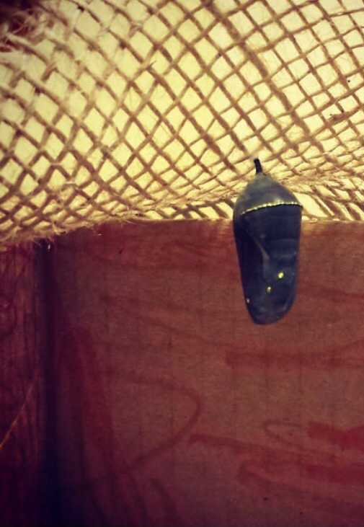
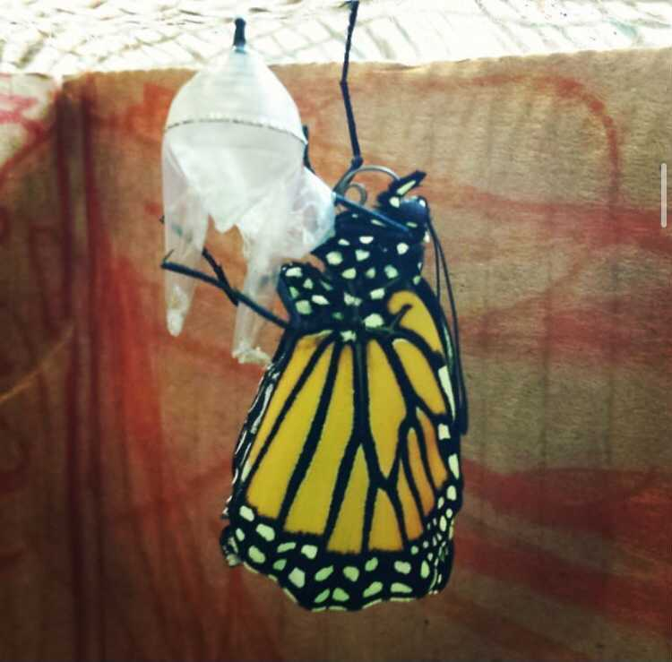
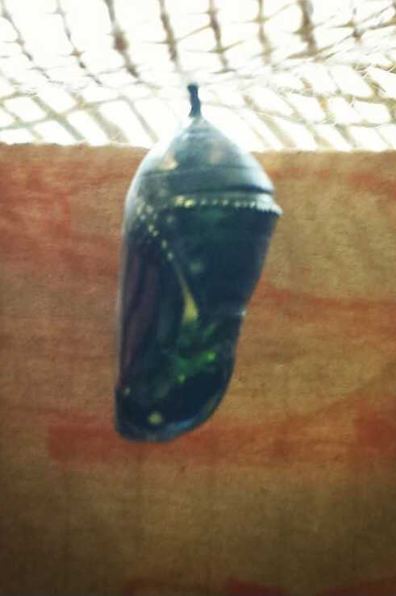

Slide 49
PROPHETIC PROMISES
The Encounter with God | The Passage | The Lie | The Prophetic Promise
Watching the monarch butterfly Lula emerge from its cocoon. (9/6/14—9/17/14) | 2 Corinthians 5:17 Therefore, if anyone is in Christ, he is a new creation. The old has passed away; behold, the new has come.

Slide 50
PROPHETIC PROMISES
The Encounter with God | The Passage | The Lie | The Prophetic Promise
Watching the monarch butterfly Lula emerge from its cocoon. (9/6/14—9/17/14) | 2 Corinthians 5:17 Therefore, if anyone is in Christ, he is a new creation. The old has passed away; behold, the new has come. | You’ll be sunk by anxiety like others before you. It’s just a matter of time before something bad happens.

Slide 51
PROPHETIC PROMISES
The Encounter with God | The Passage | The Lie | The Prophetic Promise
Watching the monarch butterfly Lula emerge from its cocoon. (9/6/14—9/17/14) | 2 Corinthians 5:17 Therefore, if anyone is in Christ, he is a new creation. The old has passed away; behold, the new has come. | You’ll be sunk by anxiety like others before you. It’s just a matter of time before something bad happens. | I’m a NEW creation! I’m being transformed.

Slide 52
HOMEWORK:
Memorize Philippians 3:8.
Choose a 2021 Word of the Year
Join me in reading the Whole Bible Under 2 Years
Journal through The Great Annual Examen
Pray your Prophetic Promises

Slide 53
CONFIDENCE IN CHRIST!
¹² Not that I have already obtained this or am already perfect, but I press on to make it my own, because Christ Jesus has made me his own. ¹³ Brothers and sisters, I do not consider that I have made it my own. But one thing I do: forgetting what lies behind and straining forward to what lies ahead, ¹⁴ I press on toward the goal for the prize of the upward call of God in Christ Jesus.
Philippians 3:12-14

Slide 54
CONFIDENCE IN CHRIST!
¹⁵ Let those of us who are mature think this way, and if in anything you think otherwise, God will reveal that also to you. ¹⁶ Only let us hold true to what we have attained.
Philippians 3:15-16

Slide 56
Who You Say
I Am
“Who You Say I Am” by Ben Fielding and Reuben Morgan.

Slide 57
Who am I that the highest King
Would welcome me
I was lost but He brought me in
Oh, His love for me
Oh, His love for me
“Who You Say I Am” by Ben Fielding and Reuben Morgan.

Slide 58
Who the Son sets free, Oh is free indeed
I’m a child of God; Yes, I am
“Who You Say I Am” by Ben Fielding and Reuben Morgan.

Slide 59
Free at last, He has ransomed me
His grace runs deep
While I was a slave to sin
Jesus died for me
Yes, He died for me
“Who You Say I Am” by Ben Fielding and Reuben Morgan.

Slide 60
Who the Son sets free, Oh is free indeed
I’m a child of God; Yes, I am
In my Father’s house there’s a place for me
I’m a child of God; Yes, I am
“Who You Say I Am” by Ben Fielding and Reuben Morgan.

Slide 61
I am chosen, not forsaken
I am who You say I am
You are for me, not against me
I am who You say I am
(Repeat)
“Who You Say I Am” by Ben Fielding and Reuben Morgan.

Slide 62
Who the Son sets free, Oh is free indeed
I’m a child of God; Yes, I am
In my Father’s house there’s a place for me
I’m a child of God; Yes, I am
“Who You Say I Am” by Ben Fielding and Reuben Morgan.

Slide 63
In my Father’s house there’s a place for me
I’m a child of God; Yes, I am
“Who You Say I Am” by Ben Fielding and Reuben Morgan.

Slide 64
I am chosen, not forsaken
I am who You say I am
You are for me, not against me
I am who You say I am
(Repeat)
“Who You Say I Am” by Ben Fielding and Reuben Morgan.

Slide 65
I am who You say I am
I am who You say I am
“Who You Say I Am” by Ben Fielding and Reuben Morgan.

Slide 66
Who the Son sets free, Oh is free indeed
I’m a child of God; Yes, I am
In my Father’s house there’s a place for me
I’m a child of God; Yes, I am
“Who You Say I Am” by Ben Fielding and Reuben Morgan.

Slide 68
New Wine
“New Wine” by Brooke Ligertwood. CCLI: 7102397

Slide 69
In the crushing, In the pressing
You are making new wine
In the soil I now surrender
You are breaking new ground
“New Wine” by Brooke Ligertwood. CCLI: 7102397

Slide 70
So I yield to You
and to Your careful hand
When I trust You
I don’t need to understand
“New Wine” by Brooke Ligertwood. CCLI: 7102397

Slide 71
Make me Your vessel
Make me an offering
Make me whatever You want me to be
“New Wine” by Brooke Ligertwood. CCLI: 7102397

Slide 72
I came here with nothing
But all You have given me
Jesus bring new wine out of me
“New Wine” by Brooke Ligertwood. CCLI: 7102397

Slide 73
In the crushing, In the pressing
You are making new wine
In the soil I now surrender
You are breaking new ground
“New Wine” by Brooke Ligertwood. CCLI: 7102397

Slide 74
Make me Your vessel
Make me an offering
Make me whatever You want me to be
“New Wine” by Brooke Ligertwood. CCLI: 7102397

Slide 75
I came here with nothing
But all You have given me
Jesus bring new wine out of me
Jesus bring new wine out of me
Jesus bring new wine out of me
“New Wine” by Brooke Ligertwood. CCLI: 7102397

Slide 76
Where there is new wine
There is new power
There is new freedom
“New Wine” by Brooke Ligertwood. CCLI: 7102397

Slide 77
The Kingdom is here
I lay down my old flames
To carry Your new fire today
“New Wine” by Brooke Ligertwood. CCLI: 7102397

Slide 78
Make me Your vessel
Make me an offering
Make me whatever You want me to be
“New Wine” by Brooke Ligertwood. CCLI: 7102397

Slide 79
I came here with nothing
But all You have given me
Jesus bring new wine out of me
“New Wine” by Brooke Ligertwood. CCLI: 7102397

Slide 80
So I yield to You and to Your careful hand
I’ll trust You; help when I don’t understand
In the crushing, In the pressing
You are making new wine
“New Wine” by Brooke Ligertwood. CCLI: 7102397

Slide 82
WELCOME!

