Slide 1
WELCOME!

Slide 2
WELCOME TO TALLGRASS CHURCH’S ADVENT 2020 CENTRAL GATHERINGS IN BOYS & GIRLS CLUB!

Slide 3
O Come All
Ye Faithful
“O Come All Ye Faithful” By C. Frederick Oakley David LaChance Jr. John Francis Wade

Slide 4
O come, all ye faithful,
joyful and triumphant!
O come ye, O come ye to Bethlehem!
Come and behold him,
born the King of angels;
“O Come All Ye Faithful” By C. Frederick Oakley David LaChance Jr. John Francis Wade

Slide 5
O come, let us adore Him,
O come, let us adore Him,
O come, let us adore Him,
Christ, the Lord!
“O Come All Ye Faithful” By C. Frederick Oakley David LaChance Jr. John Francis Wade

Slide 6
O come all ye faithful
O come all ye faithful
O come all ye faithful
to Bethlehem
repeat
“O Come All Ye Faithful” By C. Frederick Oakley David LaChance Jr. John Francis Wade

Slide 7
Sing, choirs of angels,
sing in exultation,
Sing, all ye citizens of heav'n above:
"Glory to God, all glory in the highest!"
“O Come All Ye Faithful” By C. Frederick Oakley David LaChance Jr. John Francis Wade

Slide 8
O come, let us adore Him,
O come, let us adore Him,
O come, let us adore Him,
Christ, the Lord!
“O Come All Ye Faithful” By C. Frederick Oakley David LaChance Jr. John Francis Wade

Slide 9
O come all ye faithful
O come all ye faithful
O come all ye faithful
to Bethlehem
repeat
“O Come All Ye Faithful” By C. Frederick Oakley David LaChance Jr. John Francis Wade

Slide 10
Yea, Lord, we greet Thee,
born this happy morning;
Jesus, to thee be all glory giv'n;
Word of the Father,
now in flesh appearing;
“O Come All Ye Faithful” By C. Frederick Oakley David LaChance Jr. John Francis Wade

Slide 11
O come, let us adore Him,
O come, let us adore Him,
O come, let us adore Him,
Christ, the Lord!
“O Come All Ye Faithful” By C. Frederick Oakley David LaChance Jr. John Francis Wade

Slide 12
O come all ye faithful
O come all ye faithful
O come all ye faithful
to Bethlehem
“O Come All Ye Faithful” By C. Frederick Oakley David LaChance Jr. John Francis Wade

Slide 13
O come all ye faithful
O come all ye faithful
O come all ye faithful
“O Come All Ye Faithful” By C. Frederick Oakley David LaChance Jr. John Francis Wade

Slide 14
O come, let us adore Him,
O come, let us adore Him,
O come, let us adore Him,
Christ, the Lord!
“O Come All Ye Faithful” By C. Frederick Oakley David LaChance Jr. John Francis Wade

Slide 15
O come all ye faithful
O come all ye faithful
O come all ye faithful
to Bethlehem
“O Come All Ye Faithful” By C. Frederick Oakley David LaChance Jr. John Francis Wade

Slide 17
WELCOME TO WEEK 4 OF ADVENT 2020

Slide 19
GET YOUR CHRISTMAS PACK…
TODAY!
IT’S NOT TOO LATE TO INVITE YOUR FRIENDS, FAMILY, AND NEIGHBORS! LET BEN KNOW HOW MANY ADDITIONAL PACKS YOU NEED.

Slide 20
WELCOME TO WEEK 4 OF ADVENT 2020

Slide 22
Behold Our God
“Behold Our God” By Jonathan Baird, Meghan Baird, Ryan Baird, Stephen Altrogge © 2011

Slide 23
Who has held the oceans in His hands?
Who has numbered every grain of sand?
Kings and nations tremble at His voice.
All creation rises to rejoice!
“Behold Our God” By Jonathan Baird, Meghan Baird, Ryan Baird, Stephen Altrogge © 2011

Slide 24
Behold our God seated on His throne
Come let us adore Him
Behold our King, nothing can compare
Come let us adore Him!
“Behold Our God” By Jonathan Baird, Meghan Baird, Ryan Baird, Stephen Altrogge © 2011

Slide 25
Who has given counsel to the Lord?
Who can question any of His words?
Who can teach the One who knows all things
Who can fathom all His wondrous deeds?
“Behold Our God” By Jonathan Baird, Meghan Baird, Ryan Baird, Stephen Altrogge © 2011

Slide 26
Behold our God seated on His throne
Come let us adore Him
Behold our King, nothing can compare
Come let us adore Him!
“Behold Our God” By Jonathan Baird, Meghan Baird, Ryan Baird, Stephen Altrogge © 2011

Slide 28
Who has felt the nails upon His hands
bearing all the guilt of sinful man?
God eternal, humbled to the grave.
Jesus, Savior, risen now to reign!
“Behold Our God” By Jonathan Baird, Meghan Baird, Ryan Baird, Stephen Altrogge © 2011

Slide 29
Behold our God seated on His throne
Come let us adore Him
Behold our King, nothing can compare
Come let us adore Him!
repeat
“Behold Our God” By Jonathan Baird, Meghan Baird, Ryan Baird, Stephen Altrogge © 2011

Slide 30
O come, let us adore Him,
O come, let us adore Him,
O come, let us adore Him,
Christ, the Lord!
“Behold Our God” By Jonathan Baird, Meghan Baird, Ryan Baird, Stephen Altrogge © 2011

Slide 32
WELCOME TO WEEK 4 OF ADVENT 2020

Slide 33
Sing! *advent twenty-twenty*

Slide 34
Paul Sang!
²⁵ About midnight Paul and Silas were praying and singing hymns to God, and the prisoners were listening to them…
Acts 16:25-34

Slide 35
Paul Sang!
¹⁴ Do all things without grumbling or complaining, ¹⁵ that you may be blameless and innocent, children of God without blemish in the midst of a crooked and twisted generation, among whom you shine as lights in the world, ¹⁶ holding fast to the word of life…
Philippians 2:14-16a

Slide 36
The Heavens Sang!
And suddenly there was with the angel a multitude of the heavenly host praising God and saying,
“Glory to God in the highest and on earth peace among those with whom he is pleased!”
Luke 2:13-14

Slide 37
The Shepherds Sang!
And the shepherds returned, glorifying and praising God for all they had heard and seen, as it had been told them.
Luke 2:20

Slide 38
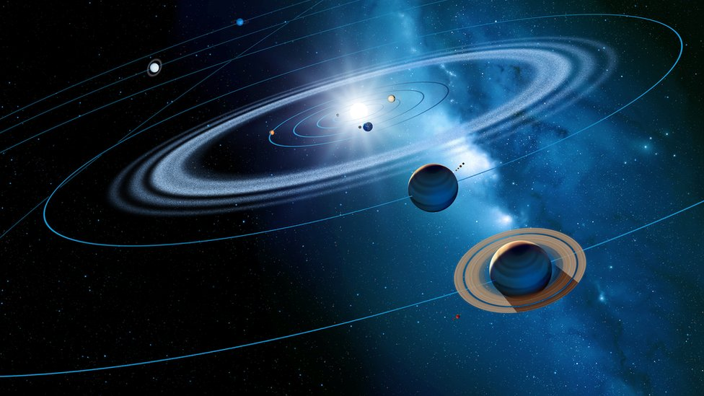

Slide 39
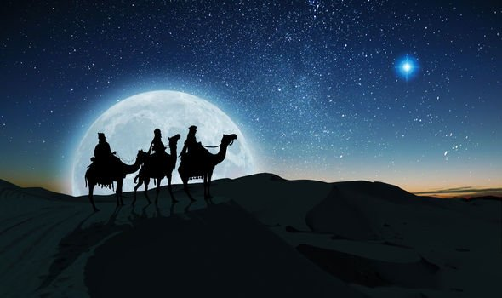

Slide 40
The Heavens Sing!
¹ The heavens declare the glory of God, and the sky above proclaims his handiwork. ² Day to day pours out speech, and night to night reveals knowledge. ⁴ Their voice goes out through all the earth, and their words to the end of the world.
Psalm 19:1-2, 4

Slide 41
Jesus Sang!
And when they had sung a hymn, they went out to the Mount of Olives.
Mark 14:26 (Matthew 26:30)

Slide 42
Jesus Sings!
⁹ But we see him who for a little while was made lower than the angels, namely Jesus, crowned with glory and honor because of the suffering of death, so that by the grace of God he might taste death for everyone. ¹⁰ For it was fitting that he, for whom and by whom all things exist, in bringing many sons to glory, should make the founder of their salvation perfect through suffering.
Hebrews 2:9-10

Slide 43
Jesus Sings!
¹¹ For he who sanctifies and those who are sanctified all have one source. That is why he is not ashamed to call them brothers and sisters, ¹² saying,
“I will tell of your name to my brothers and sisters; in the midst of the congregation I will sing your praise.” (quoting Psalm 18:49)
Hebrews 2:11-12

Slide 44
Jesus Sings!
The Lord your God is in your midst, a mighty one who will save; he will rejoice over you with gladness; he will quiet you by his love; he will exult over you with loud singing.
Zephaniah 3:17

Slide 45
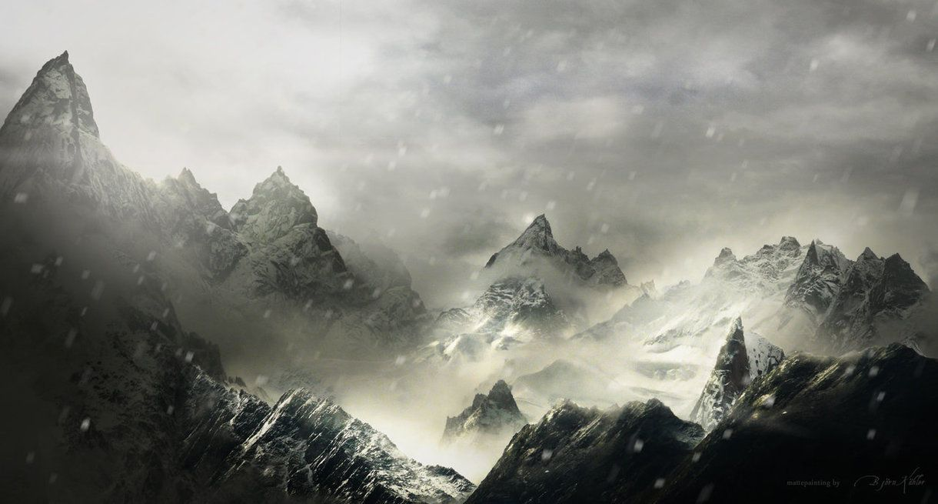

Slide 46
Jesus Sings!
The Lord your God is in your midst, a mighty one who will save; he will rejoice over you with gladness; he will quiet you by his love; he will exult over you with loud singing.
Zephaniah 3:17
What is Jesus singing over you?

Slide 47
HOMEWORK:
Memorize Zephaniah 3:17.
Get outside and look up at the starry song and dance!
Listen to Jesus singing over you.
Feel the worth of your soul
and the love of God…
and then…sing!

Slide 48
Sing! *advent twenty-twenty*

Slide 50
Little Drummer Boy
“Little Drummer Boy” By Katherine Kennicott Davis, 1941

Slide 51
Come they told me…
A newborn King to see…
Our finest gifts we bring…
To lay before the King…
So to honor Him… here we come!
“Little Drummer Boy” By Katherine Kennicott Davis, 1941

Slide 53
Little baby…
I am a poor boy too…
I have no gift to bring…
That’s fit to give our King…
Shall I play for You?… On my drum!
“Little Drummer Boy” By Katherine Kennicott Davis, 1941

Slide 54
Make a joyful noise to the LORD,
all the earth! Serve the LORD
with gladness! Come into
his presence with singing!
Psalm 100:1-2

Slide 55
Mary nodded…
The ox and lamb kept time…
I played my drum for Him…
I played my best for Him…
Then He smiled at me…
Me and my drum!
“Little Drummer Boy” By Katherine Kennicott Davis, 1941

Slide 56
air drumming &
chest thumping
is encouraged

Slide 58
King of Kings
“King of Kings” By By Jason Ingram, Brooke Ligertwood & Scott Ligertwood © 2019 Hillsong Music Publishing

Slide 59
In the darkness in the waiting
Without hope without light
Till from heaven You came running
There was mercy in Your eyes
To fulfill the law and prophets
To a virgin came the Word
From a throne of endless glory
To a cradle in the dirt
“King of Kings” By By Jason Ingram, Brooke Ligertwood & Scott Ligertwood © 2019 Hillsong Music Publishing

Slide 60
Praise the Father, Praise the Son,
Praise the Spirit three in One.
God of glory – Majesty.
Praise, forever, to the King of Kings.
“King of Kings” By By Jason Ingram, Brooke Ligertwood & Scott Ligertwood © 2019 Hillsong Music Publishing

Slide 61
To reveal the kingdom coming,
And to reconcile the lost,
To redeem the whole creation,
You did not despise the cross.
For even in Your suffering
You saw to the other side,
Knowing this was our salvation
Jesus for our sake You died.
“King of Kings” By By Jason Ingram, Brooke Ligertwood & Scott Ligertwood © 2019 Hillsong Music Publishing

Slide 62
Praise the Father, Praise the Son,
Praise the Spirit three in One.
God of glory – Majesty.
Praise, forever, to the King of Kings.
“King of Kings” By By Jason Ingram, Brooke Ligertwood & Scott Ligertwood © 2019 Hillsong Music Publishing

Slide 63
And the morning that You rose
All of heaven held its breath
‘till that stone was moved for good
For the Lamb had conquered death.
And the dead rose from their tombs
And the angels stood in awe
For the souls of all who’d come
To the Father are restored.
“King of Kings” By By Jason Ingram, Brooke Ligertwood & Scott Ligertwood © 2019 Hillsong Music Publishing

Slide 64
And the Church of Christ was born
Then the Spirit lit the flame
Now this gospel truth of old
Shall not kneel shall not faint.
By His blood and in His Name
In His freedom I am free
For the love of Jesus Christ
Who has resurrected me!
“King of Kings” By By Jason Ingram, Brooke Ligertwood & Scott Ligertwood © 2019 Hillsong Music Publishing

Slide 65
Praise the Father, Praise the Son,
Praise the Spirit three in One.
God of glory – Majesty.
Praise, forever, to the King of Kings.
Praise, forever, to the King of Kings!
“King of Kings” By By Jason Ingram, Brooke Ligertwood & Scott Ligertwood © 2019 Hillsong Music Publishing

Slide 67
Graves into
Gardens
“Graves into Gardens” by Steven Furtick, Chris Brown, Tiffany Hammer, Brandon Lake

Slide 68
I searched the world
But it couldn’t fill me
Man’s empty praise
and treasures that fade
Are never enough
“Graves into Gardens” by Steven Furtick, Chris Brown, Tiffany Hammer, Brandon Lake

Slide 69
Then You came along
And put me back together
And every desire
is now satisfied
Here in Your love
“Graves into Gardens” by Steven Furtick, Chris Brown, Tiffany Hammer, Brandon Lake

Slide 70
Oh there’s nothing better than You
There’s nothing better than You
Lord there’s nothing;
nothing is better than You.
“Graves into Gardens” by Steven Furtick, Chris Brown, Tiffany Hammer, Brandon Lake

Slide 71
I’m not afraid
To show You my weakness
My failures and flaws
Lord You’ve seen them all
And You still call me friend
“Graves into Gardens” by Steven Furtick, Chris Brown, Tiffany Hammer, Brandon Lake

Slide 72
‘Cause the God of the mountain
is the God of the valley
There’s not a place
Your mercy and grace
Won’t find me again
“Graves into Gardens” by Steven Furtick, Chris Brown, Tiffany Hammer, Brandon Lake

Slide 73
Oh there’s nothing better than You
There’s nothing better than You
Lord there’s nothing;
nothing is better than You.
“Graves into Gardens” by Steven Furtick, Chris Brown, Tiffany Hammer, Brandon Lake

Slide 74
You turn morning to dancing
You give beauty for ashes
You turn shame into glory
You’re the only One who can
“Graves into Gardens” by Steven Furtick, Chris Brown, Tiffany Hammer, Brandon Lake

Slide 75
You turn graves into gardens
You turn bones into armies
You turn seas into highways
You’re the only One who can
“Graves into Gardens” by Steven Furtick, Chris Brown, Tiffany Hammer, Brandon Lake

Slide 76
You’re the only
One who can!
“Graves into Gardens” by Steven Furtick, Chris Brown, Tiffany Hammer, Brandon Lake

Slide 77
Oh there’s nothing better than You
There’s nothing better than You
Lord there’s nothing;
nothing is better than You.
“Graves into Gardens” by Steven Furtick, Chris Brown, Tiffany Hammer, Brandon Lake

Slide 78
You turn graves into gardens
You turn bones into armies
You turn seas into highways
You’re the only One who can
“Graves into Gardens” by Steven Furtick, Chris Brown, Tiffany Hammer, Brandon Lake

Slide 79
You’re the only
One who can!
You’re the only
One who can!
“Graves into Gardens” by Steven Furtick, Chris Brown, Tiffany Hammer, Brandon Lake

