Slide 1
WELCOME!

Slide 2
WELCOME TO TALLGRASS CHURCH’S ADVENT 2020 CENTRAL GATHERINGS IN BOYS & GIRLS CLUB!

Slide 3
Joy to the World
“Joy to the World” By George Frideric Handel, Isaac Watts

Slide 4
Joy to the world, the Lord is come!
Let earth receive her King;
Let every heart prepare Him room,
And Heaven and nature sing,
And Heaven and nature sing,
And Heaven, & Heaven, & nature sing.
“Joy to the World” By George Frideric Handel, Isaac Watts

Slide 5
Joy to the earth, the Savior reigns!
Let men their songs employ;
While fields & floods, rocks, hills & plains
Repeat the sounding joy,
Repeat the sounding joy,
Repeat, repeat, the sounding joy.
“Joy to the World” By George Frideric Handel, Isaac Watts

Slide 6
May the God of hope fill you with all joy and peace in believing, so that by the power of the Holy Spirit you may abound in hope.
– Romans 15:13

Slide 7
You Are My Joy
“You Are My Joy” By Andrea Marie Reagan, Brock Human, Will Reagan

Slide 8
You are my joy, You are my joy.
You are my joy, You are my joy!
“You Are My Joy” By Andrea Marie Reagan, Brock Human, Will Reagan

Slide 9
He rules the world with truth and grace,
And makes the nations prove
The glories of His righteousness,
And wonders of His love,
And wonders of His love,
And wonders, wonders, of His love.
“Joy to the World” By George Frideric Handel, Isaac Watts

Slide 10
You are my joy, You are my joy.
You are my joy, You are my joy!
“You Are My Joy” By Andrea Marie Reagan, Brock Human, Will Reagan

Slide 11
You are my joy, You are my joy.
(In You is all my hope and my peace)
You are my joy, You are my joy!
(In You is all my hope and my peace)
“You Are My Joy” By Andrea Marie Reagan, Brock Human, Will Reagan

Slide 12
Joy to the world, the Lord is come!
Let earth receive her King;
Let every heart prepare Him room,
And Heaven and nature sing,
And Heaven and nature sing,
And Heaven, & Heaven, & nature sing.
“Joy to the World” By George Frideric Handel, Isaac Watts

Slide 13
You are my joy, You are my joy!
“You Are My Joy” By Andrea Marie Reagan, Brock Human, Will Reagan

Slide 15
WELCOME TO WEEK 3 OF ADVENT 2020

Slide 16
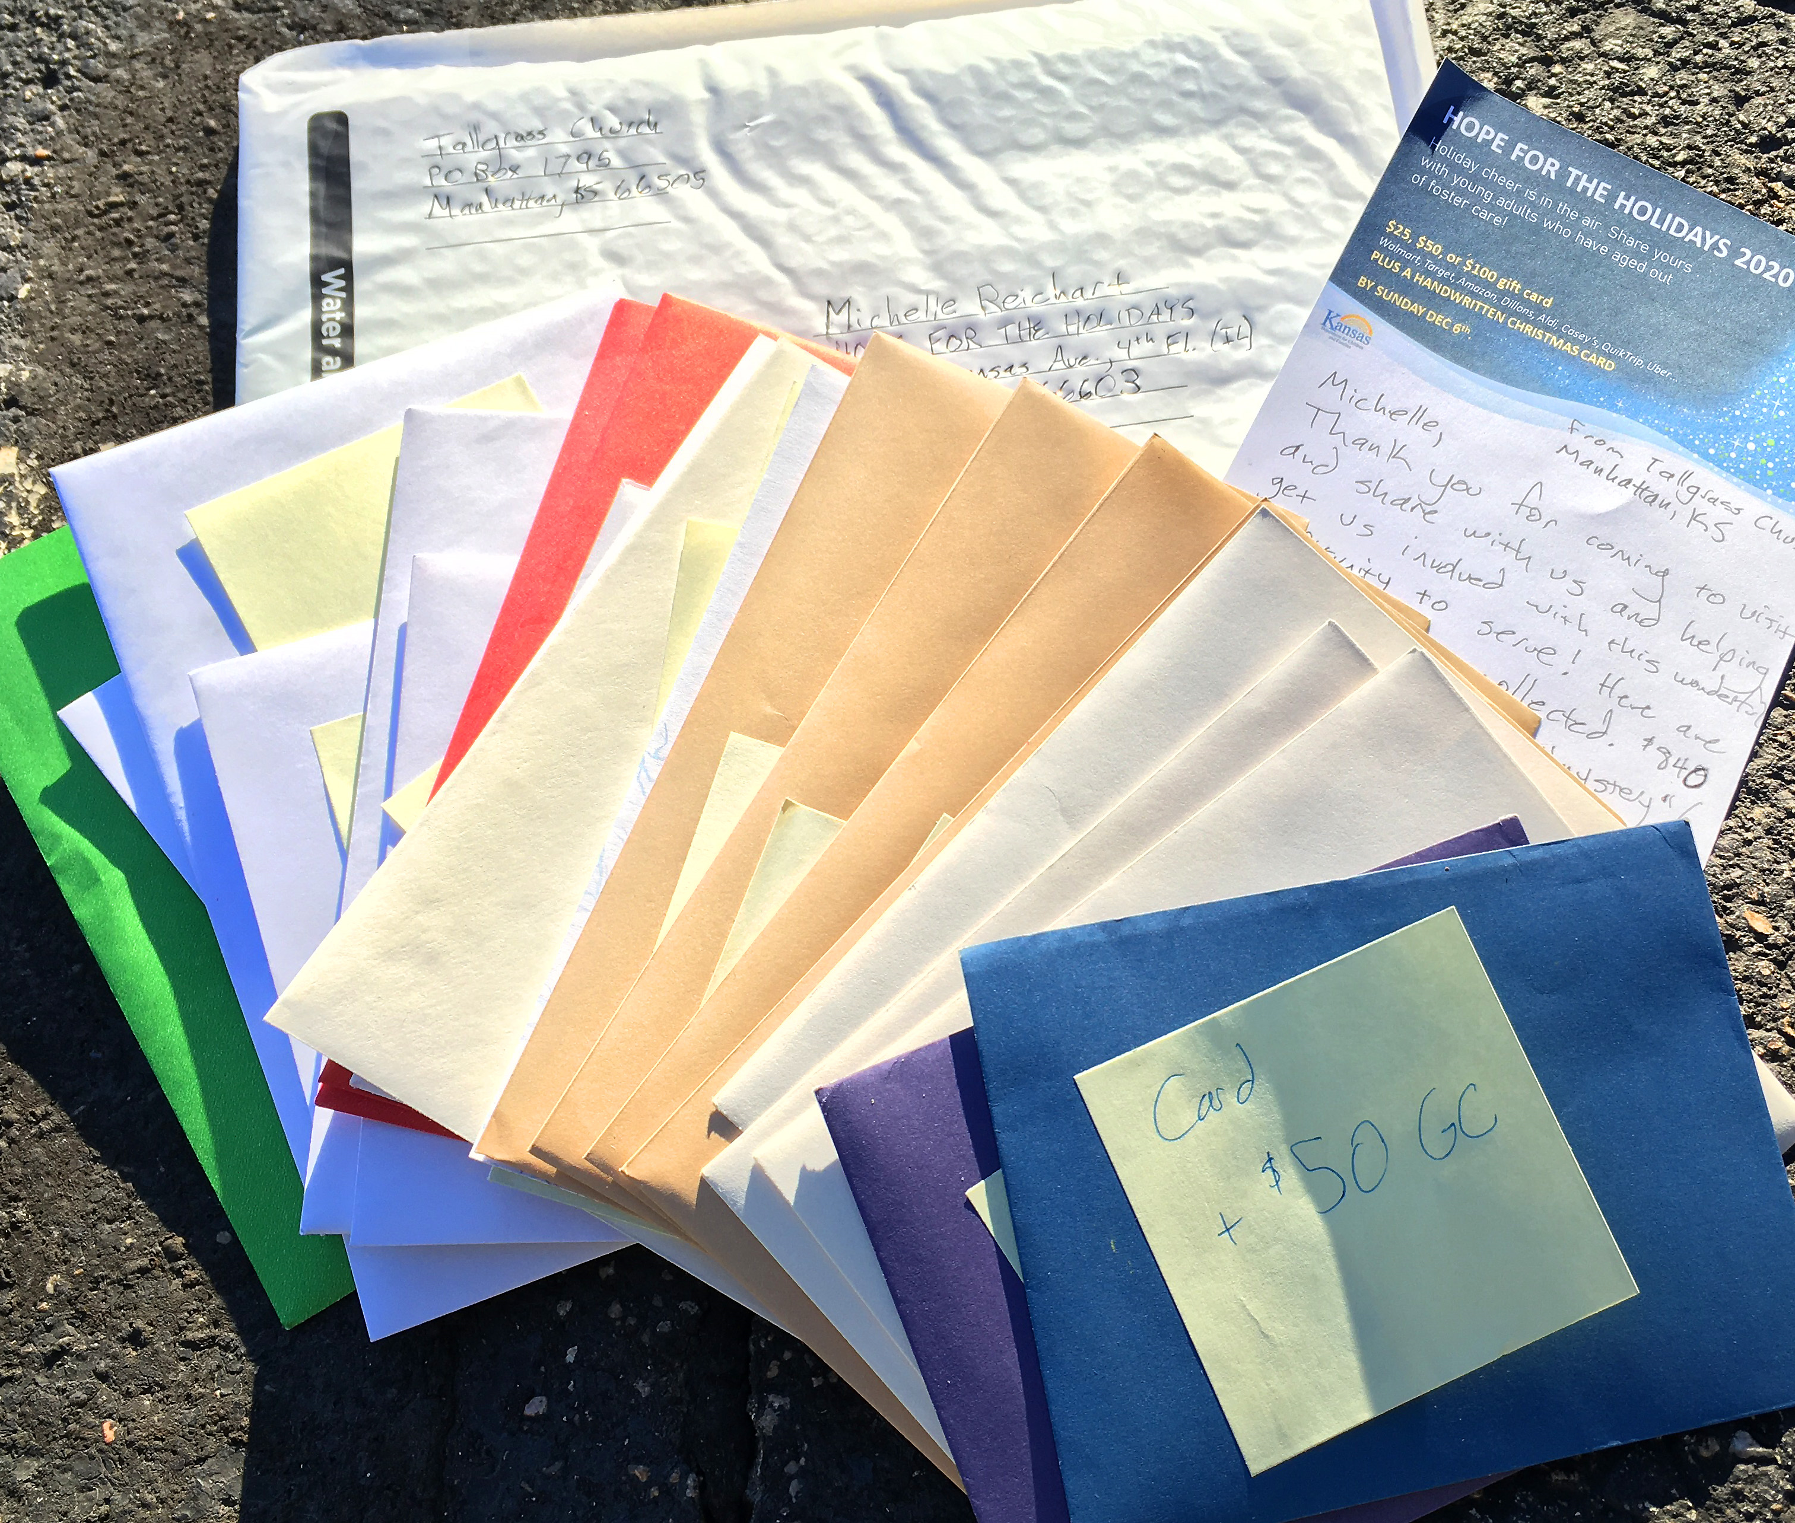
TITLES GO HERE CAPS
HOPE FOR THE HOLIDAYS 2020
Type stuff in here. Make at least 35 pt Ubuntu. Pref 40+
We were able to give 21 handwritten Christmas cards and almost $1000 of gift cards to young adults who have aged out of foster care! Way to #neighboringwellyall

Slide 18
GET YOUR CHRISTMAS PACK!
You’ll need a special CHRISTMAS PACK for the Zoom PJ Party CG on Sunday Dec 27! LET US KNOW BY THIS WEDNESDAY (Dec 16) if you want to pick yours up next Sunday morning (Dec 20) or prefer a local delivery on Tuesday, Dec 22: bendeaver@tallgrass.church.
INVITE YOUR FRIENDS, FAMILY, AND NEIGHBORS NOW! LET US KNOW HOW MANY ADDITIONAL PACKS YOU’LL NEED.

Slide 19
WELCOME TO WEEK 3 OF ADVENT 2020

Slide 20
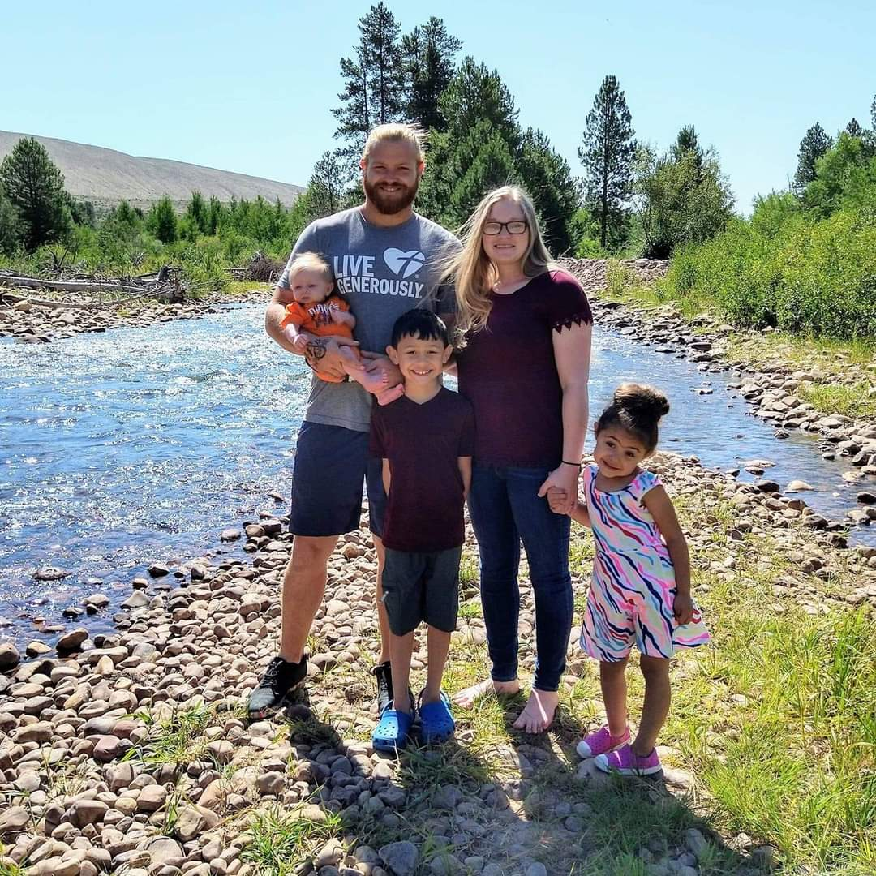
Daniel Schmitz

Slide 21
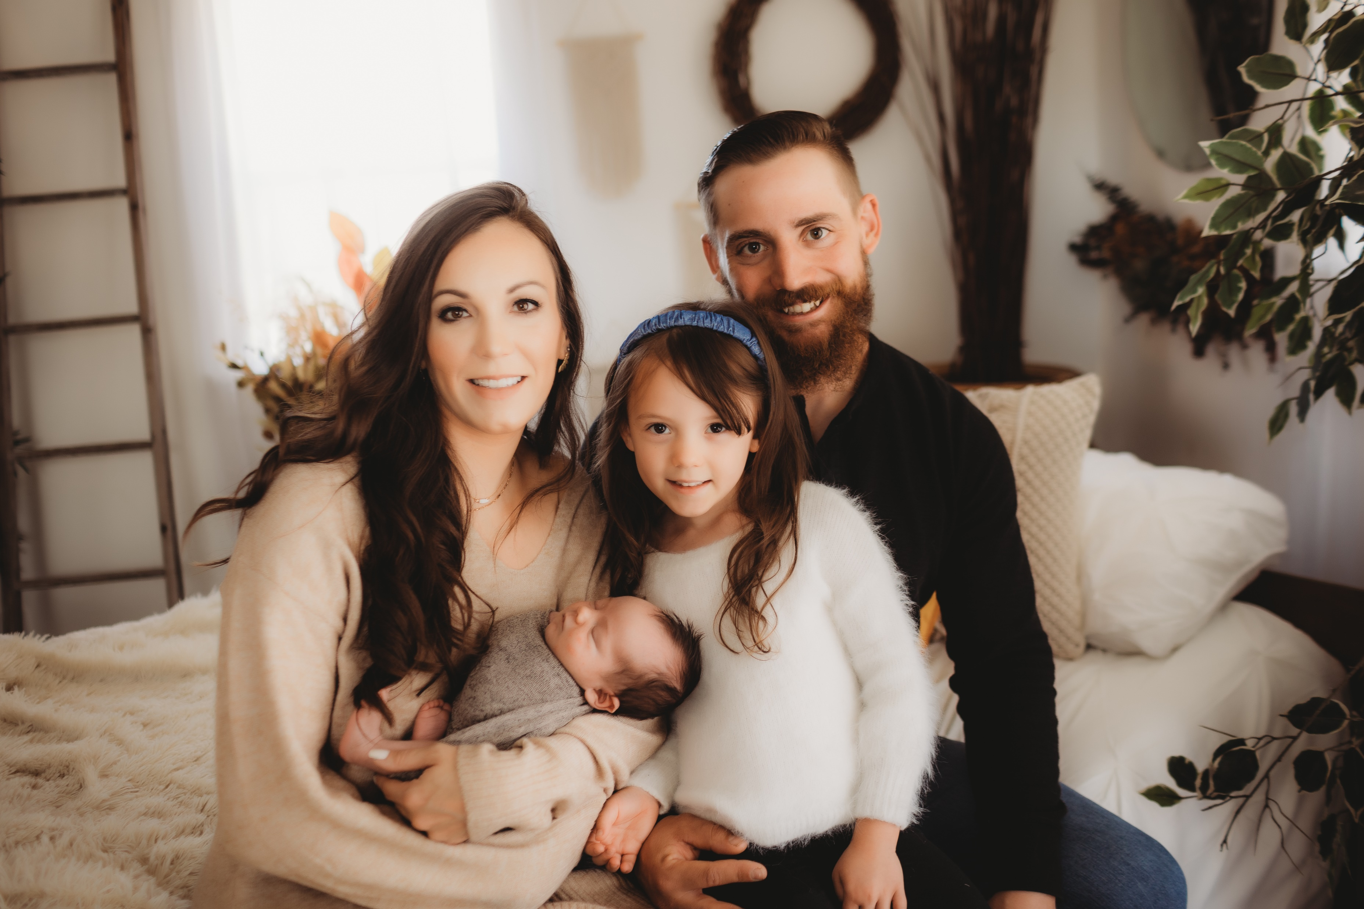
Kane Boeckman

Slide 22
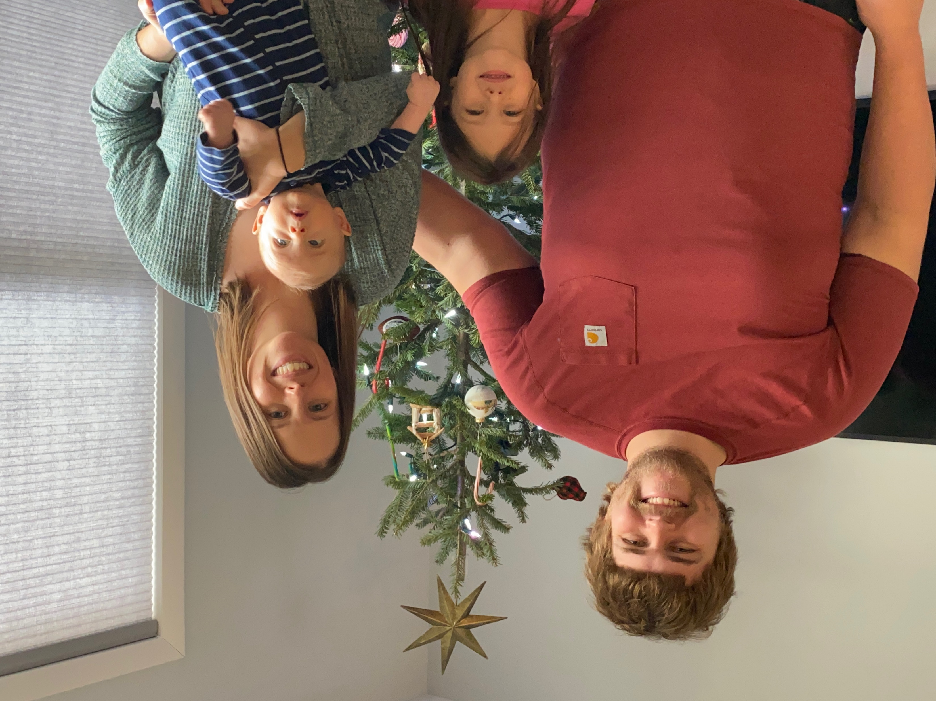
Bruce Chapman

Slide 23
Silent Night
By: Franz Xaver Gruber John Freeman Young Joseph Mohr

Slide 24
Silent night, holy night,
All is calm, all is bright
Round yon virgin mother and Child.
Holy Infant, so tender and mild,
Sleep in heavenly peace,
Sleep in heavenly peace.
By: Franz Xaver Gruber John Freeman Young Joseph Mohr

Slide 25
Silent night, holy night,
Shepherds quake at the sight;
Glories stream from heaven afar,
Heavenly hosts sing Alleluia!
Christ the Savior is born,
Christ the Savior is born!
By: Franz Xaver Gruber John Freeman Young Joseph Mohr

Slide 26
Silent night, holy night,
Son of God, love’s pure light;
Radiant beams from Thy holy face
With the dawn of redeeming grace,
Jesus, Lord, at Thy birth,
Jesus, Lord, at Thy birth.
By: Franz Xaver Gruber John Freeman Young Joseph Mohr

Slide 27
Silent night, holy night
Wondrous star, lend thy light;
With the angels let us sing,
Alleluia to our King;
Christ the Savior is born,
Christ the Savior is born!
By: Franz Xaver Gruber John Freeman Young Joseph Mohr

Slide 29
WELCOME TO WEEK 3 OF ADVENT 2020

Slide 30
Speak! *advent twenty-twenty*

Slide 31
Speak! *advent twenty-twenty*
Proverbs 12:18 There is one whose rash words are like sword thrusts, but the tongue of the wise brings healing.
James 3:11-12 ¹¹ Does a spring pour forth from the same opening both fresh and salt water? ¹² Can a fig tree, my brothers, bear olives, or a grapevine produce figs? Neither can a salt pond yield fresh water.

Slide 32
Speak! *advent twenty-twenty*
James 3:9-10 ⁹ With it we bless our Lord and Father, and with it we curse people who are made in the likeness of God. ¹⁰ From the same mouth come blessing and cursing. My brothers and sisters, these things ought not to be so.

Slide 33
Speak! *advent twenty-twenty*
James 3:5-8 ⁵ So also the tongue is a small member, yet it boasts of great things. How great a forest is set ablaze by such a small fire! ⁶ And the tongue is a fire, a world of unrighteousness. The tongue is set among our members, staining the whole body, setting on fire the entire course of life, and set on fire by hell. ⁷ For every kind of beast and bird, of reptile and sea creature, can be tamed and has been tamed by mankind, ⁸ but no human being can tame the tongue. It is a restless evil, full of deadly poison.

Slide 34
Speak! *advent twenty-twenty*
¹⁴ Do all things without grumbling or disputing, ¹⁵ that you may be blameless and innocent, children of God without blemish in the midst of a crooked and twisted generation, among whom you
shine as lights in the world, ^{16a} holding fast to the word of life…
Philippians 2:14-16a

Slide 35
Speak! *advent twenty-twenty*
John 1:1-5 ¹ In the beginning was the Word, and the Word was with God, and the Word was God. ² He was in the beginning with God. ³ All things were made through him, and without him was not any thing made that was made. ⁴ In him was life, and the life was the light of men. ⁵ The light shines in the darkness, and the darkness has not overcome it.

Slide 36
Psalm Nineteen
¹ The heavens declare the glory of God, and the sky above proclaims his handiwork. ² Day to day pours out speech, and night to night reveals knowledge. ³ There is no speech, nor are there words, whose voice is not heard. ⁴ Their voice goes out through all the earth, and their words to the end of the world.

Slide 37
Speak! *advent twenty-twenty*
John 1:14 And the Word became flesh and dwelt among us, and we have seen his glory, glory as of the only Son from the Father, full of grace and truth.

Slide 38
Speak! *advent twenty-twenty*
John 1:16-18 ¹⁶ For from his fullness we have all received, grace upon grace. ¹⁷ For the law was given through Moses; grace and truth came through Jesus Christ. ¹⁸ No one has ever seen God; the only God, who is at the Father's side, he has made him known. (explained him; declared him; exegeted him)

Slide 39
Reflection Questions:
What hurtful words do you need to bring into a path of healing?
What words do you long to hear? What words do you long to hear spoken to you? And from who?
What words do you speak to yourself?
What’s the tone of the words you speak? What do you want the tone of your words to be?
What do people feel when you begin to open your mouth?
Who can you build up this week with your words? What will you say? How will you say it?

Slide 40
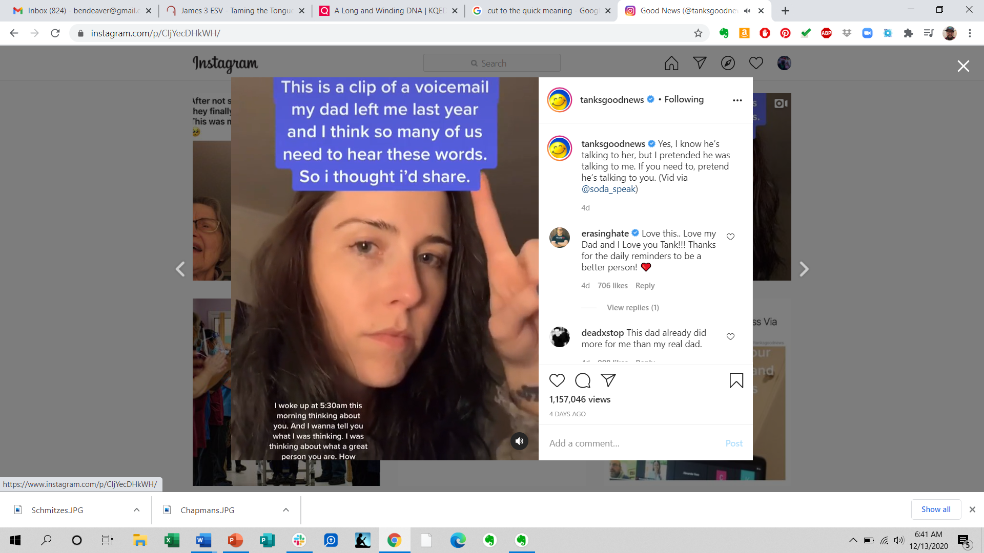

Slide 41
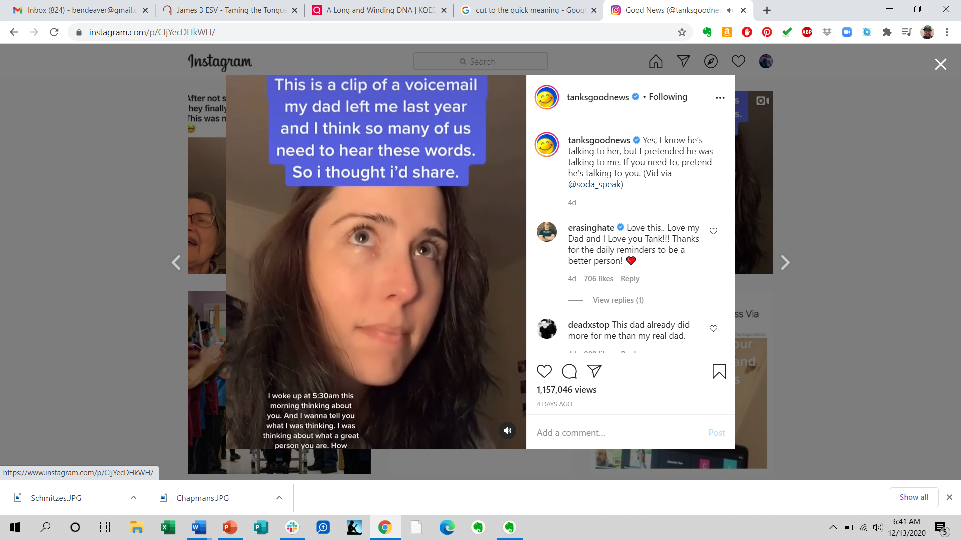

Slide 42
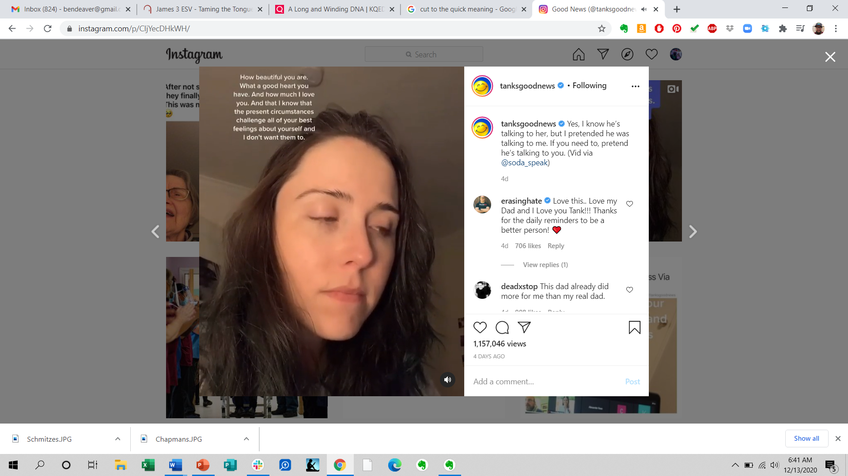

Slide 43
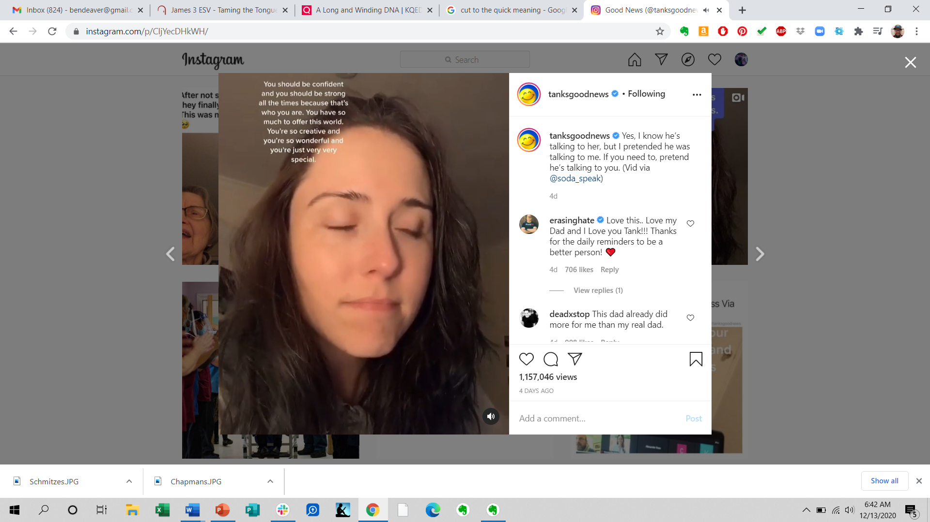
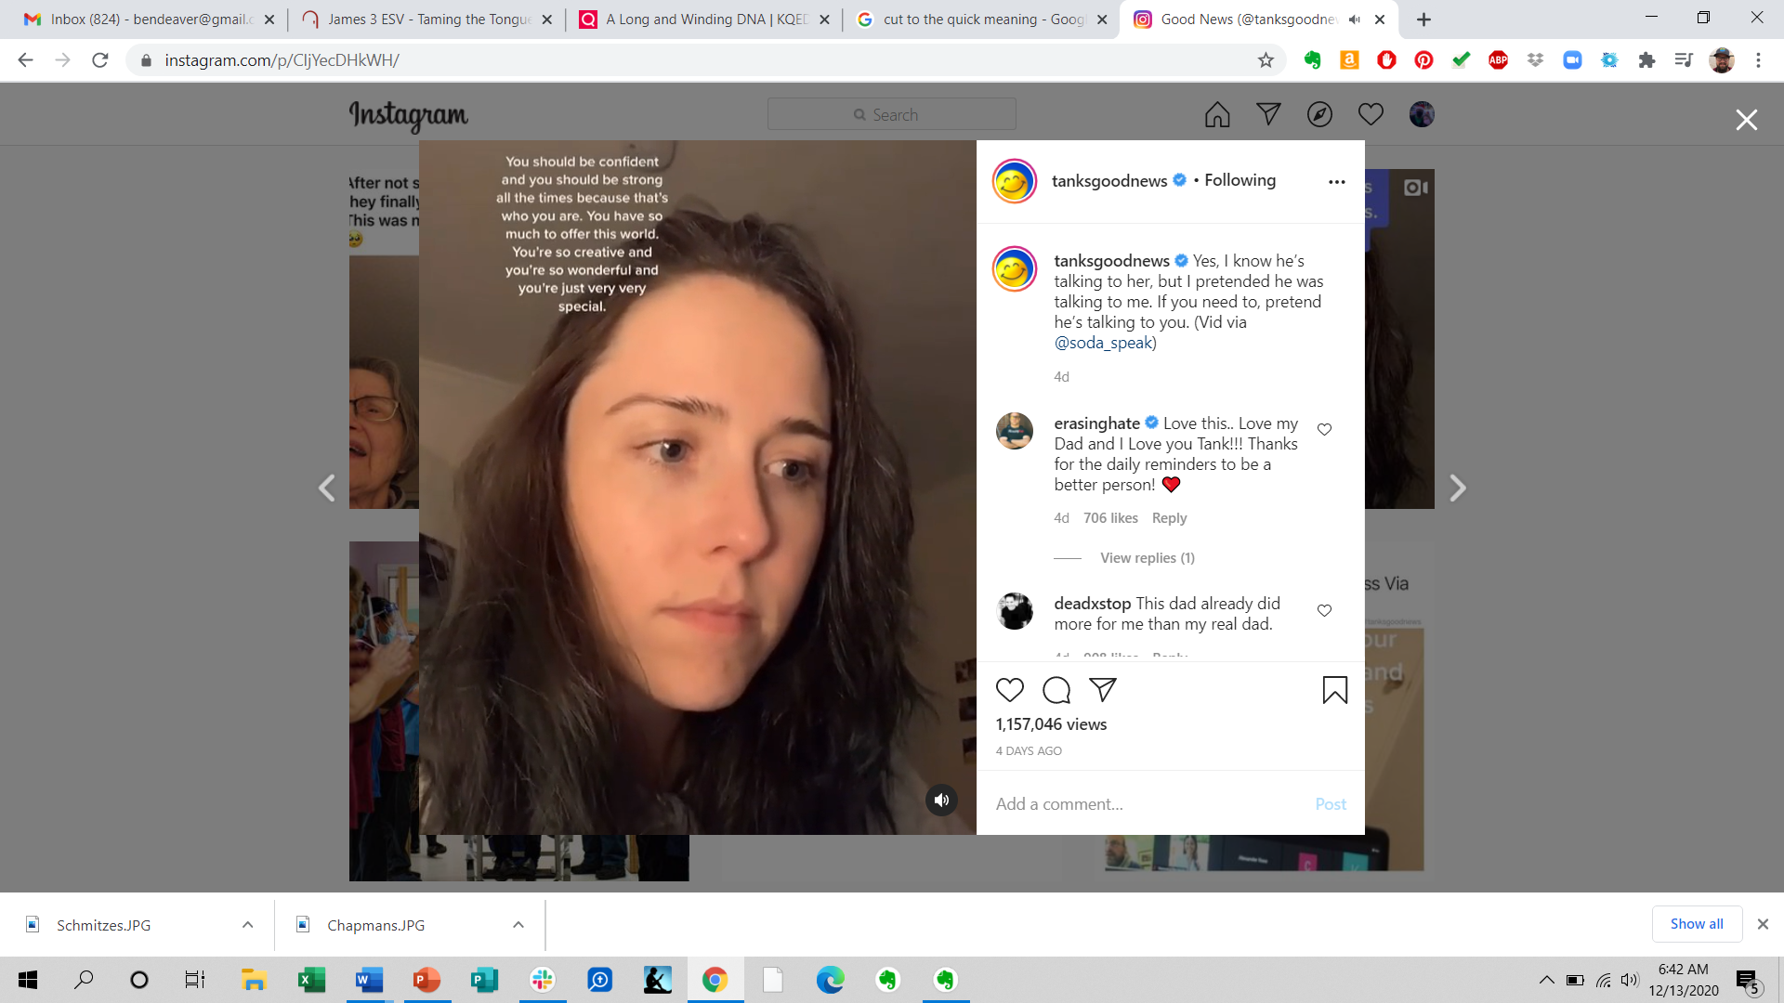

Slide 45
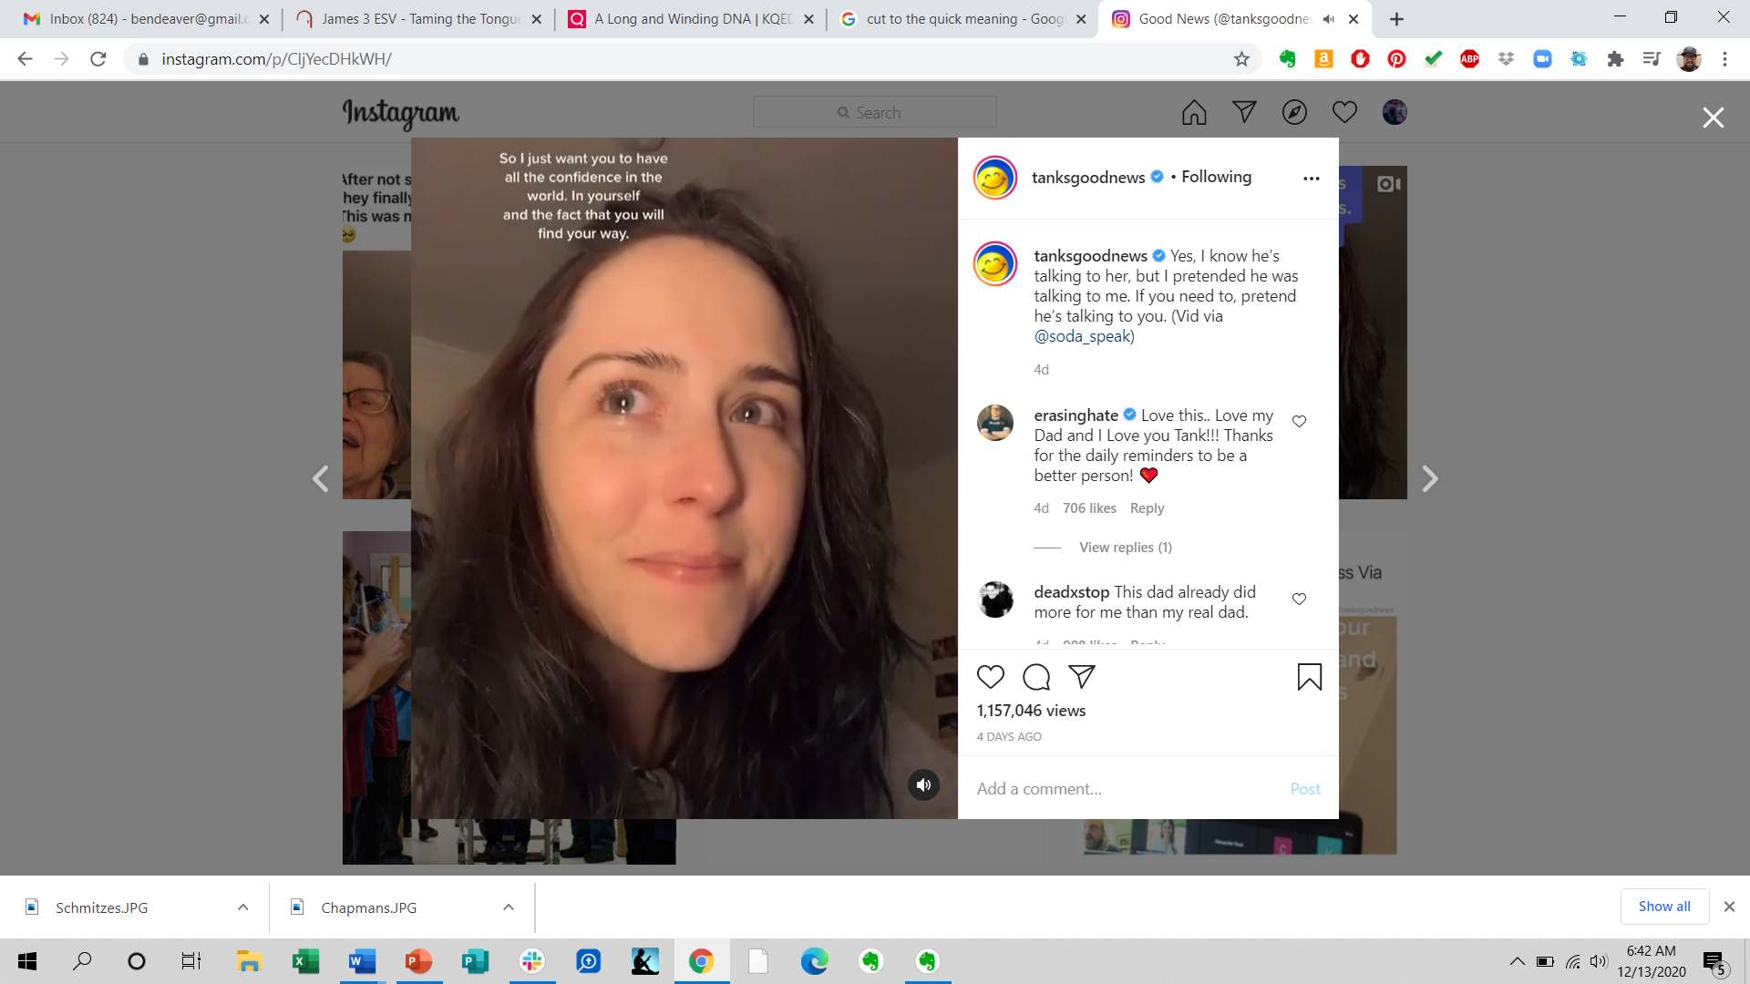

Slide 46
Speak! *advent twenty-twenty*
Ephesians 4:29 Let no corrupting talk come out of your mouths, but only such as is good for building up, as fits the occasion, that it may give grace to those who hear.
Isaiah 50:4a The Lord God has given me the tongue of those who are taught, that I may know how to sustain with a word him who is weary. Morning by morning he awakens; he awakens my ear to hear as those who are taught.

Slide 47
Speak! *advent twenty-twenty*
Proverbs 25:15 ^{MSG} Patient persistence pierces through indifference; gentle speech breaks down rigid defenses.
Colossians 4:6 Let your speech always be gracious, seasoned with salt, so that you may know how you ought to answer each person.

Slide 48
HOMEWORK:
Memorize words that will help you speak like Christ. Choose one verse: Proverbs 12:18, Isaiah 50:4, Ephesians 4:29, or Colossians 4:6.
Speak life-giving words to someone this week.
Build one another up through words through Discipleship 101.
Carry the light-giving Message into the night… Philippians 2:16a ^{MSG}

Slide 49
Speak! *advent twenty-twenty*
¹⁴ Do all things without grumbling or disputing, ¹⁵ that you may be blameless and innocent, children of God without blemish in the midst of a crooked and twisted generation, among whom you
shine as lights in the world, ^{16a} holding fast to the word of life, so that in the day of Christ I may be proud that I did not run in vain or labor in vain.
Philippians 2:14-16

Slide 50
Reflection Questions:
What hurtful words do you need to bring into a path of healing?
What words do you long to hear? What words do you long to hear spoken to you? And from who?
What words do you speak to yourself?
What’s the tone of the words you speak? What do you want the tone of your words to be?
What do people feel when you begin to open your mouth?
Who can you build up this week with your words? What will you say? How will you say it?

Slide 51
Speak! *advent twenty-twenty*

Slide 53
O Holy Night
Text: John S. Dwight, Music: Adolphe Adam

Slide 54
O Holy Night!
The stars are brightly shining,
It is the night of the dear Savior's birth.
Long lay the world in sin and error pining.
Till He appeared & the soul felt its worth.
A thrill of hope the weary world rejoices,
For yonder breaks a new & glorious morn.
Text: John S. Dwight, Music: Adolphe Adam

Slide 55
Fall on your knees!
Oh, hear the angel voices!
O night divine,
O night when Christ was born;
O night divine,
O night, O night divine!
Text: John S. Dwight, Music: Adolphe Adam

Slide 56
Led by the light
of faith serenely beaming
with glowing hearts by His cradle we stand;
So led by light of a star sweetly gleaming
Here came the wise men from Orient land.
The King of kings lay thus in lowly manger,
In all our trials born to be our friend;
Text: John S. Dwight, Music: Adolphe Adam

Slide 57
He knows our need;
our weakness is no stranger
Behold your King, before Him lowly bend
Behold your King, before Him lowly bend
Text: John S. Dwight, Music: Adolphe Adam

Slide 58
Truly He taught us to love one another,
His law is love & His gospel is peace.
Chains He shall break, for the enslaved
are our sisters/brothers
And in His name all oppression shall cease.
Sweet Hymns of joy in grateful chorus
raise we, with all our hearts we
praise His holy name.
Text: John S. Dwight, Music: Adolphe Adam

Slide 59
Christ is the Lord;
Oh praise His name forever!
His power and glory evermore proclaim!
Text: John S. Dwight, Music: Adolphe Adam

Slide 60
Christ is the Lord;
Oh praise His name forever!
His power and glory evermore proclaim,
His power and glory evermore proclaim!
Text: John S. Dwight, Music: Adolphe Adam

Slide 62
King of Kings
“King of Kings” By By Jason Ingram, Brooke Ligertwood & Scott Ligertwood © 2019 Hillsong Music Publishing

Slide 63
In the darkness in the waiting
Without hope without light
Till from heaven You came running
There was mercy in Your eyes
To fulfill the law and prophets
To a virgin came the Word
From a throne of endless glory
To a cradle in the dirt
“King of Kings” By By Jason Ingram, Brooke Ligertwood & Scott Ligertwood © 2019 Hillsong Music Publishing

Slide 64
Praise the Father, Praise the Son,
Praise the Spirit three in One.
God of glory – Majesty.
Praise, forever, to the King of Kings.
“King of Kings” By By Jason Ingram, Brooke Ligertwood & Scott Ligertwood © 2019 Hillsong Music Publishing

Slide 65
To reveal the kingdom coming,
And to reconcile the lost,
To redeem the whole creation,
You did not despise the cross.
For even in Your suffering
You saw to the other side,
Knowing this was our salvation
Jesus for our sake You died.
“King of Kings” By By Jason Ingram, Brooke Ligertwood & Scott Ligertwood © 2019 Hillsong Music Publishing

Slide 66
Praise the Father, Praise the Son,
Praise the Spirit three in One.
God of glory – Majesty.
Praise, forever, to the King of Kings.
“King of Kings” By By Jason Ingram, Brooke Ligertwood & Scott Ligertwood © 2019 Hillsong Music Publishing

Slide 67
And the morning that You rose
All of heaven held its breath
‘till that stone was moved for good
For the Lamb had conquered death.
And the dead rose from their tombs
And the angels stood in awe
For the souls of all who’d come
To the Father are restored.
“King of Kings” By By Jason Ingram, Brooke Ligertwood & Scott Ligertwood © 2019 Hillsong Music Publishing

Slide 68
And the Church of Christ was born
Then the Spirit lit the flame
Now this gospel truth of old
Shall not kneel shall not faint.
By His blood and in His Name
In His freedom I am free
For the love of Jesus Christ
Who has resurrected me!
“King of Kings” By By Jason Ingram, Brooke Ligertwood & Scott Ligertwood © 2019 Hillsong Music Publishing

Slide 69
Praise the Father, Praise the Son,
Praise the Spirit three in One.
God of glory – Majesty.
Praise, forever, to the King of Kings.
Praise, forever, to the King of Kings!
“King of Kings” By By Jason Ingram, Brooke Ligertwood & Scott Ligertwood © 2019 Hillsong Music Publishing

