Slide 1
WELCOME!

Slide 2
Rejoice!
“Rejoice” by Dustin Kensrue and Stuart Townend
CCLI 11372766

Slide 3
Come and stand before your maker,
full of wonder, full of fear.
Come behold His power and glory,
yet with confidence draw near
“Rejoice” by Dustin Kensrue and Stuart Townend

Slide 4
For the One who holds the heavens
and commands the stars above
is the God who bends to bless us
with an unrelenting Love
“Rejoice” by Dustin Kensrue and Stuart Townend

Slide 5
Rejoice! Come and lift your hands
and raise your voice;
He is worthy of all praise.
Rejoice! Sing of mercies of your King
And with trembling, rejoice!
“Rejoice” by Dustin Kensrue and Stuart Townend

Slide 6
We are children of the promise,
the beloved of the Lord;
Won with everlasting kindness,
bought with sacrificial blood.
“Rejoice” by Dustin Kensrue and Stuart Townend

Slide 7
Bringing reconciliation to a world
that longs to know
the affections of a Father
who will never let them go.
“Rejoice” by Dustin Kensrue and Stuart Townend

Slide 8
Rejoice! Come and lift your hands
and raise your voice;
He is worthy of all praise.
Rejoice! Sing of mercies of your King
And with trembling, rejoice!
“Rejoice” by Dustin Kensrue and Stuart Townend

Slide 9
All our sickness, all our sorrows;
Jesus carried up the hill.
He has walked this path before us
He is walking with us still.
“Rejoice” by Dustin Kensrue and Stuart Townend

Slide 10
Turning tragedy to triumph
Turning agony to praise
There is blessing in the battle,
So take heart and stand amazed!
“Rejoice” by Dustin Kensrue and Stuart Townend

Slide 11
Rejoice; when you cry to Him
He hears your voice.
He will wipe away your tears. Rejoice in the midst of suffering.
He will help you sing…
“Rejoice” by Dustin Kensrue and Stuart Townend

Slide 12
Rejoice! Come and lift your hands
and raise your voice;
He is worthy of all praise.
Rejoice! Sing of mercies of your King
And with trembling, rejoice!
“Rejoice” by Dustin Kensrue and Stuart Townend

Slide 14
Surrounded
“Surrounded” by Elyssa Smith

Slide 15
There’s a table
that You’ve prepared for me
In the presence of my enemies
It’s Your body and Your blood
You shed for me:
This is how I fight my battles
“Surrounded” by Elyssa Smith

Slide 16
And I believe You’ve overcome
and I will lift my song of
praise for all You’ve done!
“Surrounded” by Elyssa Smith

Slide 17
This is how I fight my battles
This is how I fight my battles
This is how I fight my battles
This is how…
*2 Chronicles 20
“Surrounded” by Elyssa Smith

Slide 18
In the valley I know that You’re with me
And surely Your goodness
and Your mercy fall on me
So my weapons are praise & thanksgiving
This is how I fight my battles
“Surrounded” by Elyssa Smith

Slide 19
And I believe You’ve overcome
and I will lift my song of
praise for all You’ve done!
“Surrounded” by Elyssa Smith

Slide 20
This is how I fight my battles
This is how I fight my battles
This is how I fight my battles
This is how…
*2 Chronicles 20
“Surrounded” by Elyssa Smith

Slide 21
Do not be anxious about anything, but in everything by prayer and supplication with thanksgiving let your requests be made known to God. And the peace of God, which surpasses all understanding, will guard your hearts and your minds in Christ Jesus.
Philippians 4:6
“Surrounded” by Elyssa Smith

Slide 22
It may look like I’m surrounded
But I’m surrounded by You
“Surrounded” by Elyssa Smith

Slide 23
This is how I fight my battles
This is how I fight my battles
“Surrounded” by Elyssa Smith

Slide 24
It may look like I’m surrounded
But I’m surrounded by You
“Surrounded” by Elyssa Smith

Slide 25
This is how I fight my battles
This is how I fight my battles
“Surrounded” by Elyssa Smith

Slide 26
It may look like I’m surrounded
But I’m surrounded by You
“Surrounded” by Elyssa Smith

Slide 28
WELCOME!

Slide 29
WELCOME TO TALLGRASS CHURCH’S CENTRAL GATHERING IN BOYS & GIRLS CLUB!

Slide 30
2021 FAMILY BUDGET
Your feedback is invited through next Sunday, Nov. 29. elders@tallgrass.church

Slide 31
HOW TO GIVE

Slide 32
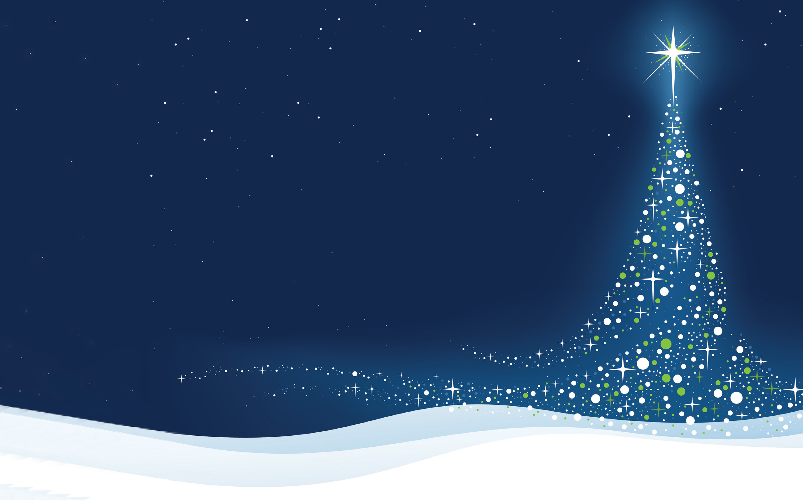
TITLES GO HERE CAPS
HOPE FOR THE HOLIDAYS 2020
Type stuff in here. Make at least 35 pt Ubuntu. Pref 40+
Holiday cheer is in the air. Share yours with young adults who have aged out of foster care!
MICHELLE REICHART

Slide 33
TITLES GO HERE CAPS
HOPE FOR THE HOLIDAYS 2020
Type stuff in here. Make at least 35 pt Ubuntu. Pref 40+
Holiday cheer is in the air. Share yours with young adults who have aged out of foster care!
$25, $50, or $100 gift card Walmart, Target, Amazon, Dillons, Aldi, Casey’s, QuikTrip, Uber…
PLUS A HANDWRITTEN CHRISTMAS CARD
BY SUNDAY DEC 6th.
MICHELLE REICHART

Slide 35
HAPPY
THANKSGIVING

Slide 36
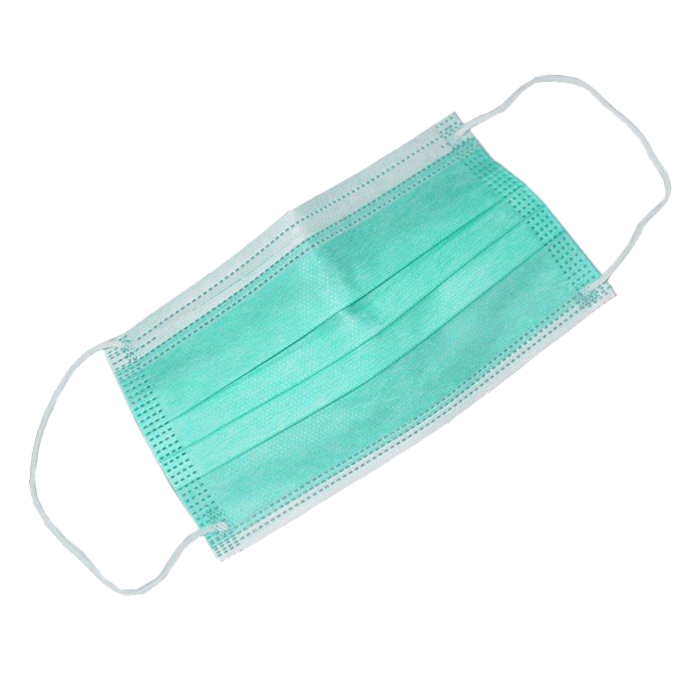
THANKSGIVING
IS
CANCELED

Slide 37
THANKSGIVING
NOT
IS
CANCELED

Slide 38
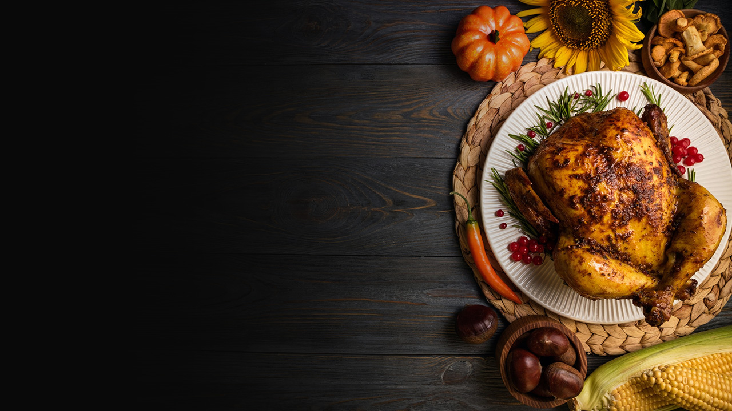
GENESIS 1-3

Slide 39
Then the Lord God formed the man of dust from the ground and breathed into his nostrils the breath of life, and the man became a living creature. And the Lord God planted a garden in Eden, in the east, and there he put the man whom he had formed.
GENESIS 2:7-8

Slide 40
For although they knew God, they did not honor him as God or give thanks to him, but they became futile in their thinking, and their foolish hearts were darkened.
ROMANS 1:21

Slide 41
“The worst moment for an atheist is when he feels a profound sense of gratitude and has no one to thank.”
G. K. CHESTERTON

Slide 42
“Gratitude exclaims, very properly, ‘How good of God to give me this.’”
C. S. LEWIS

Slide 43
Do not be deceived, my beloved brothers. Every good gift and every perfect gift is from above, coming down from the Father of lights
JAMES 1:16-17

Slide 44
…but God shows his love for us in that while we were still sinners, Christ died for us.
ROMANS 5:8

Slide 45
For by grace you have been saved through faith. And this is not your own doing; it is the gift of God
EPHESIANS 2:8

Slide 46
When you were dead in your sins and in the uncircumcision of your flesh, God made you alive with Christ. He forgave us all our sins, …nailing it to the cross. And having disarmed the powers and authorities, he made a public spectacle of them, triumphing over them by the cross.
COLOSSIANS 2:13-15

Slide 47
CALLED TO THANKSGIVING

Slide 48
1 THESSALONIANS 5:16-18 Rejoice always, pray without ceasing, give thanks in all circumstances; for this is the will of God in Christ Jesus for you.
CALLED TO THANKSGIVING

Slide 49
1 THESSALONIANS 5:16-18 Rejoice always, pray without ceasing, give thanks in all circumstances; for this is the will of God in Christ Jesus for you.
Luke 17
Ephesians 5:18-20
Colossians 4:2
1 Timothy 2:1
Acts 2:42
Philippians 4:4
Philippians 4:6
Colossians 2:6-7
Colossians 3:15
CALLED TO THANKSGIVING

Slide 50
3 GOOD THING EXERCISE
MARTIN SELIGMAN
“Positive Psychology Progress.” American Psychologist, 60 (5), 2005, 410-421.

Slide 51
3 GOOD THING EXERCISE
2% increase after 1 week
5% increase after 1 month
9% increase after 6 months
MARTIN SELIGMAN
“Positive Psychology Progress.” American Psychologist, 60 (5), 2005, 410-421.

Slide 52
3 GOOD THING EXERCISE
2% increase after 1 week
5% increase after 1 month
9% increase after 6 months
Depressive symptoms declined by 28% after one week, and continued to lower as it continued.
MARTIN SELIGMAN
“Positive Psychology Progress.” American Psychologist, 60 (5), 2005, 410-421.

Slide 53
BLESSINGS, HASSLES, & EVENTS
ROBERT EMMONS
“Thanks! How the New Science of Gratitude Can Make You Happier” New York: Houghton Mifflin Co., 2007, 30.

Slide 54
BLESSINGS, HASSLES, & EVENTS
The “blessings” group were 25% happier than other participants.
ROBERT EMMONS
“Thanks! How the New Science of Gratitude Can Make You Happier” New York: Houghton Mifflin Co., 2007, 30.

Slide 55
THANKFULNESS LOWERED RISKS:
ALEX WOOD
Alex M. Wood (et al.), “Gratitude and well-being: A review and theoretical integration” Clinical Psychology Review (2010)

Slide 56
THANKFULNESS LOWERED RISKS:
Major depression
Generalized anxiety disorder
Phobia
Nicotine dependence
Alcohol dependence
Drug abuse/dependence
Bulimia nervosa
PTSD
ALEX WOOD
Alex M. Wood (et al.), “Gratitude and well-being: A review and theoretical integration” Clinical Psychology Review (2010)

Slide 57
PHYSICAL BENEFITS OF GRATITUDE
WENDY MENDES
Lecture given for the John Templeton Foundation’s “Greater Good Science Center” (2014), “Effects of Measured and Manipulated Gratitude on Biomarkers of Health and Aging.”

Slide 58
PHYSICAL BENEFITS OF GRATITUDE
At a biological level, we find that people who are higher in gratitude have lower resting blood pressure.
…lower blood pressure response
…higher good cholesterol and lower bad cholesterol.
WENDY MENDES
Lecture given for the John Templeton Foundation’s “Greater Good Science Center” (2014), “Effects of Measured and Manipulated Gratitude on Biomarkers of Health and Aging.”

Slide 59
PHYSICAL BENEFITS OF GRATITUDE
ROBERT EMMONS
“Thanks! How the New Science of Gratitude Can Make You Happier” New York: Houghton Mifflin Co., 2007, 67.

Slide 60
PHYSICAL BENEFITS OF GRATITUDE
People who scored high on optimism had a 50 percent lower risk of premature death than those who scored as being more pessimistic.
ROBERT EMMONS
“Thanks! How the New Science of Gratitude Can Make You Happier” New York: Houghton Mifflin Co., 2007, 67.

Slide 61
…we take captive every thought to make it obedient to Christ
2 CORINTHIANS 10:5

Slide 62
Do not be conformed to this world, but be transformed by the renewal of your mind
ROMANS 12:2

Slide 63
Rejoice in the Lord always; again I will say, rejoice. Let your reasonableness be known to everyone. The Lord is at hand
PHILIPPIANS 4:4-5

Slide 64
PRACTICE THANKSGIVING

Slide 65
1 THESSALONIANS 5:16-18 Rejoice always, pray without ceasing, give thanks in all circumstances; for this is the will of God in Christ Jesus for you.
PRACTICE THANKSGIVING

Slide 66
1 THESSALONIANS 5:16-18 Rejoice always, pray without ceasing, give thanks in all circumstances; for this is the will of God in Christ Jesus for you.
PRACTICE THANKSGIVING 3 THINGS EXERCISE

Slide 67
THANKSGIVING
NOT
IS
CANCELED
PRACTICE THANKSGIVING 3 THINGS EXERCISE

Slide 68
Graves into
Gardens
“Graves into Gardens” by Steven Furtick, Chris Brown, Tiffany Hammer, Brandon Lake

Slide 69
I searched the world
But it couldn’t fill me
Man’s empty praise
and treasures that fade
Are never enough
“Graves into Gardens” by Steven Furtick, Chris Brown, Tiffany Hammer, Brandon Lake

Slide 70
Then You came along
And put me back together
And every desire
is now satisfied
Here in Your love
“Graves into Gardens” by Steven Furtick, Chris Brown, Tiffany Hammer, Brandon Lake

Slide 71
Oh there’s nothing better than You
There’s nothing better than You
Lord there’s nothing;
nothing is better than You.
“Graves into Gardens” by Steven Furtick, Chris Brown, Tiffany Hammer, Brandon Lake

Slide 72
I’m not afraid
To show You my weakness
My failures and flaws
Lord You’ve seen them all
And You still call me friend
“Graves into Gardens” by Steven Furtick, Chris Brown, Tiffany Hammer, Brandon Lake

Slide 73
‘Cause the God of the mountain
is the God of the valley
There’s not a place
Your mercy and grace
Won’t find me again
“Graves into Gardens” by Steven Furtick, Chris Brown, Tiffany Hammer, Brandon Lake

Slide 74
Oh there’s nothing better than You
There’s nothing better than You
Lord there’s nothing;
nothing is better than You.
“Graves into Gardens” by Steven Furtick, Chris Brown, Tiffany Hammer, Brandon Lake

Slide 75
You turn morning to dancing
You give beauty for ashes
You turn shame into glory
You’re the only One who can
“Graves into Gardens” by Steven Furtick, Chris Brown, Tiffany Hammer, Brandon Lake

Slide 76
You turn graves into gardens
You turn bones into armies
You turn seas into highways
You’re the only One who can
“Graves into Gardens” by Steven Furtick, Chris Brown, Tiffany Hammer, Brandon Lake

Slide 77
You’re the only
One who can!
“Graves into Gardens” by Steven Furtick, Chris Brown, Tiffany Hammer, Brandon Lake

Slide 78
Oh there’s nothing better than You
There’s nothing better than You
Lord there’s nothing;
nothing is better than You.
“Graves into Gardens” by Steven Furtick, Chris Brown, Tiffany Hammer, Brandon Lake

Slide 79
You turn graves into gardens
You turn bones into armies
You turn seas into highways
You’re the only One who can
“Graves into Gardens” by Steven Furtick, Chris Brown, Tiffany Hammer, Brandon Lake

Slide 80
You’re the only
One who can!
You’re the only
One who can!
“Graves into Gardens” by Steven Furtick, Chris Brown, Tiffany Hammer, Brandon Lake

Slide 82
Build My Life
Pat Barrett, Kirby Kaple, Matt Redman, Brett Yonker and Karl Martin

Slide 83
Worthy of every song
we could ever sing,
Worthy of all the praise
we could ever bring,
Worthy of every breath
we could ever breathe;
We live for You
Pat Barrett, Kirby Kaple, Matt Redman, Brett Yonker and Karl Martin

Slide 84
Jesus, the name above
every other name
Jesus the only One
who could ever save
Worthy of every breath
we could ever breathe;
We live for You
Pat Barrett, Kirby Kaple, Matt Redman, Brett Yonker and Karl Martin

Slide 85
Holy, there is no one like You
There is none beside You*
Open up my eyes in wonder
Show me who You are
Fill me with Your heart
Lead me in Your love
to those around me
*1 Samuel 2:2
Pat Barrett, Kirby Kaple, Matt Redman, Brett Yonker and Karl Martin

Slide 86
Worthy of every song
we could ever sing,
Worthy of all the praise
we could ever bring,
Worthy of every breath
we could ever breathe;
We live for You
Pat Barrett, Kirby Kaple, Matt Redman, Brett Yonker and Karl Martin

Slide 87
Jesus, the name above
every other name
Jesus the only One
who could ever save
Worthy of every breath
we could ever breathe;
We live for You
Pat Barrett, Kirby Kaple, Matt Redman, Brett Yonker and Karl Martin

Slide 88
Holy, there is no one like You
There is none beside You*
Open up my eyes in wonder
Show me who You are
Fill me with Your heart
Lead me in Your love
to those around me
*1 Samuel 2:2
Pat Barrett, Kirby Kaple, Matt Redman, Brett Yonker and Karl Martin

Slide 89
I will build my life upon Your love
It is a firm foundation*
I will put my trust in You alone
And I will not be shaken
*Matthew 7:24
Pat Barrett, Kirby Kaple, Matt Redman, Brett Yonker and Karl Martin

Slide 90
Holy, there is no one like You
There is none beside You*
Open up my eyes in wonder
Show me who You are
Fill me with Your heart
Lead me in Your love
to those around me
*1 Samuel 2:2
Pat Barrett, Kirby Kaple, Matt Redman, Brett Yonker and Karl Martin

Slide 91
I will build my life upon Your love
It is a firm foundation*
I will put my trust in You alone
And I will not be shaken
*Matthew 7:24
Pat Barrett, Kirby Kaple, Matt Redman, Brett Yonker and Karl Martin

Slide 93
Joy
“Joy” by Rend Collective

Slide 94
In the shadows, In the sorrows,
In the desert, When the pain hits;
You are constant, Ever-present,
You're the song of my heart!
“Joy” by Rend Collective

Slide 95
You're the joy, joy, joy lighting my soul.
The joy, joy, joy making me whole.
Though I'm broken, I am running
into Your arms of love
“Joy” by Rend Collective

Slide 97
WELCOME!

