Slide 1
WELCOME

Slide 2
Happy
MOTHER’S DAY!

Slide 3
HOLY WATER
Andrew Bergthold, Ed Cash, Franni Cash,
Martin Cash Scott Cash. #7136448

Slide 4
HOLY WATER
God, I'm on my knees again
God, I'm begging please again
I need You
Oh, I need You

Slide 5
HOLY WATER
Walking down this desert road
Water for my thirsty soul
I need You
Oh, I need You

Slide 6
HOLY WATER
Your forgiveness
Is like sweet, sweet honey
On my lips
Like the sound of a symphony
To my ears
Like holy water on my skin

Slide 7
HOLY WATER
Dead man walking, slave to sin
I wanna know about being born again
I need You
Oh, God, I need You

Slide 8
HOLY WATER
So, take me to the riverside
Take me under, baptize
I need You
Oh, God, I need You

Slide 9
HOLY WATER
Your forgiveness
Is like sweet, sweet honey
On my lips
Like the sound of a symphony
To my ears
Like holy water on my skin
On my skin

Slide 10
HOLY WATER
I don't wanna abuse Your grace
God, I need it every day
It's the only thing that ever really
Makes me wanna change
(4x)

Slide 11
HOLY WATER
Your forgiveness
Is like sweet, sweet honey
On my lips
Like the sound of a symphony
To my ears
It's like holy water

Slide 12
HOLY WATER
Your forgiveness
Oh, is like sweet, sweet honey
On my lips
Like the sound of a symphony
To my ears
Oh, it's like holy water on my skin
Yeah, it's like holy water on my skin
Oh, it's like holy water

Slide 13
SPROUTS

Slide 14
SPROUTS
4th-6th GRADERS SHARING

Slide 15
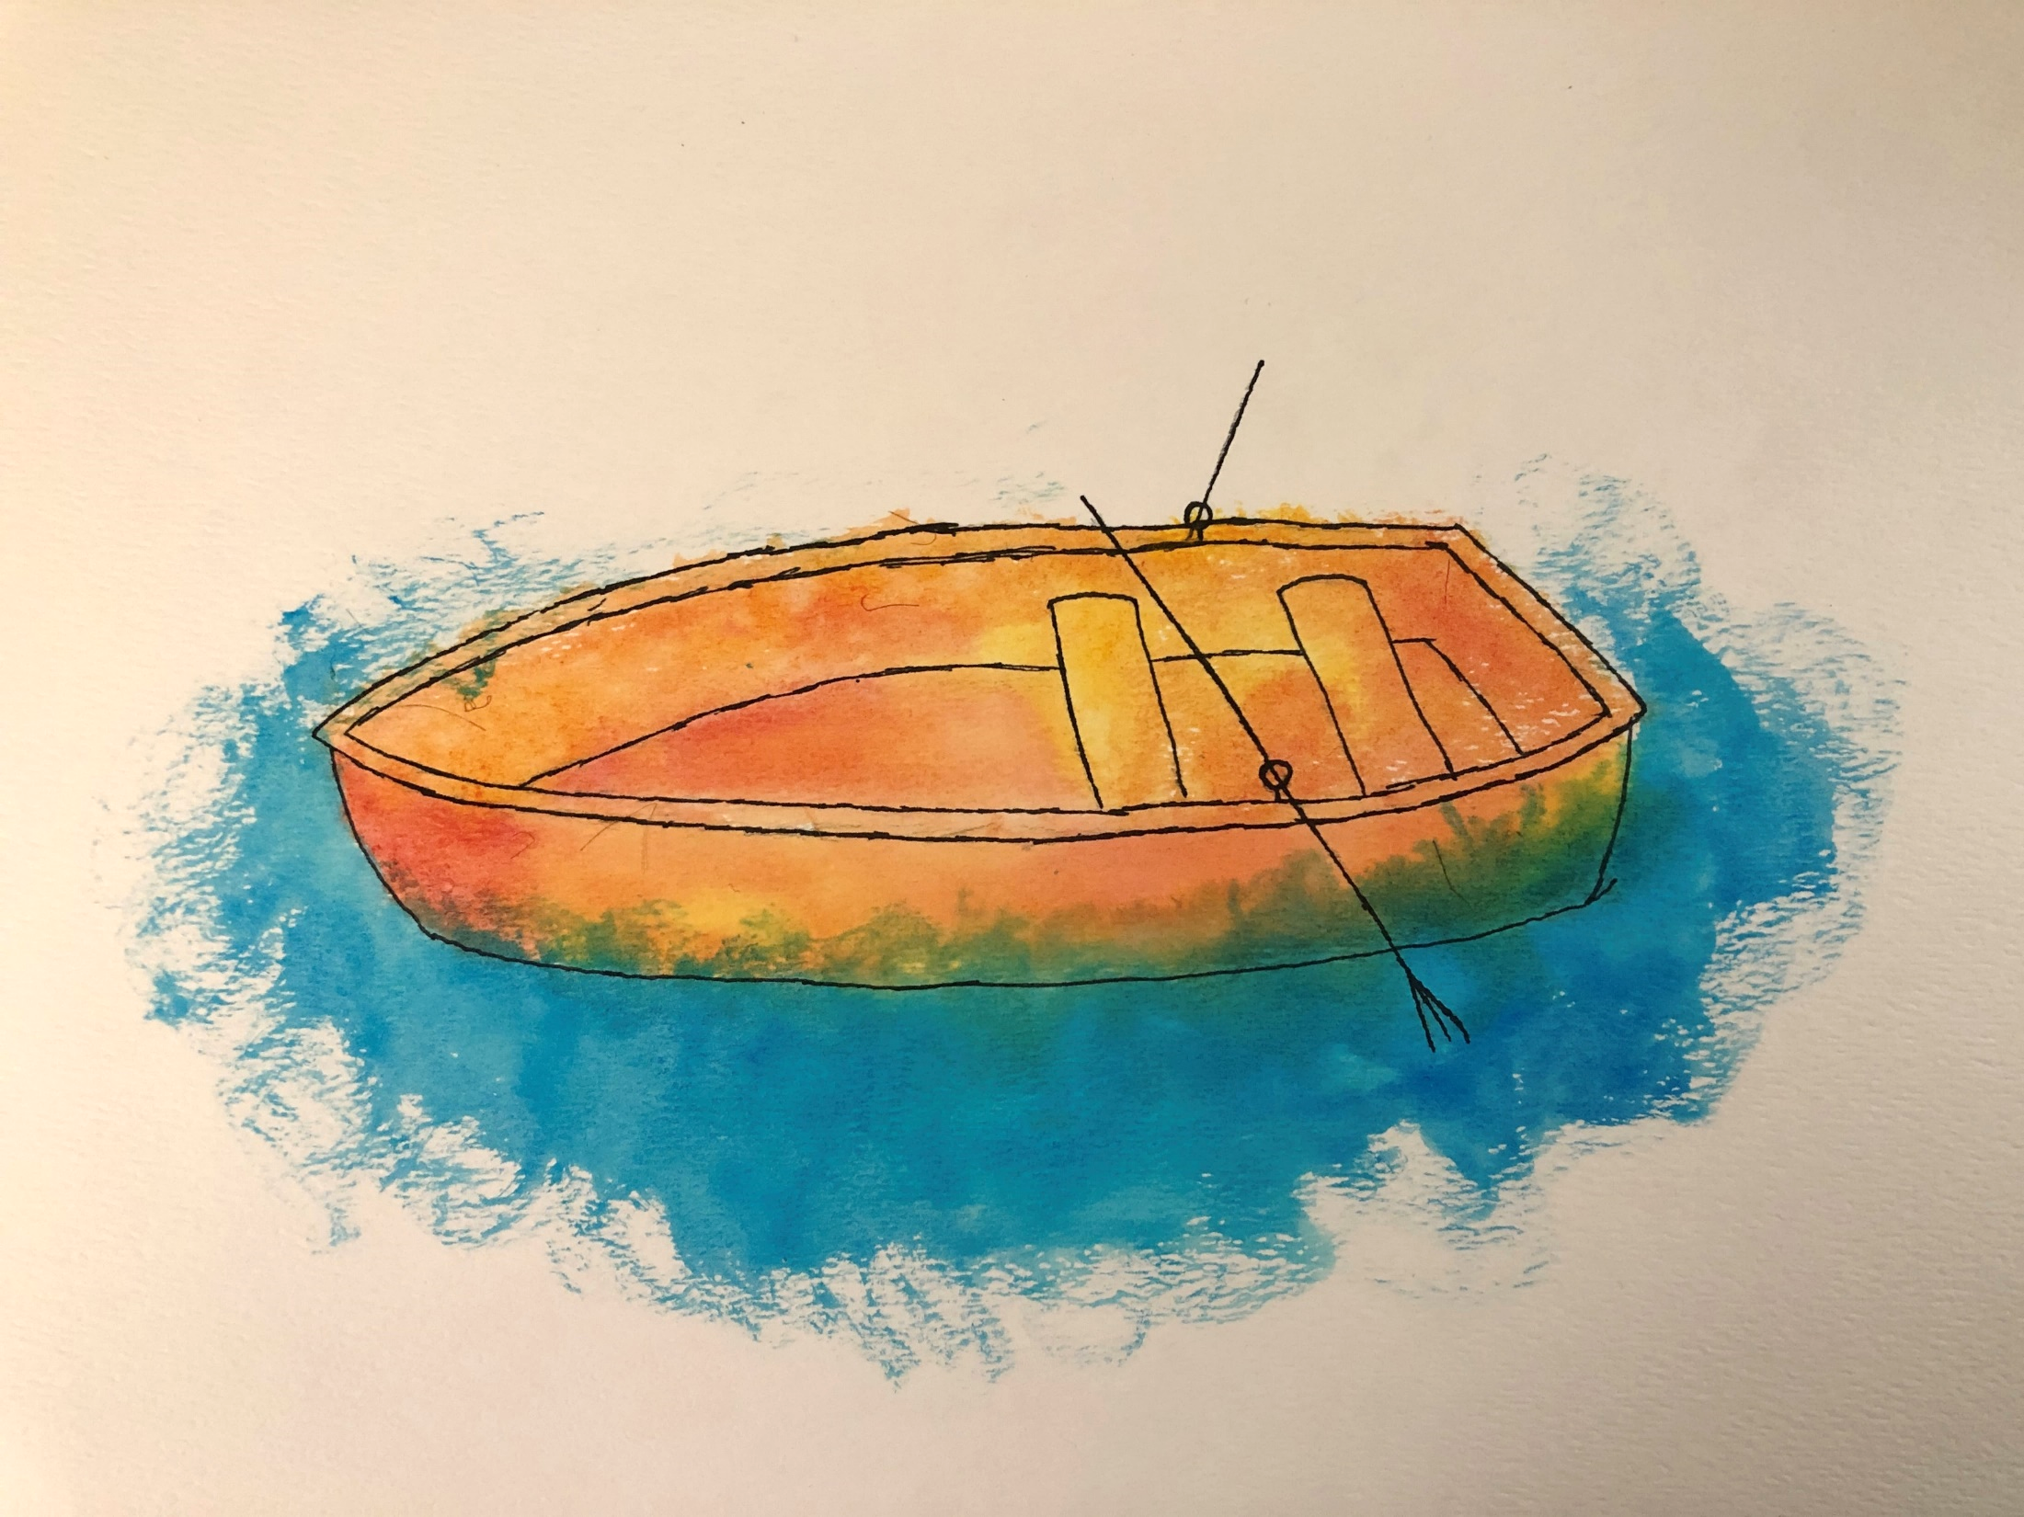

Slide 16
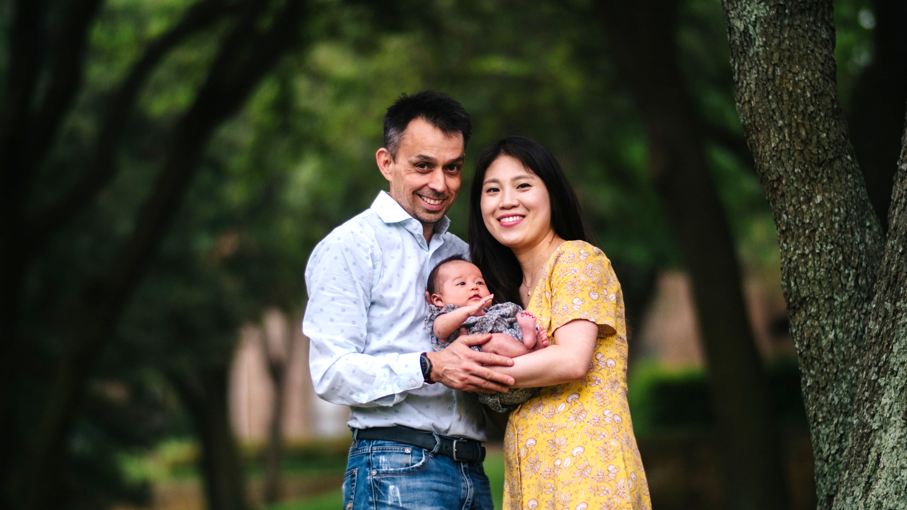
Josh Millard & Pyungwha Oh
with Doris Elena (March 2, 2020)

Slide 17
SPROUTS
Mothers of the Bible (Igniter)

Slide 18
SPROUTS
HAPPY MOTHER’S DAY!

Slide 19
MINGLE QUESTION
WHAT’S YOUR FAVORITE FRUIT?

Slide 21
God has invited us into something new and profound through this unique season: personal renewal! This current season of disruption has been that divine invitation.
We’ve tried to slow way down together, focusing specifically on rediscovering and reclaiming personal habits and practices that have proven from generation to generation to lead us each into personal renewal, growth, and vital connection with God Himself.

Slide 22
God has invited us into something new and profound through this unique season: personal renewal! This current season of disruption has been that divine invitation.
We’ve tried to slow way down together, focusing specifically on rediscovering and reclaiming personal habits and practices that have proven from generation to generation to lead us each into personal renewal, growth, and vital connection with God Himself.
Now we’re curious about what’s next?

Slide 23
NEW NORMAL
CHURCH RENEWAL IN PANDEMIC
⁷ “Blessed is the man who trusts in the Lord, whose trust is the Lord. ⁸ He is like a tree planted by water, that sends out its roots by the stream, and does not fear when heat comes, for its leaves remain green, and is not anxious in the year of drought, for it does not cease to bear fruit.”
Jeremiah 17:7-8

Slide 24
NEW NORMAL
CHURCH RENEWAL IN PANDEMIC
⁷ “Blessed is the man who trusts in the Lord, whose trust is the Lord. ⁸ He is like a tree planted by water, that sends out its roots by the stream, and does not fear when heat comes, for its leaves remain green, and is not anxious in the year of drought, for it does not cease to bear fruit.”
Jeremiah 17:7-8

Slide 26
NEW NORMAL
CHURCH RENEWAL IN PANDEMIC
¹¹ And God said, “Let the earth sprout vegetation, plants yielding seed, and fruit trees bearing fruit in which is their seed, each according to its kind, on the earth.” And it was so. ¹² The earth brought forth vegetation, plants yielding seed according to their own kinds, and trees bearing fruit in which is their seed, each according to its kind. And God saw that it was good.
¹³ And there was evening and there was morning, the third day.
Genesis 1:11-13

Slide 27
NEW NORMAL
CHURCH RENEWAL IN PANDEMIC
²⁶ Then God said,
“Let us make man in our image, after our likeness.”
²⁷ So God created man in his own image, in the image of God he created him; male and female he created them.
²⁸ And God blessed them. And God said to them,
“Be fruitful and multiply and fill the earth…”
Genesis 1:26a, 27-28a

Slide 28
NEW NORMAL
CHURCH RENEWAL IN PANDEMIC
And God blessed Noah and his sons and said to them,
“Be fruitful and multiply and fill the earth…”
“And you, be fruitful and multiply, increase greatly on the earth and multiply in it.”
Genesis 9:1, 7

Slide 29
NEW NORMAL
CHURCH RENEWAL IN PANDEMIC
And God blessed Noah and his sons and said to them,
“Be fruitful and multiply and fill the earth…”
“And you, be fruitful and multiply, increase greatly on the earth and multiply in it.”
Genesis 9:1, 7
For you formed my inward parts;
you knitted me together in my mother's womb.
I praise you, for I am fearfully and wonderfully made.
Wonderful are your works;
my soul knows it very well.
-King David in Psalm 139:13-14

Slide 30
BARB SANDERSON
LIFE CHOICE MINISTRIES

Slide 31
FUNDEASY.COM

Slide 32
BENEDICTION
Greg LaFollette.

Slide 33
BENEDICTION
Father, give Your benediction
Give us Your peace before we part
Still our minds with truth’s conviction
Calm with trust each anxious heart

Slide 34
BENEDICTION
Father, give Your benediction
Bid our grief and struggles end
Peace which passes understanding
On our waiting spirit send

Slide 35
BENEDICTION
Amen. Amen.
Amen. Amen.
Amen. Amen.

Slide 36
AFTER PARTY

Slide 37
THANKS

