Slide 1
WELCOME TO TALLGRASS

Slide 2
TELL IT TO JESUS
Edmund S. Lorenz.

Slide 3
TELL IT TO JESUS
Are you weary, are you heavyhearted?
Tell it to Jesus,
Tell it to Jesus;
Are you grieving over joys departed?
Tell it to Jesus alone.

Slide 4
TELL IT TO JESUS
Tell it to Jesus, tell it to Jesus,
He is a friend that's well-known;
You've no other such a friend or brother,
Tell it to Jesus alone.

Slide 5
TELL IT TO JESUS
Do the tears flow down your cheeks unbidden?
Tell it to Jesus,
Tell it to Jesus;
Have you sins that to men's eyes are hidden?
Tell it to Jesus alone.

Slide 6
TELL IT TO JESUS
Tell it to Jesus, tell it to Jesus,
He is a friend that's well-known;
You've no other such a friend or brother,
Tell it to Jesus alone.

Slide 7
TELL IT TO JESUS
Do you fear the gath'ring clouds of sorrow?
Tell it to Jesus,
Tell it to Jesus;
Are you anxious what shall be tomorrow?
Tell it to Jesus alone.

Slide 8
TELL IT TO JESUS
Tell it to Jesus, tell it to Jesus,
He is a friend that's well-known;
You've no other such a friend or brother,
Tell it to Jesus alone.

Slide 9
TELL IT TO JESUS
Are you troubled at the thought of dying?
Tell it to Jesus,
Tell it to Jesus;
For Christ's coming Kingdom are you sighing?
Tell it to Jesus alone.

Slide 10
TELL IT TO JESUS
Tell it to Jesus, tell it to Jesus,
He is a friend that's well-known;
You've no other such a friend or brother,
Tell it to Jesus alone.

Slide 11
MINGLE QUESTION
HOW WAS YOUR TG SABBATH WEEK?

Slide 12
WHAT A FRIEND
WE HAVE IN JESUS
Charles Crozat Converse, Joseph M. Scriven. #27714

Slide 13
WHAT A FRIEND
WE HAVE IN JESUS
What a friend we have in Jesus
All our sins and griefs to bear
And what a privilege to carry
Everything to God in prayer

Slide 14
WHAT A FRIEND
WE HAVE IN JESUS
Oh, what peace we often forfeit
Oh, what needless pain we bear
All because we do not carry
Everything to God in prayer

Slide 15
WHAT A FRIEND
WE HAVE IN JESUS
Have we trials and temptations?
Is there trouble anywhere?
We should never be discouraged
Take it to the Lord in prayer

Slide 16
WHAT A FRIEND
WE HAVE IN JESUS
Can we find a friend so faithful
Who will all our sorrows share?
Jesus knows our every weakness
Take it to the Lord in prayer

Slide 17
WHAT A FRIEND
WE HAVE IN JESUS
Are we weak and heavy-laden?
Cumbered with a load of care?
Precious Savior, still our refuge --
Take it to the Lord in prayer

Slide 18
WHAT A FRIEND
WE HAVE IN JESUS
Do thy friends despise, for sake thee?
Take it to the Lord in prayer
In His arms He’ll take and shield thee,
Thou wilt find a solace there.

Slide 19
WHAT A FRIEND
WE HAVE IN JESUS
What a friend we have in Jesus
All our sins and griefs to bear
And what a privilege to carry
Everything to God in prayer

Slide 20
WHAT A FRIEND
WE HAVE IN JESUS
Oh, what peace we often forfeit
Oh, what needless pain we bear
All because we do not carry
Everything to God in prayer

Slide 25
FASTING

Slide 26
GOD’S WORD

Slide 27
SILENCE & SOLITUDE

Slide 28
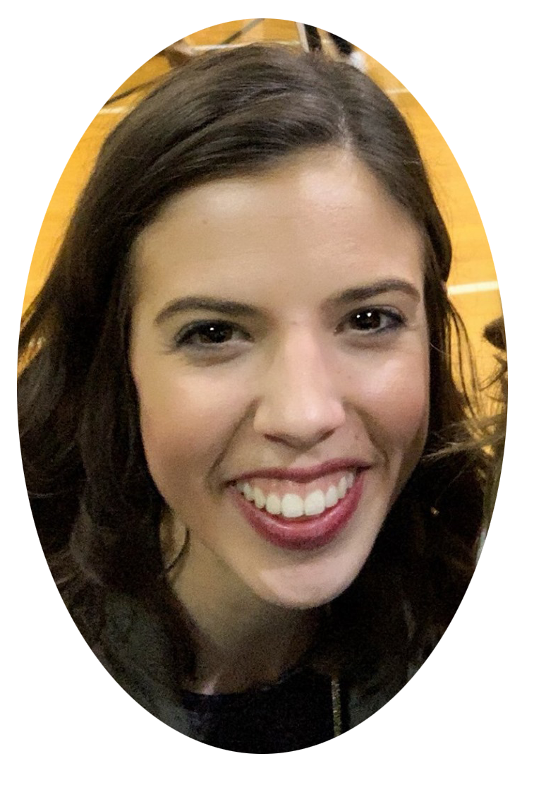
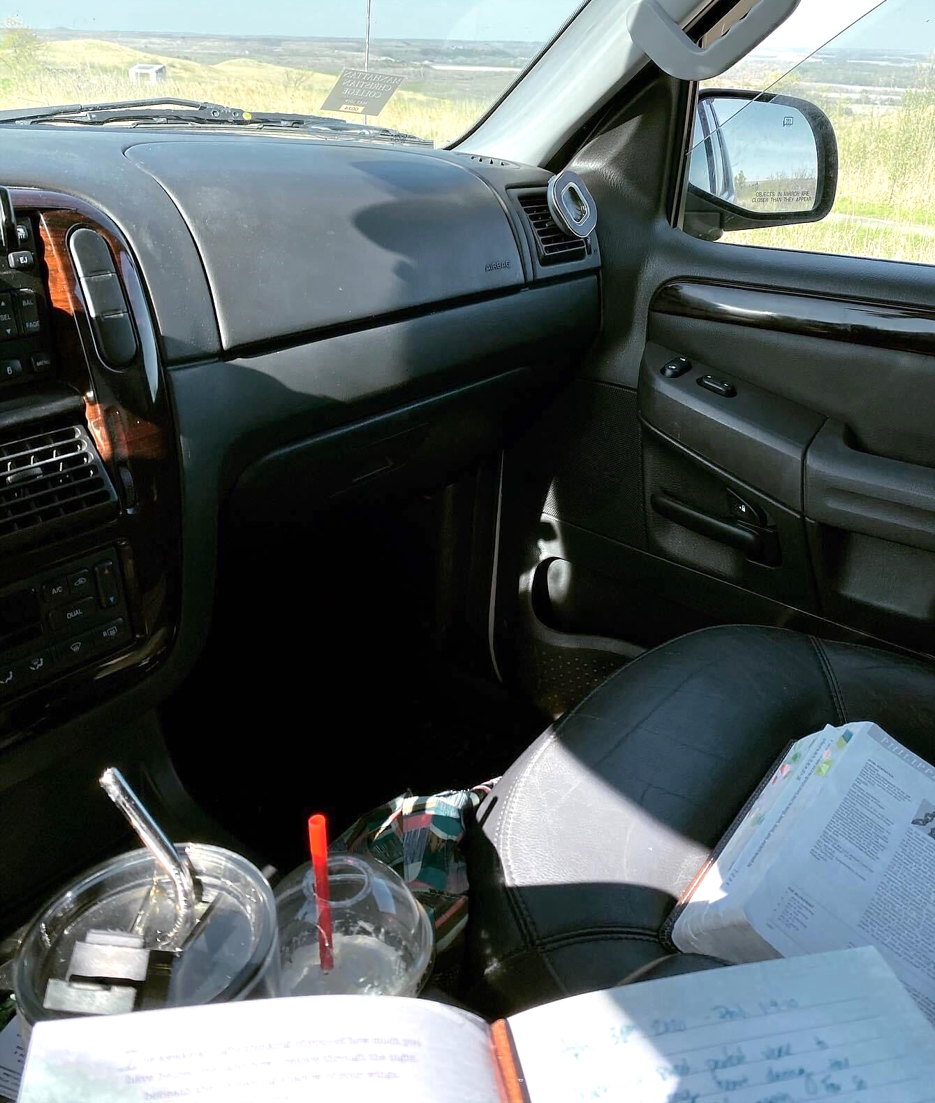
CRYSTAL’S SLOWING STORY
Unbusyness. Before quarantine this word frightened me. Honestly, I don’t think I even muttered the word ever. Down time sent me into anxiousness that caused me to question what I was forgetting in my to do list. I was in a constant need for some-thing, anything to keep my time. I ran from sun up to sun down and missed so much around me. So, when quarantine hit my world was rocked. I found my anxiousness and need for things to consume my time coming out in other ways, anger, grief, sleeping to quiet the voice in my head telling me I wasn’t doing enough. That I was failing at this quarantine thing. How CRAZY is that. How can I fail at something we haven’t experienced before? But the thought was there... and it. was. strong.
My word I chose to focus on this year ironically was “enjoy.” I guess it took a world pandemic for me to realize what that word could mean in my

Slide 29
CRYSTAL’S SLOWING STORY
life. That’s how busy I was making myself. But through grace for myself, being intentional when those thoughts of “you’re not enough/you’re not doing enough” popped up, and taking the grace and kind words from others, I realized what small beauties I tend to overlook. The small moments that were overshadowed. The key moments in friendships and my marriage that I often breezed through.
How crazy would it be to bring these small glimpses of unbusyness into the new normal we are gradually entering. If this was you, you’re not alone. It’s okay to feel the unbusyness and find joy in it. Maybe even love pieces of it enough to thread that into your life beyond quarantine. To be able to discern the important yeses from those things you can say no to. To find the good in the bad situations. I can’t wait to see what our new normals look like on the other side of this.

Slide 30
SILENCE & SOLITUDE

Slide 31
PRAYER

Slide 32
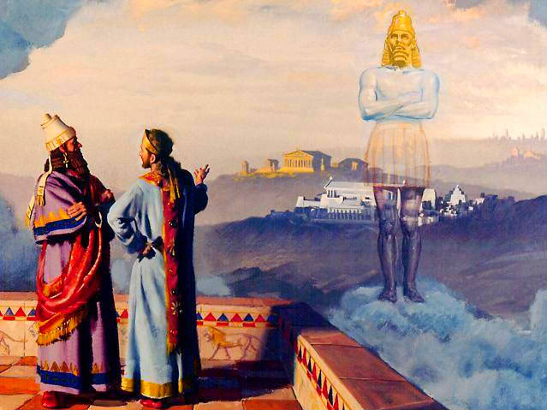
REVIVALS IN THE BIBLE:
Daniel

Slide 33
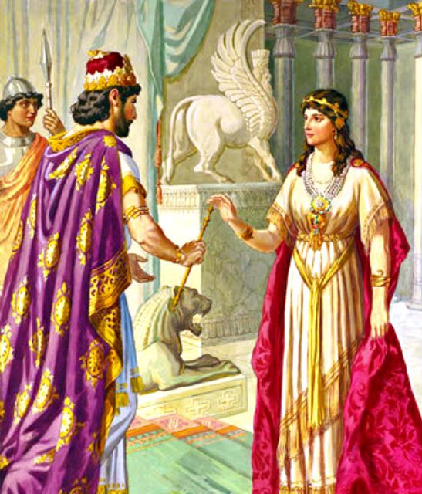
REVIVALS IN THE BIBLE:
Daniel
Esther

Slide 34
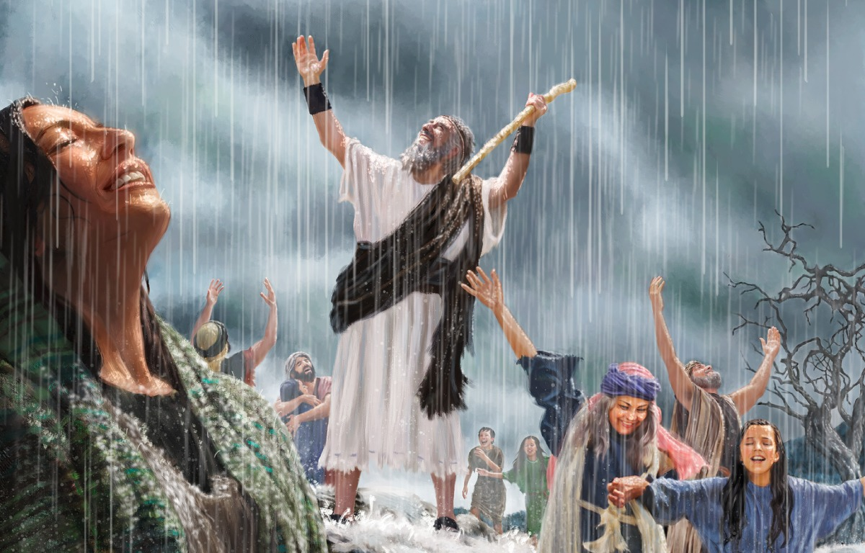
REVIVALS IN THE BIBLE:
Daniel
Esther
Elijah ^{(1 Kings 18)}

Slide 35
REVIVALS IN THE BIBLE:
Daniel
Esther
Elijah ^{(1 Kings 18)}
James 5:16-18 ^{16b} The prayer of a righteous person has great power as it is working. ¹⁷ Elijah was a man with a nature like ours, and he prayed fervently that it might not rain, and for three years and six months it did not rain on the earth. ¹⁸ Then he prayed again, and heaven gave rain, and the earth bore its fruit.

Slide 36
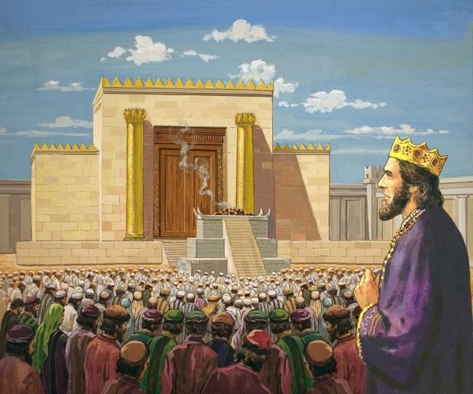
REVIVALS IN THE BIBLE:
Daniel
Esther
Elijah ^{(1 Kings 18)}
Solomon
2 Chronicles 7:13-14 ¹³ “When I shut up the heavens so that there is no rain, or command the locust to devour the land,
or send pestilence among my people,¹⁴ if my people who are called by my name humble themselves, and pray and seek my face and turn from their wicked ways, then I will hear from heaven and will forgive their sin and heal their land.

Slide 37
REVIVALS IN THE BIBLE:
Daniel
Esther
Elijah ^{(1 Kings 18)}
Solomon
1 Corinthians 3:16 Do you not know that you are God's temple and that God's Spirit dwells in you?
2 Chronicles 7:13-14 ¹³ “When I shut up the heavens so that there is no rain, or command the locust to devour the land,
or send pestilence among my people,¹⁴ if my people who are called by my name humble themselves, and pray and seek my face and turn from their wicked ways, then I will hear from heaven and will forgive their sin and heal their land.

Slide 38
REVIVALS IN THE BIBLE:
Daniel
Esther
Elijah ^{(1 Kings 18)}
Solomon
1 Corinthians 3:16 Do yall not know that yall are God's temple and that God's Spirit dwells in yall?
2 Chronicles 7:13-14 ¹³ “When I shut up the heavens so that there is no rain, or command the locust to devour the land,
or send pestilence among my people,¹⁴ if my people who are called by my name humble themselves, and pray and seek my face and turn from their wicked ways, then I will hear from heaven and will forgive their sin and heal their land.

Slide 39
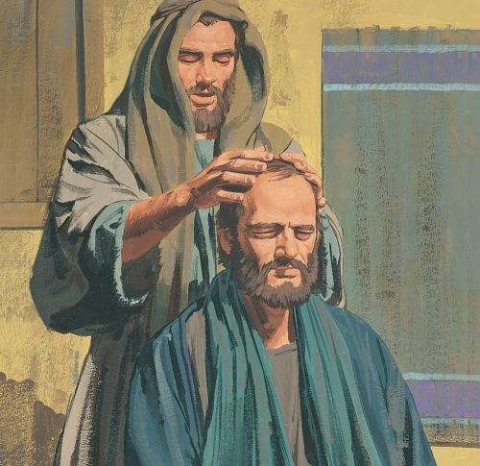
REVIVAL IN THE CHURCH AGE
Acts 9: Ananias & Paul

Slide 40
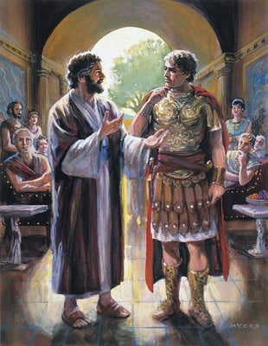
REVIVAL IN THE CHURCH AGE
Acts 9: Ananias & Paul
Acts 10: Peter & Cornelius

Slide 41
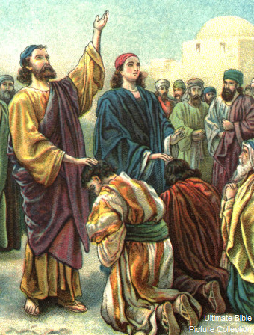
REVIVAL IN THE CHURCH AGE
Acts 9: Ananias & Paul
Acts 10: Peter & Cornelius
Acts 13: Paul & Barnabas

Slide 42
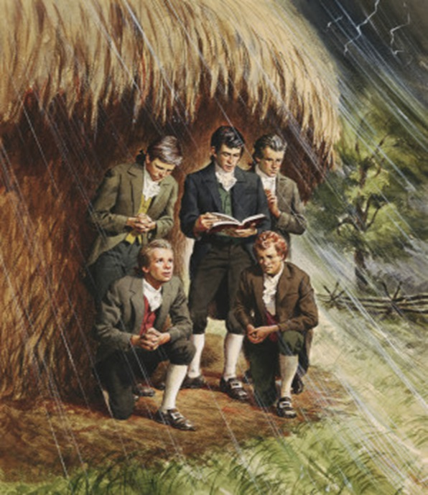
REVIVAL IN THE CHURCH AGE
Acts 9: Ananias & Paul
Acts 10: Peter & Cornelius
Acts 13: Paul & Barnabas
1806: Haystack Prayer Meeting

Slide 43
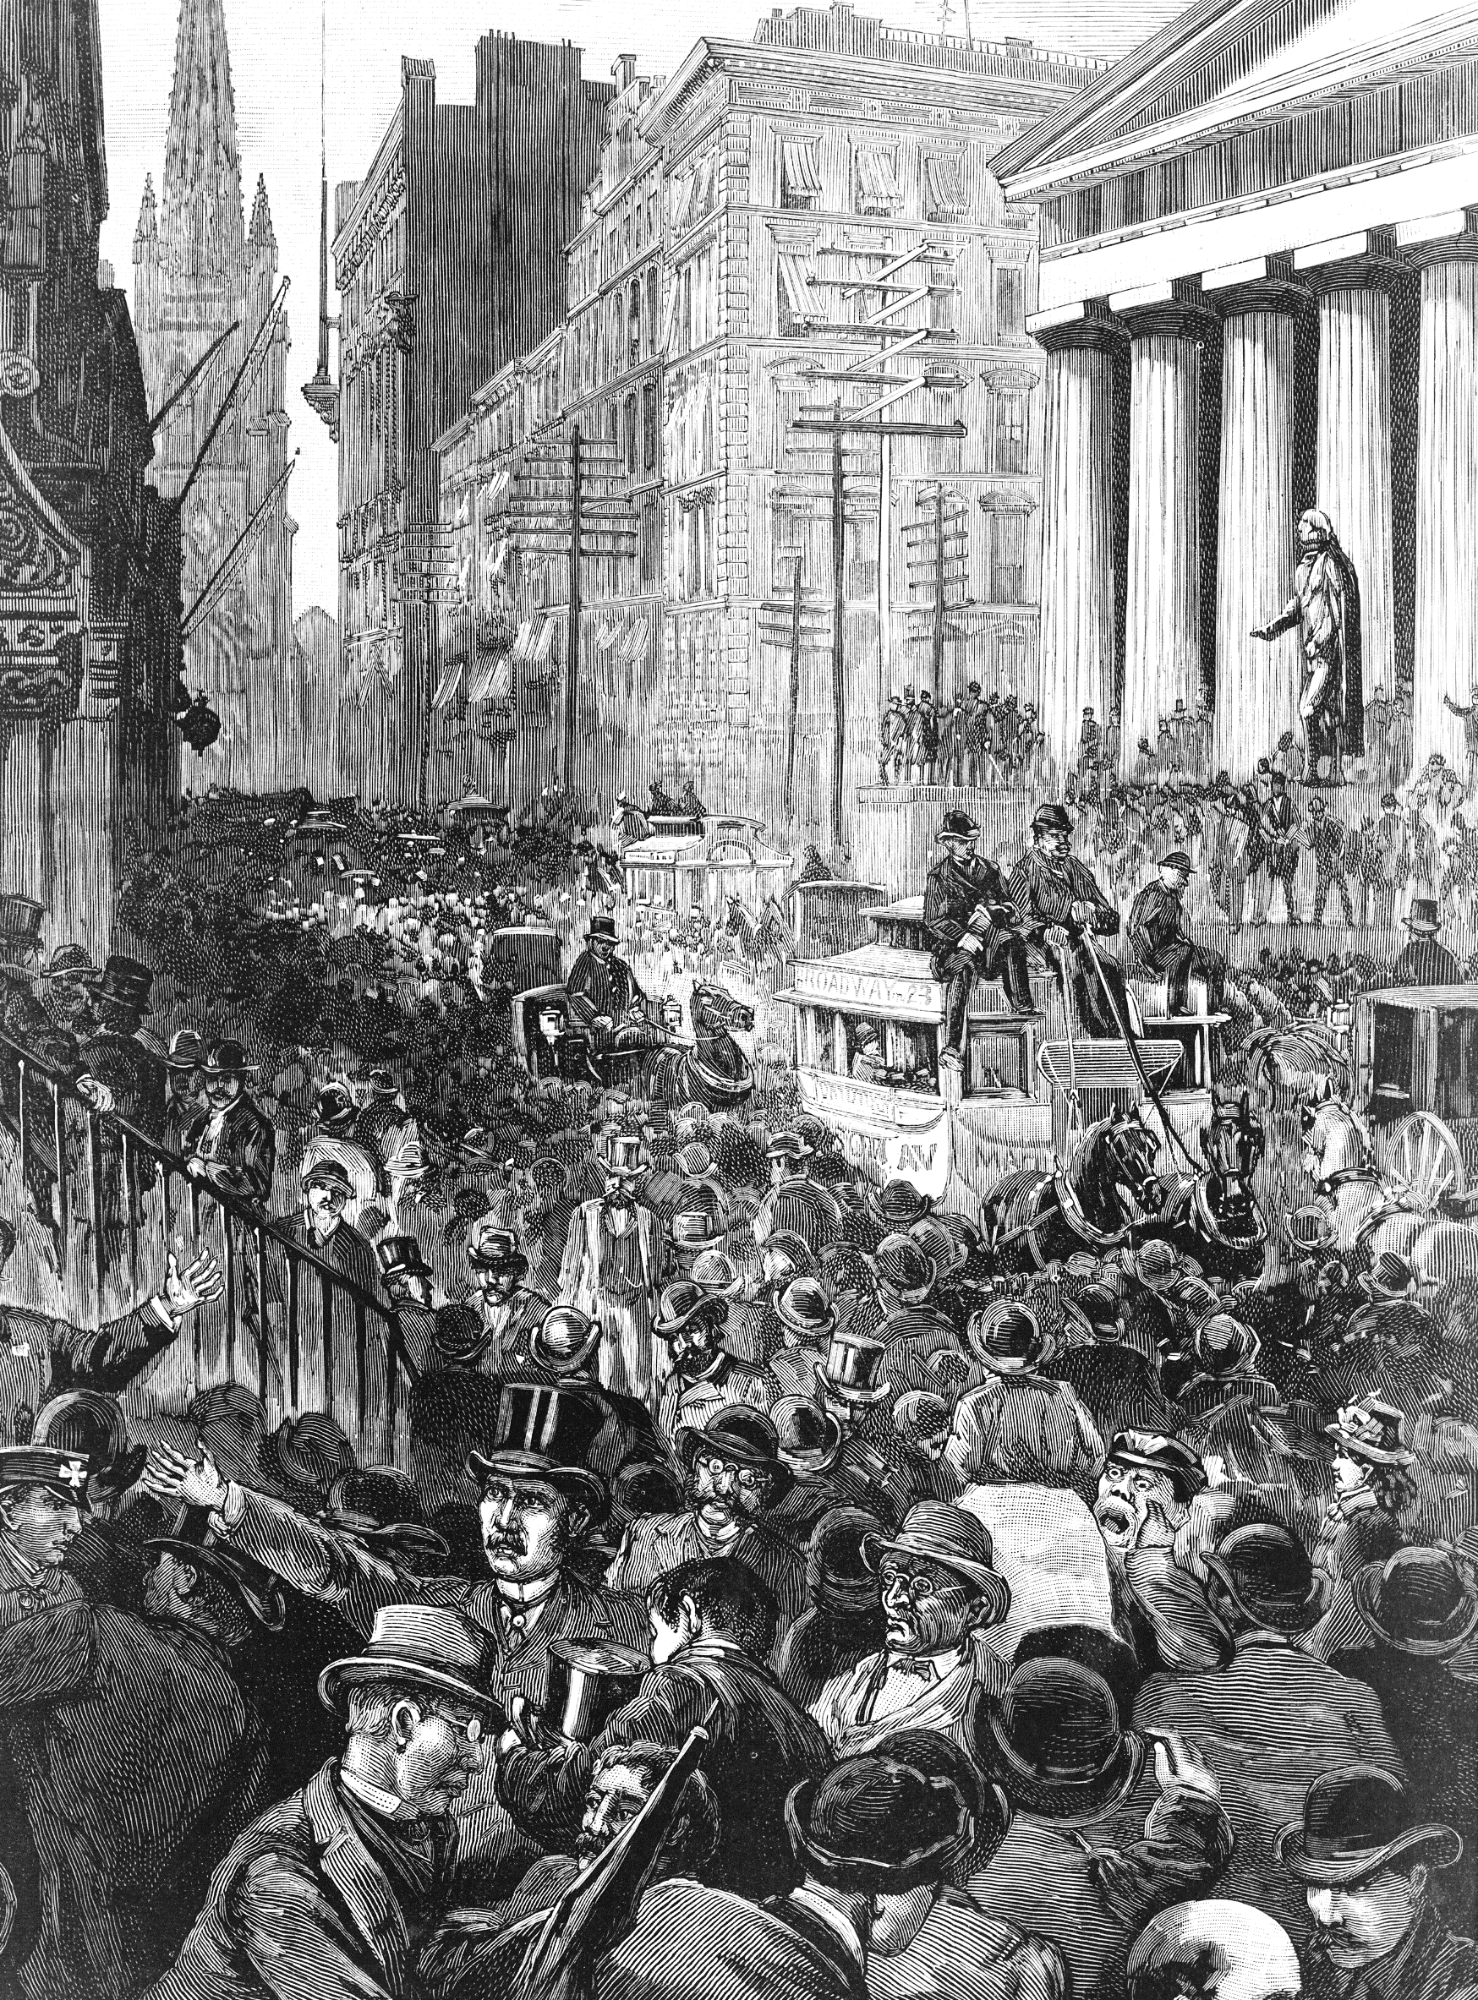
REVIVAL IN THE CHURCH AGE
Acts 9: Ananias & Paul
Acts 10: Peter & Cornelius
Acts 13: Paul & Barnabas
1806: Haystack Prayer Meeting
1857: Fulton St. Revival in Manhattan, NY

Slide 45
GOD OF THIS CITY
Aaron Boyd, Andrew McCann, Ian Jordan, Peter Comfort,
Peter Kernoghan, Richard Bleakley. #5037070

Slide 46
GOD OF THIS CITY
You’re the God of this city
You’re the King of these people
You’re the Lord of the nations
You are
You’re the light in this darkness
You’re the hope to the hopeless
You’re the peace to the restless
You are

Slide 47
GOD OF THIS CITY
For there is no one like our God
There is no one like our God
Greater things have yet to come
Greater things are still to be done
In this city
Greater things have yet to come
Greater things are still to be done
In this city

Slide 48
GOD OF THIS CITY
You’re the God of this city
You’re the King of these people
You’re the Lord of the nations
You are
You’re the light in this darkness
You’re the hope to the hopeless
You’re the peace to the restless
You are

Slide 49
GOD OF THIS CITY
You’re the strength in our weakness
You’re the love to the broken
You’re the joy in the sadness
You are

Slide 50
GOD OF THIS CITY
There is no one like our God
There is no one like our God
Greater things have yet to come
Greater things are still to be done
In this city (repeat)
Greater things have yet to come
And greater things have still To be done here!

Slide 51
BUILD YOUR
KINGDOM HERE
Build Your kingdom here
Let the darkness fear
Show Your mighty hand
Heal our streets & land
Set Your church on fire
Win the nations back
Change the atmosphere
Build Your Kingdom here
We pray

Slide 52
THE AFTER PARTY
HOW WAS TALLGRASS SABBATH WEEK?
WHAT ARE YOU LONGING TO SEE GOD DO IN OUR DAY / LAND?

