Slide 1
WELCOME

Slide 2
CELEBRATING
TWO YEARS
LAST SUNDAY!

Slide 3
I WILL WAIT ^{FOR} YOU
Jordan Kauflin, Keith Getty, Matthew Merker, Stuart Townend. #7118914

Slide 4
I WILL WAIT FOR YOU
⁵ I wait for the Lord, my soul waits,
and in his word I hope;
⁶ my soul waits for the Lord
more than watchmen for the morning,
more than watchmen for the morning.
Psalm 130:5-6

Slide 5
I WILL WAIT FOR YOU
Out of the depths I cry to You
In darkest places I will call
Incline Your ear to me anew
And hear my cry for mercy Lord

Slide 6
I WILL WAIT FOR YOU
Were You to count my sinful ways
How could I come before Your throne
Yet full forgiveness meets my gaze
I stand redeemed by grace alone

Slide 7
I WILL WAIT FOR YOU
I will wait for You, I will wait for You
On Your word I will rely
I will wait for You, surely wait for You
Till my soul is satisfied

Slide 8
I WILL WAIT FOR YOU
So put Your hope in God alone
Take courage in His power to save
Completely and forever won
By Christ emerging from the grave

Slide 9
I WILL WAIT FOR YOU
I will wait for You, I will wait for You
On Your word I will rely
I will wait for You, surely wait for You
Till my soul is satisfied

Slide 10
I WILL WAIT FOR YOU
Now He has come to make a way
And God Himself has paid the price
That all who trust in Him today
Find healing in His sacrifice
That all who trust in Him today
Find healing in His sacrifice

Slide 11
I WILL WAIT FOR YOU
I will wait for You, I will wait for You
On Your word I will rely
I will wait for You, surely wait for You
Till my soul is satisfied

Slide 12
SPROUTS

Slide 13
MINGLE QUESTIONS
What’s the best / most elaborate invitation you’ve ever received?
How would you like to spend an extra 3 hours this week?

Slide 15
We're convinced that God is inviting us into something new and profound through this unique season: personal renewal! This current season of disruption could be that divine invitation.
So we're going to slow way down together, focusing specifically on rediscovering and reclaiming personal habits and practices that have proven from generation to generation to lead us each into personal renewal, growth, and vital connection with God Himself.

Slide 16
⁷ “Blessed is the man who trusts in the Lord, whose trust is the Lord. ⁸ He is like a tree planted by water, that sends out its roots by the stream, and does not fear when heat comes, for its leaves remain green, and is not anxious in the year of drought, for it does not cease to bear fruit.”
Jeremiah 17:7-8

Slide 17
ASHLEY SMITH
HUNGER FOR THE WORD & PRAYER

Slide 18
NEW NORMAL
DIVINE INVITATION TO UNBUSYNESS

Slide 19
NEW NORMAL
DIVINE INVITATION TO UNBUSYNESS
²⁸ “Come to me, all who labor and are heavy laden, and I will give you rest. ²⁹ Take my yoke upon you, and learn from me, for I am gentle and lowly in heart, and you will find rest for your souls. ³⁰ For my yoke is easy, and my burden is light.”
—Jesus in Matthew 11:28-30

Slide 20
NEW NORMAL
DIVINE INVITATION TO UNBUSYNESS
²⁸ “Come to me, all who labor and are heavy laden, and I will give you rest. ²⁹ Take my yoke upon you, and learn from me, for I am gentle and lowly in heart, and you will find rest for your souls. ³⁰ For my yoke is easy, and my burden is light.”
—Jesus in Matthew 11:28-30
Abide in me, and I in you. As the branch cannot bear fruit by itself, unless it abides in the vine, neither can you, unless you abide in me.
—Jesus in John 15:4

Slide 21
SABBATH WEEK
DIVINE INVITATION TO UNBUSYNESS

Slide 22
SABBATH WEEK
DIVINE INVITATION TO UNBUSYNESS
“Think about the average workweek in this country. It wasn’t that long ago we had futurists predicting that one of the main challenges for coming generations would be too much spare time. In 1967, for example, testimony before a Senate subcommittee claimed that by 1985 the average workweek would be just twenty-two hours.”
—Crazy Busy by Kevin DeYoung, p. 23

Slide 23
SABBATH WEEK
DIVINE INVITATION TO UNBUSYNESS
“Instead, Americans lead the industrialized world in annual work hours. Our annual hours have increased from 1,716 for the average worker in 1967 to 1,878 hours in the years 2000. British workers put in an extra hour every day compared to the Germans and the Italians, but that’s still almost an hour less than Americans.”
—Crazy Busy by Kevin DeYoung, p. 23

Slide 24
SABBATH WEEK
DIVINE INVITATION TO UNBUSYNESS
¹²Observe the Sabbath day, to keep it holy, as the LORD your God commanded you.
¹⁵ You shall remember that you were a slave in the land of Egypt, and the LORD your God brought you out from there with a mighty hand and an outstretched arm.
Therefore the LORD your God commanded you to keep the Sabbath day.
—Deuteronomy 5:12, 15

Slide 25
SABBATH WEEK
DIVINE INVITATION TO UNBUSYNESS
Pick an “S” word—Solitude, Silence, Slowing

Slide 26
SABBATH WEEK
DIVINE INVITATION TO UNBUSYNESS
Pick an “S” word—Solitude, Silence, Slowing, Stillness, Seeing

Slide 27
SABBATH WEEK
DIVINE INVITATION TO UNBUSYNESS
Pick an “S” word—Solitude, Silence, Slowing, Stillness, Seeing
Pick an “L” word—Leisure, Linger

Slide 28
SABBATH WEEK
DIVINE INVITATION TO UNBUSYNESS
Pick an “S” word—Solitude, Silence, Slowing, Stillness, Seeing
Pick an “L” word—Leisure, Linger
“Be still, and know that I am God.”
Psalm 46:10a

Slide 29
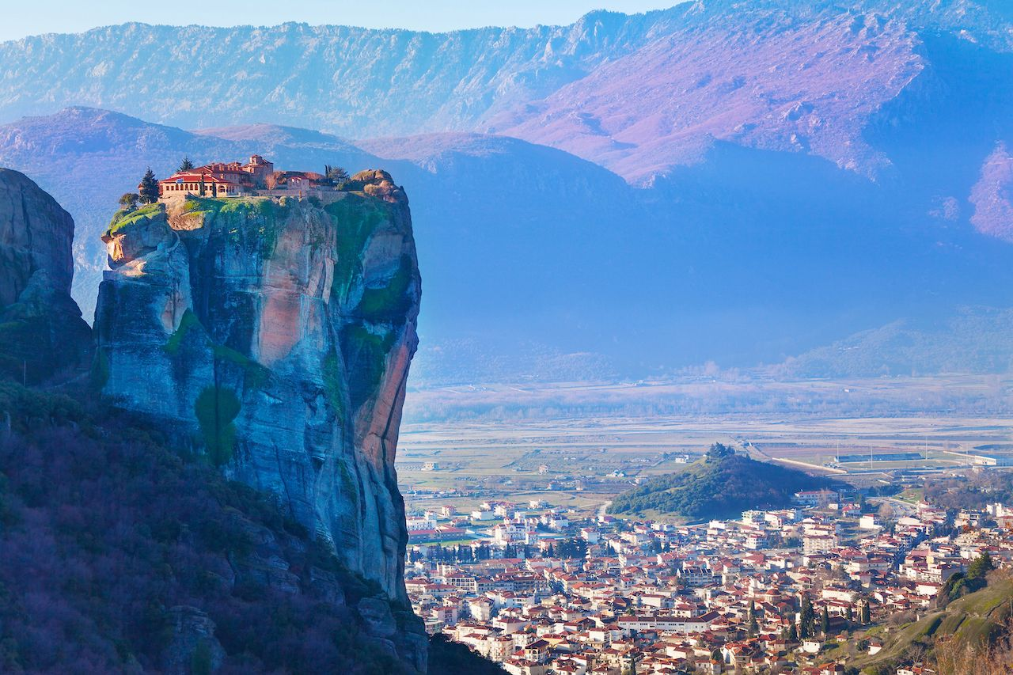

Slide 30
Holy Trinity Monastery (Greece)

Slide 31
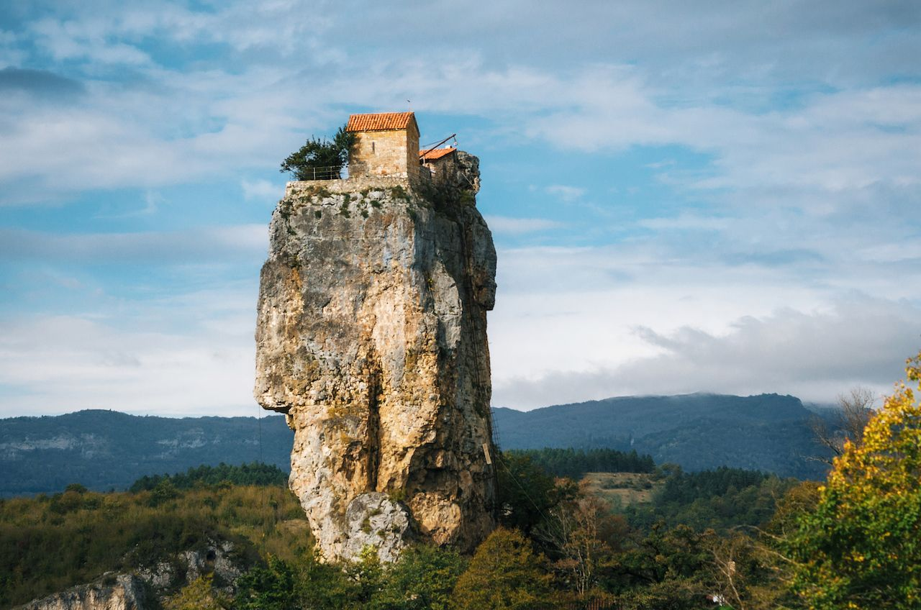

Slide 32
Katskhi Pillar (Georgia)

Slide 33
WIN THE MORNING
#WINTHEDANGDAY
Psalm 143:8 Let me hear in the morning of your steadfast love, for in you I trust. Make me know the way I should go, for to you I lift up my soul.
Psalm 90:14 Satisfy us in the morning with your steadfast love, that we may rejoice and be glad all our days.
Psalm 5:3 O Lord, in the morning you hear my voice; in the morning I prepare a sacrifice for you and watch.
Psalm 119:147 I rise before dawn and cry for help; I hope in your words.
Psalm 57:7-8 ⁷ My heart is steadfast, O God, my heart is steadfast! I will sing and make melody! ⁸ Awake, my glory! Awake, O harp and lyre! I will awake the dawn!
Psalm 46:10 “Be still, and know that I am God. I will be exalted among the nations, I will be exalted in the earth!”

Slide 34
SOLID SLEEP
Psalm 4:4 Be angry, and do not sin; ponder in your own hearts on your beds, and be silent. Selah
Psalm 4:8 In peace I will both lie down and sleep; for you alone, O Lord, make me dwell in safety.
Psalm 42:8 By day the Lord commands his steadfast love, and at night his song is with me, a prayer to the God of my life.
Psalm 63:5-7 ⁵ My soul will be satisfied as with fat and rich food, and my mouth will praise you with joyful lips, ⁶ when I remember you upon my bed, and meditate on you in the watches of the night; ⁷ for you have been my help, and in the shadow of your wings I will sing for joy.
Psalm 121:3-4 ³ He will not let your foot be moved; he who keeps you will not slumber. ⁴ Behold, he who keeps Israel will neither slumber nor sleep.
Psalm 127:2 It is in vain that you rise up early and go late to rest, eating the bread of anxious toil; for he gives to his beloved sleep.
Psalm 130:5-6 ⁵ I wait for the Lord, my soul waits, and in his word I hope; ⁶ my soul waits for the Lord more than watchmen for the morning, more than watchmen for the morning.
Ephesians 4:26-27 ²⁶ Be angry and do not sin; do not let the sun go down on your anger, ²⁷ and give no opportunity to the devil.

Slide 35
SOLID SLEEP
Conquer Series Acrostics:
H.A.L.T.— Hungry, Angry, Lonely, Tired
F.A.S.T.E.R. Relapse Awareness Scale—Forgetting Priorities, Anxiety, Speeding Up, Ticked Off, Exhausted, Relapse
S.E.E.D.S.— Social Contacts, Exercise, Education, Diets, Sleep
Practical steps towards solid sleep:
No screens 30 minutes before bed
15 minutes deep breathing and meditation on Jesus
15 minutes of something spiritual that you're excited about (e.g. Scripture memory, gratitude journal, etc.)

Slide 36
DAVID RENBERG
STEPS TO WHAT’S BEST NEXT

Slide 37
SET YOUR STAGE
FOR SUCCESS

Slide 39
DIVINE INVITATION
Eric Owyoung, Steve Hindalong. #4328096

Slide 40
AFTER PARTY

Slide 41
THANKS

