Slide 1
WELCOME

Slide 2
CELEBRATING
TWO YEARS
TODAY!!!

Slide 3
^{TO} GOD ^{BE THE} GLORY
Fanny Jane Crosby, William Howard Doane. #23426

Slide 4
TO GOD BE THE GLORY
To God be the glory, great things He hath done,
So loved He the world that He gave us His Son,
Who yielded His life an atonement for sin,
And opened the life gate that all may go in.

Slide 5
TO GOD BE THE GLORY
Praise the Lord, praise the Lord, let the earth hear His voice!
Praise the Lord, praise the Lord, let the people rejoice!
Oh, come to the Father, through Jesus the Son,
And give Him the glory, great things He hath done.

Slide 6
TO GOD BE THE GLORY
Oh, perfect redemption, the purchase of blood,
To every believer the promise of God;
The vilest offender who truly believes,
That moment from Jesus a pardon receives.

Slide 7
TO GOD BE THE GLORY
Praise the Lord, praise the Lord, let the earth hear His voice!
Praise the Lord, praise the Lord, let the people rejoice!
Oh, come to the Father, through Jesus the Son,
And give Him the glory, great things He hath done.

Slide 8
VIDEO #1

Slide 9
SPROUTS

Slide 10
NEW NORMAL
HAPPY BIRTHDAY, TALLGRASS!
WHAT WILL YEAR THREE BRING?

Slide 11
⁷ “Blessed is the man who trusts in the Lord, whose trust is the Lord. ⁸ He is like a tree planted by water, that sends out its roots by the stream, and does not fear when heat comes, for its leaves remain green, and is not anxious in the year of drought, for it does not cease to bear fruit.”
Jeremiah 17:7-8
“Jeremiah 17:7-8 is something I have been memorizing and meditating on. I desire this for Tallgrass and want to see it happen during this time of drought.”
-Ricky Greeve

Slide 12
The secret to the survival of the prairie plants in such a hostile environment is that 75-80% of the prairie’s biomass, or plant material, is underground. The visible plants seen on the landscape are merely the photo-synthetic leaves gathering sunlight for a much larger community underground. Just beneath the surface lies the main stems or rhizomes, running horizontally. Here they lie protected from drying, grazing, trampling, fire, and frost. —From the National Park Service on the Tallgrass Prairie

Slide 13
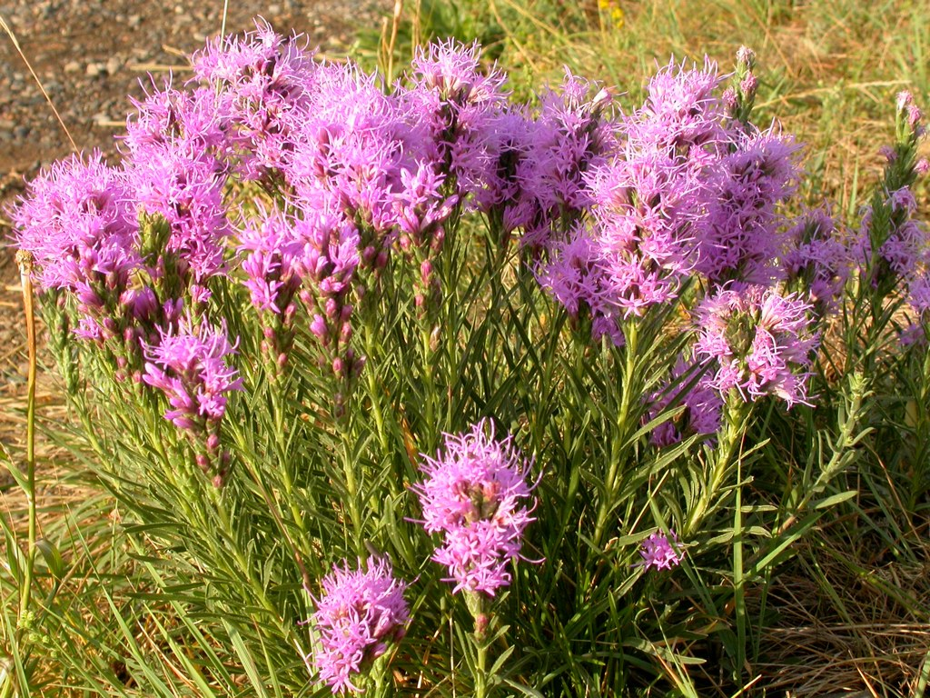
Tough fibrous roots descend from these rhizomes deep into the ground. Roots of some plants such as dotted gayfeather have been reported to go 10 to 15 feet deep. On these roots, are microscopic "rootlets" numbering in the billions and utilized by the plant. The roots of plants are so numerous, that were one plant's roots placed end to end they would stretch for miles. —From the National Park Service on the Tallgrass Prairie

Slide 14
LOVE ONE ANOTHER
The passage that comes to mind when I think about Tallgrass now and also casting vision is John 13:34-35. That we love one another and would continue to do so— in the midst of Coronavirus, in the midst of joy, in the midst of mourning.
Loving one another also includes teaching one another, admonishing one another, and discipling one another. That we would model this well so that our neighbors, friends, coworkers, families, and MHK community would see Tallgrass members and know the love between us as Jesus' disciples. — Kassi Chapman

Slide 15
LOVE ONE ANOTHER
The passage that comes to mind when I think about Tallgrass now and also casting vision is John 13:34-35. That we love one another and would continue to do so— in the midst of Coronavirus, in the midst of joy, in the midst of mourning.
Loving one another also includes teaching one another, admonishing one another, and discipling one another. That we would model this well so that our neighbors, friends, coworkers, families, and MHK community would see Tallgrass members and know the love between us as Jesus' disciples. — Kassi Chapman
Because God first loved us, we exist to love God and love our neighbors!

Slide 16
HOW ^{TO} GIVE ^{AT} TALLGRASS
ONLINE at tallgrass.church with your Bank Account or Credit Card
CHECK/CASH in the black box OR SNAIL MAIL TO PO BOX 1795, MHK, 66505
TEXT 2 GIVE (785) 789-3259 … text “REGISTER” to set it up

Slide 18
WHY WE DO IT
Our hearts break for abandoned youth!
The Fatherless Defend the weak and the fatherless.
Psalm 82:3
The Prisoner I was in prison and you came to me.
Matthew 25:36
The Poor The angel answered, “Your prayers and gifts to the poor have come up as a memorial offering before God.” Acts 10:4
The ‘Least of These’ The King will reply, ‘Truly I tell you, whatever you did for one of the least of these brothers and sisters of mine, you did for me.’ Matthew 25:40

Slide 19
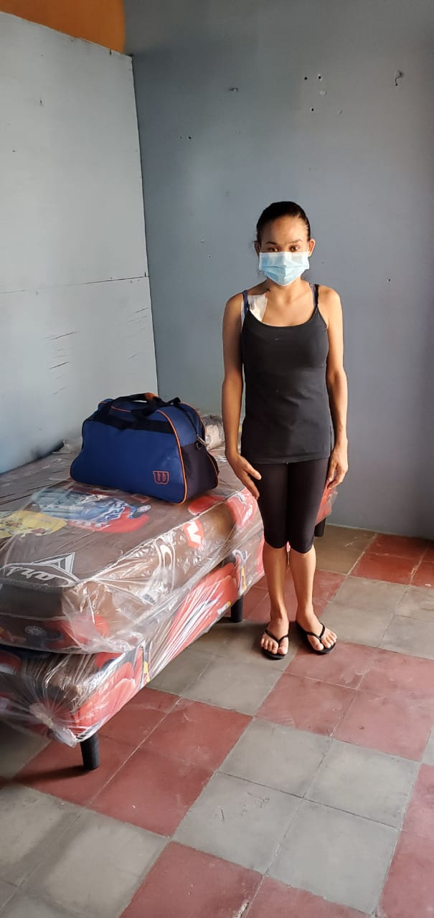
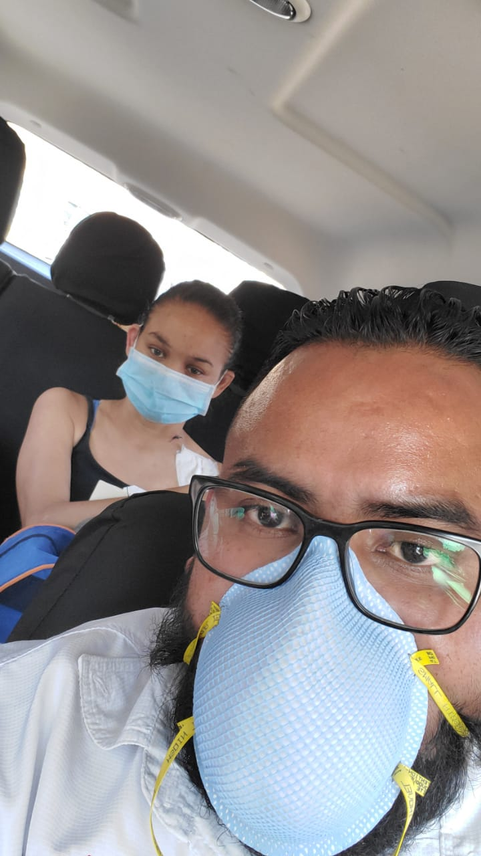
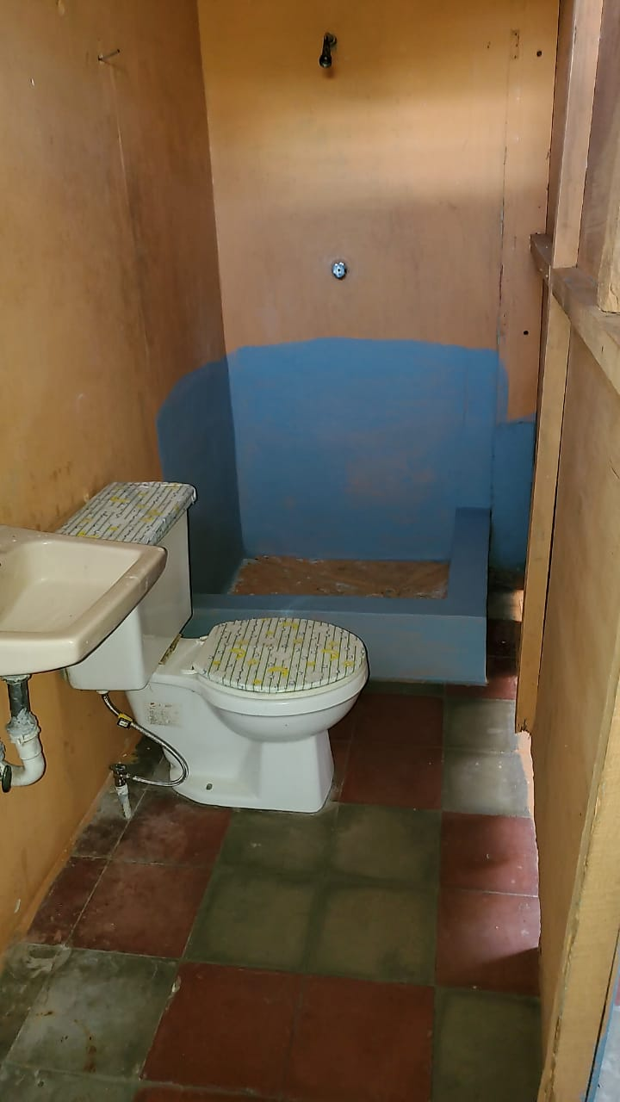
Maribelle

Slide 20
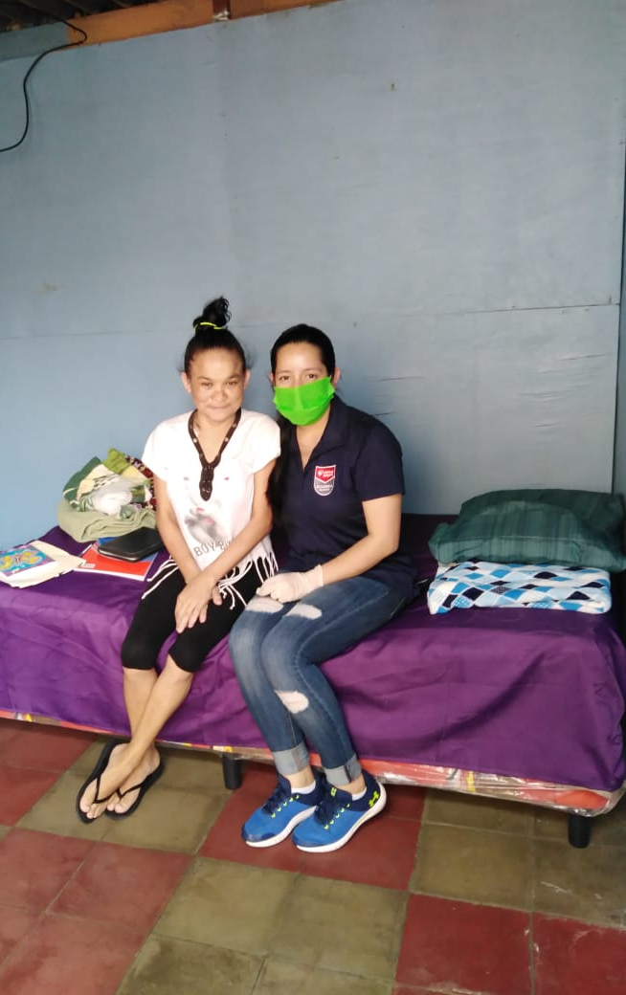

Slide 21
VIDEO #2

Slide 22
TAKE COURAGE
And when all our enemies heard of it, all the nations around us were afraid and fell greatly in their own esteem, for they perceived that this work had been accomplished with the help of our God. Nehemiah 6:16

Slide 23
TAKE COURAGE
And when all our enemies heard of it, all the nations around us were afraid and fell greatly in their own esteem, for they perceived that this work had been accomplished with the help of our God. Nehemiah 6:16
May everyone know that Tallgrass is formed and standing because our God is great. -Bill Bickmeier

Slide 24
TAKE COURAGE
Jeremy Riddle, Joel Taylor, Kristene DiMarco. #7074837

Slide 25
TAKE COURAGE
Slow down, take time
"Breathe in," He said
He'd reveal what's to come
The thoughts in His mind
*Always higher than mine
He'll reveal all to come
*See Isaiah 55:8-9

Slide 26
TAKE COURAGE
So take courage my heart
Stay steadfast my soul
He's in the waiting
He's in the waiting
And hold onto your hope
As your triumph unfolds
He's never failing
He's never failing

Slide 27
TAKE COURAGE
Sing praise my soul
*Find strength in joy
Let His words lead you on
Do not forget
His great faithfulness
He'll finish all He's begun
*See Nehemiah 8:10

Slide 28
TAKE COURAGE
So take courage my heart
Stay steadfast my soul
He's in the waiting
He's in the waiting
And hold onto your hope
As your triumph unfolds
He's never failing
He's never failing

Slide 29
TAKE COURAGE
And You who hold the stars
Who call them each by name
Will surely keep Your promise to me
That I will rise in Your victory!
Repeat

Slide 30
TAKE COURAGE
So take courage my heart
Stay steadfast my soul
He's in the waiting
He's in the waiting
And hold onto your hope
As your triumph unfolds
He's never failing
He's never failing

Slide 31
VIDEO #3

Slide 32
WAY MAKER
Osinachi Kalu Okoro Egbu. #7115744

Slide 33
WAY MAKER
You are here moving in our midst
I worship You, I worship You
You are here working in this place
I worship You, I worship You

Slide 34
WAY MAKER
Way Maker, Miracle Worker
Promise Keeper,
Light in the Darkness
My God
That is who You are

Slide 35
WAY MAKER
You are here touching every heart
I worship You, I worship You
You are here healing every heart
I worship You, I worship You

Slide 36
WAY MAKER
You are here turning lives around
We worship You, we worship You
You are here mending every heart
We worship You, we worship You

Slide 37
WAY MAKER
Way Maker, Miracle Worker
Promise Keeper,
Light in the Darkness
My God
That is who You are

Slide 38
WAY MAKER
That is who You are
That is who You are
Repeat

Slide 39
WAY MAKER
Way Maker, Miracle Worker
Promise Keeper,
Light in the Darkness
My God
That is who You are

Slide 40
WAY MAKER
Even when I don’t see it You’re working
Even when I don’t feel it You’re working
You never stop, You never stop working
You never stop, You never stop working
Repeat

Slide 41
WAY MAKER
Way Maker, Miracle Worker
Promise Keeper,
Light in the Darkness
My God
That is who You are

Slide 42
DOXOLOGY
Praise God from whom all blessings flow
Praise Him all creatures here below
Praise Him above ye heavenly hosts
Praise Father, Son, and Holy Ghost
Amen.

Slide 43
AFTER PARTY

Slide 44
THANKS

