Slide 1
WELCOME

Slide 2
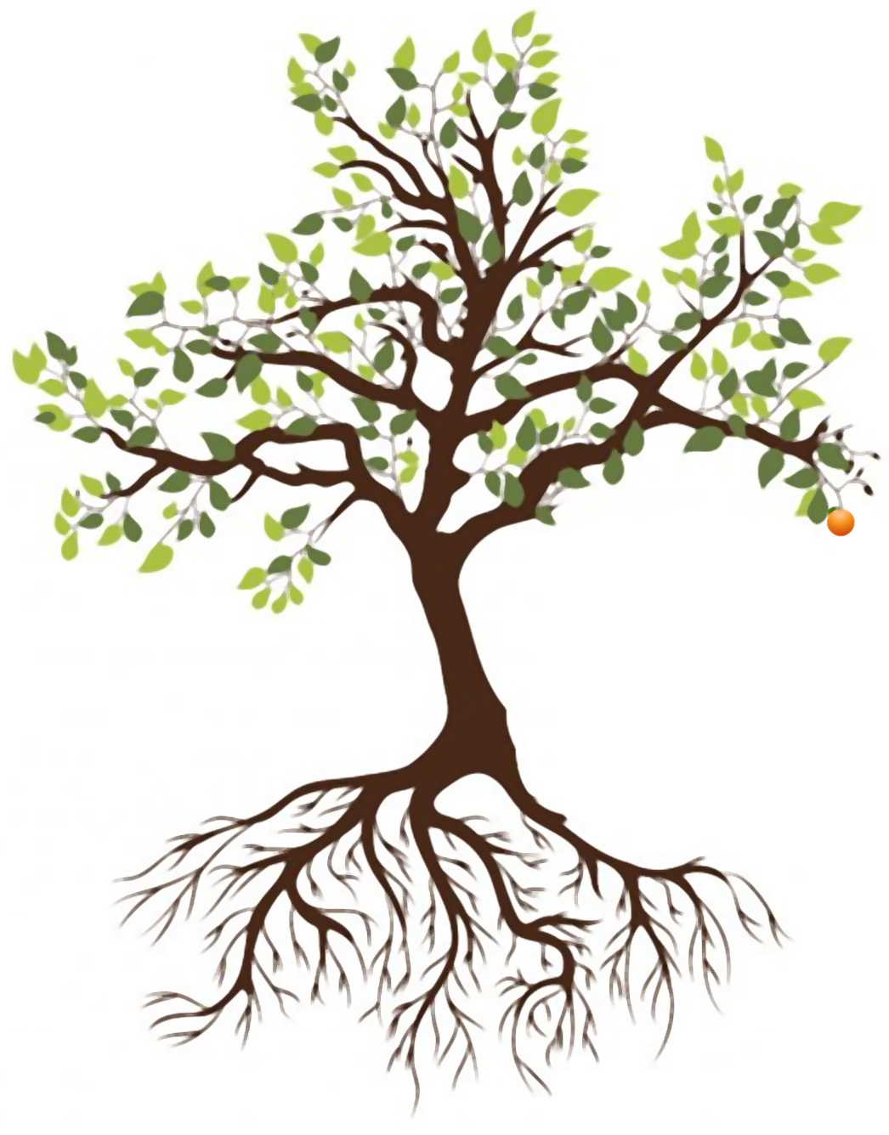
EASTER SUNDAY
TALLGRASS COMMUNITY CHURCH

Slide 3
CELEBRATING
TWO YEARS
NEXT SUNDAY!!!

Slide 4
KINGS OF KINGS
Brooke Ligertwood, Jason Ingram, Scott Ligertwood. #7127647

Slide 5
KINGS OF KINGS
In the darkness we were waiting
Without hope without light
Till from heaven You came running
There was mercy in Your eyes

Slide 6
KINGS OF KINGS
To fulfill the law and prophets
To a virgin came the Word
From a throne of endless glory
To a cradle in the dirt

Slide 7
KINGS OF KINGS
Praise the Father, Praise the Son
Praise the Spirit three in one
God of glory, Majesty
Praise forever to the King of kings

Slide 8
KINGS OF KINGS
To reveal the Kingdom coming
And to reconcile the lost
To redeem the whole creation
You did not despise the cross

Slide 9
KINGS OF KINGS
For even in Your suffering
You saw to the other side
Knowing this was our salvation
Jesus for our sake You died

Slide 10
KINGS OF KINGS
Praise the Father, Praise the Son
Praise the Spirit three in one
God of glory, Majesty
Praise forever to the King of kings

Slide 11
KINGS OF KINGS
And the morning that You rose
All of heaven held its breath
Till that stone was moved for good
For the Lamb had conquered death

Slide 12
KINGS OF KINGS
And the dead rose from their tombs
And the angels stood in awe
For the souls of all who’d come
To the Father are restored

Slide 13
KINGS OF KINGS
And the Church of Christ was born
Then the Spirit lit the flame
Now this gospel truth of old
Shall not kneel shall not faint

Slide 14
KINGS OF KINGS
By His blood and in His Name
In His freedom I am free
For the love of Jesus Christ
Who has resurrected me

Slide 15
KINGS OF KINGS
Praise the Father, Praise the Son
Praise the Spirit three in one
God of glory, Majesty
Praise forever to the King of kings
Praise forever to the King of kings

Slide 17
NEW NORMAL
PHYSICAL RESURRECTION &
NO MORE SOCIAL DISTANCING

Slide 18
We're convinced that God is inviting us into something new and profound through this unique season: personal renewal! This current season of disruption could be that divine invitation.
So we're going to slow way down together, focusing specifically on rediscovering and reclaiming personal habits and practices that have proven from generation to generation to lead us each into personal renewal, growth, and vital connection with God Himself.

Slide 19
⁷ “Blessed is the man who trusts in the Lord, whose trust is the Lord. ⁸ He is like a tree planted by water, that sends out its roots by the stream, and does not fear when heat comes, for its leaves remain green, and is not anxious in the year of drought, for it does not cease to bear fruit.”
Jeremiah 17:7-8

Slide 21
PAUL & SOCIAL DISTANCING
Philippians 1:12-14 ¹² I want you to know, brothers, that what has happened to me has really served to advance the gospel, ¹³ so that it has become known throughout the whole imperial (praetorian) guard and to all the rest that my imprisonment is for Christ. ¹⁴ And most of the brothers, having become confident in the Lord by my imprisonment, are much more bold to speak the word without fear.

Slide 22
PAUL & SOCIAL DISTANCING
Philippians 4:4-7 ⁴ Rejoice in the Lord always; again I will say, rejoice. ⁵ Let your reasonableness be known to everyone. The Lord is at hand; ⁶ do not be anxious about anything, but in everything by prayer and supplication with thanksgiving let your requests be made known to God. ⁷ And the peace of God, which surpasses all understanding, will guard your hearts and your minds in Christ Jesus.

Slide 23
PAUL & SOCIAL DISTANCING
Philippians 1:18b-21 ^{18b} Yes, and I will rejoice, ¹⁹ for I know that through your prayers and the help of the Spirit of Jesus Christ this will turn out for my deliverance, ²⁰ as it is my eager expectation and hope that I will not be at all ashamed, but that with full courage now as always Christ will be honored in my body, whether by life or by death. ²¹ For to me to live is Christ, and to die is gain.

Slide 24
PAUL & SOCIAL DISTANCING
Philippians 1:22-26 ²² If I am to live in the flesh, that means fruitful labor for me. Yet which I shall choose I cannot tell. ²³ I am hard pressed between the two. My desire is to depart and be with Christ, for that is far better. ²⁴ But to remain in the flesh is more necessary on your account. ²⁵ Convinced of this, I know that I will remain and continue with you all, for your progress and joy in the faith, ²⁶ so that in me you may have ample cause to glory in Christ Jesus, because of my coming to you again.

Slide 25
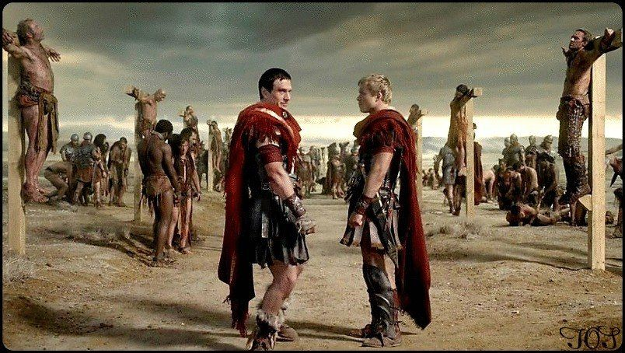

Slide 26
SEED & RESURRECTION
John 12:24 Truly, truly, I say to you, unless a grain of wheat falls into the earth and dies, it remains alone; but if it dies, it bears much fruit.

Slide 27
JESUS PAID IT ALL
Alex Nifong Elvina M. Hall John Thomas Grape. #4689508

Slide 28
JESUS PAID IT ALL
I hear the Savior say,
“Thy strength indeed is small
Child of weakness, watch and pray
Find in me thine all in all”

Slide 29
JESUS PAID IT ALL
Jesus paid it all
All to him I owe
Sin had left a crimson stain
He washed it white as snow

Slide 30
JESUS PAID IT ALL
Lord, now indeed I find
Thy power and thine alone
can change the leper's spots
and melt the heart of stone

Slide 31
JESUS PAID IT ALL
Jesus paid it all
All to him I owe
Sin had left a crimson stain
He washed it white as snow

Slide 32
JESUS PAID IT ALL
Oh praise the one who paid my debt
and raised this life up from the dead
(repeat)

Slide 33
JESUS PAID IT ALL
And when before the throne
I stand in Him complete
“Jesus died, my soul to save!”,
My lips shall still repeat

Slide 34
JESUS PAID IT ALL
Jesus paid it all
All to him I owe
Sin had left a crimson stain
He washed it white as snow
Sin had left a crimson stain
He washed it white as snow

Slide 35
NEW NORMAL
PHYSICAL RESURRECTION &
NO MORE SOCIAL DISTANCING

Slide 36
SEED & RESURRECTION
Romans 8:22-25 ²² For we know that the whole creation has been groaning together in the pains of childbirth until now. ²³ And not only the creation, but we ourselves, who have the firstfruits of the Spirit, groan inwardly as we wait eagerly for adoption as sons, the redemption of our bodies. ²⁴ For in this hope we were saved. Now hope that is seen is not hope. For who hopes for what he sees? ²⁵ But if we hope for what we do not see, we wait for it with patience.

Slide 37
SEED & RESURRECTION
Luke 13:18-19 ¹⁸ He said therefore, “What is the kingdom of God like? And to what shall I compare it? ¹⁹ It is like a grain of mustard seed that a man took and sowed in his garden, and it grew and became a tree, and the birds of the air made nests in its branches.”

Slide 38
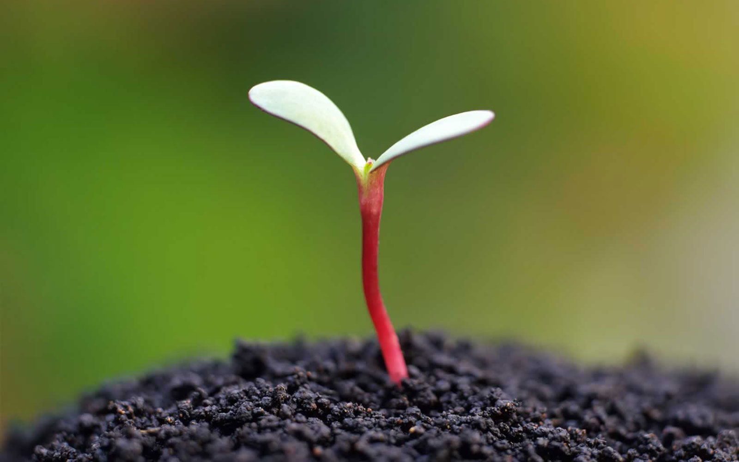

Slide 39
SEED & RESURRECTION
1 Corinthians 15:42-44 ⁴² So is it with the resurrection of the dead. What is sown is perishable; what is raised is imperishable. ⁴³ It is sown in dishonor; it is raised in glory. It is sown in weakness; it is raised in power. ⁴⁴ It is sown a natural body; it is raised a spiritual body. If there is a natural body, there is also a spiritual body.

Slide 40
SEED & RESURRECTION
2 Corinthians 4:16-18 ¹⁶ So we do not lose heart. Though our outer self is wasting away, our inner self is being renewed day by day. ¹⁷ For this light momentary affliction is preparing for us an eternal weight of glory beyond all comparison, ¹⁸ as we look not to the things that are seen but to the things that are unseen. For the things that are seen are transient, but the things that are unseen are eternal.

Slide 41
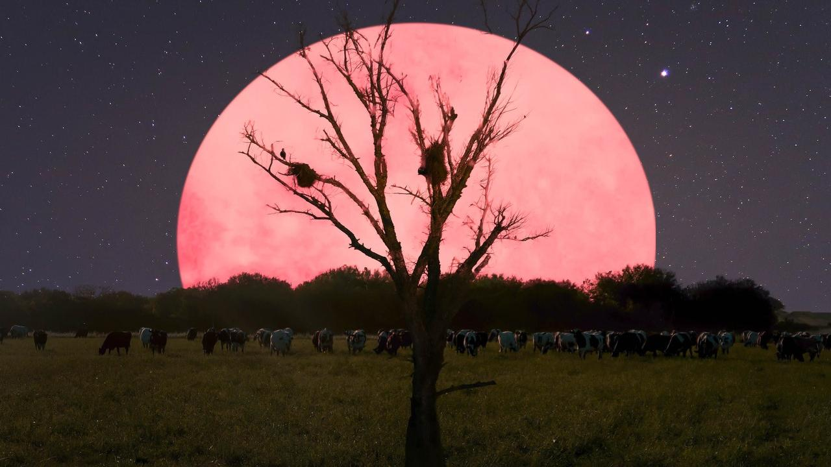

Slide 42
RESURRECTION RESOURCES
Discovering God: Exploring the Possibilities of Faith by Dennis McCallum
The Case for Easter: A Journalist Investigates Evidence for the Resurrection by Lee Strobel
The Case for the Resurrection by Gary Habermas and Mike Licona

Slide 43
SEED & RESURRECTION
Jeremiah 17:7-8 ⁷ “Blessed is the person who trusts in the Lord, whose trust is the Lord. ⁸ He or she is like a tree planted by water, that sends out its roots by the stream, and does not fear when heat comes, for its leaves remain green, and is not anxious in the year of drought, for it does not cease to bear fruit.”

Slide 44
SEED & RESURRECTION
1 Corinthians 9:25-27 ²⁵ Every athlete exercises self-control in all things. They do it to receive a perishable wreath, but we an imperishable. ²⁶ So I do not run aimlessly; I do not box as one beating the air. ²⁷ But I discipline my body and keep it under control, lest after preaching to others I myself should be disqualified.

Slide 45
SEED & RESURRECTION
1 Corinthians 9:25-27 ²⁵ Every athlete exercises self-control in all things. They do it to receive a perishable wreath, but we an imperishable. ²⁶ So I do not run aimlessly; I do not box as one beating the air. ²⁷ But I discipline my body and keep it under control, lest after preaching to others I myself should be disqualified.
What’s your next intentional step this Easter during the COVID-19 era?

Slide 46
BECAUSE HE LIVES
Gloria Gaither William J. Gaither. #16880

Slide 47
BECAUSE HE LIVES
God sent His son, they called Him, Jesus;
He came to love, heal and forgive;
He lived and died to buy my pardon,
An empty grave is there to prove my Savior lives!

Slide 48
BECAUSE HE LIVES
Because He lives, I can face tomorrow,
Because He lives, all fear is gone;
Because I know He holds the future,
And life is worth the living,
Just because He lives!

Slide 49
BECAUSE HE LIVES
And then one day, I'll cross the river,
I'll fight life's final war with pain;
And then, as death gives way to victory,
I'll see the lights of glory and I'll know He lives!

Slide 50
BECAUSE HE LIVES
Because He lives, I can face tomorrow,
Because He lives, all fear is gone;
Because I know He holds the future,
And life is worth the living,
Just because He lives!

Slide 51
BECAUSE HE LIVES
How sweet to hold a newborn baby,
And feel the pride and joy he gives;
But greater still the calm assurance:
This child can face uncertain days
Because He lives!

Slide 52
BECAUSE HE LIVES
Because He lives, I can face tomorrow,
Because He lives, all fear is gone;
Because I know He holds the future,
And life is worth the living,
Just because He lives!
And life is worth the living,
Just because He lives!

Slide 53
Let us pray to God, who alone makes us dwell in safety:
For all who are affected by coronavirus, through illness or isolation or anxiety, that they may find relief and recovery:
Lord, hear us, Lord, graciously hear us.
From The Church of England Coronavirus (COVID-19) liturgy and prayer resources

Slide 54
For those who are guiding our nation at this time, and shaping national policies, that they may make wise decisions:
Lord, hear us, Lord, graciously hear us.
From The Church of England Coronavirus (COVID-19) liturgy and prayer resources

Slide 55
For doctors, nurses, and medical researchers, that through their skill and insights many will be restored to health:
Lord, hear us, Lord, graciously hear us.
From The Church of England Coronavirus (COVID-19) liturgy and prayer resources

Slide 56
For the vulnerable and the fearful, for the gravely ill and the dying, that they may know your comfort and peace:
Lord, hear us, Lord, graciously hear us.
From The Church of England Coronavirus (COVID-19) liturgy and prayer resources

Slide 57
For personal renewal, that we would establish a new normal now, so when things go back to normal we never go back to normal, but instead live in greater anticipation of physical resurrection when there is no more social distancing ever again.
Lord, hear us, Lord, graciously hear us.
From The Church of England Coronavirus (COVID-19) liturgy and prayer resources

Slide 58
1 Corinthians 15:53-58 ⁵³For this perishable body must put on the imperishable, and this mortal body must put on immortality. ⁵⁴When the perishable puts on the imperishable, and the mortal puts on immortality, then shall come to pass the saying that is written:
“Death is swallowed up in victory.”
⁵⁵“O death, where is your victory?
O death, where is your sting?”
⁵⁶ The sting of death is sin, and the power of sin is the law. ⁵⁷ But thanks be to God, who gives us the victory through our Lord Jesus Christ. ⁵⁸Therefore, my beloved brothers and sisters, be steadfast, im-movable, always abounding in the work of the Lord, knowing that in the Lord your labor is not in vain.

Slide 59
We commend ourselves, and all for whom we pray, to the mercy and protection of God.
Merciful Father, accept these prayers for the sake of your Son, our Savior Jesus Christ. Amen.
From The Church of England Coronavirus (COVID-19) liturgy and prayer resources

Slide 60
NEW NORMAL
PHYSICAL RESURRECTION &
NO MORE SOCIAL DISTANCING

Slide 61
THANKS

