Slide 1
IT IS WELL WITH MY SOUL
Horatio Spafford Philip Bliss

Slide 2
IT IS WELL WITH MY SOUL
When peace like a river, attendeth my way, When sorrows like sea billows roll Whatever my lot, thou hast taught me to say It is well, it is well, with my soul
It is well (it is well) With my soul (with my soul) It is well, it is well with my soul

Slide 3
IT IS WELL WITH MY SOUL
Though Satan should buffet, though trials should come, Let this blest assurance control, That Christ has regarded my helpless estate, And hath shed His own blood for my soul
It is well (it is well) With my soul (with my soul) It is well, it is well with my soul

Slide 4
IT IS WELL WITH MY SOUL
My sin, oh, the bliss of this glorious thought My sin, not in part but the whole, Is nailed to the cross, and I bear it no more, Praise the Lord! Praise the Lord, o my soul!
It is well (it is well) With my soul (with my soul) It is well, it is well with my soul

Slide 6
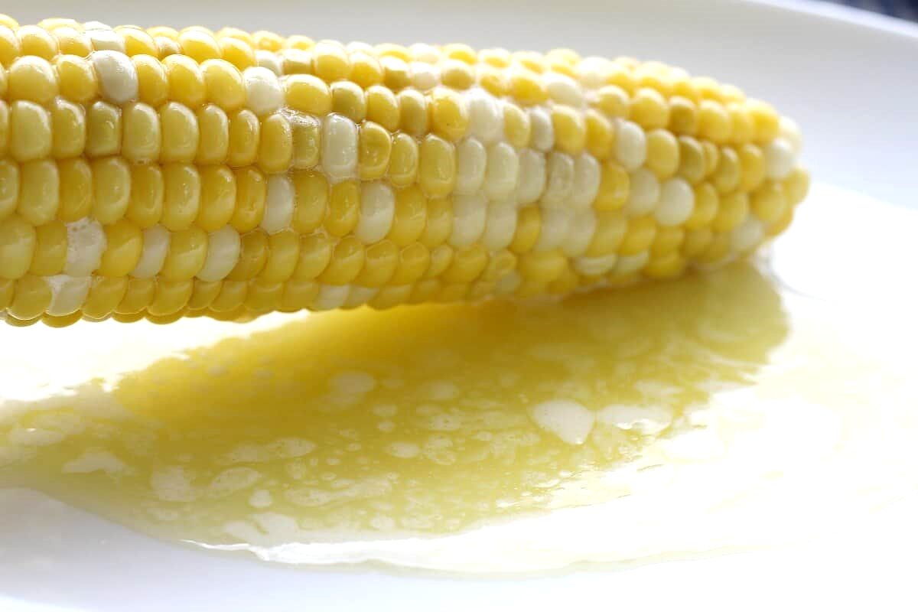

Slide 10
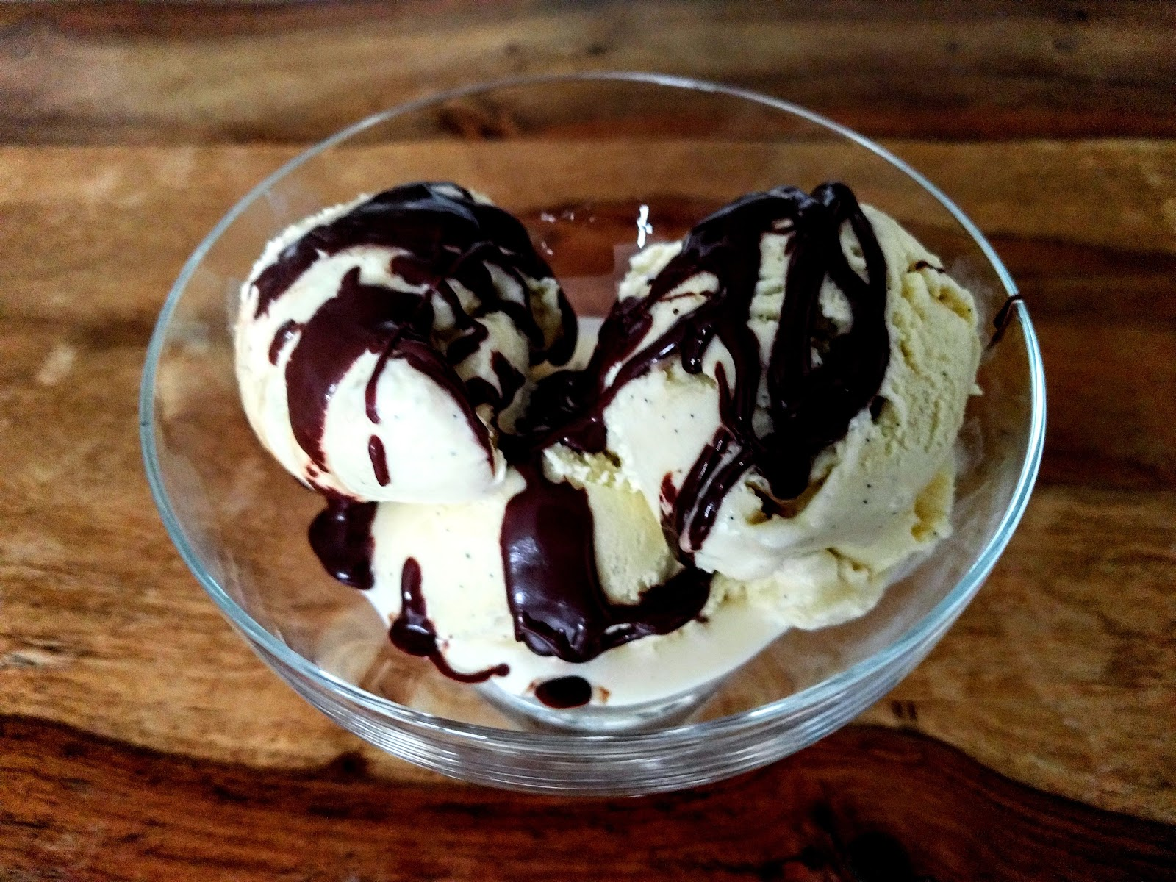

Slide 11
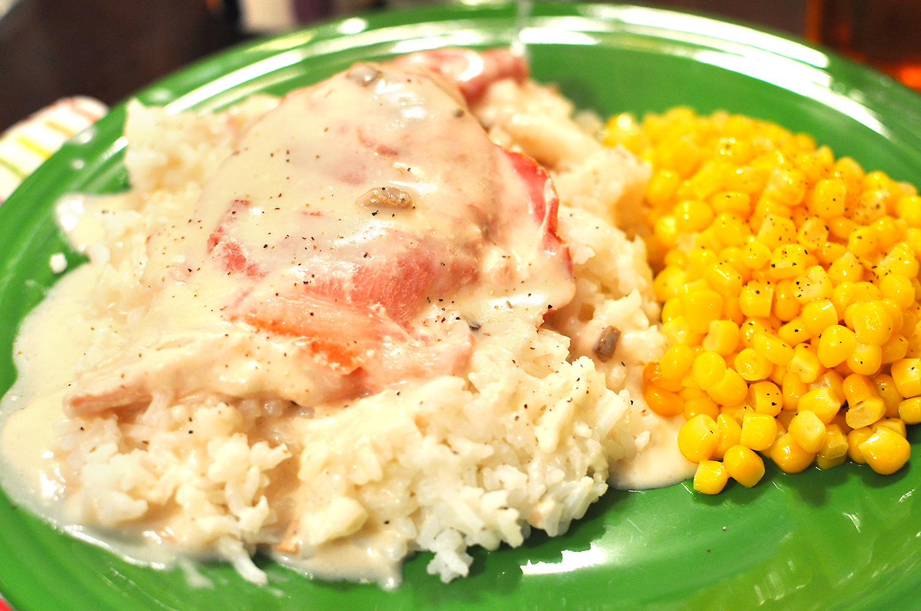

Slide 13
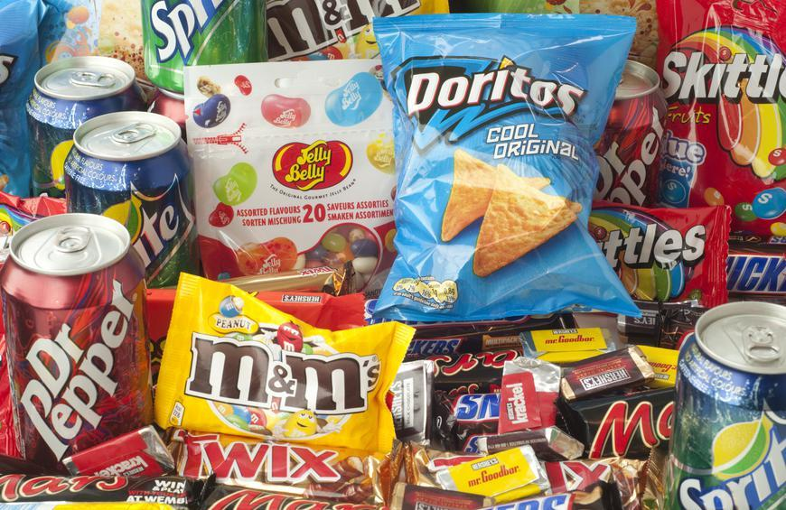
WHAT JUNK FOOD HAVE YOU BEEN FEEDING YOUR SOUL?

Slide 14
WHAT JUNK FOOD HAVE YOU BEEN FEEDING YOUR SOUL?
Pornography
Control
Power
Manipulation

Slide 15
WHAT JUNK FOOD HAVE YOU BEEN FEEDING YOUR SOUL?
Pornography
Control
Power
Manipulation
Social Media
News
Movies/Shows
Video Games

Slide 16
WHAT JUNK FOOD HAVE YOU BEEN FEEDING YOUR SOUL?
Pornography
Control
Power
Manipulation
Social Media
News
Movies/Shows
Video Games
Work
$ecurity
Books
Relationships
Social Justice

Slide 17
WHAT JUNK FOOD HAVE YOU BEEN FEEDING YOUR SOUL?
Pornography
Control
Power
Manipulation
Social Media
News
Movies/Shows
Video Games
Work
$ecurity
Books
Relationships
Social Justice
NONE OF THESE WILL NOURISH YOUR SOUL

Slide 18
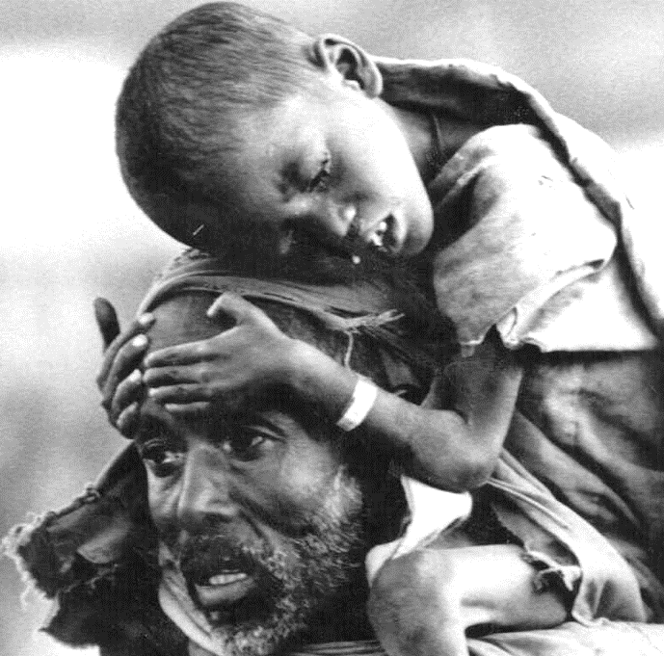
¹¹ “Behold, the days are coming,” declares the Lord God, “when I will send a famine on the land—not a famine of bread, nor a thirst for water, but of hearing the words of the Lord. ¹² They shall wander from sea to sea, and from north to east; they shall run to and fro, to seek the word of the Lord, but they shall not find it. ¹³ “In that day the lovely virgins and the young men shall faint for thirst.
Amos 8:11-13

Slide 19
¹¹ “Behold, the days are coming,” declares the Lord God, “when I will send a famine on the land—not a famine of bread, nor a thirst for water, but of hearing the words of the Lord. ¹² They shall wander from sea to sea, and from north to east; they shall run to and fro, to seek the word of the Lord, but they shall not find it. ¹³ “In that day the lovely virgins and the young men shall faint for thirst.
Amos 8:11-13

Slide 20
Begin to feed yourself on God’s Word
Get a copy of the Bible – NLT or ESV.
Start in Psalms or John.
Begin by praying for God to help you understand His Word.
Read 1 chapter.
End with a brief prayer of thanks.
Go deeper with God’s Word
Write your own book reports
Memorize God’s Word

Slide 22
HUNGRY (FALLING ON MY KNEES)
Kathryn Scott Vineyard

Slide 23
HUNGRY (FALLING ON MY KNEES)
Hungry I come to You for I know You satisfy I am empty, but I know Your love does not run dry
So I wait for You So I wait for You
I’m falling on my knees Offering all of me Jesus, You're all this heart is living for

Slide 24
HUNGRY (FALLING ON MY KNEES)
Broken I run to You for Your arms are open wide I am weary, but I know Your touch restores my life
So I wait for You So I wait for You
I’m falling on my knees Offering all of me Jesus, You're all this heart is living for

Slide 26
DISCUSS & SHARE
Questions |Comments |Testimonies

