Slide 2
Matthew 11:27-30 ^{(ESV)}
²⁷ All things have been handed over to me by my Father, and no one knows the Son except the Father, and no one knows the Father except the Son and anyone to whom the Son chooses to reveal him. ²⁸ Come to me, all who labor and are heavy laden, and I will give you rest. ²⁹ Take my yoke upon you, and learn from me, for I am gentle and lowly in heart, and you will find rest for your souls. ³⁰ For my yoke is easy, and my burden is light.”

Slide 3
``

Slide 4
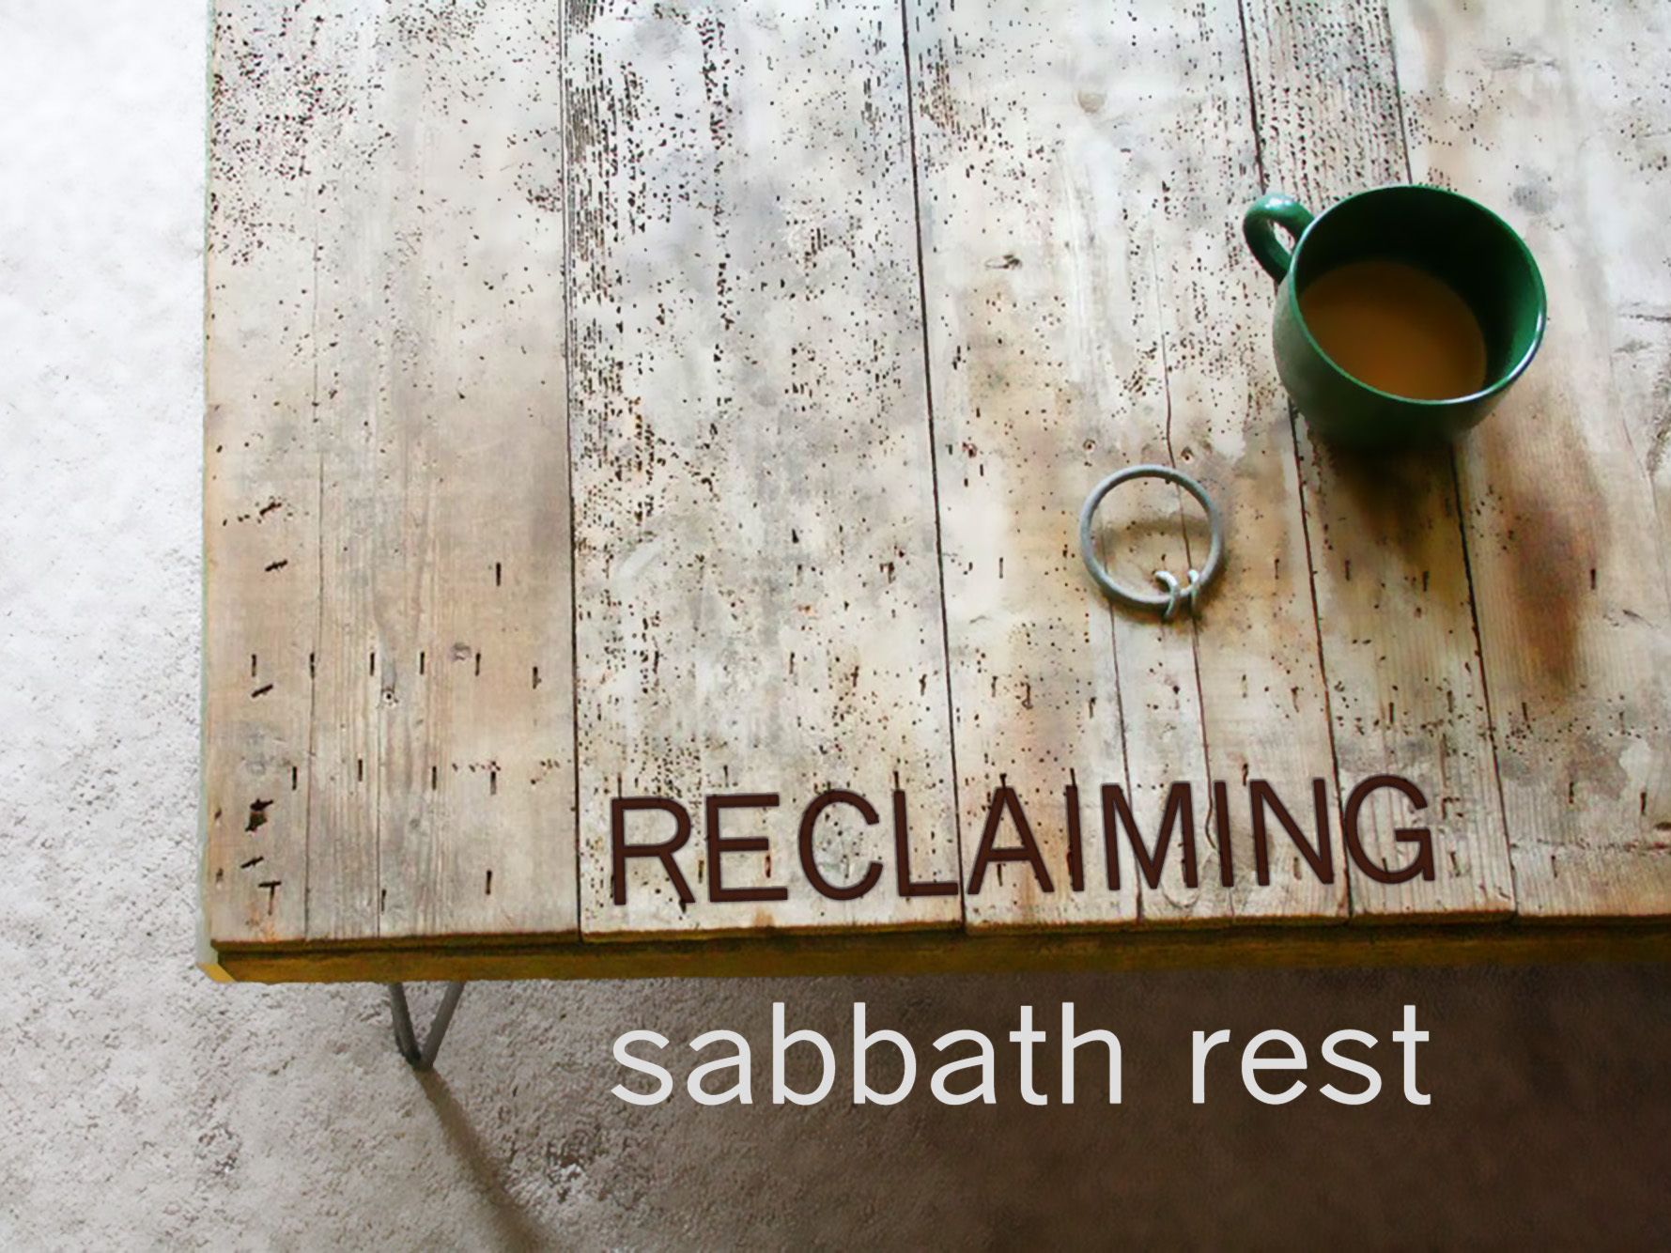

Slide 5
Modern Society
1. Insecure Jobs

Slide 6
Modern Society
1. Insecure Jobs
2. Income Gap

Slide 7
Modern Society
1. Insecure Jobs
2. Income Gap
3. Technology

Slide 8
Modern Society
1. Insecure Jobs
2. Income Gap
3. Technology
4. Identity from Work

Slide 9
Modern Society
1. Insecure Jobs
2. Income Gap
3. Technology
4. Identity from Work
We need rest!

Slide 10
Modern Society
1. Insecure Jobs
2. Income Gap
3. Technology
4. Identity from Work
We can’t rest!

Slide 11
Creation as a Foundation for Rest
Exodus 20:8, 11 ⁸ Remember the Sabbath day, to keep it holy. ¹¹ For in six days the Lord made heaven and earth, the sea, and all that is in them, and rested on the seventh day. Therefore the Lord blessed the Sabbath day and made it holy.

Slide 12
Creation as a Foundation for Rest
Exodus 20:8, 11 ⁸ Remember the Sabbath day, to keep it holy. ¹¹ For in six days the Lord made heaven and earth, the sea, and all that is in them, and rested on the seventh day. Therefore the Lord blessed the Sabbath day and made it holy.
To Sabbath is to reflect.

Slide 13
Creation as a Foundation for Rest
Exodus 20:8, 11 ⁸ Remember the Sabbath day, to keep it holy. ¹¹ For in six days the Lord made heaven and earth, the sea, and all that is in them, and rested on the seventh day. Therefore the Lord blessed the Sabbath day and made it holy.
To Sabbath is to reflect.
true rest = satisfaction in what’s been done

Slide 14
Salvation as a Foundation for Rest
Deuteronomy 5:12, 15 ¹² Observe the Sabbath day, to keep it holy, as the Lord your God commanded you. ¹⁵ You shall remember that you were a slave in the land of Egypt, and the Lord your God brought you out from there with a mighty hand and an outstretched arm. Therefore the Lord your God commanded you to keep the Sabbath day.

Slide 15
Salvation as a Foundation for Rest
Deuteronomy 5:12, 15 ¹² Observe the Sabbath day, to keep it holy, as the Lord your God commanded you. ¹⁵ You shall remember that you were a slave in the land of Egypt, and the Lord your God brought you out from there with a mighty hand and an outstretched arm. Therefore the Lord your God commanded you to keep the Sabbath day.
To Sabbath is to restore.

Slide 16
Jesus Reclaims Rest
Matthew 11:27a All things have been handed over to me by my Father…

Slide 17
Matthew 12:1-8 ^{(ESV)}
At that time Jesus went through the grainfields on the Sabbath. His disciples were hungry, and they began to pluck heads of grain and to eat. ² But when the Pharisees saw it, they said to him, “Look, your disciples are doing what is not lawful to do on the Sabbath.” ³ He said to them, “Have you not read what David did when he was hungry, and those who were with him: ⁴ how he entered the house of God and ate the bread of the Presence, which it was not lawful for him to eat nor for those who were with him, but only for the priests? ⁵ Or have you not read in the Law how on the Sabbath the priests in the temple profane the Sabbath and are guiltless? ⁶ I tell you, something greater than the temple is here. ⁷ And if you had known what this means, ‘I desire mercy, and not sacrifice,’ you would not have condemned the guiltless. ⁸ For the Son of Man is lord of the Sabbath.”

Slide 18
Matthew 12:1-8 ^{(ESV)}
At that time Jesus went through the grainfields on the Sabbath. His disciples were hungry, and they began to pluck heads of grain and to eat. ² But when the Pharisees saw it, they said to him, “Look, your disciples are doing what is not lawful to do on the Sabbath.” ³ He said to them, “Have you not read what David did when he was hungry, and those who were with him: ⁴ how he entered the house of God and ate the bread of the Presence, which it was not lawful for him to eat nor for those who were with him, but only for the priests? ⁵ Or have you not read in the Law how on the Sabbath the priests in the temple profane the Sabbath and are guiltless? ⁶ I tell you, something greater than the temple is here. ⁷ And if you had known what this means, ‘I desire mercy, and not sacrifice,’ you would not have condemned the guiltless. ⁸ For the Son of Man is lord of the Sabbath.”
Jesus is Lord of rest!

Slide 19
Matthew 12:9-14 ^{(ESV)}
⁹ He went on from there and entered their synagogue. ¹⁰ And a man was there with a withered hand. And they asked him, “Is it lawful to heal on the Sabbath?”—so that they might accuse him. ¹¹ He said to them, “Which one of you who has a sheep, if it falls into a pit on the Sabbath, will not take hold of it and lift it out? ¹² Of how much more value is a man than a sheep! So it is lawful to do good on the Sabbath.” ¹³ Then he said to the man, “Stretch out your hand.” And the man stretched it out, and it was restored, healthy like the other. ¹⁴ But the Pharisees went out and conspired against him, how to destroy him.

Slide 20
Matthew 12:9-14 ^{(ESV)}
⁹ He went on from there and entered their synagogue. ¹⁰ And a man was there with a withered hand. And they asked him, “Is it lawful to heal on the Sabbath?”—so that they might accuse him. ¹¹ He said to them, “Which one of you who has a sheep, if it falls into a pit on the Sabbath, will not take hold of it and lift it out? ¹² Of how much more value is a man than a sheep! So it is lawful to do good on the Sabbath.” ¹³ Then he said to the man, “Stretch out your hand.” And the man stretched it out, and it was restored, healthy like the other. ¹⁴ But the Pharisees went out and conspired against him, how to destroy him.
Jesus is Lord of rest!

Slide 21
Jesus Reclaims Rest
Isaiah 30:15 For thus said the Lord God, the Holy One of Israel, “In returning and rest you shall be saved; in quietness and in trust shall be your strength.” But you were unwilling…

Slide 22
Jesus Reclaims Rest
Isaiah 30:15 For thus said the Lord God, the Holy One of Israel, “In returning and rest you shall be saved; in quietness and in trust shall be your strength.” But you were unwilling…
Isaiah 57:21 ²¹ There is no peace,” says my God, “for the wicked.” (See also Isaiah 48:22)

Slide 23
Jesus Reclaims Rest
2 Corinthians 5:21 For our sake he made him to be sin who knew no sin, so that in him we might become the righteousness of God.

Slide 24
Jesus Reclaims Rest
2 Corinthians 5:21 For our sake he made him to be sin who knew no sin, so that in him we might become the righteousness of God.
true rest = satisfaction in what’s been done

Slide 25
Jesus is Lord of Rest
Matthew 11:28-30 ²⁸ Come to me, all who labor and are heavy laden, and I will give you rest. ²⁹ Take my yoke upon you, and learn from me, for I am gentle and lowly in heart, and you will find rest for your souls. ³⁰ For my yoke is easy, and my burden is light.

Slide 26
Jesus is Lord of Rest
Matthew 11:28-30 ²⁸ Come to me, all who labor and are heavy laden, and I will give you rest. ²⁹ Take my yoke upon you, and learn from me, for I am gentle and lowly in heart, and you will find rest for your souls. ³⁰ For my yoke is easy, and my burden is light.
Matt. 23:4-5; 1 John 5:3; Psalm 127:2; Zeph. 3:17

Slide 27
More Sabbath Rest

Slide 28
More Sabbath Rest
Balanced Sabbath Rest

Slide 29
More Sabbath Rest
Balanced Sabbath Rest
-Avocational Rest

Slide 30
More Sabbath Rest
Balanced Sabbath Rest
-Avocational Rest
-Contemplative Rest

Slide 31
More Sabbath Rest
Balanced Sabbath Rest
-Avocational Rest
-Contemplative Rest
-Inactive Rest

Slide 32
More Sabbath Rest
Balanced Sabbath Rest
Sporadic Sabbath Rest

Slide 33
More Sabbath Rest
Balanced Sabbath Rest
Sporadic Sabbath Rest
Smart Sabbath Rest

Slide 34
More Sabbath Rest
Balanced Sabbath Rest
Sporadic Sabbath Rest
Smart Sabbath Rest
Accountable Sabbath Rest

