Slide 3
Face with Tears of Joy

Slide 4
PHILIPPIANS 3:12-17 ^{ESV}
12 Not that I have already obtained this or am already perfect, but I press on to make it my own, because Christ Jesus has made me his own. 13 Brothers, I do not consider that I have made it my own. But one thing I do: forgetting what lies behind and straining forward to what lies ahead, 14 I press on toward the goal for the prize of the upward call of God in Christ Jesus. 15 Let those of us who are mature think this way, and if in anything you think otherwise, God will reveal that also to you. 16 Only let us hold true to what we have attained. 17 Brothers, join in imitating me, and keep your eyes on those who walk according to the example you have in us.

Slide 5
PHILIPPIANS 3:12-17 ^{ESV}
12 Not that I have already obtained this or am already perfect, but I press on to make it my own, because Christ Jesus has made me his own. 13 Brothers, I do not consider that I have made it my own. But one thing I do: forgetting what lies behind and straining forward to what lies ahead, 14 I press on toward the goal for the prize of the upward call of God in Christ Jesus. 15 Let those of us who are mature think this way, and if in anything you think otherwise, God will reveal that also to you. 16 Only let us hold true to what we have attained. 17 Brothers, join in imitating me, and keep your eyes on those who walk according to the example you have in us.
To press on toward the prize we have to process the past and plan for the future while persevering in the present.

Slide 6
PHILIPPIANS 3:3-6 ^{ESV}
3 For we are the circumcision, who worship by the Spirit of God and glory in Christ Jesus and put no confidence in the flesh— 4 though I myself have reason for confidence in the flesh also. If anyone else thinks he has reason for confidence in the flesh, I have more: 5 circumcised on the eighth day, of the people of Israel, of the tribe of Benjamin, a Hebrew of Hebrews; as to the law, a Pharisee; 6 as to zeal, a persecutor of the church; as to righteousness under the law, blameless.

Slide 7
PHILIPPIANS 3:7-11 ^{ESV}
7 But whatever gain I had, I counted as loss for the sake of Christ. 8 Indeed, I count everything as loss because of the surpassing worth of knowing Christ Jesus my Lord. For his sake I have suffered the loss of all things and count them as rubbish, in order that I may gain Christ 9 and be found in him, not having a righteousness of my own that comes from the law, but that which comes through faith in Christ, the righteousness from God that depends on faith— 10 that I may know him and the power of his resurrection, and may share his sufferings, becoming like him in his death, 11 that by any means possible I may attain the resurrection from the dead.

Slide 8
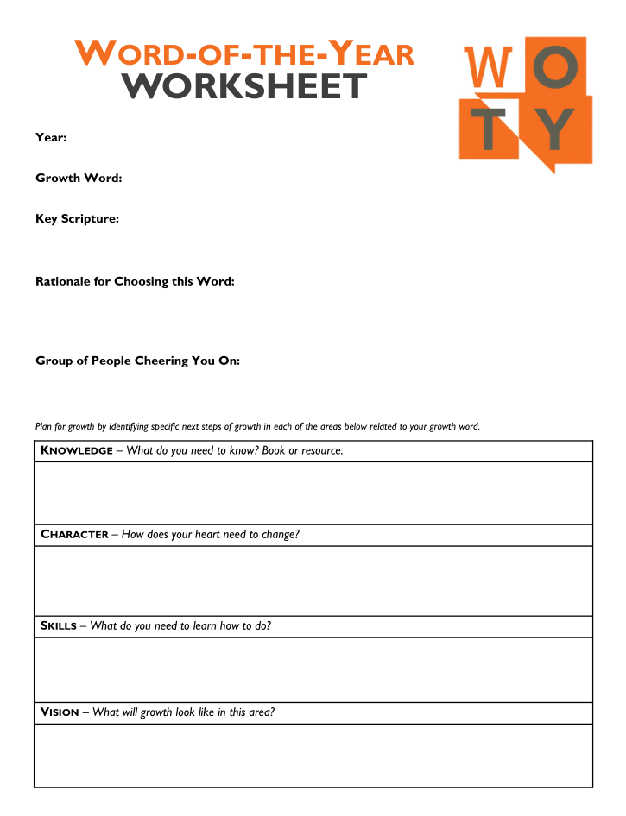

Slide 10
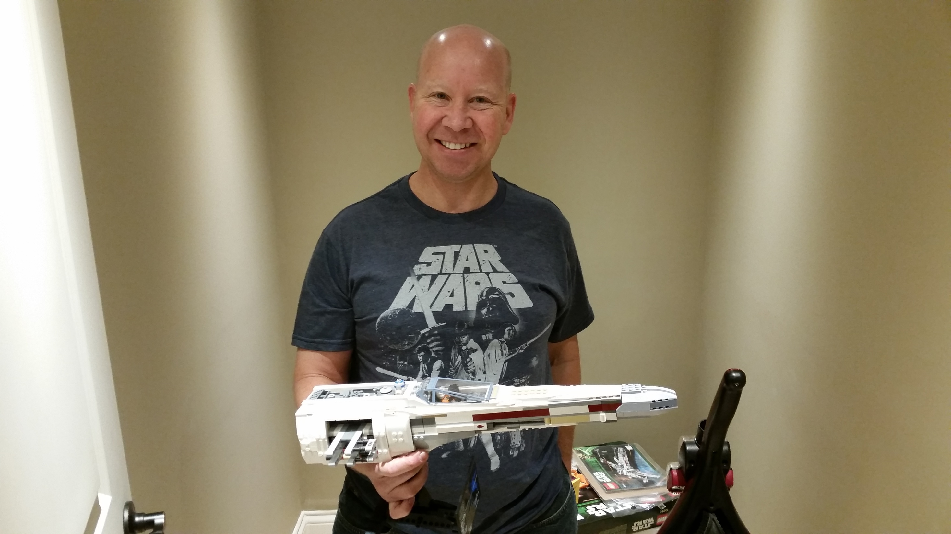

Slide 11
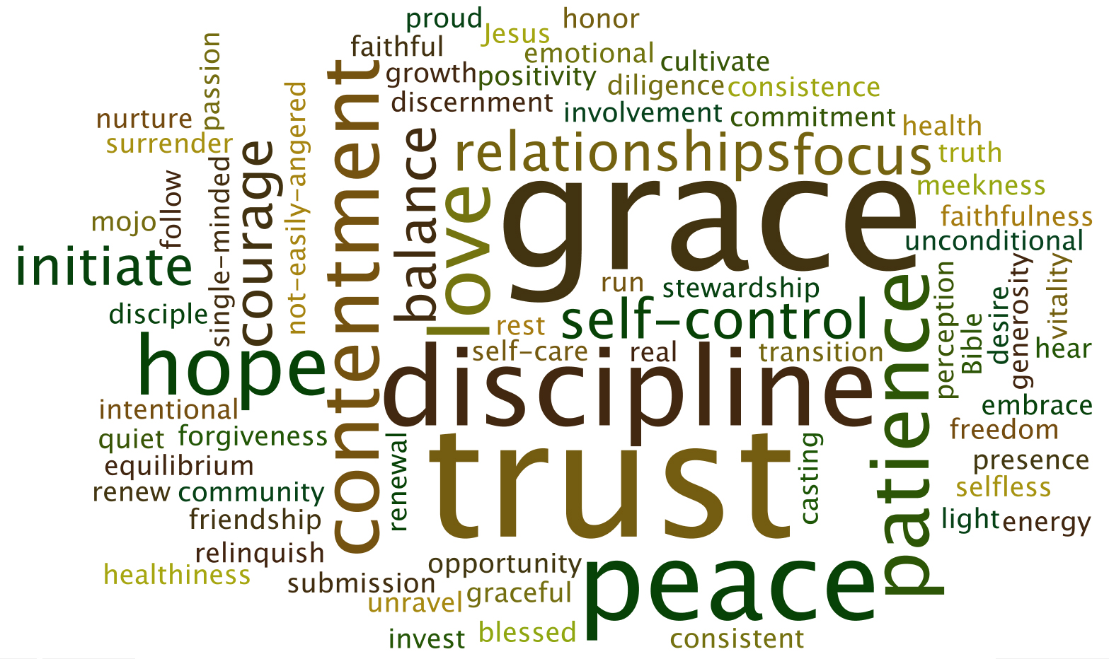

Slide 12
My WOTY Journey Thus Far
2011 = sensitivity

Slide 13
My WOTY Journey Thus Far
2011 = sensitivity
2012 = prayerfulness

Slide 14
My WOTY Journey Thus Far
2011 = sensitivity
2012 = prayerfulness

Slide 15
My WOTY Journey Thus Far
2011 = sensitivity
2012 = prayerfulness
2013 = joy

Slide 16
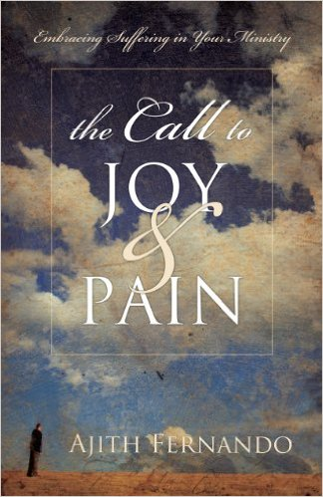
My WOTY Journey Thus Far
2011 = sensitivity
2012 = prayerfulness
2013 = joy

Slide 17
My WOTY Journey Thus Far
2011 = sensitivity
2012 = prayerfulness
2013 = joy
2014 = cultivate

Slide 18
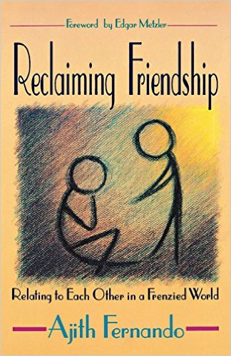
My WOTY Journey Thus Far
2011 = sensitivity
2012 = prayerfulness
2013 = joy
2014 = cultivate

Slide 19
My WOTY Journey Thus Far
2011 = sensitivity
2012 = prayerfulness
2013 = joy
2014 = cultivate
2015 = self-control

Slide 20
My WOTY Journey Thus Far
2011 = sensitivity
2012 = prayerfulness
2013 = joy
2014 = cultivate
2015 = self-control
²² But the fruit
of the Spirit is
love, joy, peace, patience, kindness, goodness, faithfulness,
²³ gentleness,
self-control;
against such things there is no law.
Galatians 5:22-23

Slide 21
My WOTY Journey Thus Far
2011 = sensitivity
2012 = prayerfulness
2013 = joy
2014 = cultivate
2015 = self-control
2016 = ???

Slide 22
My WOTY Journey Thus Far
2011 = sensitivity
2012 = prayerfulness
2013 = joy
2014 = cultivate
2015 = self-control
2016 = σπλάγχνον???

