Slide 1
WELCOME

Slide 2
Born is the King

Slide 3
Born is the King
Do-doot do-doot doot do do
Do-doot do-doot doot do do
Do-doot do-doot doot do do
Do-doot do-doot doot do do do
(repeat)

Slide 4
Born is the King
Born unto us this day a Savior
Gifted from heaven to a manger
The hope of the world
a light for all mankind
All of the earth rejoice
It’s Christmas time!

Slide 5
Born is the King
So lift up your voice and sing out His praise It’s Christmas
Born is the King rejoice in the day
It’s Christmas
Make a joyful sound, It’s Christmas
Let His praise resound, It’s Christmas

Slide 6
Born is the King
Good will to all the earth
And peace divine
All of the earth rejoice
It’s Christmas time
It’s Christmas time

Slide 7
Born is the King
So lift up your voice and sing out His praise It’s Christmas
Born is the King rejoice in the day
It’s Christmas
Make a joyful sound, It’s Christmas
Let His praise resound, It’s Christmas
(repeat)

Slide 8
Born is the King
Do-doot do-doot doot do do
Do-doot do-doot doot do do
Do-doot do-doot doot do do
Do-doot do-doot doot do do do
(repeat)

Slide 9
Born is the King
So lift up your voice and sing out His praise It’s Christmas
Born is the King rejoice in the day
It’s Christmas
Make a joyful sound, It’s Christmas
Let His praise resound, It’s Christmas

Slide 10
Born is the King
Do-doot do-doot doot do do
Do-doot do-doot doot do do
Do-doot do-doot doot do do
Do-doot do-doot doot do do do
(repeat)

Slide 11
MINGLE QUESTION
What’s something you look forward to during the Christmas season?

Slide 12
Thursday, December 5, 7-9pm
Here in the Fellowship Hall
Drinks. Treats. Crafts. Hanging Out. Bring an item to donate to MESI

Slide 13
Proposed 2020 Budget

Slide 14
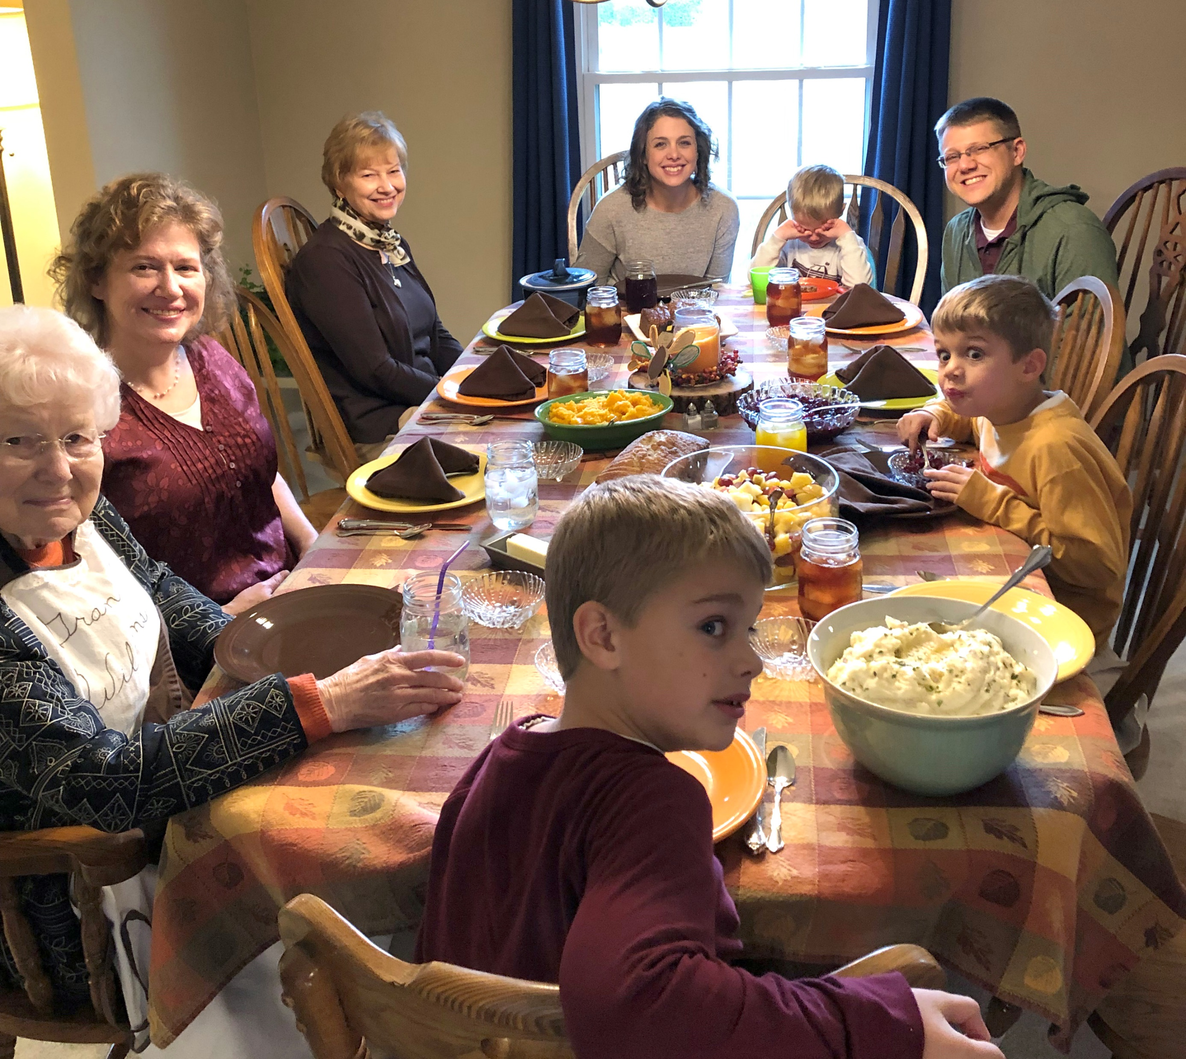

Slide 18
BAD NEWS ^{OF} GREAT SORROW

Slide 19
^{1b}[The Serpent] said to the woman, “Did God actually say….?” … ⁶ So when the woman saw that the tree was good for food, and that it was a delight to the eyes, and that the tree was to be desired to make one wise, she took of its fruit and ate, and she also gave some to her husband who was with her, and he ate. ⁷ Then the eyes of both were opened, and they knew that they were naked. And they sewed fig leaves together and made themselves loincloths. ⁸ And they heard the sound of the Lord God walking in the garden in the cool of the day, and the man and his wife hid themselves from the presence of the Lord God among the trees of the garden.
GENESIS 3: BAD NEWS ^{OF} GREAT SORROW

Slide 20
¹⁴ The Lord God said to the serpent…
“¹⁵ I will put enmity between you and the woman, and between your offspring [SEED] and her offspring [SEED]; he shall bruise your head, and you shall bruise his heel.”
GENESIS 3: BAD NEWS + GOOD NEWS

Slide 21
³ When Adam had lived … 930 years, and he died.
⁶ When Seth had lived … 912 years, and he died.
⁹ When Enosh had lived … 905 years, and he died.
¹² When Kenan had lived … 910 years, and he died.
¹⁵ When Mahalalel had lived … 895 years, and he died.
¹⁸ When Jared had lived … 962 years, and he died.
^{… 25} When Methuselah had lived … 969 years, and he died.
²⁸ When Lamech had lived … 777 years, and he died.
GENESIS 5: BAD NEWS ^{OF} GREAT SORROW

Slide 22
³ When Adam had lived … 930 years, and he died.
⁶ When Seth had lived … 912 years, and he died.
⁹ When Enosh had lived … 905 years, and he died.
¹² When Kenan had lived … 910 years, and he died.
¹⁵ When Mahalalel had lived … 895 years, and he died.
¹⁸ When Jared had lived … 962 years, and he died.
^{… 25} When Methuselah had lived … 969 years, and he died.
²⁸ When Lamech had lived … 777 years, and he died.
Therefore, just as sin entered the world through one man, and death through sin, so also death was passed on to all men, because all sinned. … Death reigned from the time of Adam… Romans 5:12,14
GENESIS 5: BAD NEWS ^{OF} GREAT SORROW

Slide 23
SARAH - barren & old (Genesis 17)
REBEKAH – barren (Genesis 25:21)
RACHEL – barren (Genesis 29)
LEAH – unwanted (Genesis 29)
TAMAR – widowed and rejected (Genesis 38)
RAHAB – foreigner, prostitute (Joshua 2,6)
RUTH – foreigner, widowed, childless (Ruth 1)
BATHSHEBA – widow, dead child (2 Samuel 11)
SAMSON’S MOTHER – barren (Judges 13)
HANNAH, SAMUEL’S MOTHER – barren (1 Samuel 1)
ISRAEL – called a barren woman (Isaiah 54)
EVE – mother of life/death (Genesis 3)
THE SEED: THROUGH BARREN WOMEN

Slide 24
SARAH - barren & old (Genesis 17)
REBEKAH – barren (Genesis 25:21)
RACHEL – barren (Genesis 29)
LEAH – unwanted (Genesis 29)
TAMAR – widowed and rejected (Genesis 38)
RAHAB – foreigner, prostitute (Joshua 2,6)
RUTH – foreigner, widowed, childless (Ruth 1)
BATHSHEBA – widow, dead child (2 Samuel 11)
SAMSON’S MOTHER – barren (Judges 13)
HANNAH, SAMUEL’S MOTHER – barren (1 Samuel 1)
ISRAEL – called a barren woman (Isaiah 54)
EVE – mother of life/death (Genesis 3)
ELIZABETH – barren & old (Luke 1)
THE SEED: THROUGH BARREN WOMEN

Slide 25
²⁶ In the sixth month the angel Gabriel was sent from God to a city of Galilee named Nazareth, ²⁷ to a virgin betrothed to a man whose name was Joseph, of the house of David. And the virgin's name was Mary. ²⁸ And he came to her and said, “Greetings, O favored one, the Lord is with you!” ²⁹ But she was greatly troubled at the saying, and tried to discern what sort of greeting this might be. ³⁰ And the angel said to her, “Do not be afraid, Mary, for you have found favor with God. ³¹ And behold, you will conceive in your womb and bear a son, and you shall call his name Jesus. ³² He will be great and will be
LUKE 1: MARY

Slide 26
called the Son of the Most High. And the Lord God will give to him the throne of his father David, ³³and he will reign over the house of Jacob forever, and of his kingdom there will be no end.”
LUKE 1: MARY

Slide 27
called the Son of the Most High. And the Lord God will give to him the throne of his father David, ³³and he will reign over the house of Jacob forever, and of his kingdom there will be no end.”
³⁴ And Mary said to the angel, “How will this be, since I am a virgin?”
³⁵ And the angel answered her, “The Holy Spirit will come upon you, and the power of the Most High will overshadow you; therefore the child to be born will be called holy—the Son of God. ³⁶ And behold, your relative
LUKE 1: MARY

Slide 28
Elizabeth in her old age has also conceived a son, and this is the sixth month with her who was called barren. ³⁷ For nothing will be impossible with God.”
LUKE 1: MARY

Slide 29
Elizabeth in her old age has also conceived a son, and this is the sixth month with her who was called barren. ³⁷ For nothing will be impossible with God.”
Isaiah 7:14 Therefore the Lord himself will give you a sign. Behold, the virgin shall conceive and bear a son, and shall call his name Immanuel. Galatians 3:16 Now the promises were made to Abraham and to his offspring [seed]. It does not say, “And to offsprings [seeds],” referring to many, but referring to one, “And to your offspring [seed],” who is Christ.
LUKE 1: MARY

Slide 30
Elizabeth in her old age has also conceived a son, and this is the sixth month with her who was called barren. ³⁷ For nothing will be impossible with God.”
LUKE 1: MARY

Slide 31
Elizabeth in her old age has also conceived a son, and this is the sixth month with her who was called barren. ³⁷ For nothing will be impossible with God.”
³⁸ And Mary said, “Behold, I am the servant of the Lord; let it be to me according to your word.”
LUKE 1: MARY

Slide 32
Elizabeth in her old age has also conceived a son, and this is the sixth month with her who was called barren. ³⁷ For nothing will be impossible with God.”
³⁸ And Mary said, “Behold, I am the servant of the Lord; let it be to me according to your word.”
John 12:24 Very truly I tell you, unless a kernel of wheat falls to the ground and dies, it remains only a single seed. But if it dies, it produces many seeds.
Romans 14:9 For this reason Christ died and returned to life, so that He might be the Lord of both the dead and the living.
LUKE 1: MARY

Slide 33
Revelation 22 ¹Then the angel showed me … ^{4b}the Lord God will be their light, and they will reign forever and ever. ⁷ “And behold, I am coming soon. … ¹² “Behold, I am coming soon… ¹⁶ “I, Jesus, have sent my angel to testify to you about these things for the churches. I am the root and the descendant of David, the bright morning star.” ¹⁷ The Spirit and the Bride say, “Come.” And let the one who hears say, “Come.” And let the one who is thirsty come; let the one who desires take the water of life without price…. ²⁰ He who testifies to these things says, “Surely I am coming soon.” AMEN. COME, LORD JESUS!
REVELATION 22: THE GOSPEL OF CHRISTMAS

Slide 34
O Come, All Ye Faithful

Slide 35
O Come, All Ye Faithful
O come, all ye faithful
Joyful and triumphant
O come ye, O come ye
To Bethlehem
Come and behold Him
Born the King of angels

Slide 36
O Come, All Ye Faithful
O come, let us adore Him
O come, let us adore Him
O come, let us adore Him
Christ the Lord

Slide 37
O Come, All Ye Faithful
Sing choirs of angels
Sing in exultation
Sing all ye citizens of heaven above
Glory to God
All glory in the highest

Slide 38
O Come, All Ye Faithful
O come, let us adore Him
O come, let us adore Him
O come, let us adore Him
Christ the Lord

Slide 39
O Come, All Ye Faithful
Yea, Lord we greet Thee
Born that happy morning
Jesus, to Thee be all glory giv’n
Word of the Father
Now in flesh appearing

Slide 40
O Come, All Ye Faithful
O come, let us adore Him
O come, let us adore Him
O come, let us adore Him
Christ the Lord

Slide 41
Way Maker

Slide 42
Way Maker
You are here moving in our midst
I worship You, I worship You
You are here working in this place
I worship You, I worship You
(repeat)

Slide 43
Way Maker
Way Maker, Miracle Worker
Promise Keeper, Light in the Darkness
My God, That is who You are
(repeat)

Slide 44
Way Maker
You are here touching every heart
I worship You, I worship You
You are here healing every heart
I worship You, I worship You

Slide 45
Way Maker
You are here turning lives around
I worship You, I worship You
You are here mending every heart
I worship You, I worship You

Slide 46
Way Maker
Way Maker, Miracle Worker
Promise Keeper, Light in the Darkness
My God, That is who You are
(repeat)

Slide 47
Way Maker
That is who You are, That is who You are
That is who You are, That is who You are
(repeat)

Slide 48
Way Maker
Even when I can’t see it You’re working
Even when I can’t feel it You’re working
You never stop, You never stop working
You never stop, You never stop working
(repeat)

Slide 49
Way Maker
Way Maker, Miracle Worker
Promise Keeper, Light in the Darkness
My God, That is who You are
(repeat)

Slide 50
O Come, All Ye Faithful
O come, let us adore Him
O come, let us adore Him
O come, let us adore Him
Christ the Lord

Slide 51
O Come, All Ye Faithful
For You Alone are worthy
For You Alone are worthy
For You Alone are worthy
Christ the Lord

Slide 52
Joy to the World

Slide 53
Joy to the World
Joy to the world, the Lord is come Let earth receive her King Let every heart prepare Him room And Heaven and nature sing And Heaven and nature sing And Heaven, and Heaven, and nature sing

Slide 54
Joy to the World
We will sing, sing, sing
Joy to the world
We will sing, sing, sing

Slide 55
Joy to the World
Joy to the World, the Savior reigns!
Let men their songs employ
While fields and floods, rocks, hills & plains
Repeat the sounding joy
Repeat the sounding joy
Repeat, repeat, the sounding joy

Slide 56
Joy to the World
We will sing, sing, sing
Joy to the world
We will sing, sing, sing

Slide 57
Joy to the World
No more let sins and sorrows grow
Nor thorns infest the ground
He comes to make His blessings flow
Far as the curse is found
Far as the curse is found
Far as, far as, the curse is found

Slide 58
Joy to the World
We will sing, sing, sing
Joy to the world
We will sing, sing, sing

Slide 59
Joy to the World
Joyful, joyful we adore Thee
God of glory, Lord of love
Hearts unfold like flowers before Thee
Opening to the sun above
(repeat)

Slide 60
Joy to the World
We will sing, sing, sing
Joy to the world
We will sing, sing, sing

Slide 61
Joy to the World
He rules the world with truth and grace
And makes the nations prove
The glories of His righteousness
And wonders of His love And wonders of His love
And wonders, wonders, of His love

Slide 62
Joy to the World
We will sing, sing, sing
Joy to the world
We will sing, sing, sing

