Slide 1
WELCOME

Slide 3
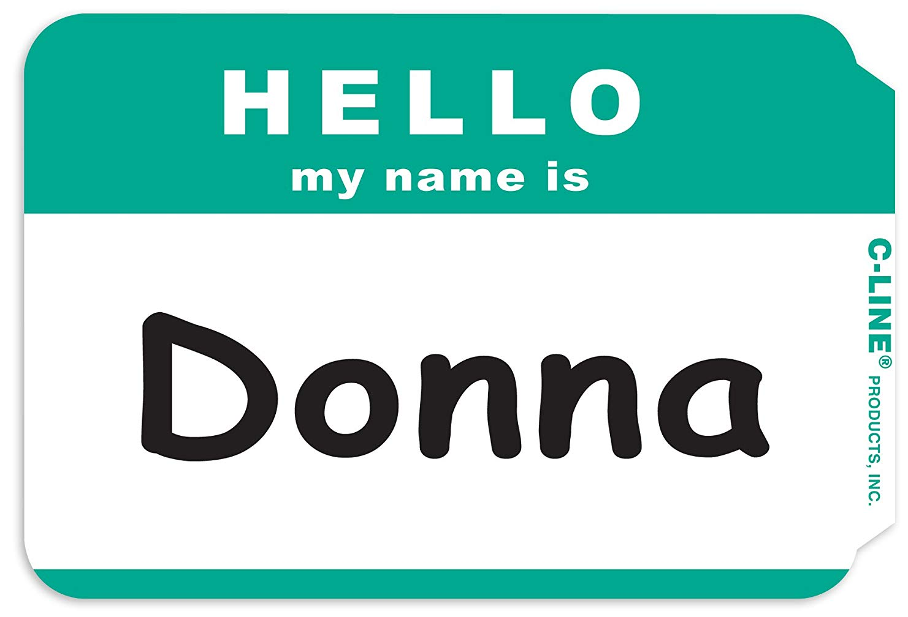
NAMETAG NOVEMBER
Hannah Hertzig
Slap on a nametag from the table at the entrance. Let’s get to know one another’s names!
+ your fav. Thanksgiving food

Slide 4
CHRISTMAS SERIES starts next Sunday!

Slide 5
TALLGRASS.CHURCH
HD Videos (much higher quality than Facebook Live!)
Audio
PowerPoints
Teaching Notes
Podcasts
Events
News
Online Giving
MOBILE FRIENDLY!

Slide 6
PODCASTS ARE LIVE!
TALLGRASS IS NOW ON PODCASTS!
Search for “Tallgrass Church” on Apple Podcasts or Google Play and subscribe today to both:
TALLGRASS CHURCH TEACHINGS
THE CHOPPING BLOCK

Slide 7
MINGLE QUESTION
What are you doing for Thanksgiving?

Slide 8
Monday w/ Deaver LIFE Group
Tuesday w/ Renberg LIFE Group
Thursday w/ Bill Bickmeier & friends

Slide 9
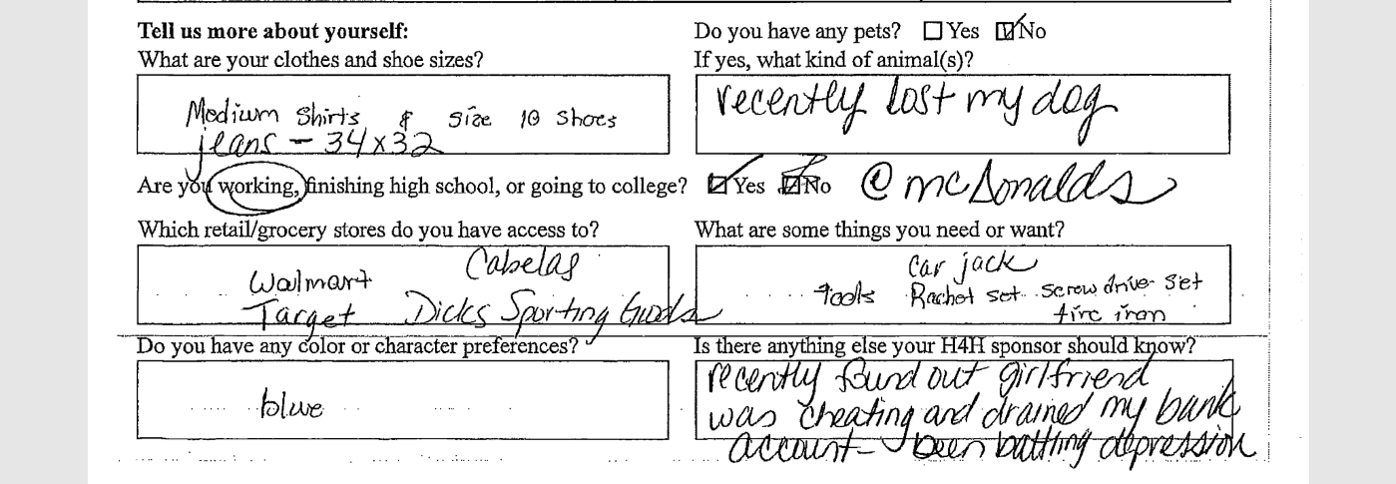

Slide 10
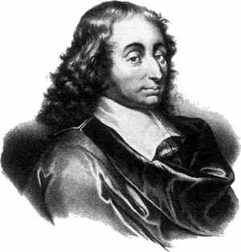
“All men seek happiness. This is without exception. Whatever different means they employ, they all tend to this end. The cause of some going to war, and of others avoiding it, is the same desire in both, attended with different views. The will never takes the least step but to this object. This is the motive of every action of every man, even of those who hang themselves.”
Blaise Pascal (1623-1662)

Slide 13
⁴ Rejoice in the Lord always;
again I will say, rejoice.
⁵ Let your reasonableness be known to everyone.
The Lord is at hand; ⁶ do not be anxious about anything,
but in everything by prayer and supplication
with thanksgiving
let your requests be made known to God.
Philippians 4:4-6

Slide 14
⁴ Be happy in the Lord always;
again I will say, be happy.
⁵ Let your reasonableness be known to everyone.
The Lord is at hand; ⁶ don’t worry about anything,
but in everything by prayer and supplication
with thanksgiving
let your requests be made known to God.
Philippians 4:4-6

Slide 15
⁴ Be happy in the Lord always;
again I will say, be happy.
⁵ Let your reasonableness be known to everyone.
The Lord is at hand; ⁶ don’t worry about anything,
but in everything by prayer and supplication
with thanksgiving
let your requests be made known to God.
Philippians 4:4-6

Slide 16
⁴ Be happy in the Lord always;
again I will say, be happy.
⁵ Let your reasonableness be known to everyone.
The Lord is at hand; ⁶ don’t worry about anything,
but in everything by prayer and supplication
with thanksgiving
let your requests be made known to God.
Philippians 4:4-6

Slide 17
Gratitude Visit
Martin Seligman, “Positive Psychology Progress: Empirical Validation of Interventions”

Slide 18
Gratitude Visit
10% immediate increase in happiness
Martin Seligman, “Positive Psychology Progress: Empirical Validation of Interventions”

Slide 19
Gratitude Visit
10% immediate increase in happiness
Results were cut in half within one week
Martin Seligman, “Positive Psychology Progress: Empirical Validation of Interventions”

Slide 20
Gratitude Visit
10% immediate increase in happiness
Results were cut in half within one week
Results were totally gone within six months
Martin Seligman, “Positive Psychology Progress: Empirical Validation of Interventions”

Slide 21
Gratitude Visit
10% immediate increase in happiness
Results were cut in half within one week
Results were totally gone within six months
“3 Good Things” Exercise
Martin Seligman, “Positive Psychology Progress: Empirical Validation of Interventions”

Slide 22
Gratitude Visit
10% immediate increase in happiness
Results were cut in half within one week
Results were totally gone within six months
“3 Good Things” Exercise
2% increase in happiness after one week
Martin Seligman, “Positive Psychology Progress: Empirical Validation of Interventions”

Slide 23
Gratitude Visit
10% immediate increase in happiness
Results were cut in half within one week
Results were totally gone within six months
“3 Good Things” Exercise
2% increase in happiness after one week
5% increase in happiness after one month
Martin Seligman, “Positive Psychology Progress: Empirical Validation of Interventions”

Slide 24
Gratitude Visit
10% immediate increase in happiness
Results were cut in half within one week
Results were totally gone within six months
“3 Good Things” Exercise
2% increase in happiness after one week
5% increase in happiness after one month
9% increase in happiness after six months
Martin Seligman, “Positive Psychology Progress: Empirical Validation of Interventions”

Slide 25
And the peace of God,
which surpasses all understanding,
will guard your hearts and your minds in Christ Jesus.
Philippians 4:7

Slide 26
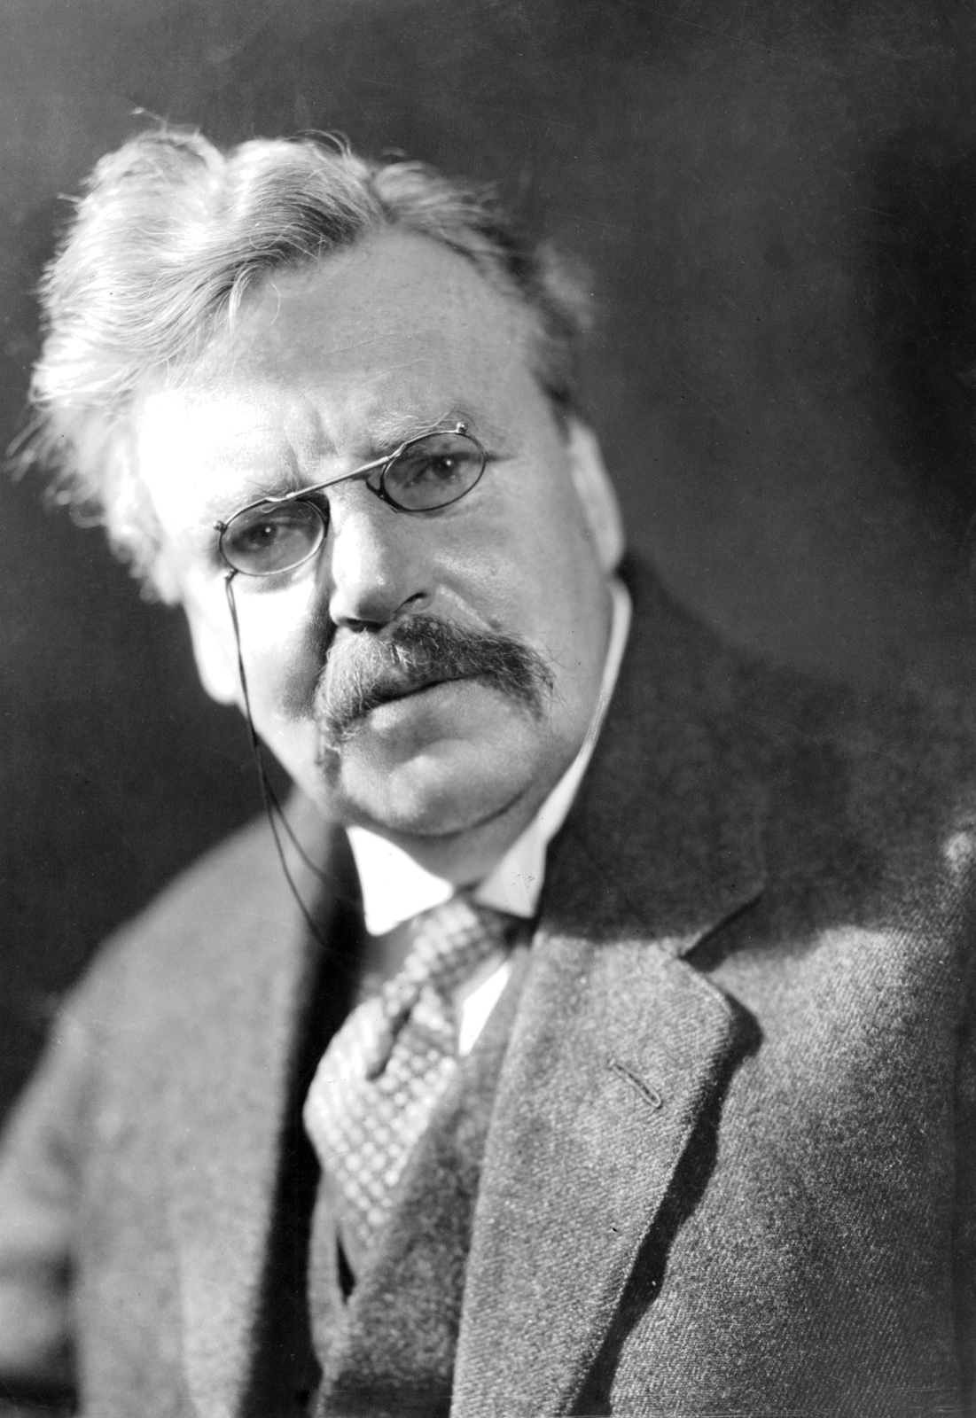
“The worst moment for an atheist is when he is really thankful and has no one to thank.”
G.K. Chesterton (1874-1936)

Slide 27
Choose Thanksgiving

Slide 28
Choose Thanksgiving
Would others say you’re becoming a more grateful person or a more grumbling person?

Slide 29
Choose Thanksgiving
Would others say you’re becoming a more grateful person or a more grumbling person?
What’s a current difficult circumstance that you can choose to give thanks in?

Slide 30
Choose Thanksgiving
Would others say you’re becoming a more grateful person or a more grumbling person?
What’s a current difficult circumstance that you can choose to give thanks in?
How can you choose thanksgiving this Thanksgiving?

Slide 31
Choose Thanksgiving
Gratitude Chain

Slide 32
Choose Thanksgiving
Gratitude Chain
Thank You Note

Slide 33
Choose Thanksgiving
Gratitude Chain
Thank You Note
“3 Good Things” Exercise

Slide 34
Choose Thanksgiving
Gratitude Chain
Thank You Note
“3 Good Things” Exercise
Scripture Memory

Slide 35
Choose Thanksgiving
Gratitude Chain
Thank You Note
“3 Good Things” Exercise
Scripture Memory
Philippians 4:4-7
1 Thessalonians 5:16-18

Slide 36
Choose Thanksgiving
Gratitude Chain
Thank You Note
“3 Good Things” Exercise
Scripture Memory
Thanksgiving Week Reading Plan

Slide 37
Choose Thanksgiving
Gratitude Chain
Thank You Note
“3 Good Things” Exercise
Scripture Memory
Thanksgiving Week Reading Plan
Day | S | M | T | W | Th | F | S
Psalm | 100 | 111 | 118 | 136 | 138 | 92 | 107

Slide 38
Choose Thanksgiving
Gratitude Chain
Thank You Note
“3 Good Things” Exercise
Scripture Memory
Thanksgiving Week Reading Plan
Meditation & Prayer

Slide 39
Choose Thanksgiving
Gratitude Chain
Thank You Note
“3 Good Things” Exercise
Scripture Memory
Thanksgiving Week Reading Plan
Meditation & Prayer
Bonus: Stones of Remembrance

Slide 40
Q&R&Testimonies

Slide 41
COME THOU FOUNT

Slide 42
Come thou fount of every blessing
Tune my heart to sing thy grace
Streams of mercy, never ceasing
call for songs of loudest praise
Teach me some melodious sonnet
sung by flaming tongues above
Praise the mount, I’m fixed upon it
Mount of Thy redeeming love
COME THOU FOUNT

Slide 43
Here I raise my Ebenezer
Hither by Thy help I’m come
And I hope by Thy good pleasure
safely to arrive at home
Jesus sought me when a stranger
wandering from the fold of God
He, to rescue me from danger
interposed His precious love
COME THOU FOUNT

Slide 44
O to grace how great a debtor
daily I’m constrained to be
Let Thy goodness like a fetter
bind my wandering heart to Thee
Prone to wander, Lord I feel it
Prone to leave the God I love
Here’s my heart, O take and seal it
Seal it for Thy courts above
COME THOU FOUNT

Slide 45
The Lord’s Supper

Slide 46
SO WILL I

Slide 47
God of creation
There at the start
Before the beginning of time
With no point of reference
You spoke to the dark
And fleshed out the wonder of light
SO WILL I

Slide 48
And as You speak
A hundred billion galaxies are born
In the vapor of Your breath the planets form
If the stars were made to worship so will I
SO WILL I

Slide 49
I can see Your heart in everything You’ve made
Every burning star
a signal fire of grace
If creation sings Your praises so will I
SO WILL I

Slide 50
God of Your promise
You don’t speak in vain
No syllable empty or void
For once You have spoken
All nature and science
Follow the sound of Your voice
SO WILL I

Slide 51
And as You speak
A hundred billion creatures catch Your breath
Evolving in pursuit of what You said
If it all reveals Your nature so will I
SO WILL I

Slide 52
I can see Your heart in everything You say
Every painted sky
a canvas of Your grace
If creation still obeys You so will I
SO WILL I

Slide 53
If the stars were made to worship so will I
If the mountains bow in reverence so will I
If the oceans roar Your greatness so will I
For if everything exists to lift You high so will I
SO WILL I

Slide 54
If the wind goes where You send it so will I
If the rocks cry out in silence so will I
If the sum of all our praises still falls shy
Then we’ll sing again a hundred billion times
SO WILL I

Slide 55
God of salvation
You chased down my heart
Through all of my failure and pride
On a hill You created
The light of the world
Abandoned in darkness to die
SO WILL I

Slide 56
And as You speak
A hundred billion failures disappear
Where You lost Your life so I could find it here
If You left the grave behind You so will I
SO WILL I

Slide 57
I can see Your heart in everything You’ve done
Every part designed in a work of art called love
If You gladly chose surrender so will I
SO WILL I

Slide 58
I can see Your heart
Eight billion different ways
Every precious one
A child You died to save
If You gave Your life to love them so will I
SO WILL I

Slide 59
Like You would again a hundred billion times
But what measure could amount to Your desire
You’re the One who never leaves the one behind
SO WILL I

Slide 60
RAISE A HALLELUJAH

Slide 61
I raise a hallelujah, in the presence of my enemies
I raise a hallelujah, louder than the unbelief
I raise a hallelujah, my weapon is a melody
I raise a hallelujah, heaven comes to fight for me
RAISE A HALLELUJAH

Slide 62
I'm gonna sing, in the middle of the storm
Louder and louder, you're gonna hear my praises roar
Up from the ashes, hope will arise
Death is defeated, the King is alive!
RAISE A HALLELUJAH

Slide 63
I raise a hallelujah, with everything inside of me
I raise a hallelujah, I will watch the darkness flee
I raise a hallelujah, in the middle of the mystery
I raise a hallelujah, fear you lost your hold on me!
RAISE A HALLELUJAH

Slide 64
I'm gonna sing, in the middle of the storm
Louder and louder, you're gonna hear my praises roar
Up from the ashes, hope will arise
Death is defeated, the King is alive!
RAISE A HALLELUJAH

Slide 65
Sing a little louder (In the presence of my enemies)
Sing a little louder (Louder than the unbelief)
Sing a little louder (My weapon is a melody)
Sing a little louder (Heaven comes to fight for me)
RAISE A HALLELUJAH

Slide 66
Sing a little louder (In the presence of my enemies)
Sing a little louder (Louder than the unbelief)
Sing a little louder (My weapon is a melody)
Sing a little louder!
RAISE A HALLELUJAH

Slide 67
I'm gonna sing, in the middle of the storm
Louder and louder, you're gonna hear my praises roar
Up from the ashes, hope will arise
Death is defeated, the King is alive!
RAISE A HALLELUJAH

Slide 68
BENEDICTION

Slide 69
Father, give Your benediction
Give us Your peace before we part
Still our minds with truth’s conviction Calm with trust each anxious heart
BENEDICTION

Slide 70
Father, give Your benediction
Bid our grief and struggles end Peace which passes understanding On our waiting spirit send
BENEDICTION

Slide 71
Amen. Amen.
Amen. Amen.
Amen. Amen.
BENEDICTION
Amen: let it be so

