Slide 1
WELCOME

Slide 2
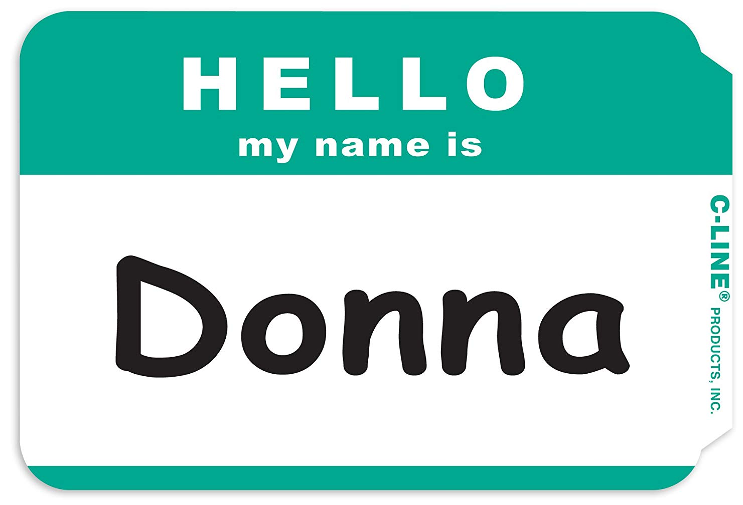
NAMETAG NOVEMBER
Hannah Hertzig
Slap on a nametag from the table at the entrance. Let’s get to know one another’s names!

Slide 3
4 KEYS TO RETIREMENT
TODAY, NOV 17TH 6-7pm in the Parlor Rm. Free workshop brought to us by Thrivent Financial, a not-for-profit financial services organization that several Tallgrass families use for their financial planning. If you haven’t RSVP’ed still come! Food and childcare will just be on your own.
4 KEYS TO RETIREMENT

Slide 4
PRAYER W/ 1st FREE
This Saturday
930-1030am
Join Lewis Smith (pastor of First Free Methodist) and Ben and Dave as we pray together for our churches and community. We'll meet at First Free Methodist just south of Poyntz across from City Park.
You won't regret spending some of your Saturday morning in prayer with other brothers and sisters!

Slide 5
MINGLE QUESTION
Are you a hugger?

Slide 7
Luke 5:12a While he was in one of the cities, there came a man full of leprosy.

Slide 8
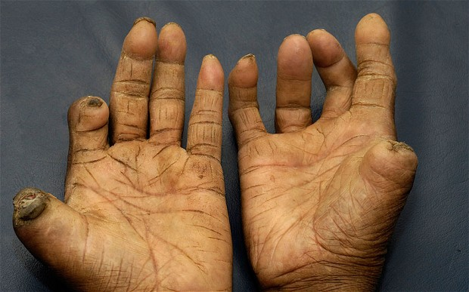
Luke 5:12a While he was in one of the cities, there came a man full of leprosy.

Slide 9
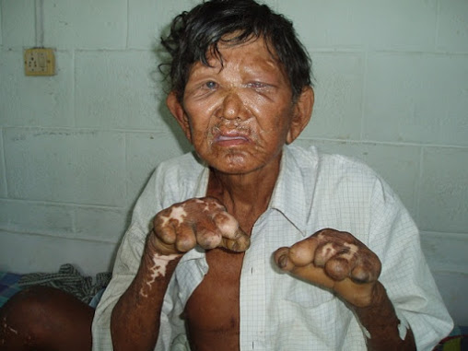
Luke 5:12a While he was in one of the cities, there came a man full of leprosy.

Slide 10
Luke 5:12b And when he saw Jesus, he fell on his face and begged him, “Lord, if you will, you can make me clean.”

Slide 11
And Jesus stretched out his hand…
Luke 5:13a

Slide 12
…and touched him…
Luke 5:13b

Slide 13
That which was from the beginning, which we have heard, which we have seen with our eyes, which we looked upon and have touched with our hands…
1 John 1:1
…and touched him…
Luke 5:13b

Slide 14
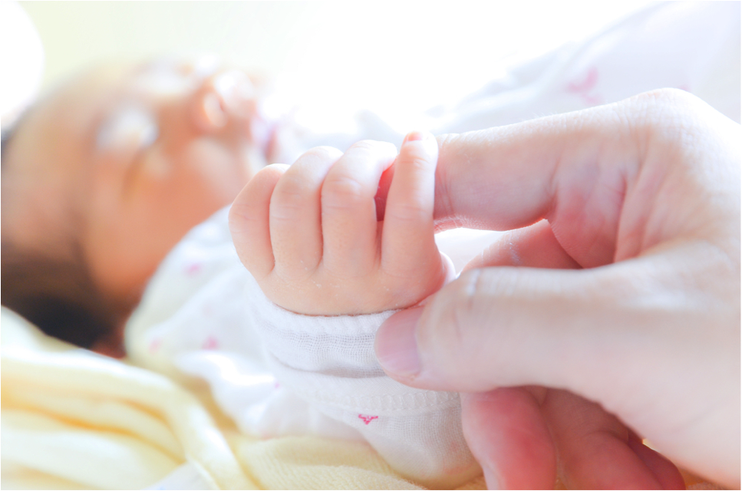

Slide 16
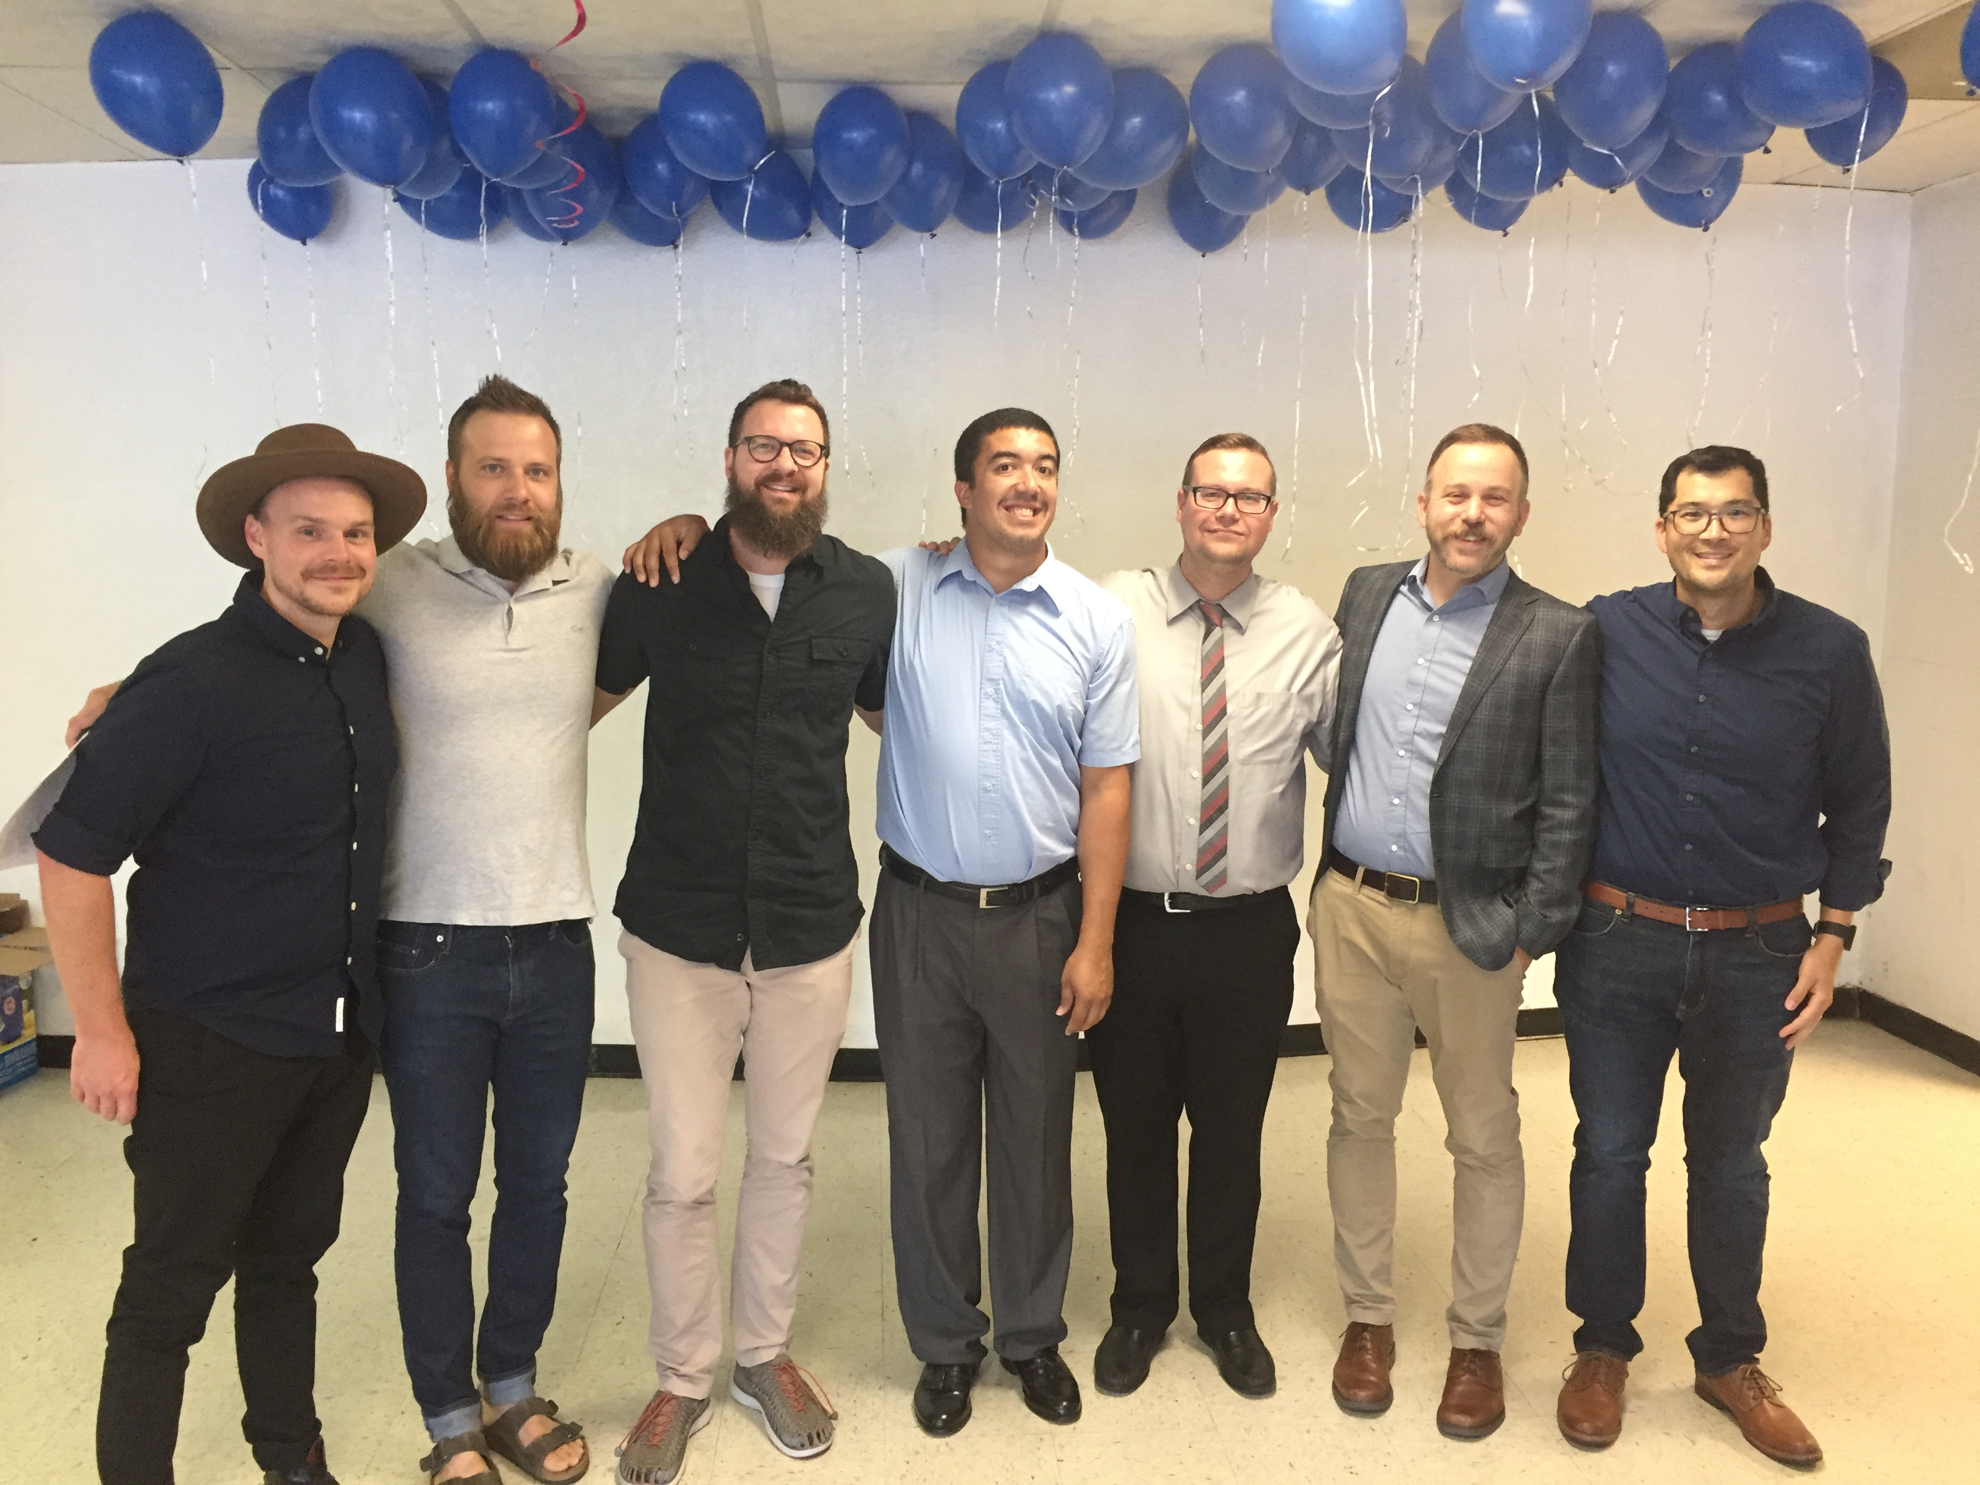

Slide 17
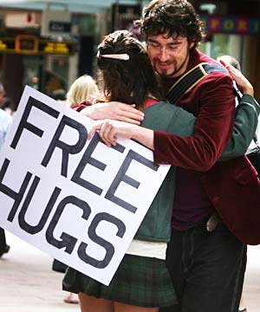
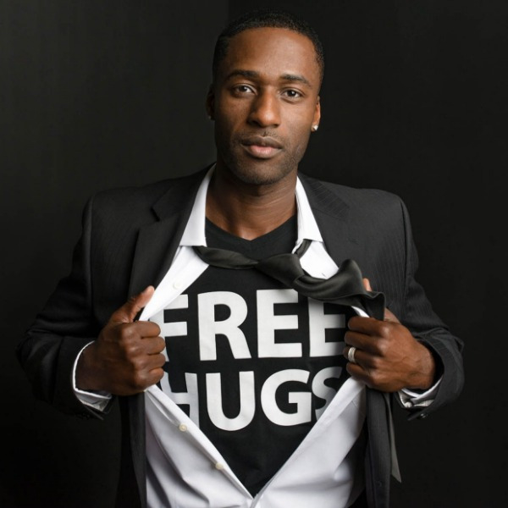

Slide 19
Luke 5:13 ¹³ And Jesus stretched out his hand and touched him, saying, “I will; be clean.” And immediately the leprosy left him.

Slide 20
Luke 5:13 ¹³ And Jesus stretched out his hand and touched him, saying, “I will; be clean.” And immediately the leprosy left him.
Touching Stories in Luke:
Jesus allows the sinful woman to touch Him—Luke 7:36-50
The bleeding woman touches Jesus’ garment—Luke 8:44-46
Jesus takes the little girl by the hand—Luke 8:54
Jesus touches the woman with the disabling spirit of 18 years—Luke 13:13

Slide 21
Be the hands of Jesus.

Slide 22
Be the hands of Jesus.
As you sent me into the world, so I have sent them into the world.
John 17:18

Slide 23
Be the hands of Jesus.
Because God first loved us, we exist to love God and love our neighbors.

Slide 24
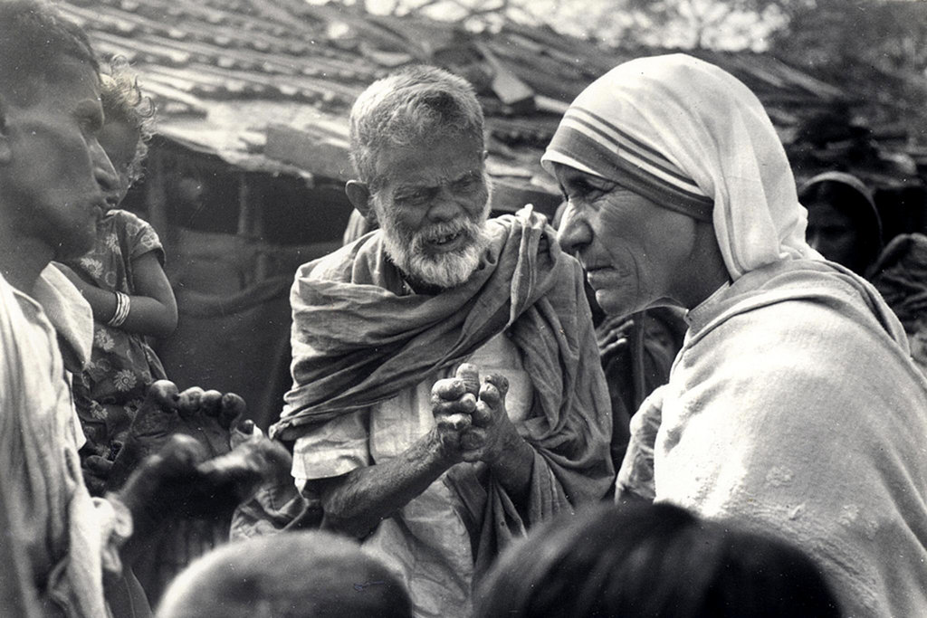

Slide 25
Long to hug Jesus.
Be the hands of Jesus.

Slide 26
Q&R / TESTIMONIES

Slide 27
Experiencing Jesus
What does Jesus want you to hear?

Slide 28
Experiencing Jesus
What does Jesus want you to hear? See?

Slide 29
Experiencing Jesus
What does Jesus want you to hear? See? Feel?

Slide 30
Experiencing Jesus
What does Jesus want you to hear? See? Feel?
How can you intensify your longing to be physically present with Jesus?

Slide 31
Experiencing Jesus
What does Jesus want you to hear? See? Feel?
How can you intensify your longing to be physically present with Jesus?
How do you need to experience the Body of Christ more tangibly?

Slide 32
Experiencing Jesus
What does Jesus want you to hear? See? Feel?
How can you intensify your longing to be physically present with Jesus?
How do you need to experience the Body of Christ more tangibly?
Who does Jesus want to touch through you?

Slide 34
Whisper

Slide 35
Whisper
Jesus when you speak to me
I hope I’m listening to you
Let this heart of mine receive
what is full of grace and truth

Slide 36
Whisper
Whisper, whisper,
whisper in my ear
Tell me words I thought I’d never hear
Show me, show me,
show me what you see
Illuminate what’s right in front of me
Oh, oh, oh, oh…. Oh, oh
Oh, oh, oh, oh…. Oh, oh

Slide 37
Whisper
There’s so much more to what we see
sometimes I’m scared to take it in
Is that you right in front of me
are you the stranger or the friend?

Slide 38
Whisper
Whisper, whisper,
whisper in my ear
Tell me words I thought I’d never hear
Show me, show me,
show me what you see
Illuminate what’s right in front of me
Oh, oh, oh, oh…. Oh, oh
Oh, oh, oh, oh…. Oh, oh

Slide 39
Whisper
What you whisper in my ear,
let it find room in my heart
Like a garden
let your words begin to grow
When my faith is prone to fear
remind me of your love
Remind me that you’ll never let me go

Slide 40
Whisper
Remind me, remind me,
remind me of Your love
(repeat)

Slide 42
Hungry

Slide 43
Hungry
Hungry, I come to You
for I know You satisfy
I am empty, but I know
Your love does not run dry
So I wait for You
So I wait for You

Slide 44
Hungry
I’m falling on my knees
Offering all of me
Jesus, You’re all this heart
is living for

Slide 45
Hungry
Broken, I run to You
For Your arms are open wide
I am weary, but I know Your touch
restores my life
So I wait for You
So I wait for You

Slide 46
Hungry
I’m falling on my knees
Offering all of me
Jesus, You’re all this heart
is living for

Slide 47
Hungry
Hungry, I walk with You
for I hear Your call to me
I want to join in your work
of setting people free
So I reach out
So I reach out

Slide 48
Hungry
I’m falling on my knees
Offering all of me
Jesus, You’re all this heart
is living for

Slide 50
In the Secret

Slide 51
In the Secret
In the secret, in the quiet place
In the stillness You are there.
In the secret, in the quiet hour I wait
only for You,
Cause I want to know You more.

Slide 52
In the Secret
I want to know You.
I want to hear Your voice.
I want to know You more.
I want to touch You.
I want to see Your face.
I want to know You more.

Slide 53
In the Secret
In the secret, in the quiet place
In the stillness You are there.
In the secret, in the quiet hour I wait
only for You,
Cause I want to know You more.

Slide 54
In the Secret
I want to know You.
I want to hear Your voice.
I want to know You more.
I want to touch You.
I want to see Your face.
I want to know You more.

Slide 56
Because He Lives

Slide 57
Because He Lives
God sent His son,
they called Him, Jesus;
He came to love, heal and forgive;
He lived and died to buy my pardon,
An empty grave is there to prove
my Savior lives!

Slide 58
Because He Lives
Because He lives, I can face tomorrow,
Because He lives, all fear is gone;
Because I know He holds the future,
And life is worth the living,
Just because He lives!

Slide 60
Benediction

Slide 61
Benediction
Father, give Your benediction
Give us Your peace before we part
Still our minds with truth’s conviction Calm with trust each anxious heart

Slide 62
Benediction
Father, give Your benediction
Bid our grief and struggles end Peace which passes understanding On our waiting spirit send

Slide 63
Benediction
Amen. Amen.
Amen. Amen.
Amen. Amen.
Amen: let it be so

