Slide 1
WELCOME

Slide 2
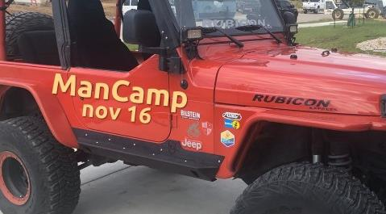
TALLGRASS PRAYER
Come join fellow Tallgrassians to pray for God’s work within and out from our church. Come and go as needed.
THIS SATURDAY, NOV. 16, 10AM-10PM
at Travis Gilbert’s house in University Park. You bring lunch. Tallgrass Church brings dinner.
RSVP to Ben Deaver. More deets at tallgrass.church/events

Slide 3
4 KEYS TO RETIREMENT
Next SUNDAY, NOV 17TH 6-7pm in the Parlor Rm. Free workshop brought to us by Thrivent Financial, a not-for-profit financial services organization that several Tallgrass families use for their financial planning. Food and childcare are provided for those who RSVP to Ben Deaver BY THIS THURSDAY, November 14.
4 KEYS TO RETIREMENT

Slide 7
orphanhelpers.org

Slide 8
@openwindowadoptioninc

Slide 9
MINGLE QUESTION
Who’s someone (living or dead) you would love to have dinner with (besides Jesus Christ or Dave Geldart)?

Slide 12
hearing

Slide 13
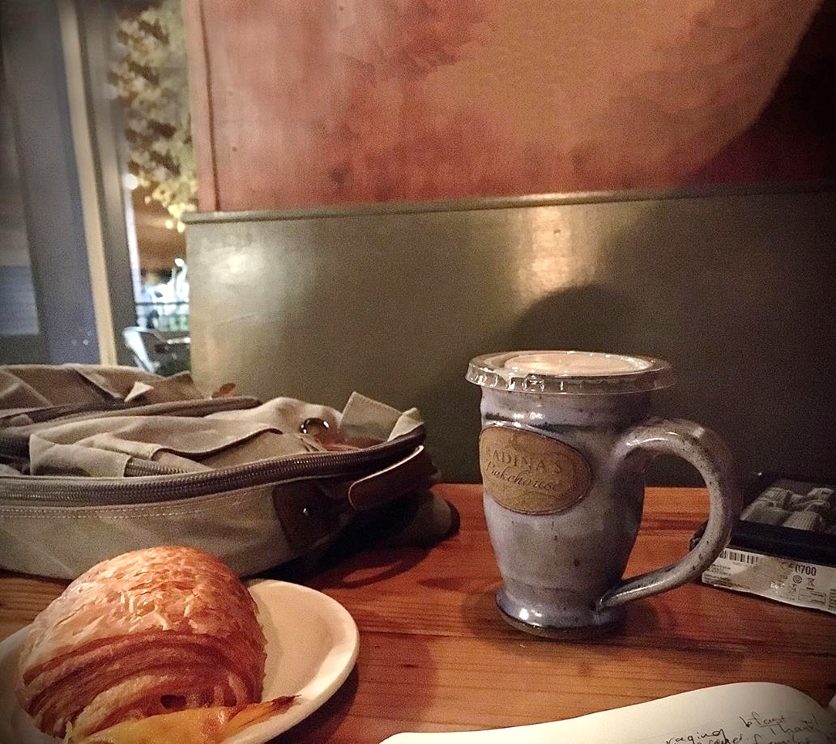

Slide 15
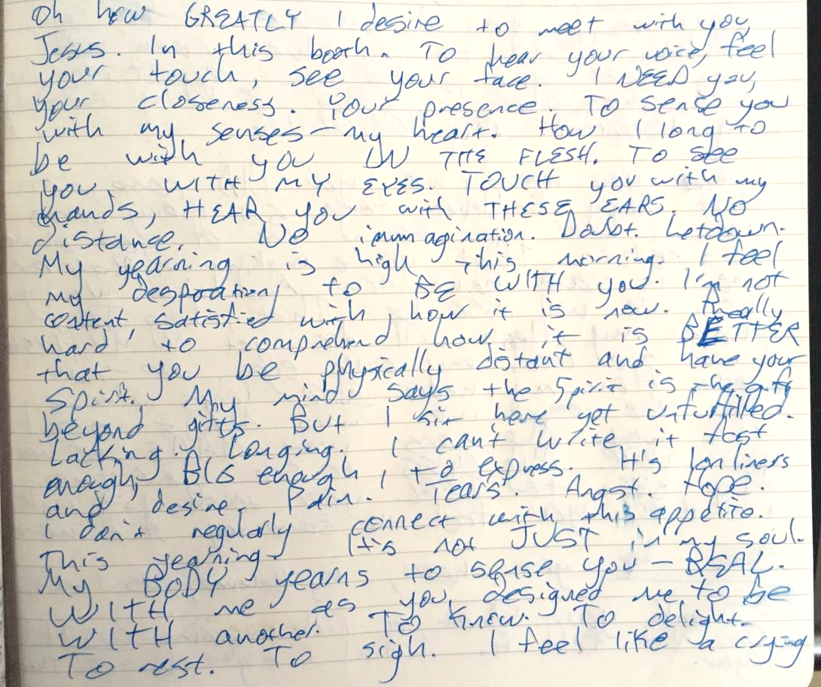

Slide 17
seeing

Slide 18
Exodus 33:20 “You cannot see My face, for no man can see Me and live!”

Slide 19
Exodus 33:20 “You cannot see My face, for no man can see Me and live!”
Exodus 33:23 “Then I will take My hand away and you shall see My back, but My face shall not be seen.”

Slide 20
Exodus 33:20 “You cannot see My face, for no man can see Me and live!”
Exodus 33:23 “Then I will take My hand away and you shall see My back, but My face shall not be seen.”
Psalm 27:4 “One thing have I asked of the LORD, that will I seek after: that I may dwell in the house of the LORD all the days of my life, to gaze upon the beauty of the LORD and to inquire in his temple.”

Slide 21
Exodus 33:20 You cannot see My face, for no man can see Me and live!”
Exodus 33:23 “Then I will take My hand away and you shall see My back, but My face shall not be seen.”
Psalm 27:4 “One thing have I asked of the LORD, that will I seek after: that I may dwell in the house of the LORD all the days of my life, to gaze upon the beauty of the LORD and to inquire in his temple.”
Psalm 24 “…the generation of those who seek Him, who seek your face, God of Jacob.”

Slide 22
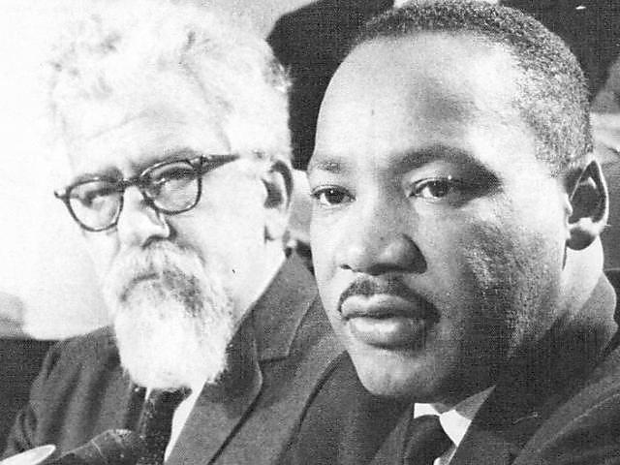
Exodus 33:20 You cannot see My face, for no man can see Me and live!”
Exodus 33:23 “Then I will take My hand away and you shall see My back, but My face shall not be seen.”
Psalm 27:4 “One thing have I asked of the LORD, that will I seek after: that I may dwell in the house of the LORD all the days of my life, to gaze upon the beauty of the LORD and to inquire in his temple.”
Psalm 24 “…the generation of those who seek Him, who seek your face, God of Jacob.”
Rabbi Abraham Herschel:
“…realize that all concepts are but glittering motes in a sunbeam. [We] want to see the sun itself.”

Slide 23
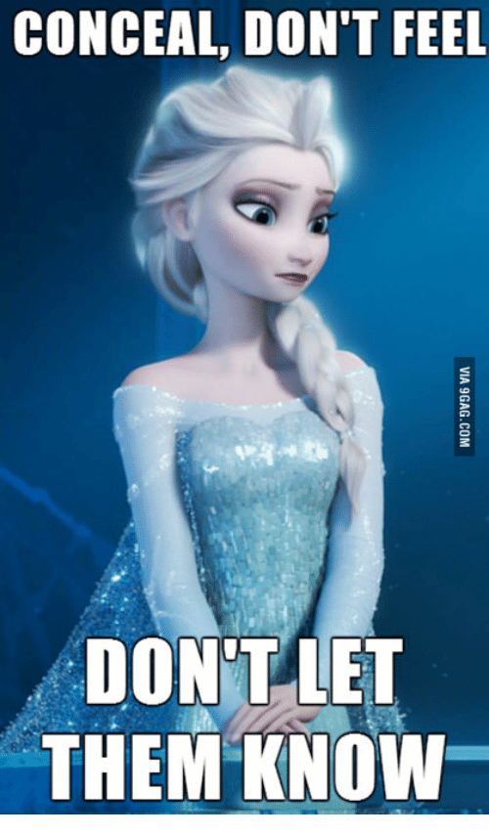
Exodus 33:20 You cannot see My face, for no man can see Me and live!”
Exodus 33:23 “Then I will take My hand away and you shall see My back, but My face shall not be seen.”
Psalm 27:4 “One thing have I asked of the LORD, that will I seek after: that I may dwell in the house of the LORD all the days of my life, to gaze upon the beauty of the LORD and to inquire in his temple.”
Psalm 24 “…the generation of those who seek Him, who seek your face, God of Jacob.”
Rabbi Abraham Herschel:
“…realize that all concepts are but glittering motes in a sunbeam. [We] want to see the sun itself.”

Slide 24
John 1“¹ In the beginning was the Word, and the Word was with God, and the Word was God. ² He was with God in the beginning. ³ Through him all things were made; without him nothing was made that has been made. ⁴ In him was life, and that life was the light of all mankind. ⁵ The light shines in the darkness, and the darkness has not overcome it. …¹⁴ The Word became flesh and made his dwelling among us. We have seen his glory, the glory of the one and only Son, who came from the Father, full of grace and truth.
… ¹⁸ No one has ever seen God, but the one and only Son, who is himself God and is in closest relationship with the Father, has made him known.

Slide 25
John 1“¹ In the beginning was the Word, and the Word was with God, and the Word was God. ² He was with God in the beginning. ³ Through him all things were made; without him nothing was made that has been made. ⁴ In him was life, and that life was the light of all mankind. ⁵ The light shines in the darkness, and the darkness has not overcome it. …¹⁴ The Word became flesh and made his dwelling among us. We have seen his glory, the glory of the one and only Son, who came from the Father, full of grace and truth.
… ¹⁸ No one has ever seen God, but the one and only Son, who is himself God and is in closest relationship with the Father, has made him known.
John 14:9 “Whoever has seen me has seen the Father.”

Slide 26
1 John 1“That which was from the beginning, which we have heard, which we have seen with our eyes, which we have looked at and our hands have touched—this we proclaim concerning the Word of life. ² The life appeared; we have seen it and testify to it, and we proclaim to you the eternal life, which was with the Father and has appeared to us. ³ We proclaim to you what we have seen and heard, so that you also may have fellowship with us. And our fellowship is with the Father and with his Son, Jesus Christ. ⁴ We write this to make our joy complete.”

Slide 27
1 John 3 “See what great love the Father has lavished on us, that we should be called children of God! And that is what we are! … ² Dear friends, now we are children of God, and what we will be has not yet been made known. But we know that when Christ appears, we shall be like him, for we shall see him as he is.

Slide 28
Revelation 22 “Then the angel showed me the river of the water of life, bright as crystal, flowing from the throne of God and of the Lamb ² through the middle of the street of the city; also, on either side of the river, the tree of life … the throne of God and of the Lamb will be in it, and his servants will worship him. ⁴ They will see his face”

Slide 29
Revelation 22 “Then the angel showed me the river of the water of life, bright as crystal, flowing from the throne of God and of the Lamb ² through the middle of the street of the city; also, on either side of the river, the tree of life … the throne of God and of the Lamb will be in it, and his servants will worship him. ⁴ They will see his face”
2 Timothy 4:8 “…all who have longed for his appearing.”

Slide 30
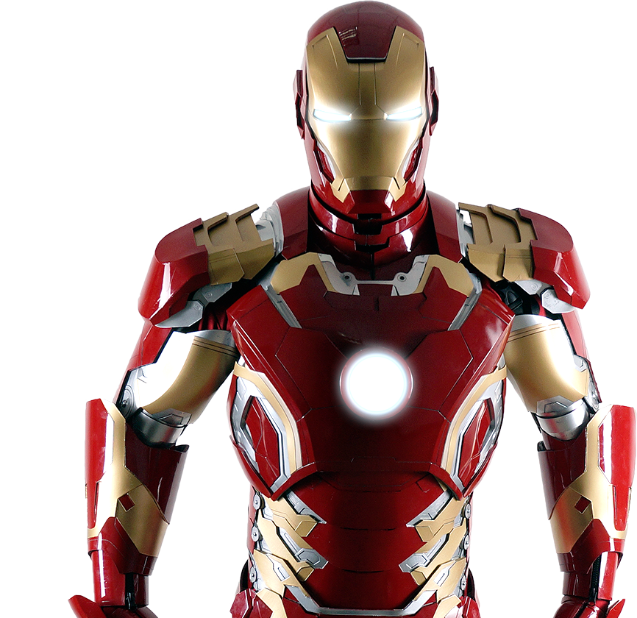
Revelation 22 “Then the angel showed me the river of the water of life, bright as crystal, flowing from the throne of God and of the Lamb ² through the middle of the street of the city; also, on either side of the river, the tree of life … the throne of God and of the Lamb will be in it, and his servants will worship him. ⁴ They will see his face”
2 Timothy 4:8 “…all who have longed for his appearing.”

Slide 31
Revelation 22 “Then the angel showed me the river of the water of life, bright as crystal, flowing from the throne of God and of the Lamb ² through the middle of the street of the city; also, on either side of the river, the tree of life … the throne of God and of the Lamb will be in it, and his servants will worship him. ⁴ They will see his face”
2 Timothy 4:8 “…all who have longed for his appearing.”
Hope of being physically with God

Slide 32
Revelation 22 “Then the angel showed me the river of the water of life, bright as crystal, flowing from the throne of God and of the Lamb ² through the middle of the street of the city; also, on either side of the river, the tree of life … the throne of God and of the Lamb will be in it, and his servants will worship him. ⁴ They will see his face”
2 Timothy 4:8 “…all who have longed for his appearing.”
Clarity & Perspective Now
Hope of being physically with God

Slide 33
Revelation 22 “Then the angel showed me the river of the water of life, bright as crystal, flowing from the throne of God and of the Lamb ² through the middle of the street of the city; also, on either side of the river, the tree of life … the throne of God and of the Lamb will be in it, and his servants will worship him. ⁴ They will see his face”
2 Timothy 4:8 “…all who have longed for his appearing.”
Clarity & Perspective Now
Seeing God’s Work Now
Hope of being physically with God

Slide 34
Revelation 22 “Then the angel showed me the river of the water of life, bright as crystal, flowing from the throne of God and of the Lamb ² through the middle of the street of the city; also, on either side of the river, the tree of life … the throne of God and of the Lamb will be in it, and his servants will worship him. ⁴ They will see his face”
2 Timothy 4:8 “…all who have longed for his appearing.”
Clarity & Perspective Now
Seeing God’s Work Now
1 Corinthians 13: ¹² For now we see in a mirror dimly, but then face to face. Now I know in part; then I shall know fully, even as I have been fully known.
1 Peter 1: ⁸ Though you have not seen him, you love him. Though you do not now see him, you believe in him and rejoice with joy that is inexpressible and filled with glory, ⁹ obtaining the outcome of your faith, the salvation of your souls.
Hope of being physically with God

Slide 35
Revelation 22 “Then the angel showed me the river of the water of life, bright as crystal, flowing from the throne of God and of the Lamb ² through the middle of the street of the city; also, on either side of the river, the tree of life … the throne of God and of the Lamb will be in it, and his servants will worship him. ⁴ They will see his face”
2 Timothy 4:8 “…all who have longed for his appearing.”
Clarity & Perspective Now
Seeing God’s Work Now
Some Do See Jesus Now
Hope of being physically with God

Slide 37
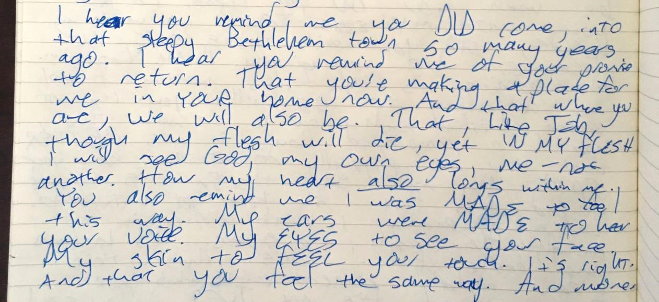

Slide 38
Listening & Reflecting
How connected am I to my longing to be with God?
How am I doing living a world I wasn’t made for?
What’s powering my life? What substitutes am I looking to?
As Jesus looks as me, what look is on his face?
Ask God to help you see clearly how he really sees you.
Imagine what it will be like to be with Jesus.

Slide 40
In the Secret
In the secret, in the quiet place
In the stillness You are there.
In the secret, in the quiet hour I wait
only for You,
Cause I want to know You more.

Slide 41
In the Secret
I want to know You.
I want to hear Your voice.
I want to know You more.
I want to touch You.
I want to see Your face.
I want to know You more.

Slide 42
In the Secret
In the secret, in the quiet place
In the stillness You are there.
In the secret, in the quiet hour I wait
only for You,
Cause I want to know You more.

Slide 43
In the Secret
I want to know You.
I want to hear Your voice.
I want to know You more.
I want to touch You.
I want to see Your face.
I want to know You more.

Slide 44
Fountains
I have tasted life
Nothing satisfies like You do
The fount that won’t run dry
Nothing satisfies like You do
repeat

Slide 45
Fountains
All my fountains are in You
All my hope is built on Your love
All my fountains are in You
With every breath
I live for You, Lord
x3

Slide 46
Fountains
All that I ever wanted
My heart has found in You

Slide 47
In the Secret
I want to know You.
I want to hear Your voice.
I want to know You more.
I want to touch You.
I want to see Your face.
I want to know You more.

Slide 48
Fountains

Slide 49
Fountains
I will never forget the
moment I met You
The moment You called my name
You pulled me out of the darkness,
gave me a promise
To never thirst again
repeat

Slide 50
Fountains
All that I ever wanted
My heart has found in You

Slide 51
Fountains
I have tasted life
Nothing satisfies like You do
The fount that won’t run dry
Nothing satisfies like You do

Slide 52
Fountains
I want all that You offer;
Your living water,
Drink from the endless well.
I will sit at Your table
forever grateful
Forever where You dwell

Slide 53
Fountains
All that I ever wanted
My heart has found in You

Slide 54
Fountains
I have tasted life
Nothing satisfies like You do
The fount that won’t run dry
Nothing satisfies like You do
repeat

Slide 55
Fountains
All my fountains are in You
All my hope is built on Your love
All my fountains are in You
With every breath
I live for You, Lord
x3

Slide 56
Fountains
“Give thanks to the Lord,
for he is good…
for he satisfies the longing soul,
and the hungry soul he fills
with good things.”
Psalm 107

Slide 57
Fountains
All that I ever wanted
My heart has found in You

Slide 58
Fountains
I have tasted life
Nothing satisfies like You do
The fount that won’t run dry
Nothing satisfies like You do

Slide 59
Fountains
All my fountains are in You
All my hope is built on Your love
All my fountains are in You
With every breath
I live for You, Lord

Slide 61
Surrounded
There’s a table that
You’ve prepared for me
In the presence of my enemies
It’s Your body and Your blood
You shed for me:
This is how I fight my battles
repeat

Slide 62
Surrounded
And I believe You’ve overcome
And I will lift my song of praise
For all You’ve done!

Slide 63
Surrounded
This is how I fight my battles
This is how I fight my battles
This is how I fight my battles
This is how I…
repeat

Slide 64
Surrounded
In the valley I know
that You’re with me
And surely Your goodness
and Your mercy fall on me
So my weapons are
praise and thanksgiving
This is how I fight my battles

Slide 65
Surrounded
And I believe You’ve overcome
And I will lift my song of praise
For all You’ve done!

Slide 66
Surrounded
This is how I fight my battles
This is how I fight my battles
This is how I fight my battles
This is how I…
repeat

Slide 67
Surrounded
And I believe You’ve overcome
And I will lift my song of praise
For all You’ve done!

Slide 68
Surrounded
“…in everything by prayer and supplication with thanksgiving let your requests be made known to God. And the peace of God, which surpasses all understanding, will guard your hearts and your minds in Christ Jesus.”
Philippians 4

Slide 69
Surrounded
It may look like I’m surrounded
But I’m surrounded by You
x6

Slide 70
Surrounded
This is how I fight my battles
This is how I fight my battles
repeat

Slide 71
Surrounded
This is how I fight my battles
This is how I fight my battles
This is how I fight my battles
This is how I…

Slide 72
Surrounded
It may look like I’m surrounded
But I’m surrounded by You
x4

Slide 74
I Will Wait
Out of the depths I cry to you,
O Lord! O Lord, hear my voice!
Let your ears be attentive
to the voice of my pleas for mercy!
Psalm 130

Slide 75
I Will Wait
Out of the depths I cry to You
In darkest places I will call
Incline Your ear to me anew
and hear my cry for mercy Lord

Slide 76
I Will Wait
If you, O Lord, should mark iniquities,
O Lord, who could stand?
But with you there is forgiveness,
that you may be feared.
Psalm 130

Slide 77
I Will Wait
Were You to count my sinful ways
How could I come before Your throne
Yet full forgiveness meets my gaze
I stand redeemed by grace alone

Slide 78
I Will Wait
I will wait for You, I will wait for You
On Your word I will rely
I will wait for You, surely wait for You
Till my soul is satisfied

Slide 79
I Will Wait
I wait for the Lord, my soul waits,
and in his word I hope;
my soul waits for the Lord
Psalm 130

Slide 80
I Will Wait
So put Your hope in God alone
Take courage in His power to save
Completely and forever won
By Christ emerging from the grave

Slide 81
I Will Wait
I will wait for You, I will wait for You
On Your word I will rely
I will wait for You, surely wait for You
Till my soul is satisfied

Slide 82
I Will Wait
O Israel, hope in the Lord!
For with the Lord there is
steadfast love,
and with him is plentiful redemption.
And he will redeem Israel
from all his iniquities.
Psalm 130

Slide 83
I Will Wait
Now He has come to make a way
And God Himself has paid the price
That all who trust in Him today
Find healing in His sacrifice
That all who trust in Him today
Find healing in His sacrifice

Slide 84
I Will Wait
I will wait for You, I will wait for You
Through the storm & through the night
I will wait for You, surely wait for You
Till my soul is satisfied
x3

Slide 85
I Will Wait
“Give thanks to the Lord,
for he is good…
for he satisfies the longing soul,
and the hungry soul he fills
with good things.”
Psalm 107

Slide 86
I Will Wait
I will wait for You, I will wait for You
On Your word I will rely
I will wait for You, surely wait for You
Till my soul is satisfied
repeat

Slide 88
Benediction

Slide 89
Benediction
Father, give Your benediction
Give us Your peace before we part
Still our minds with truth’s conviction Calm with trust each anxious heart

Slide 90
Benediction
Father, give Your benediction
Bid our grief and struggles end Peace which passes understanding On our waiting spirit send

Slide 91
Benediction
Amen. Amen.
Amen. Amen.
Amen. Amen.
Amen: let it be so

Slide 92
AFTER PARTY TONIGHT

