Slide 1
WELCOME

Slide 2
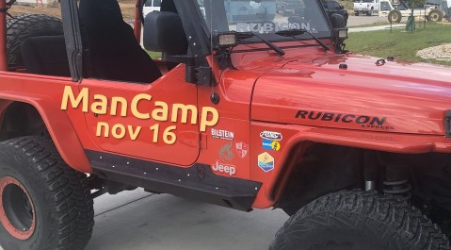
TALLGRASS PRAYER
Come join fellow Tallgrassians to pray for God’s work within and out from our church. Come and go as needed.
SATURDAY, NOVEMBER 16, 10AM
at Travis Gilbert’s back yard in University Park. You bring camping stuff. Tallgrass provides food.
RSVP to Ben Deaver. More deets at tallgrass.church/events

Slide 3
MINGLE QUESTION
Share about a time when you felt connected to God.

Slide 4
Giving Intentions
Report

Slide 6
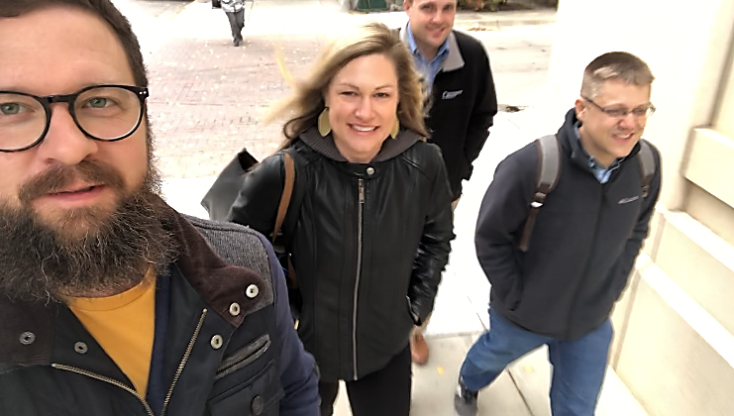
Core Team: Ben, Maris, David, & Dave

Slide 8
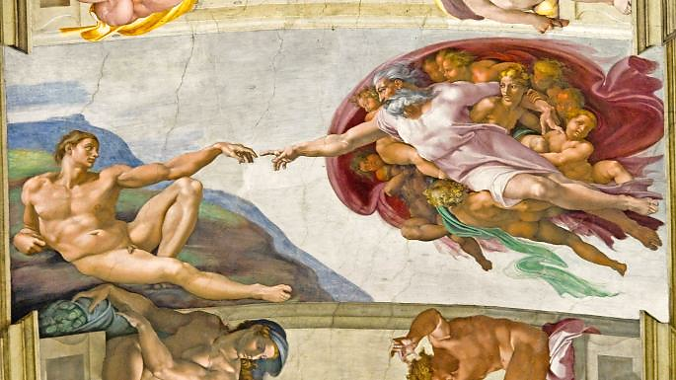

Slide 10
Because God has made us for Himself, our hearts are restless until they rest in Him. -St. Augustine of Hippo

Slide 11
One thing have I asked of the Lord… -King David in Psalm 27:4

Slide 12
And they heard the sound of the Lord God walking in the garden… -Adam & Eve in Genesis 3:8a

Slide 13
And the Word became flesh and dwelt among us… John 1:14a

Slide 14
And the Word became flesh and dwelt among us… John 1:14a

Slide 15
Tangible Jesus
That which was from the beginning, which we have heard, which we have seen with our eyes, which we looked upon and have touched with our hands, concerning the word of life— ² the life was made manifest, and we have seen it, and testify to it and proclaim to you the eternal life, which was with the Father and was made manifest to us— ³ that which we have seen and heard we proclaim also to you, so that you too may have fellowship with us; and indeed our fellowship is with the Father and with his Son Jesus Christ. ⁴ And we are writing these things so that our joy may be complete.
1 John 1:1-4

Slide 16
Tangible Jesus
That which was from the beginning, which we have heard, which we have seen with our eyes, which we looked upon and have touched with our hands, concerning the word of life— ² the life was made manifest, and we have seen it, and testify to it and proclaim to you the eternal life, which was with the Father and was made manifest to us— ³ that which we have seen and heard we proclaim also to you, so that you too may have fellowship with us; and indeed our fellowship is with the Father and with his Son Jesus Christ. ⁴ And we are writing these things so that our joy may be complete.
1 John 1:1-4

Slide 17
Tangible Jesus
That which was from the beginning, which we have heard, which we have seen with our eyes, which we looked upon and have touched with our hands, concerning the word of life— ² the life was made manifest, and we have seen it, and testify to it and proclaim to you the eternal life, which was with the Father and was made manifest to us— ³ that which we have seen and heard we proclaim also to you, so that you too may have fellowship with us; and indeed our fellowship is with the Father and with his Son Jesus Christ. ⁴ And we are writing these things so that our joy may be complete.
1 John 1:1-4

Slide 18
Tangible Jesus
That which was from the beginning, which we have heard, which we have seen with our eyes, which we looked upon and have touched with our hands, concerning the word of life— ² the life was made manifest, and we have seen it, and testify to it and proclaim to you the eternal life, which was with the Father and was made manifest to us— ³ that which we have seen and heard we proclaim also to you, so that you too may have fellowship with us; and indeed our fellowship is with the Father and with his Son Jesus Christ. ⁴ And we are writing these things so that our joy may be complete.
1 John 1:1-4

Slide 19
Synagogue Jesus Taught In

Slide 20
Church of the Beatitudes

Slide 21
The Sea of Galilee

Slide 22
The Western Wall

Slide 23
Jesus turned and saw them following and said to them, “What are you seeking?” John 1:38

Slide 24
hearing Jesus

Slide 25
hearing Jesus
The Scriptures,
The Spirit,
& The Saints

Slide 26
solitude & silence
“It is much easier to talk about it and read about it than to actually become quiet.”

Slide 27
solitude & silence
“It is much easier to talk about it and read about it than to actually become quiet.
We are a very busy, wordy, and heady faith tradition.”

Slide 28
solitude & silence
“It is much easier to talk about it and read about it than to actually become quiet.
We are a very busy, wordy, and heady faith tradition.
Yet we are desperate to find ways to open ourselves to our God who is, in the end, beyond all of our human constructs and human agendas.”

Slide 29
St. Benedict’s Abbey

Slide 30
practicing silence
Is there any grief you’ve been holding in that you need to bring to Jesus?

Slide 31
practicing silence
Is there any grief you’ve been holding in that you need to bring to Jesus?
Is there anything you’re grateful for that you need to thank Jesus for?

Slide 32
practicing silence
Is there any grief you’ve been holding in that you need to bring to Jesus?
Is there anything you’re grateful for that you need to thank Jesus for?
What words of truth do you need to hear Jesus speak to you?

Slide 33
practicing silence
Is there any grief you’ve been holding in that you need to bring to Jesus?
Is there anything you’re grateful for that you need to thank Jesus for?
What words of truth do you need to hear Jesus speak to you? Can you hear Him speaking these true words to you?

Slide 34
practicing silence
Is there any grief you’ve been holding in that you need to bring to Jesus?
Is there anything you’re grateful for that you need to thank Jesus for?
What words of truth do you need to hear Jesus speak to you? Can you hear Him speaking these true words to you?
What is happening inside you and your relationship with Jesus that seems to be inviting you into solitude and silence?

Slide 35
the pit & the cross
Psalm 88 & 22

Slide 36
Q&R / TESTIMONIES

Slide 38
Word of God Speak

Slide 39
Word of God Speak
I'm finding myself at a loss for words
And the funny thing is it's ok
The last thing I need is to be heard
But to hear what You would say

Slide 40
Word of God Speak
Word of God speak Would You pour down like rain?
Washing my eyes to see Your Majesty
To be still and know That You're in this place
Please let me stay & rest In Your Holiness
Word of God speak

Slide 41
Word of God Speak
I'm finding myself in the midst of You
Beyond the music, beyond the noise
All that I need is to be with You
And in the quiet hear Your voice

Slide 42
Word of God Speak
Word of God speak Would You pour down like rain?
Washing my eyes to see Your Majesty
To be still and know That You're in this place
Please let me stay & rest In Your Holiness
Word of God speak
(2x)

Slide 43
Word of God Speak
I'm finding myself at a loss for words
And the funny thing is it's ok

Slide 44
Way Maker
Way Maker, Miracle Worker
Promise Keeper, Light in the Darkness
My God
That is who You are

Slide 46
Jesus, We Love You

Slide 47
Jesus, We Love You
Old things have passed away
Your love has stayed the same
Your constant grace
remains the cornerstone
Things that we thought were dead
Are breathing in life again
You cause Your Son
to shine on darkest nights
For all that You’ve done we will
pour out our love
This will be our anthem song

Slide 48
Jesus, We Love You
Jesus, we love You
Oh, how we love You
You are the One our hearts adore

Slide 49
Jesus, We Love You
The hopeless have found their hope
The orphans now have a home
All that was lost
has found its place in You
You lift our weary head
You make us strong instead
You took these rags
& made us beautiful
For all that you’ve done we will
pour out our love
This will be our anthem song

Slide 50
Jesus, We Love You
Jesus, we love You
Oh, how we love You
You are the One our hearts adore

Slide 51
Jesus, We Love You
Our affection, our devotion
poured out on the feet of Jesus
(4x)

Slide 52
Jesus, We Love You
Jesus, we love You
Oh, how we love You
You are the One our hearts adore
(3x)

Slide 54
And Still You Give

Slide 55
And Still You Give
So lost was I,
A ghost to the world,
When you rescued me.
So lost was I,
Empty inside,
You filled the void for me.

Slide 56
And Still You Give
I thought I was gone, but yet, I live.
You gave enough, and still, You give.

Slide 57
And Still You Give
So lost was I,
Wanting to hide,
When You guided me.
So lost was I,
Barely alive,
You resurrected me.

Slide 58
And Still You Give
I thought I was gone, but yet, I live.
You gave enough, and still, You give.

Slide 59
And Still You Give
You give me strength,
Give me hope,
You are for me.
You guide me through life,
Hold the pen to my story.
I give You all of me,
You’re all I need.
God Lead me.
(4x)

Slide 60
And Still You Give
I thought I was gone, but yet, I live.
You gave enough, and still, You give.

Slide 62
Benediction

Slide 63
Benediction
Father, give Your benediction
Give us Your peace before we part
Still our minds with truth’s conviction
Calm with trust each anxious heart

Slide 64
Benediction
Father, give Your benediction
Bid our grief and struggles end
Peace which passes understanding
On our waiting spirit send

Slide 65
Benediction
Amen. Amen.
Amen. Amen.
Amen. Amen.
amen: let it be so

