Slide 1
WELCOME

Slide 2
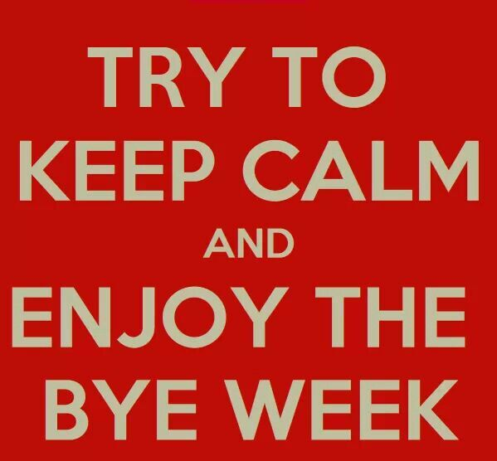
NO AFTER PARTY TODAY

Slide 3
NEXT SUNDAY
OCTOBER 13!!!

Slide 4
INVESTMEST BASICS
SUNDAY OCT. 20TH 6-7pm
in the Parlor Rm. Free workshop brought to us by Thrivent Financial, a not-for-profit financial services organization that several Tallgrass families use for their financial planning. Food and childcare are provided for those who RSVP to Ben Deaver at bendeaver@tallgrass.church.

Slide 5
MINGLE QUESTION
What's something kind someone's done for you recently (or you've done for someone else)?

Slide 6
RELATING

Slide 7
RELATING GRACIOUSLY

Slide 8
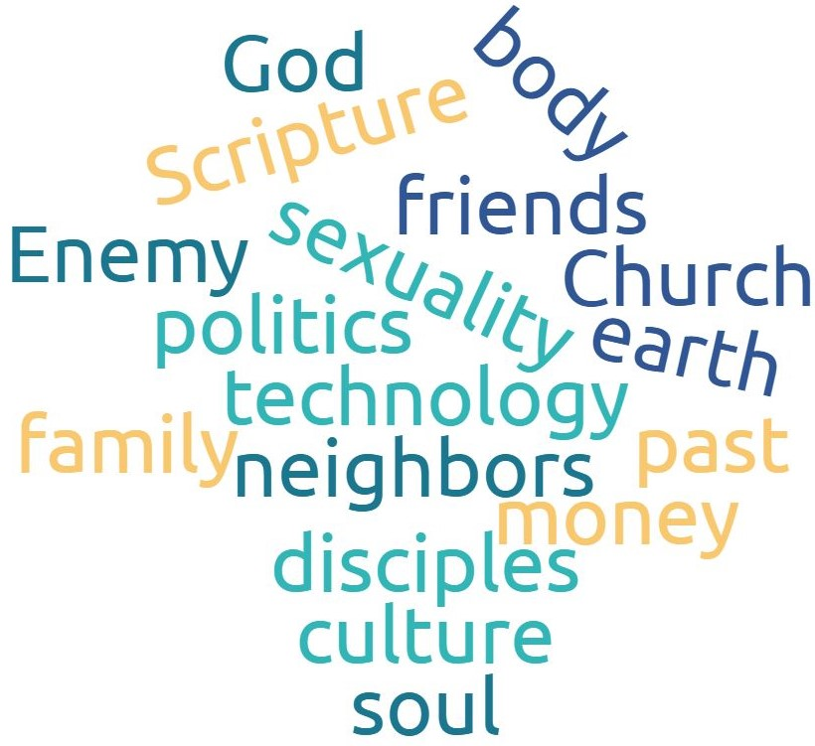
GOSPEL RELATING
Overlays like this
work

Slide 9
RELATING GRACIOUSLY
TWO CULTURAL ISSUES:
First: Moral Relativism:
Moral relativism is the view that moral judgments are true or false only relative to some particular standpoint (for instance, that of a culture or a historical period) and that no standpoint is uniquely privileged over all others.
What anyone believes is true for that person. “What you believe is true for you, what I believe is true for me." We can call the view expressed in such statements ‘relativism’ because it denies that there is any such thing as ‘absolute’ truth and holds that all truth is relative to the person who believes it.

Slide 10
RELATING GRACIOUSLY
TWO CULTURAL ISSUES:
Second: PERCEPTION OF CHRISTIANS:
Christians by believing that there are absolute truths are considered to be intolerant and judgmental people.
And historically, legalistic and self-righteous attitudes and behaviors by many believers have reinforced that perception.

Slide 11
Relating Graciously
Matthew 7:1-5 Judging Others
“Judge not, that you be not judged. ² For with the judgment you pronounce you will be judged, and with the measure you use it will be measured to you. ³ Why do you see the speck that is in your brother's eye, but do not notice the log that is in your own eye? ⁴ Or how can you say to your brother, ‘Let me take the speck out of your eye,’ when there is the log in your own eye? ⁵ You hypocrite, first take the log out of your own eye, and then you will see clearly to take the speck out of your brother's eye.”
e

Slide 12
Matthew 7:1-5
RESPONSIBILITY TO OTHERS
“Judge not,
² For with the judgment you pronounce
and with the measure you use
³ Why do you see the speck that is in your brother's eye,
⁴ Or how can you say to your brother, ‘Let me take the speck out of your eye,’
and then you will see clearly to take the speck out of your brother's eye.
RESPONSIBILITY TO SELF
that you be not judged.
you will be judged,
it will be measured to you.
but do not notice the log that is in your own eye?
⁵ You hypocrite, first take the log out of your own eye,

Slide 13
RELATING GRACIOUSLY
Keys to This Passage:
Jesus is forbidding a judgmental condescending critical attitude of judgment.

Slide 14
RELATING GRACIOUSLY
Keys to This Passage:
Jesus is calling his followers to first humbly be self-aware and work on their own weaknesses.

Slide 15
RELATING GRACIOUSLY
Keys to This Passage:
Jesus is asking us with humility and grace to discern other’s needs and to help where appropriate.

Slide 16
RELATING GRACIOUSLY
Keys to This Passage:
He is NOT saying, it doesn’t matter what others do and that we have no responsibility to help them in their spiritual growth.

Slide 17
Relating Graciously
Galatians 5:26
The Problem of Pride
5:26: Let us not become conceited, provoking one another, envying one another.

Slide 18
This 13,400 square foot home can be yours for only $8,950,000

Slide 19
And on the other hand . . .

Slide 20
Relating Graciously
Galatians 5:26 The Problem of Pride.
^{“26}Let us not become conceited, provoking one another, envying one another. . . .
The Greek word for “conceit” is “kenodoxoi”, meaning vain-glorious (false glory) or empty of honor.
Conceit flows out of a need to prove our honor or worth by comparing ourselves with others.
We are better than someone, acting superior
We don’t measure up, feeling inferior and envying

Slide 21
Relating Graciously
Galatians 5:26 The Problem of Pride.
Superiority & inferiority - two sides of the same coin.
Both are self-absorbed, looking at how others make one feel rather than serving and building up the other!
Both are bound up in works righteousness, in competition, trying to be better than others
The Superior: We win!
The Inferior: We lose!

Slide 22
Relating Graciously
Galatians 5:26 The Problem of Pride.
Superiority & inferiority - two sides of the same coin.
Both are self-absorbed, looking at how others make one feel rather than serving and building up the other!
Both are bound up in works righteousness, in competition, trying to be better than others
The Superior: We win!
The Inferior: We lose!
NEWS FLASH: We can feel superior or inferior depending on the situation.

Slide 23
Relating Graciously
Galatians 5:26 The Problem of Pride.
^{“26}Let us not become conceited, provoking one another, envying one another. . . .
Humility is not thinking less of yourself, but thinking of others less!
Low self-esteem is not gospel humility, but derives from self-absorption and not our new identity in Christ.
A feeling of pride and superiority is also self-absorption, thinking we have proved we are better than others.

Slide 24
Relating Graciously
Galatians 5:26 The Problem of Pride.
^{“26}Let us not become conceited, provoking one another, envying one another. . . . . .
We might paraphrase 5:26 above this way:
“Do not let your hunger for honor or glory
make you either despise or envy other people!

Slide 25
Relating Graciously
Galatians 6:1-5
Bear One Another’s Burdens
¹Brothers, if anyone is caught in any transgression, you who are spiritual should restore him in a spirit of gentleness. Keep watch on yourself, lest you too be tempted. ² Bear one another's burdens, and so fulfill the law of Christ. ³ For if anyone thinks he is something, when he is nothing, he deceives himself. ⁴ But let each one test his own work, and then his reason to boast will be in himself alone and not in his neighbor. ⁵ For each will have to bear his own load.”

Slide 26
Galatians 5:26-6:5
^{“6}Let us not become conceited, provoking one another
envying one another
RESPONSIBILITY TO OTHERS
¹Brothers,[if anyone is caught in any transgression, you who are spiritual should restore him in a spirit of gentleness
² Bear one another's burdens, and so fulfill the law of Christ.
RESPONSIBILITY TO SELF
^{1b}Keep watch on yourself, lest you too be tempted.
³ For if anyone thinks he is something, when he is nothing, he deceives himself.
⁴ But let each one test his own work, and then his reason to boast will be in himself alone and not in his neighbor. ⁵ For
each will have to bear his own load.

Slide 27
Relating Graciously
FOUR KEY PRINCIPLES IN THIS PASSAGE
The Party in Need: We are not to ignore a situation when a fellow Christian is “caught” (overtaken) in a sin.
Please . . . This doesn’t mean we confront every sin we see in others. ☺

Slide 28
Relating Graciously
FOUR KEY PRINCIPLES IN THIS PASSAGE
The Party in Need
The Party Responsible:
“You who are spiritual” does not mean only pastors and the spiritual elite, but anyone who is walking in the Spirit and seeking to fulfill the Law of Christ to love one another.
Galatians 5:13-15: “For you were called to freedom, brothers. Only do not use your freedom as an opportunity for the flesh, but through love serve one another. ¹⁴ For the whole law is fulfilled in one word: “You shall love your neighbor as yourself.” ¹⁵ But if you bite and devour one another, watch out that you are not consumed by one another.”

Slide 29
Relating Graciously
FOUR KEY PRINCIPLES IN THIS PASSAGE
The Party in Need
The Party Responsible
The Action Required:
To restore the person in need. The Greek word for restore is katartizdo, which literally means putting a dislocated bone back in place. It means to restore spiritual health.

Slide 30
Relating Graciously
FOUR KEY PRINCIPLES IN THIS PASSAGE
The Party in Need
The Party Responsible
The Action Required:
The Spirit or Attitude Required:
Not harshly and with an air of superiority, but gently and humbly, which comes from self awareness of one’s own susceptibility to temptation.

Slide 31
Relating Graciously
ACTION STEPS
Whether a Christian or non-Christian, learn to claim your new identity in Christ.
II Corinthians 5:17: Therefore, if anyone is in Christ, he is a new creation.^{[a]} The old has passed away; behold, the new has come.
II Corinthians 5:21: For our sake he made him to be sin who knew no sin, so that in him we might become the righteousness of God.

Slide 32
Relating Graciously
ACTION STEPS
2. Examine your thoughts and actions this week
Are you one who provokes or envys more?
Do you pick arguments or “blow up” at others?
Do you “clam up” or avoid confrontation altogether?

Slide 33
Relating Graciously
ACTION STEPS
3. Use your “Gospel Identity” in new ways to be both Humble and Bold.
Example: When you are criticized or irritated by another’s behavior.
If prideful, instead of defending and counter-attacking. . .
If inferiority attitude, instead of making excuses and getting down on ourselves and discouraged . . .
Let us Humbly think how to receive and profit from the criticism and Boldly seek to show gratitude to the one criticizing.

Slide 34
Relating Graciously
LETS PREACH THE GOSPEL TO OURSELVES EVERY DAY IN EVERY RELATIONSHIP.
THE GOSPEL: While reminding ourselves always that our ultimate security, value and worth comes from being adopted into God’s family as a child of God through the blood of Christ.

Slide 37
BLESSED ASSURANCE

Slide 38
BLESSED ASSURANCE
Blessed assurance, Jesus is mine
O what a foretaste Of glory divine
Heir of salvation, Purchase of God
Born of His Spirit, Washed in His blood

Slide 39
BLESSED ASSURANCE
This is my story, This is my song
Praising my Savior All the day long
This is my story, This is my song
Praising my Savior All the day long

Slide 40
BLESSED ASSURANCE
Perfect submission, All is at rest
I in my Savior
Am happy and blessed
Watching and waiting,
Looking above
Filled with His goodness, Lost in His love

Slide 41
BLESSED ASSURANCE
This is my story, This is my song
Praising my Savior All the day long
This is my story, This is my song
Praising my Savior All the day long

Slide 42
I SURRENDER ALL
I Surrender all, I surrender all
All to Thee my blessed Savior
I Surrender all

Slide 44
THOUGH YOU SLAY ME

Slide 45
THOUGH YOU SLAY ME
I come, God, I come
I return to the Lord
The one who's broken
The one who's torn me apart
You struck down to bind me up
You say You do it all in love
That I might know You in Your suffering

Slide 46
THOUGH YOU SLAY ME
Though You slay me
Yet I will praise You
Though You take from me
I will bless Your name
Though You ruin me
Still I will worship
Sing a song to the One who's all I need

Slide 47
THOUGH YOU SLAY ME
My heart and flesh may fail
The earth below give way
But with my eyes, with my eyes I'll see the Lord
Lifted high on that day
Behold, the Lamb that was slain
And I'll know every tear was worth it all

Slide 48
THOUGH YOU SLAY ME
Though You slay me
Yet I will praise You
Though You take from me
I will bless Your name
Though You ruin me
Still I will worship
Sing a song to the One who's all I need

Slide 49
THOUGH YOU SLAY ME
Though tonight I'm crying out
Let this cup pass from me now
You're still all that I need
You're enough for me
You're enough for me

Slide 50
THOUGH YOU SLAY ME
Though You slay me
Yet I will praise You
Though You take from me
I will bless Your name
Though You ruin me
Still I will worship
Sing a song to the One who's all I need

Slide 52
GOD OF THIS CITY

Slide 53
GOD OF THIS CITY
You're the God of this city
You're the King of these people
You're the Lord of this nation
You are

Slide 54
GOD OF THIS CITY
You're the light in this darkness
You're the hope to the hopeless
You're the peace to the restless
You are

Slide 55
GOD OF THIS CITY
There is no one like our God
There is no one like our God

Slide 56
GOD OF THIS CITY
For greater things have yet to come
And greater things are still to be done in this city
Greater things have yet to come
And greater things are still to be done in this city

Slide 57
GOD OF THIS CITY
You're the God of this city
You're the King of these people
You're the Lord of this nation
You are

Slide 58
GOD OF THIS CITY
You're the light in this darkness
You're the hope to the hopeless
You're the peace to the restless
You are

Slide 59
GOD OF THIS CITY
There is no one like our God
There is no one like our God

Slide 60
GOD OF THIS CITY
For greater things have yet to come
And greater things are still to be done in this city
Greater things have yet to come
And greater things are still to be done in this city

Slide 62
THE BENEDICTION

Slide 63
THE BENEDICTION
My friends may you grow in grace
And in the knowledge
Of our Lord and Savior.
My friends may you grow in grace
And in the knowledge
Of Jesus Christ.

Slide 64
THE BENEDICTION
To God be the glory
Now and forever,
Now and forever amen.
(repeat)

Slide 65
THE BENEDICTION
I pray tonight if we
Learned from one another,
May we glorify Him.
And if the Lord should
Bring us back together,
May we be in his arms till then.

Slide 66
THE BENEDICTION
My friends may you grow in grace
And in the knowledge
Of our Lord and Savior.
My friends may you grow in grace
And in the knowledge
Of Jesus Christ.

Slide 67
WELCOME

