Slide 1
WELCOME

Slide 2
WOMEN’S MINISTRY
Interested in serving as the Tallgrass Women’s Ministry Point Person? Contact Ben Deaver at bendeaver@tallgrass.church.

Slide 3
SPROUTS VOLUNTEERS

Slide 4
CENTRAL GATHERING
Sundays at 4:00pm Starting August 18th, 2019!!!

Slide 5
Coming soon…

Slide 6
MINGLE QUESTION
What do you do?

Slide 8
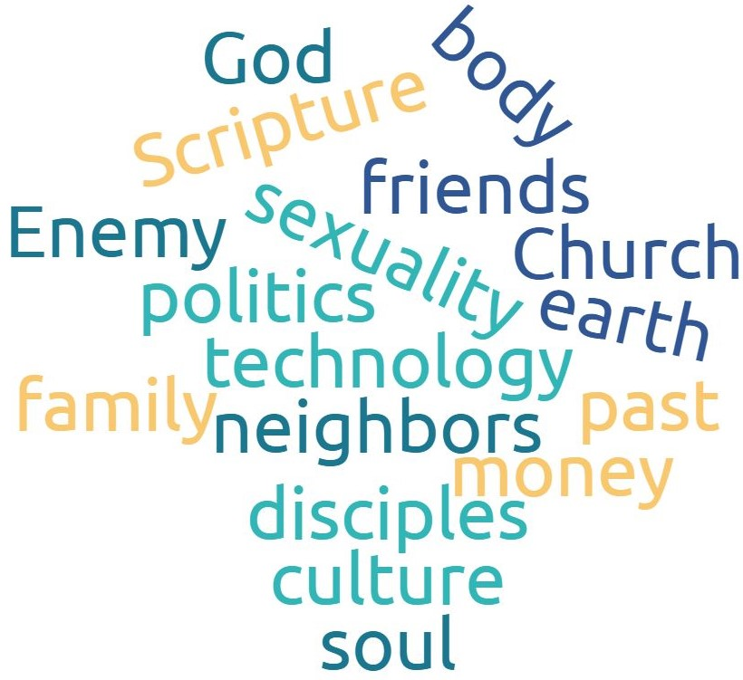
GOSPEL RELATING
Overlays like this

Slide 9
GOSPEL RELATING
Overlays like this
work

Slide 10
RELATING TO WORK

Slide 11
Relating to Work
^{3:22} Bondservants, obey in everything those who are your earthly masters, not by way of eye-service, as people-pleasers, but with sincerity of heart, fearing the Lord. ²³ Whatever you do, work heartily, as for the Lord and not for men, ²⁴ knowing that from the Lord you will receive the inheritance as your reward. You are serving the Lord Christ. ²⁵ For the wrongdoer will be paid back for the wrong he has done, and there is no partiality. ^{4:1} Masters, treat your bondservants justly and fairly, knowing that you also have a Master in heaven.
Colossians 3:22-4:1

Slide 12
Relating to Work
^{3:22} Bondservants, obey in everything those who are your earthly masters, not by way of eye-service, as people-pleasers, but with sincerity of heart, fearing the Lord. ²³ Whatever you do, work heartily, as for the Lord and not for men, ²⁴ knowing that from the Lord you will receive the inheritance as your reward. You are serving the Lord Christ. ²⁵ For the wrongdoer will be paid back for the wrong he has done, and there is no partiality. ^{4:1} Masters, treat your bondservants justly and fairly, knowing that you also have a Master in heaven.
Colossians 3:22-4:1
The Lord God took the man and put him in the garden of Eden to work it and keep it. Genesis 2:15

Slide 13
Relating to Work
^{3:22} Bondservants, obey in everything those who are your earthly masters, not by way of eye-service, as people-pleasers, but with sincerity of heart, fearing the Lord. ²³ Whatever you do, work heartily, as for the Lord and not for men, ²⁴ knowing that from the Lord you will receive the inheritance as your reward. You are serving the Lord Christ. ²⁵ For the wrongdoer will be paid back for the wrong he has done, and there is no partiality. ^{4:1} Masters, treat your bondservants justly and fairly, knowing that you also have a Master in heaven.
Colossians 3:22-4:1
^{17b} …cursed is the ground because of you; in pain you shall eat of it all the days of your life; ¹⁸ thorns and thistles it shall bring forth for you; and you shall eat the plants of the field. ^{19a} By the sweat of your face you shall eat bread… Genesis 3:17b-19a

Slide 14
Relating to Work
^{3:22} Bondservants, obey in everything those who are your earthly masters, not by way of eye-service, as people-pleasers, but with sincerity of heart, fearing the Lord. ²³ Whatever you do, work heartily, as for the Lord and not for men, ²⁴ knowing that from the Lord you will receive the inheritance as your reward. You are serving the Lord Christ. ²⁵ For the wrongdoer will be paid back for the wrong he has done, and there is no partiality. ^{4:1} Masters, treat your bondservants justly and fairly, knowing that you also have a Master in heaven.
Colossians 3:22-4:1

Slide 15
Relating to Work
^{3:22} Bondservants, obey in everything those who are your earthly masters, not by way of eye-service, as people-pleasers, but with sincerity of heart, fearing the Lord. ²³ Whatever you do, work heartily, as for the Lord and not for men, ²⁴ knowing that from the Lord you will receive the inheritance as your reward. You are serving the Lord Christ. ²⁵ For the wrongdoer will be paid back for the wrong he has done, and there is no partiality. ^{4:1} Masters, treat your bondservants justly and fairly, knowing that you also have a Master in heaven.
Colossians 3:22-4:1
Who do we work for?
How should we work?
Why should we work this way?
Where do we get energy to work this way?

Slide 16
Relating to Work
^{3:22} Bondservants, obey in everything those who are your earthly masters, not by way of eye-service, as people-pleasers, but with sincerity of heart, fearing the Lord. ²³ Whatever you do, work heartily, as for the Lord and not for men, ²⁴ knowing that from the Lord you will receive the inheritance as your reward. You are serving the Lord Christ. ²⁵ For the wrongdoer will be paid back for the wrong he has done, and there is no partiality. ^{4:1} Masters, treat your bondservants justly and fairly, knowing that you also have a Master in heaven.
Colossians 3:22-4:1
Who do we work for?

Slide 17
Who do we work for?

Slide 18
Who do we work for?

Slide 19
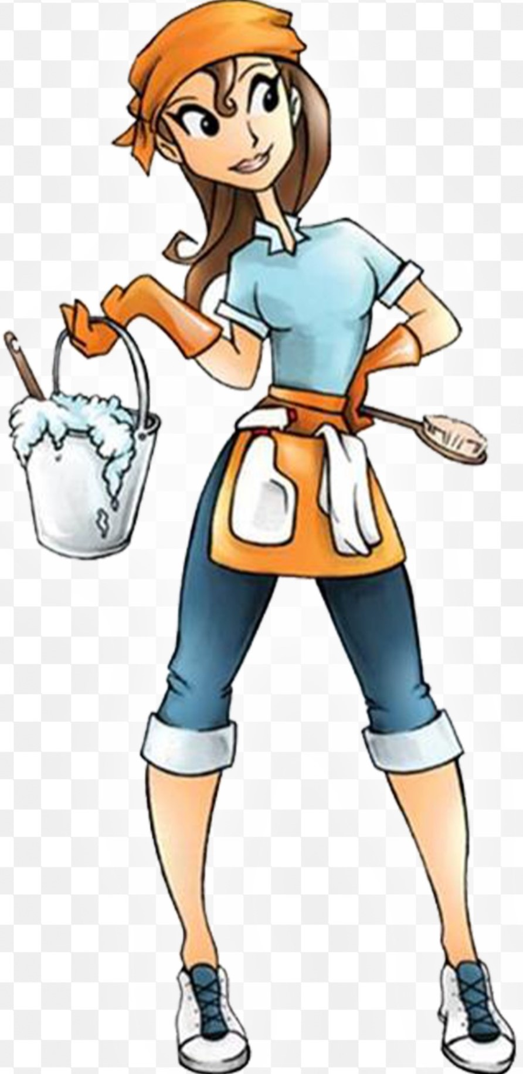
Who do we work for?

Slide 20
Who do we work for?

Slide 21
Who do we work for?

Slide 22
Who do we work for?

Slide 23
Who do we work for?

Slide 24
Who do we work for?

Slide 25
Who do we work for?

Slide 26
Who do we work for?

Slide 27
Who do we work for?

Slide 28
Who do we work for?
^{3:22} Bondservants, obey in everything those who are your earthly masters, not by way of eye-service, as people-pleasers, but with sincerity of heart, fearing the Lord. ²³ Whatever you do, work heartily, as for the Lord and not for men, ²⁴ knowing that from the Lord you will receive the inheritance as your reward. You are serving the Lord Christ. ²⁵ For the wrongdoer will be paid back for the wrong he has done, and there is no partiality. ^{4:1} Masters, treat your bondservants justly and fairly, knowing that you also have a Master in heaven.
Colossians 3:22-4:1
We work for Jesus.

Slide 29
Who do we work for?
^{3:22} Bondservants, obey in everything those who are your earthly masters, not by way of eye-service, as people-pleasers, but with sincerity of heart, fearing the Lord. ²³ Whatever you do, work heartily, as for the Lord and not for men, ²⁴ knowing that from the Lord you will receive the inheritance as your reward. You are serving the Lord Christ. ²⁵ For the wrongdoer will be paid back for the wrong he has done, and there is no partiality. ^{4:1} Masters, treat your bondservants justly and fairly, knowing that you also have a Master in heaven.
Colossians 3:22-4:1
1. Worship Jesus at work.

Slide 30
Who do we work for?
Romans 12:1 I appeal to you therefore, brothers, by the mercies of God, to present your bodies as a living sacrifice, holy and acceptable to God, which is your spiritual worship.
1 Corinthians 10:31 So, whether you eat or drink, or whatever you do, do all to the glory of God.
1. Worship Jesus at work.

Slide 31
Who do we work for?
Colossians 3:17 And whatever you do, in word or deed, do everything in the name of the Lord Jesus, giving thanks to God the Father through him.
Colossians 3:17 ^{NLT} And whatever you do or say, do it as a representative of the Lord Jesus, giving thanks through him to God the Father.
See also Exodus 35:10; 1 Chronicles 22:15-16; Proverbs 22:29
1. Represent Jesus at work.

Slide 32
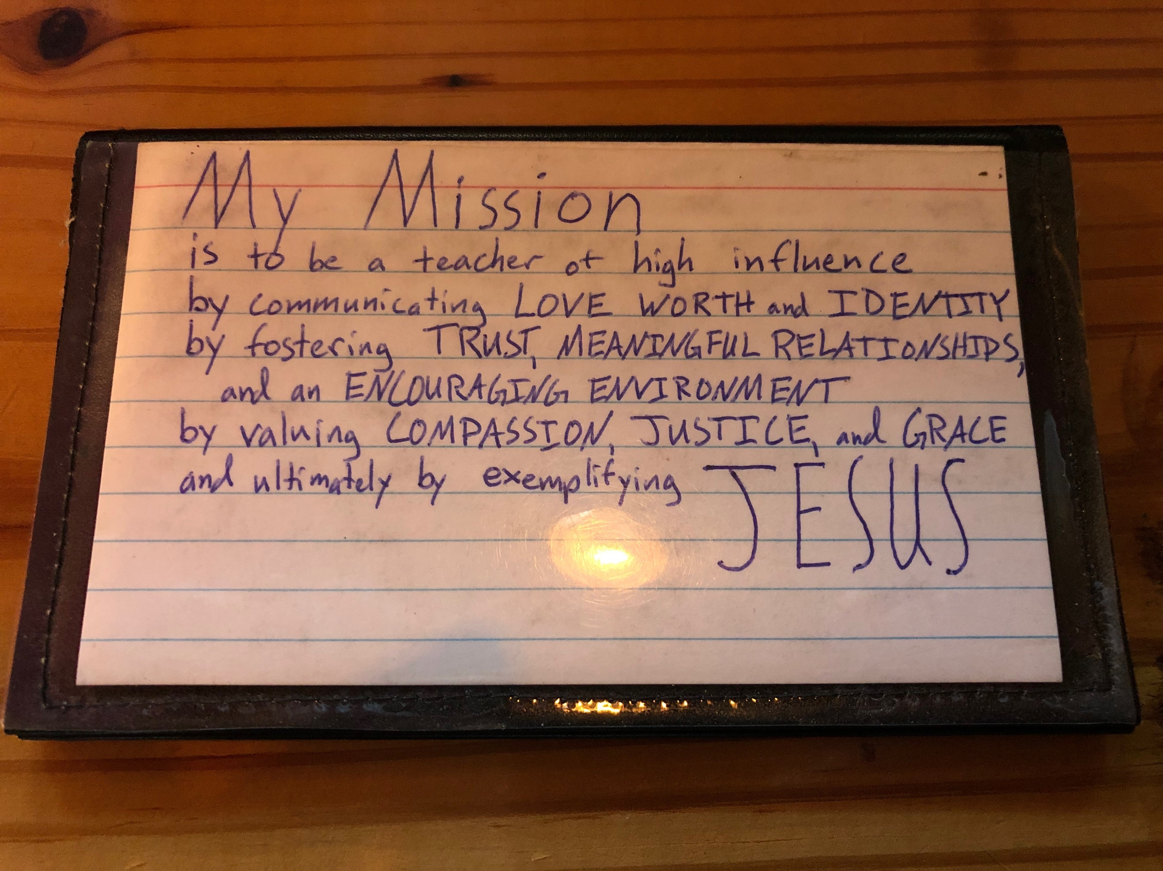
Who do we work for?
Peter Ruby’s workplace Mission Statement
1. Represent Jesus at work.

Slide 33
Sacred
Secular

Slide 34
Spiritual
Physical

Slide 35
Heavenly
Earthly

Slide 36
Church
Outside Church

Slide 37
Sundays
Mondays thru Fridays

Slide 38
Big Idea: Work like you work for Jesus, because you do!
Sundays
Mondays thru Fridays

Slide 39
Big Idea: Work like you work for Jesus, because you do!
Sundays
Sundays thru Saturdays

Slide 40
How should we work?
^{3:22} Bondservants, obey in everything those who are your earthly masters, not by way of eye-service, as people-pleasers, but with sincerity of heart, fearing the Lord. ²³ Whatever you do, work heartily, as for the Lord and not for men, ²⁴ knowing that from the Lord you will receive the inheritance as your reward. You are serving the Lord Christ. ²⁵ For the wrongdoer will be paid back for the wrong he has done, and there is no partiality. ^{4:1} Masters, treat your bondservants justly and fairly, knowing that you also have a Master in heaven.
Colossians 3:22-4:1
Who do we work for?
How should we work?
Why work this way?
Where do we get energy to work this way?

Slide 41
How should we work?
^{3:22} Bondservants, obey in everything those who are your earthly masters, not by way of eye-service, as people-pleasers, but with sincerity of heart, fearing the Lord. ²³ Whatever you do, work heartily, as for the Lord and not for men, ²⁴ knowing that from the Lord you will receive the inheritance as your reward. You are serving the Lord Christ. ²⁵ For the wrongdoer will be paid back for the wrong he has done, and there is no partiality. ^{4:1} Masters, treat your bondservants justly and fairly, knowing that you also have a Master in heaven.
Colossians 3:22-4:1
1. Respectfully & Cooperatively

Slide 42
How should we work?
^{3:22} Bondservants, obey in everything those who are your earthly masters, not by way of eye-service, as people-pleasers, but with sincerity of heart, fearing the Lord. ²³ Whatever you do, work heartily, as for the Lord and not for men, ²⁴ knowing that from the Lord you will receive the inheritance as your reward. You are serving the Lord Christ. ²⁵ For the wrongdoer will be paid back for the wrong he has done, and there is no partiality. ^{4:1} Masters, treat your bondservants justly and fairly, knowing that you also have a Master in heaven.
Colossians 3:22-4:1
Servants, be subject to your masters with all respect, not only to the good and gentle but also to the unjust. 1 Peter 2:18

Slide 43
How should we work?
^{3:22} Bondservants, obey in everything those who are your earthly masters, not by way of eye-service, as people-pleasers, but with sincerity of heart, fearing the Lord. ²³ Whatever you do, work heartily, as for the Lord and not for men, ²⁴ knowing that from the Lord you will receive the inheritance as your reward. You are serving the Lord Christ. ²⁵ For the wrongdoer will be paid back for the wrong he has done, and there is no partiality. ^{4:1} Masters, treat your bondservants justly and fairly, knowing that you also have a Master in heaven.
Colossians 3:22-4:1
2. Hard

Slide 44
How should we work?
^{3:22} Bondservants, obey in everything those who are your earthly masters, not by way of eye-service, as people-pleasers, but with sincerity of heart, fearing the Lord. ²³ Whatever you do, work heartily, as for the Lord and not for men, ²⁴ knowing that from the Lord you will receive the inheritance as your reward. You are serving the Lord Christ. ²⁵ For the wrongdoer will be paid back for the wrong he has done, and there is no partiality. ^{4:1} Masters, treat your bondservants justly and fairly, knowing that you also have a Master in heaven.
Colossians 3:22-4:1
3. Justly & Fairly

Slide 45
How should we work?
Ephesians 6:7 …rendering service with a good will as to the Lord and not to man…
1 Thessalonians 4:10b-12 ^{10b} But we urge you, brothers, to do this more and more, ¹¹ and to aspire to live quietly, and to mind your own affairs, and to work with your hands, as we instructed you, ¹² so that you may walk properly before outsiders and be dependent on no one.
4. Benevolently

Slide 46
Why work this way?
^{3:22} Bondservants, obey in everything those who are your earthly masters, not by way of eye-service, as people-pleasers, but with sincerity of heart, fearing the Lord. ²³ Whatever you do, work heartily, as for the Lord and not for men, ²⁴ knowing that from the Lord you will receive the inheritance as your reward. You are serving the Lord Christ. ²⁵ For the wrongdoer will be paid back for the wrong he has done, and there is no partiality. ^{4:1} Masters, treat your bondservants justly and fairly, knowing that you also have a Master in heaven.
Colossians 3:22-4:1
1. We work for Jesus

Slide 47
Why work this way?
Titus 2:9-10 ⁹ Bondservants are to be submissive to their own masters in everything; they are to be well-pleasing, not argumentative, ¹⁰ not pilfering, but showing all good faith, so that in everything they may adorn the doctrine of God our Savior.
See also Philippians 2:14-16
2. To adorn the Gospel

Slide 48
Why work this way?
Romans 8:28-29 ²⁸ And we know that for those who love God all things work together for good, for those who are called according to his purpose. ²⁹ For those whom he foreknew he also predestined to be conformed to the image of his Son, in order that he might be the firstborn among many brothers.
3. Character development

Slide 49
Why work this way?
Colossians 3:23-24 ²³ Whatever you do, work heartily, as for the Lord and not for men, ²⁴ knowing that from the Lord you will receive the inheritance as your reward. You are serving the Lord Christ.
Ephesians 6:7-8 ⁷ …rendering service with a good will as to the Lord and not to man, ⁸ knowing that whatever good anyone does, this he will receive back from the Lord, whether he is a bondservant or is free.
4. Reward

Slide 50
Where do we get energy?
Exhortations to Body-life almost always precedes exhortation about our social roles!
See Colossians 3-4; Romans 12-13; Ephesians 5-6; 1 Peter 1-3
1. Christian Community

Slide 51
Where do we get energy?
Colossians 4:2 Continue steadfastly in prayer, being watchful in it with thanksgiving.
2. Talking to Jesus

Slide 52
Where do we get energy?
Colossians 4:2 Continue steadfastly in prayer, being watchful in it with thanksgiving.
3. Giving Thanks

Slide 53
Reflection Questions:
What might happen in our workplaces and in our community if we worked like we worked for Jesus?
What might happen in and through our church if we worshiped and represented Jesus at work?
What might happen if we worked respectfully and cooperatively with our supervisors and coworkers and subordinates?
What might happen if we were known as hard workers who could be trusted and who were fair and just and made the workplace morale go up?
What might happen if we worked in such a way as to make the Gospel look attractive to those we work with?

Slide 54
Reflection Questions:
What might happen if we focused on character development in the workplace, welcoming each and every challenging situation and person as a gift from God?
What might happen if we worked for Jesus for the compensation that He promises that far outweighs dollar bills?
How can Christian community be more a part of your work?
How can prayer be more a part of your work?
How can giving thanks be more a part of your work?

Slide 55
BECOME A BETTER LEADER
Register for $39 (down from $209)! Talk to Ben Deaver. More info at tallgrass.church.

Slide 56
RECOMMEDED RESOURCES:
Propositions on Christ, Culture, and Career at xenos.org Article by Dennis McCallum & Scott Risley

Slide 58
RELATING TO WORK

Slide 60
MYSTERY OF FAITH

Slide 61
MYSTERY OF FAITH
Christ has died,
Christ is risen,
Christ will come again!
[repeat]

Slide 62
MYSTERY OF FAITH
We have died together,
We will rise together,
We will live together,
The body, O, the body
We are the body of Christ.

Slide 63
MYSTERY OF FAITH
We are brothers
and sisters
through our Savior’s blood.
[repeat]

Slide 64
MYSTERY OF FAITH
We have died together,
We will rise together,
We will live together,
The body, O, the body
We are the body of Christ.

Slide 66
COME THOU FOUNT

Slide 67
COME THOU FOUNT
Come thou fount of every blessing
Tune my heart to sing thy grace
Streams of mercy, never ceasing
call for songs of loudest praise
Teach me some melodious sonnet
sung by flaming tongues above
Praise the mount, I’m fixed upon it
Mount of Thy redeeming love

Slide 68
COME THOU FOUNT
Here I raise my *Ebenezer
Hither by Thy help I’m come
And I hope by Thy good pleasure
safely to arrive at home
Jesus sought me when a stranger
wandering from the fold of God
He, to rescue me from danger
interposed His precious love *1 Samuel 7:12

Slide 69
COME THOU FOUNT
O to grace how great a debtor
daily I’m constrained to be
Let Thy goodness like a fetter
bind my wandering heart to Thee
Prone to wander, Lord I feel it
Prone to leave the God I love
Here’s my heart, O take and seal it
Seal it for Thy courts above

Slide 71
GOD OF THIS CITY

Slide 72
GOD OF THIS CITY
You're the God of this city
You're the King of these people
You're the Lord of this nation
You are

Slide 73
GOD OF THIS CITY
You're the light in this darkness
You're the hope to the hopeless
You're the peace to the restless
You are

Slide 74
GOD OF THIS CITY
There is no one like our God
There is no one like our God

Slide 75
GOD OF THIS CITY
For greater things have yet to come
And greater things are still to be done in this city
Greater things have yet to come
And greater things are still to be done in this city

Slide 76
GOD OF THIS CITY
You're the God of this city
You're the King of these people
You're the Lord of this nation
You are

Slide 77
GOD OF THIS CITY
You're the light in this darkness
You're the hope to the hopeless
You're the peace to the restless
You are

Slide 78
GOD OF THIS CITY
There is no one like our God
There is no one like our God

Slide 79
GOD OF THIS CITY
For greater things have yet to come
And greater things are still to be done in this city
Greater things have yet to come
And greater things are still to be done in this city

Slide 81
MYSTERY OF FAITH

Slide 82
MYSTERY OF FAITH
Christ has died,
Christ is risen,
Christ will come again!
[repeat]

Slide 83
MYSTERY OF FAITH
We have died together,
We will rise together,
We will live together,
The body, O, the body
We are the body of Christ.

Slide 84
MYSTERY OF FAITH
We are brothers
and sisters
through our Savior’s blood.
[repeat]

Slide 85
MYSTERY OF FAITH
We have died together,
We will rise together,
We will live together,
The body, O, the body
We are the body of Christ.

Slide 87
THE BENEDICTION

Slide 88
THE BENEDICTION
My friends may you grow in grace
And in the knowledge
Of our Lord and Savior.
My friends may you grow in grace
And in the knowledge
Of Jesus Christ.

Slide 89
THE BENEDICTION
To God be the glory
Now and forever,
Now and forever amen.
(repeat)

Slide 90
THE BENEDICTION
I pray tonight if we
Learned from one another,
May we glorify Him.
And if the Lord should
Bring us back together,
May we be in his arms till then.

Slide 91
THE BENEDICTION
My friends may you grow in grace
And in the knowledge
Of our Lord and Savior.
My friends may you grow in grace
And in the knowledge
Of Jesus Christ.

