Slide 1
WELCOME

Slide 2
HAPPY MOTHER’S DAY

Slide 3
WELCOME

Slide 4
PARENTS AS FAITH TEACHERS

Slide 5
PARENTS AS FAITH TEACHERS
DEUTERONOMY 4:9,10: “Only take care, and keep your soul diligently, lest you forget the things that your eyes have seen, and lest they depart from your heart all the days of your life. Make them known to your children and your children’s children – how on the day that you stood before the Lord your God at Horeb, the Lord said to me, ‘Gather the people to me, that I may let hear my words, so that they may learn to fear me all the days that they live on the earth, and that they may teach their children so.”

Slide 6
PARENTS AS FAITH TEACHERS
DEUTERONOMY 6:4-7: “Hear, O Israel: The Lord our God, the Lord is one. You shall love the Lord your God with all your heart and with all your soul and with all your might. And these words that I command you today shall be on your heart. You shall teach them diligently to your children, and shall talk of them when you sit in your house, and when you walk by the way, and when you lie down, and when you rise.”
Also Deut. 11:18,19 – identical instructions!

Slide 7
PARENTS AS FAITH TEACHERS
PROVERBS 1:8,9:
“Hear, my son your Father’s instruction,
and forsake not your mother’s teaching,
for they are a graceful garland for your head
and pendants for your neck.”

Slide 8
PARENTS AS FAITH TEACHERS
II Timothy 3:14,15: “But as for you, continue in what you have learned and have firmly believed, knowing from whom you learned it, and how from childhood you have been acquainted with the sacred writings which are able to make you wise for salvation through faith in Christ Jesus.”

Slide 9
Mother’s
Day Panel
with Amalie Greeve,
Stephanie Chitwood,
Elisha Hillegeist,
& Kassi Chapman

Slide 10
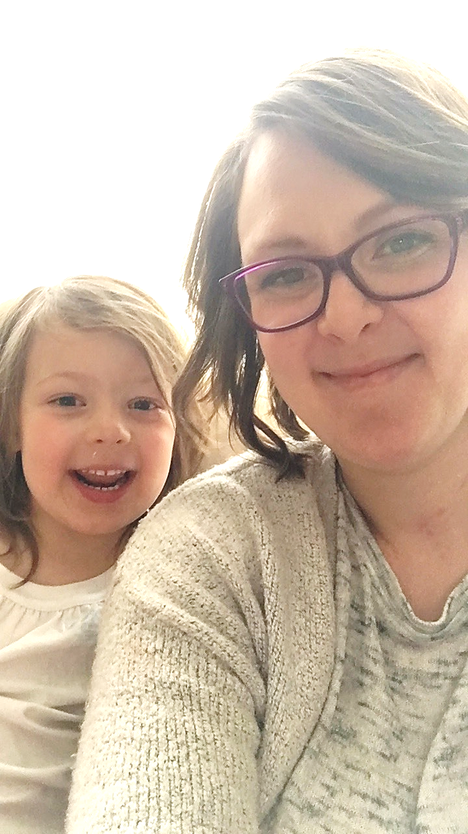
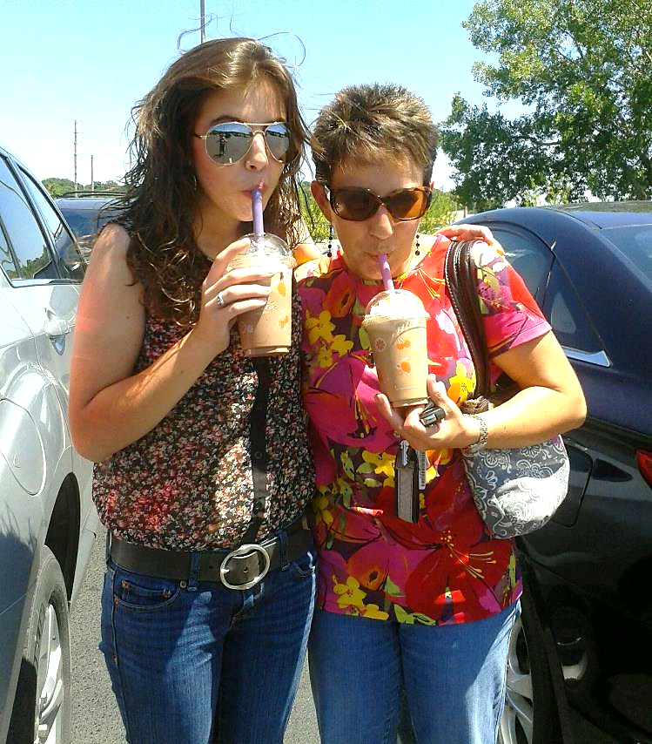
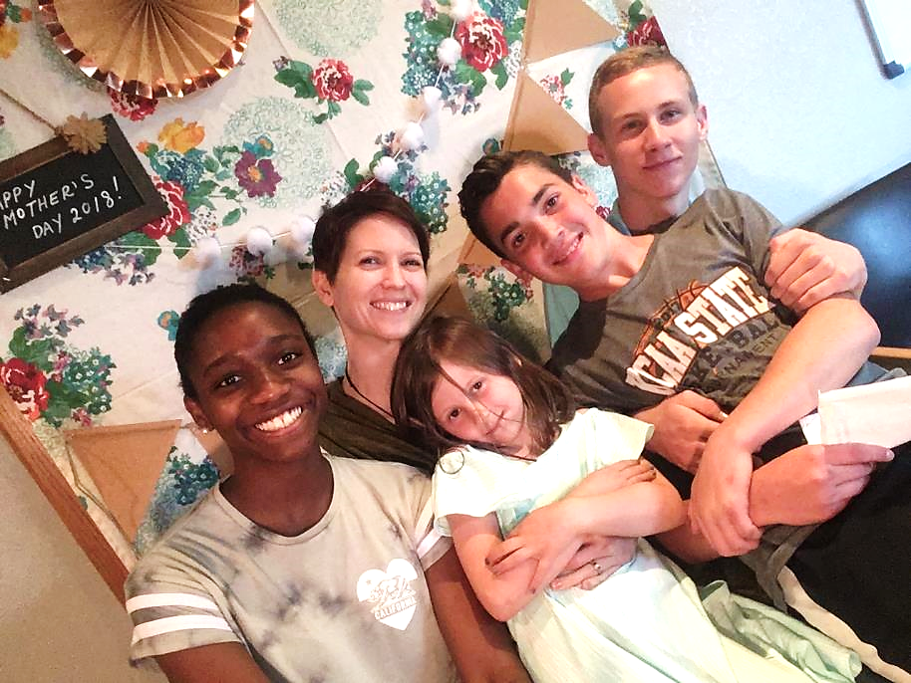
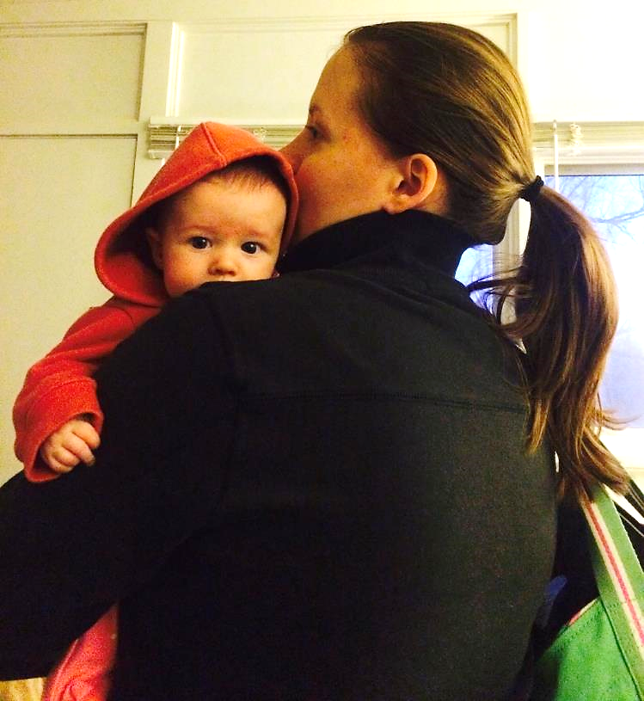

Slide 11
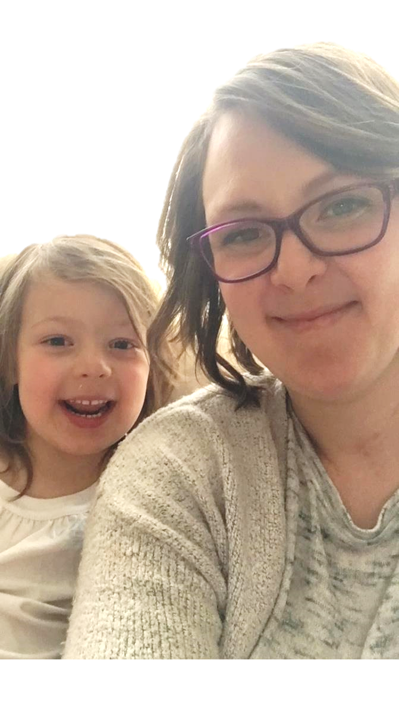
MOTHER’S DAY PANEL
Elisha Hillegeist

Slide 12
ELISHA HILLEGEIST

Slide 13
ELISHA HILLEGEIST

Slide 14
ELISHA HILLEGEIST

Slide 15
MOTHER’S DAY PANEL
Kassi Chapman

Slide 16
KASSI CHAPMAN

Slide 17
KASSI CHAPMAN

Slide 18
KASSI CHAPMAN

Slide 19
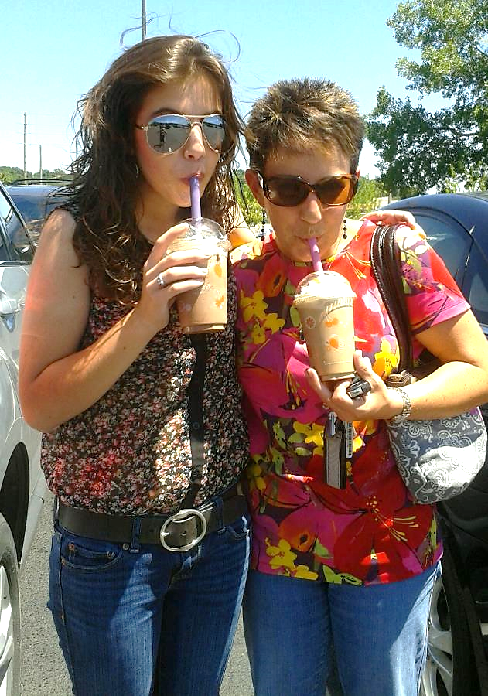
MOTHER’S DAY PANEL
Stephanie Chitwood

Slide 20
STEPHANIE CHITWOOD

Slide 21
STEPHANIE CHITWOOD

Slide 22
STEPHANIE CHITWOOD
Whoa, Mom’s Serious!
Listen to this devotion
Arlene Pellicane

Slide 23
STEPHANIE CHITWOOD

Slide 24
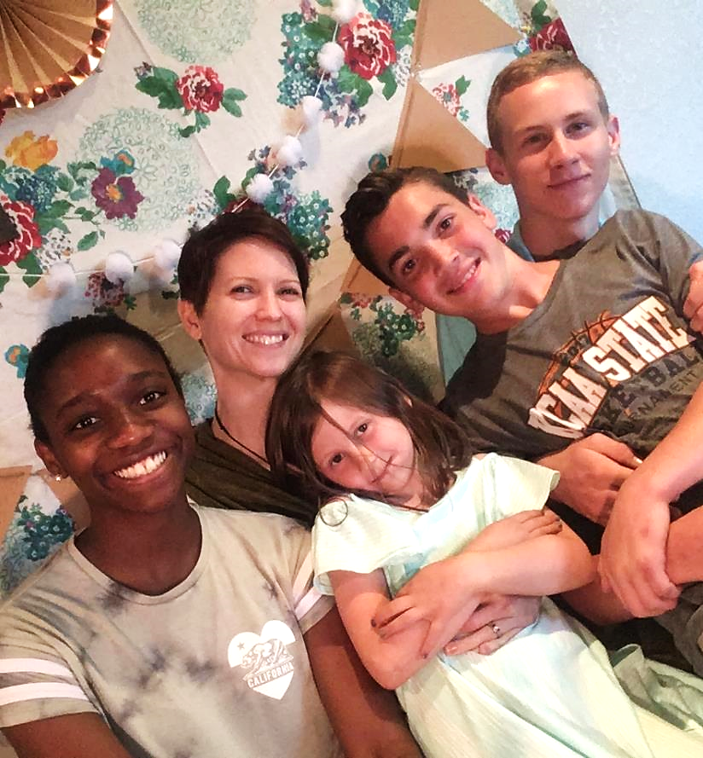
MOTHER’S DAY PANEL
Amalie Greeve

Slide 25
AMALIE GREEVE

Slide 26
AMALIE GREEVE

Slide 27
Mother’s
Day Panel
Q&R
with Amalie Greeve,
Stephanie Chitwood,
Elisha Hillegeist,
& Kassi Chapman

