Slide 1
HAPPY
EASTER!

Slide 4
Robed in shame
for our glory

Slide 5
Easter’s Good News:
Our King’s path to enthronement
was to robe Himself in our shame.
He buried our shame in His Body.
Then, through the Resurrection,
our King robes us in His glory!

Slide 6
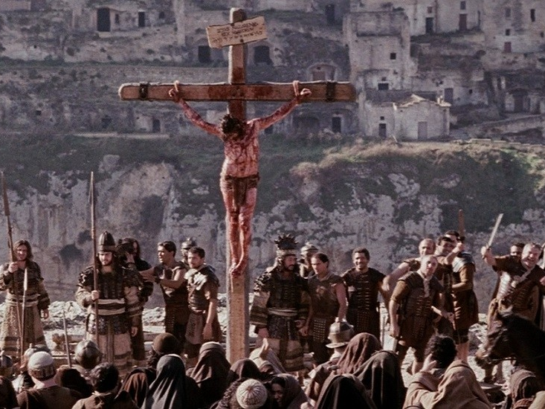

Slide 7
2 Corinthians 5:21 For our sake he made him to be sin who knew no sin, so that in him we might become the righteousness of God.

Slide 8
 | Guilt | Shame
Definition: | Feeling when I’ve done something objectively wrong. | Shame is an intensely painful feeling of being fundamentally flawed.
Examples:
Develops when?
How to try to deal with it?
How Jesus deals with it?

Slide 9
 | Guilt | Shame
Definition: | Feeling when I’ve done something objectively wrong. | Shame is an intensely painful feeling of being fundamentally flawed.
Examples: | “I did something bad.” “I need to right a wrong.” | “I am bad.” “I am worthless.”
Develops when?
How to try to deal with it?
How Jesus deals with it?

Slide 10
 | Guilt | Shame
Definition: | Feeling when I’ve done something objectively wrong. | Shame is an intensely painful feeling of being fundamentally flawed.
Examples: | “I did something bad.” “I need to right a wrong.” | “I am bad.” “I am worthless.”
Develops when? | As early as age 3-6 | As early as 15 months
How to try to deal with it?
How Jesus deals with it?

Slide 11
 | Guilt | Shame
Definition: | Feeling when I’ve done something objectively wrong. | Shame is an intensely painful feeling of being fundamentally flawed.
Examples: | “I did something bad.” “I need to right a wrong.” | “I am bad.” “I am worthless.”
Develops when? | As early as age 3-6 | As early as 15 months
How to try to deal with it? | Face the behavior that hurt self and others. Take responsibility. Seek forgiveness. Change destructive attitudes and behaviors. | Exercise self-compassion. Pursue relationships. Nurture connections and a sense of belonging with others.
How Jesus deals with it?

Slide 12
 | Guilt | Shame
Definition: | Feeling when I’ve done something objectively wrong. | Shame is an intensely painful feeling of being fundamentally flawed.
Examples: | “I did something bad.” “I need to right a wrong.” | “I am bad.” “I am worthless.”
Develops when? | As early as age 3-6 | As early as 15 months
How to try to deal with it? | Face the behavior that hurt self and others. Take responsibility. Seek forgiveness. Change destructive attitudes and behaviors. | Exercise self-compassion. Pursue relationships. Nurture connections and a sense of belonging with others.
How Jesus deals with it? | He bore our sins. | He bore our shame.

Slide 13
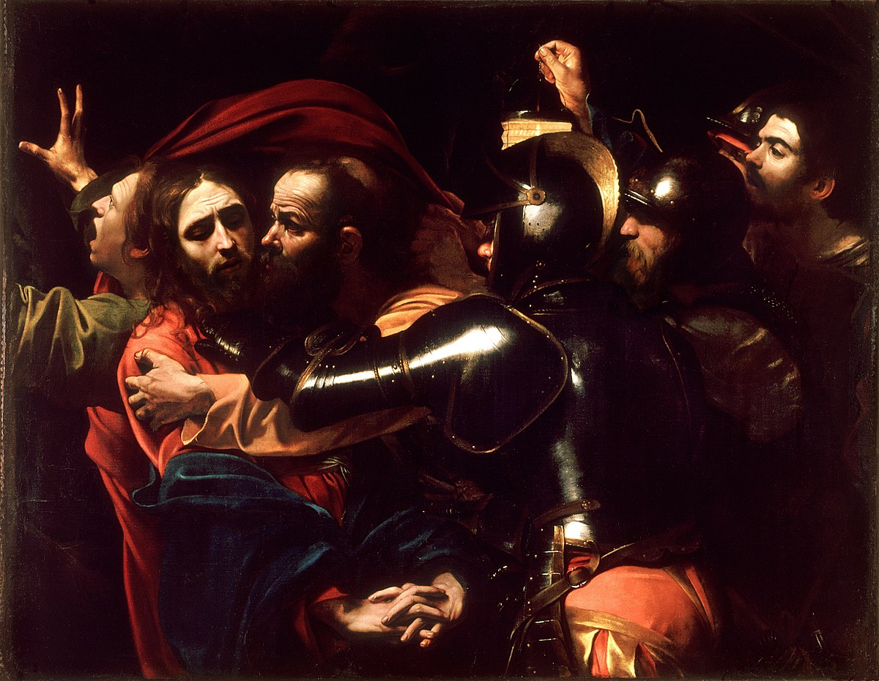
The Taking of Christ by Caravaggio
Judas Iscariot in Luke 22:47-48

Slide 14
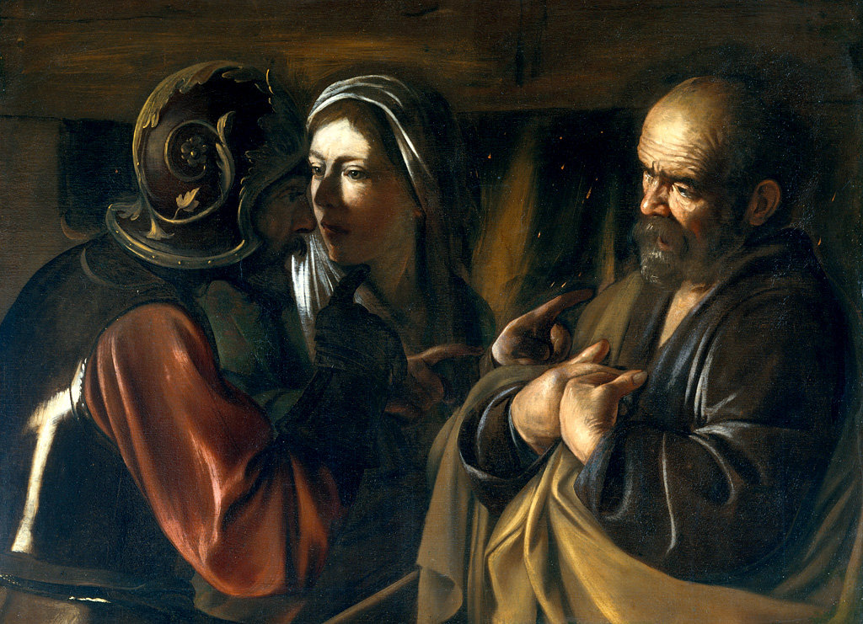
The Denial of Saint Peter by Caravaggio
Peter in Luke 22:61-62

Slide 15
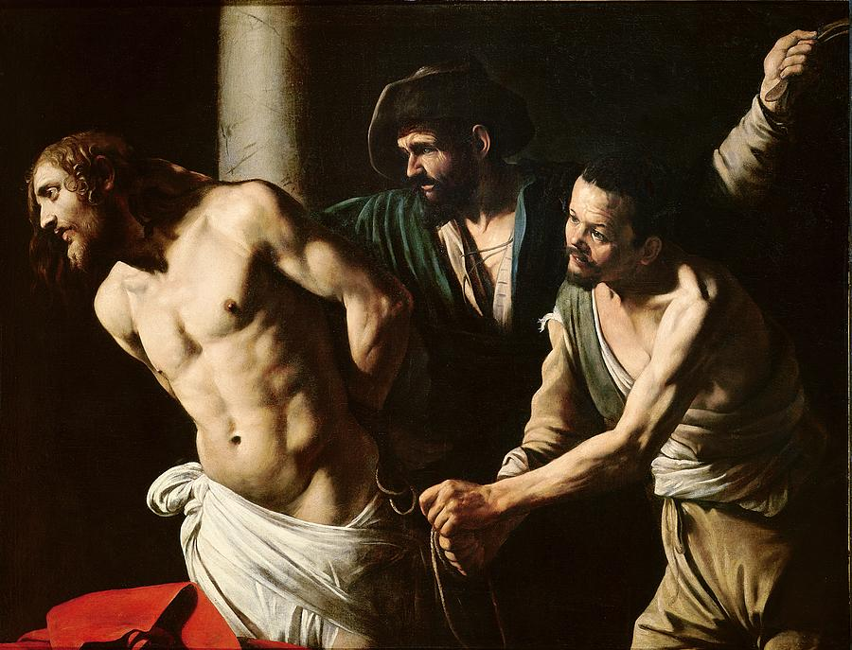
The Flagellation of Christ by Caravaggio
Prison Guards in Luke 22:63-65

Slide 16
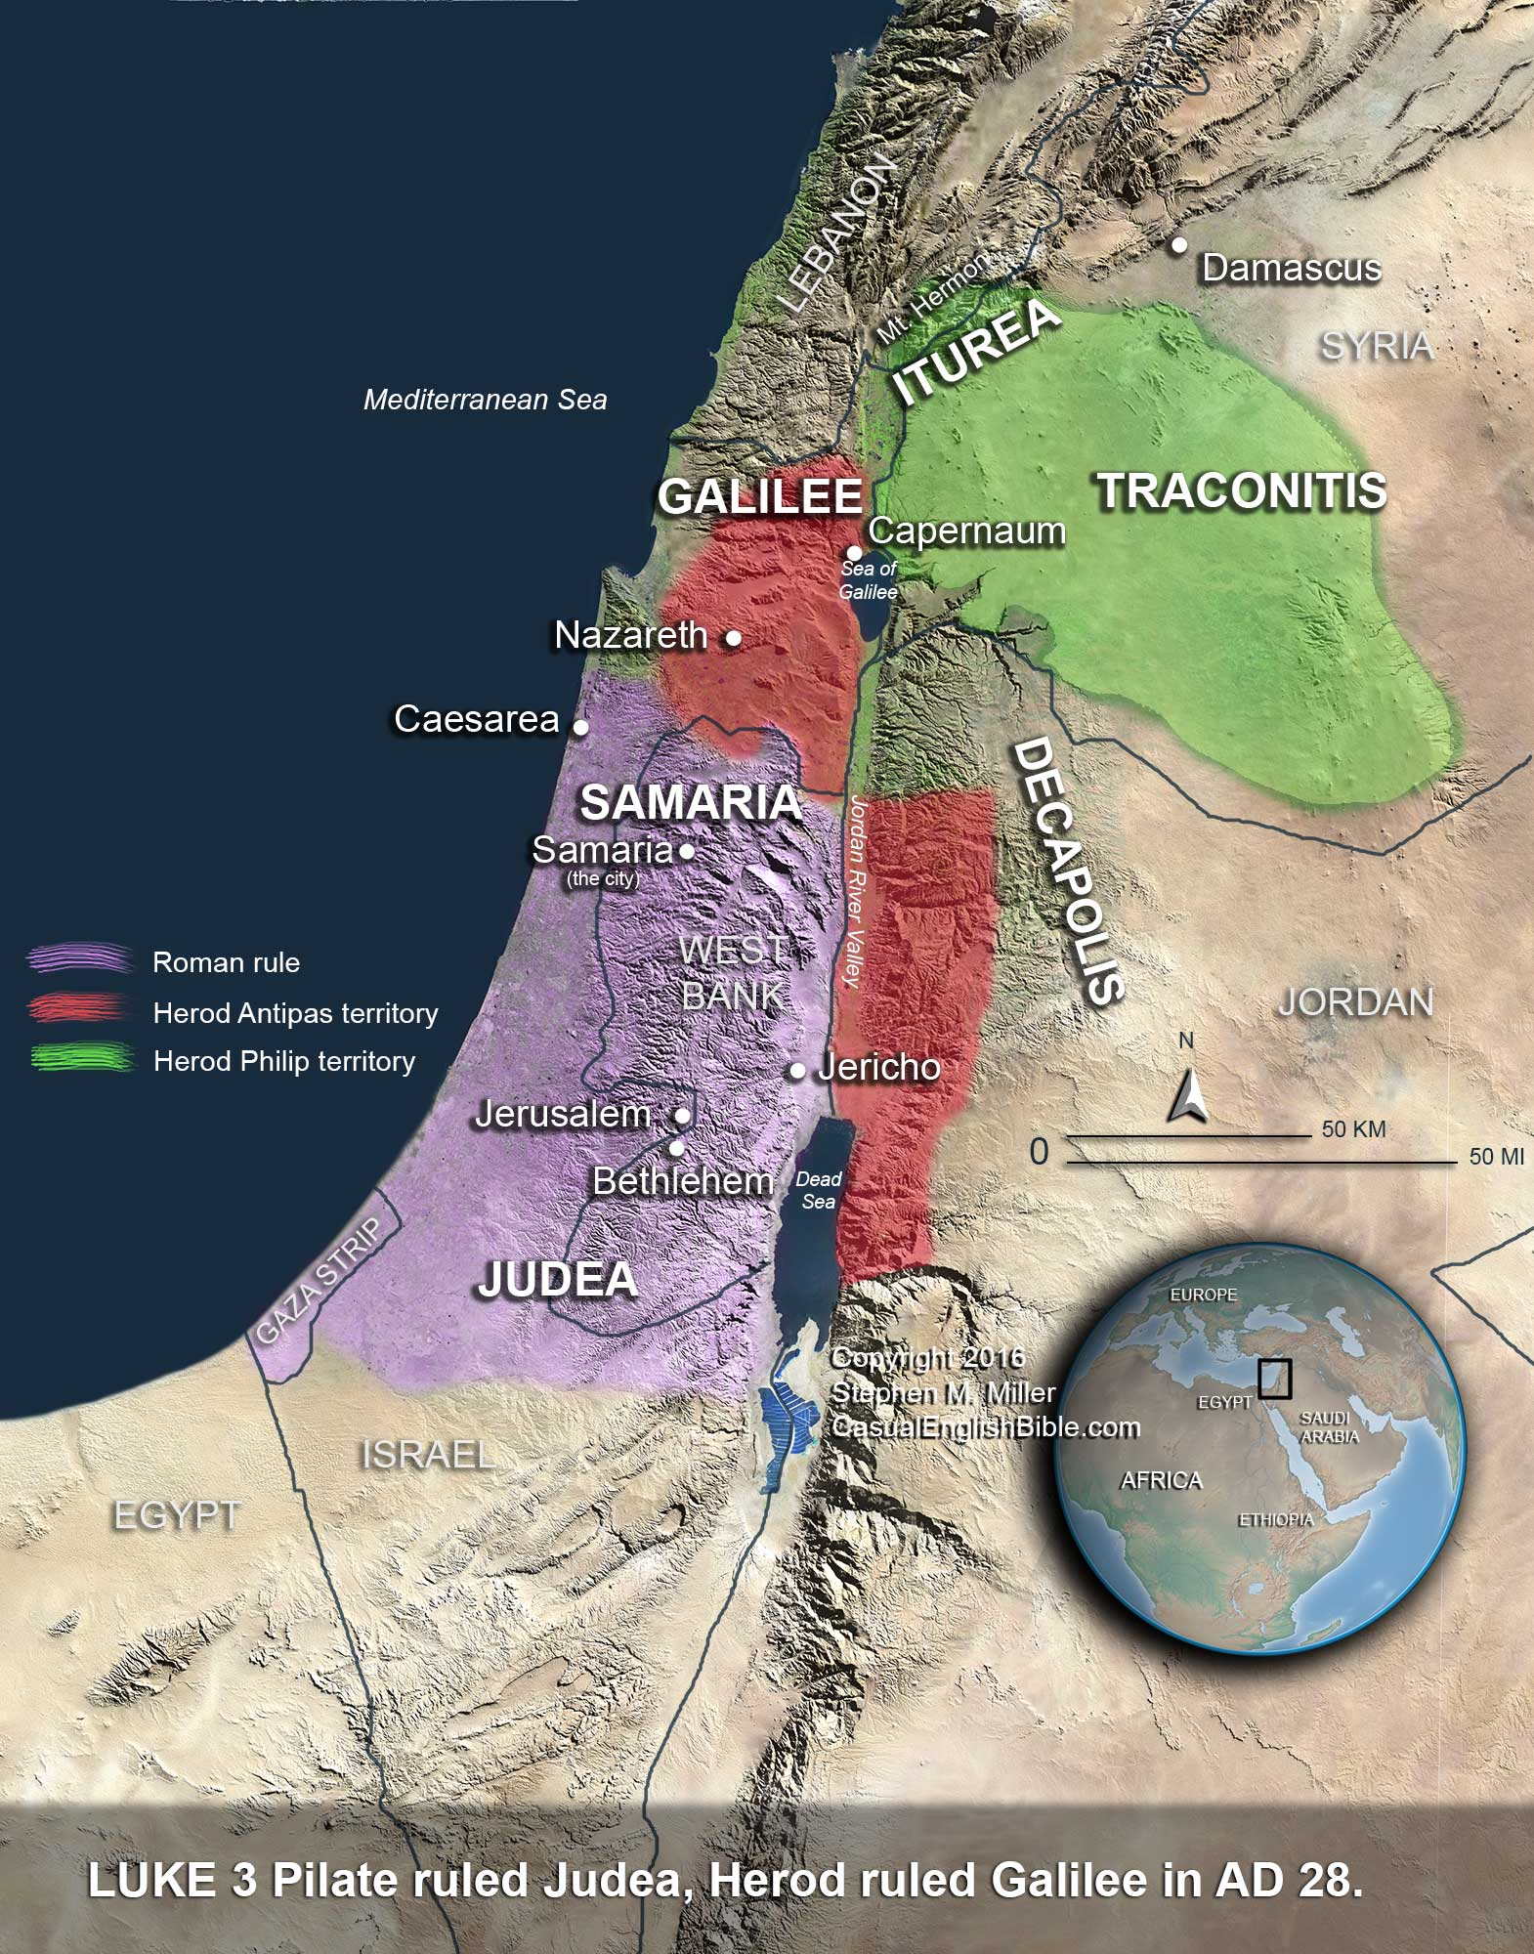
Map of Roman Rule & the Half-Brothers’ Territories
Herod Antipas & Pontius Pilate in Luke 23:8-12

Slide 17
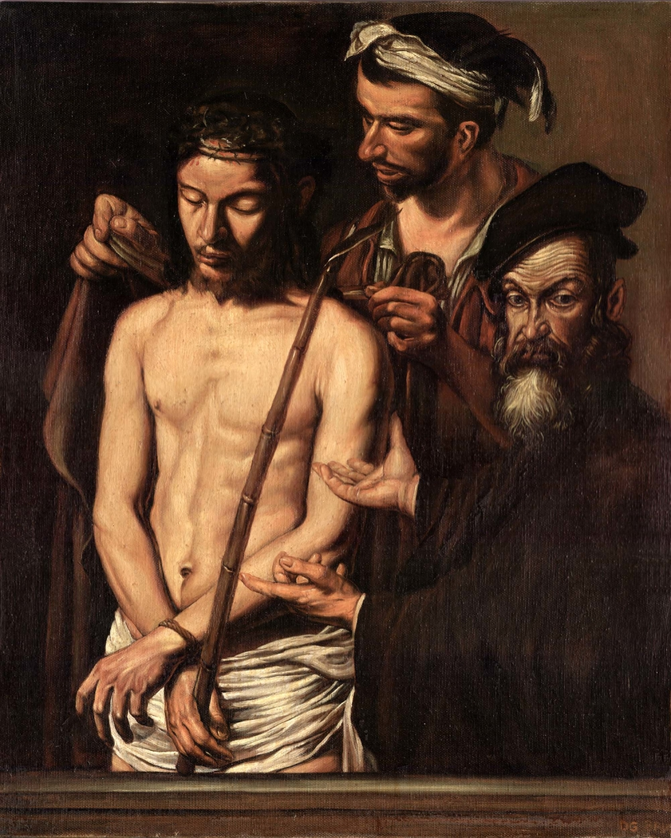
Ecce Homo by Caravaggio
Pontius Pilate in John 19:5

Slide 18
Crucifixion Scene from The Passion of the Christ
Bystanders, Soldiers, Criminals in Luke 23:34-49

Slide 19
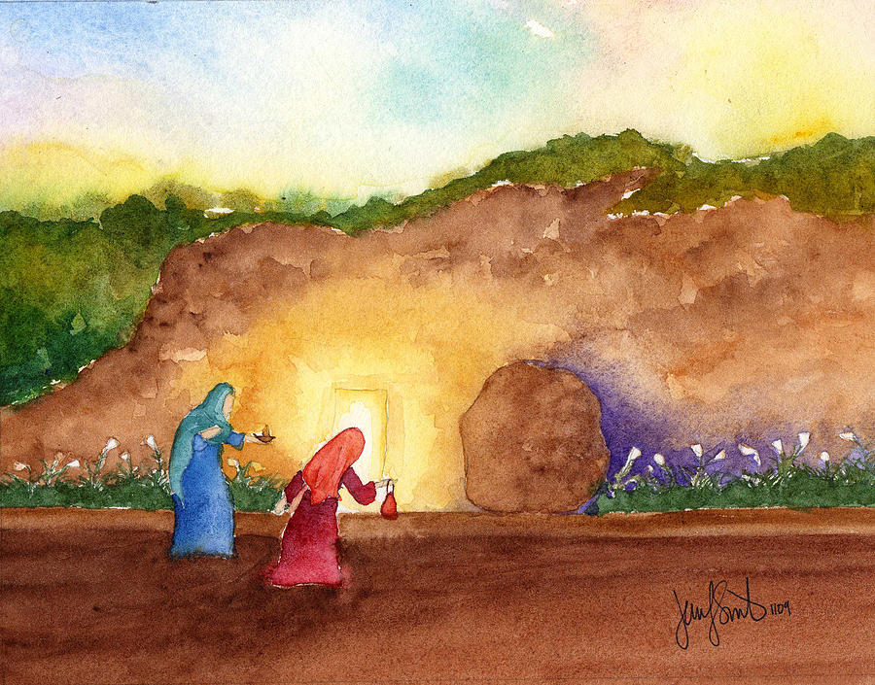

Slide 20
Luke 24:1-3 ¹ But on the first day of the week, at early dawn, they went to the tomb, taking the spices they had prepared. ² And they found the stone rolled away from the tomb, ³ but when they went in they did not find the body of the Lord Jesus.

Slide 21
Luke 24:4-5 ⁴ While they were perplexed about this, behold, two men stood by them in dazzling apparel. ⁵ And as they were frightened and bowed their faces to the ground, the men said to them, “Why do you seek the living among the dead?”

Slide 22
Luke 24:6-7 ⁶ “He is not here, but has risen. Remember how he told you, while he was still in Galilee, ⁷ that the Son of Man must be delivered into the hands of sinful men and be crucified and
on the third day rise.”

Slide 23
Luke 24:8-9 ⁸ And they remembered his words, ⁹ and returning from the tomb they told all these things to the eleven and to all the rest.

Slide 24
Luke 24:10-11 ¹⁰ Now it was Mary Magdalene and Joanna and Mary the mother of James and the other women with them who told these things to the apostles, ¹¹ but these words seemed to them
an idle tale, and they did not believe them.

Slide 25
Luke 24:12 But Peter rose and ran to the tomb; stooping
and looking in, he saw the linen cloths by themselves;
and he went home marveling at
what had happened.

Slide 26
1 Peter 2:24 He himself bore our sins in his body on the tree,
that we might die to sin and live to righteousness.
By his wounds you have been healed.

Slide 27
1 Peter 2:24 He himself bore our SHAME in his body on the tree,
that we might die to SHAME and live to GLORY.
By his wounds you have been healed.

Slide 28
1 Corinthians 15:3-4 ³ For I delivered to you as of first importance what I also received: that Christ died for our sins in accordance with the Scriptures, ⁴ that he was buried, that he was raised on the third day in accordance with the Scriptures…

Slide 29
1 Corinthians 15:17-19 ¹⁷ And if Christ has not been raised, your faith is futile and you are still in your sins. ¹⁸ Then those also who have fallen asleep in Christ have perished. ¹⁹ If in Christ we have hope in this life only, we are of all people most to be pitied.

Slide 30
1 Corinthians 15:17-20a ¹⁷ And if Christ has not been raised, your faith is futile and you are still in your sins. ¹⁸ Then those also who have fallen asleep in Christ have perished. ¹⁹ If in Christ we have hope in this life only, we are of all people most to be pitied.
^{20a} But in fact Christ has been raised from the dead…

Slide 31
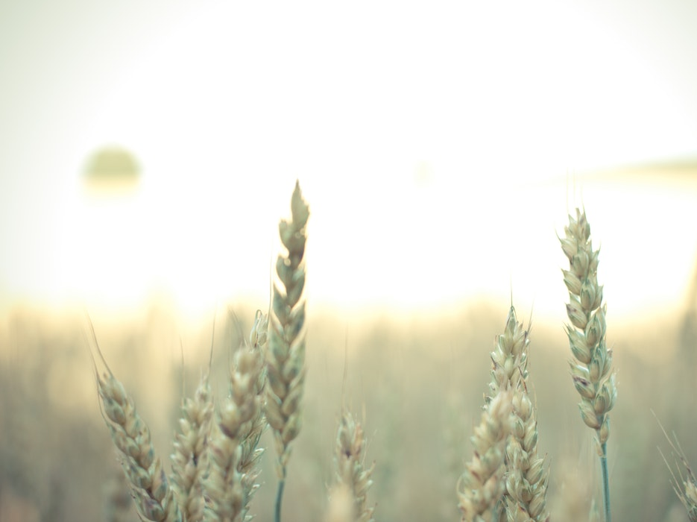
1 Corinthians 15:35-38 ³⁵ But someone will ask, “How are the dead raised? With what kind of body do they come?” ³⁶ You foolish person! What you sow does not come to life unless it dies. ³⁷ And what you sow is not the body that is to be, but a bare kernel, perhaps of wheat or of some other grain. ³⁸ But God gives it a body as he has chosen, and to each kind of seed its own body.

Slide 32
1 Corinthians 15:39-41 ³⁹ For not all flesh is the same, but there is one kind for humans, another for animals, another for birds, and another for fish. ⁴⁰ There are heavenly bodies and earthly bodies, but the glory of the heavenly is of one kind, and the glory of the earthly is of another. ⁴¹ There is one glory of the sun, and another glory of the moon, and another glory of the stars; for star differs from star in glory.

Slide 33
1 Corinthians 15:42-43 ⁴² So is it with the resurrection of the dead. What is sown is perishable; what is raised is imperishable. ⁴³ It is sown in dishonor; it is raised in glory. It is sown in weakness; it is raised in power.

Slide 34
1 Corinthians 15:42-43 ⁴² So is it with the resurrection of the dead. What is sown is perishable; what is raised is imperishable. ⁴³ It is sown in dishonor; it is raised in glory. It is sown in weakness; it is raised in power.
Colossians 2:15 He disarmed the rulers and authorities and put them to open shame, by triumphing over them in him.

Slide 35
Scary Steps of Faith:

Slide 36
Scary Steps of Faith:
Bring shame into the light.

Slide 37
Scary Steps of Faith:
Bring shame into the light.
Bring shame to the cross.

Slide 38
Scary Steps of Faith:
Bring shame into the light.
Bring shame to the cross.
Walk out your new identity in community.

Slide 39
Scary Steps of Faith:
Bring shame into the light.
Bring shame to the cross.
Walk out your new identity in community.
Walk alongside another.

Slide 41
2 Corinthians 4:16-17 ¹⁶ So we do not lose heart. Though our outer self is wasting away, our inner self is being renewed day by day. ¹⁷ For this light momentary affliction is preparing for us an eternal weight of glory beyond all comparison…

