Slide 2
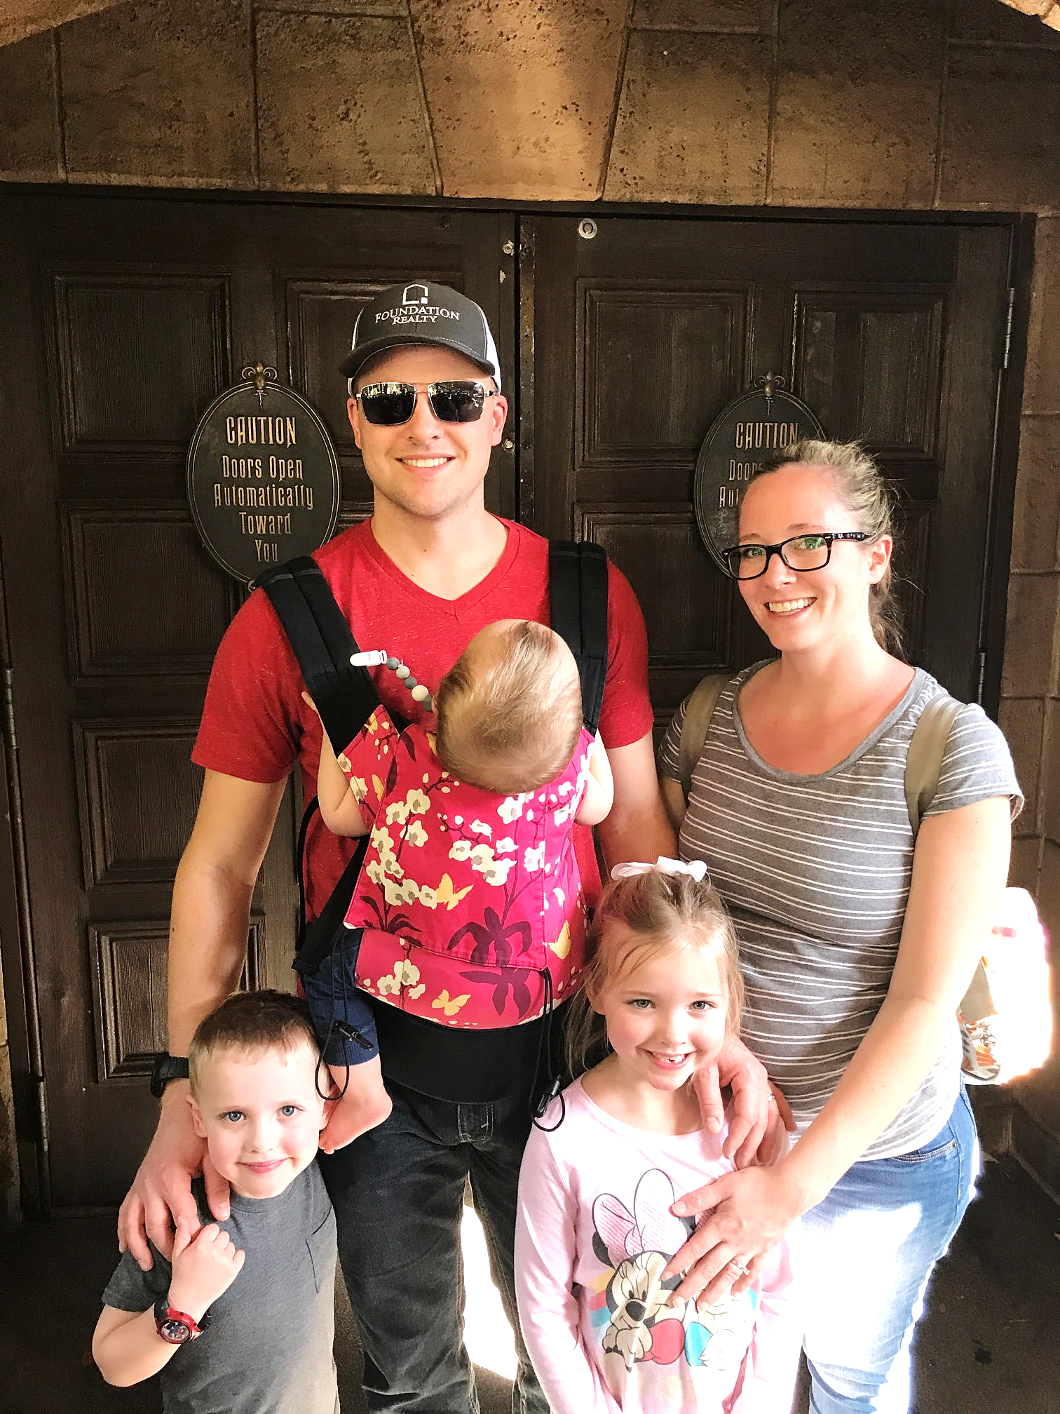

Slide 4
Rethinking hospitality
Luke 14:1-24

Slide 5
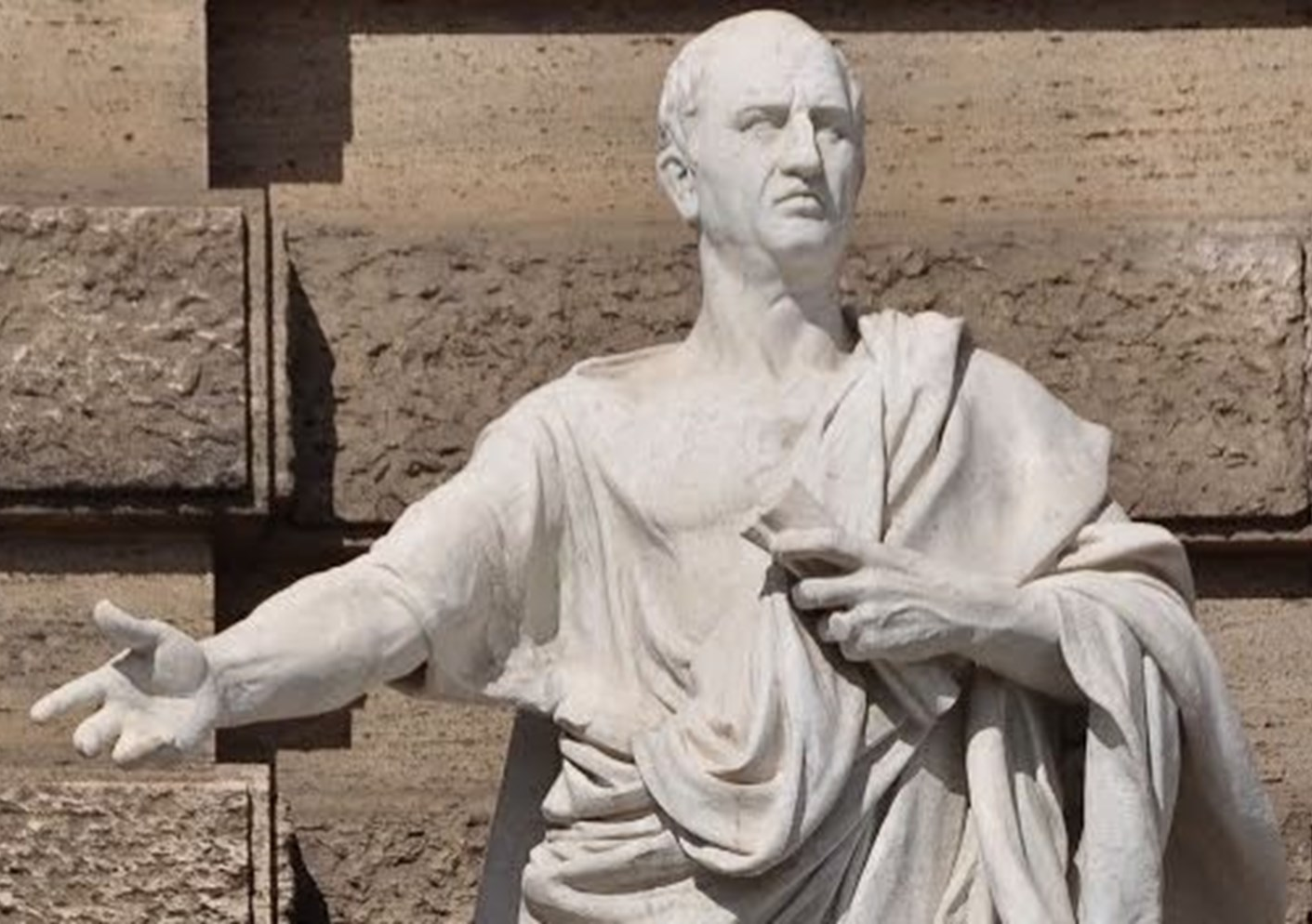
Marcus Tullius Cicero “Cicero”, Ancient Greek Philosopher 106-43 BC
“The houses of illustrious men should be open to illustrious guests.”

Slide 6
Upside-Down Hospitality
Hospitality sacrifices
self-interest to give
dignity to strangers

Slide 7
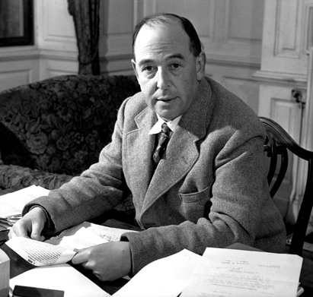
C.S. Lewis Christian Author “The Weight of Glory” 1898-1963
“There are no ordinary people. You have never talked to a mere mortal. Nations, cultures, arts, civilizations - these are mortal, and their life is to ours as the life of a gnat. But it is immortals whom we joke with, work with, marry, snub and exploit - immortal horrors or everlasting splendors. This does not mean that we are to be perpetually solemn. We must play. But our merriment must be of that kind (and it is, in fact, the merriest kind) which exists between people who have, from the outset, taken each other seriously - no flippancy, no superiority, no presumption.”

Slide 8
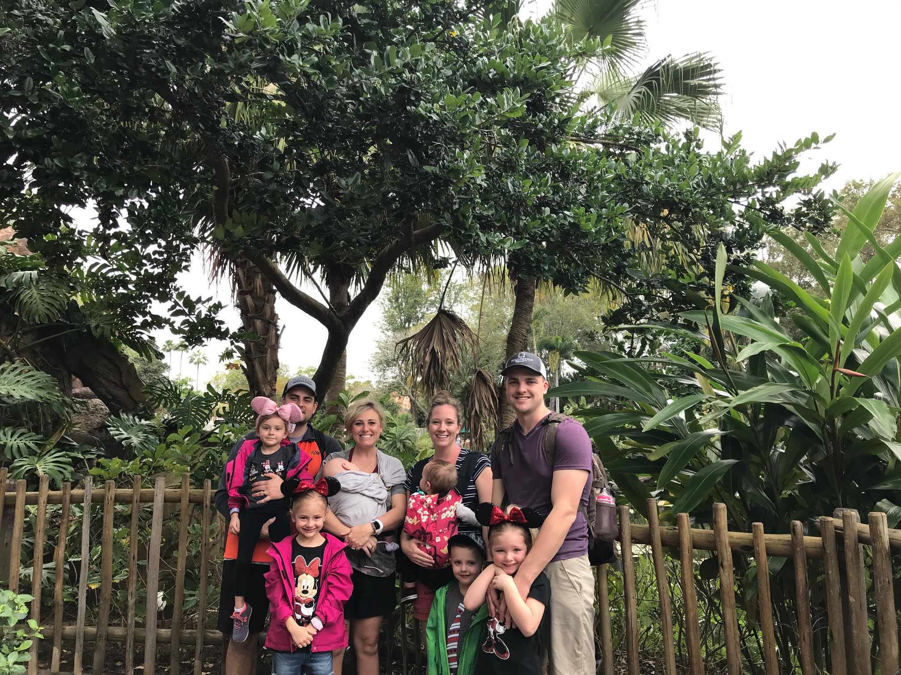
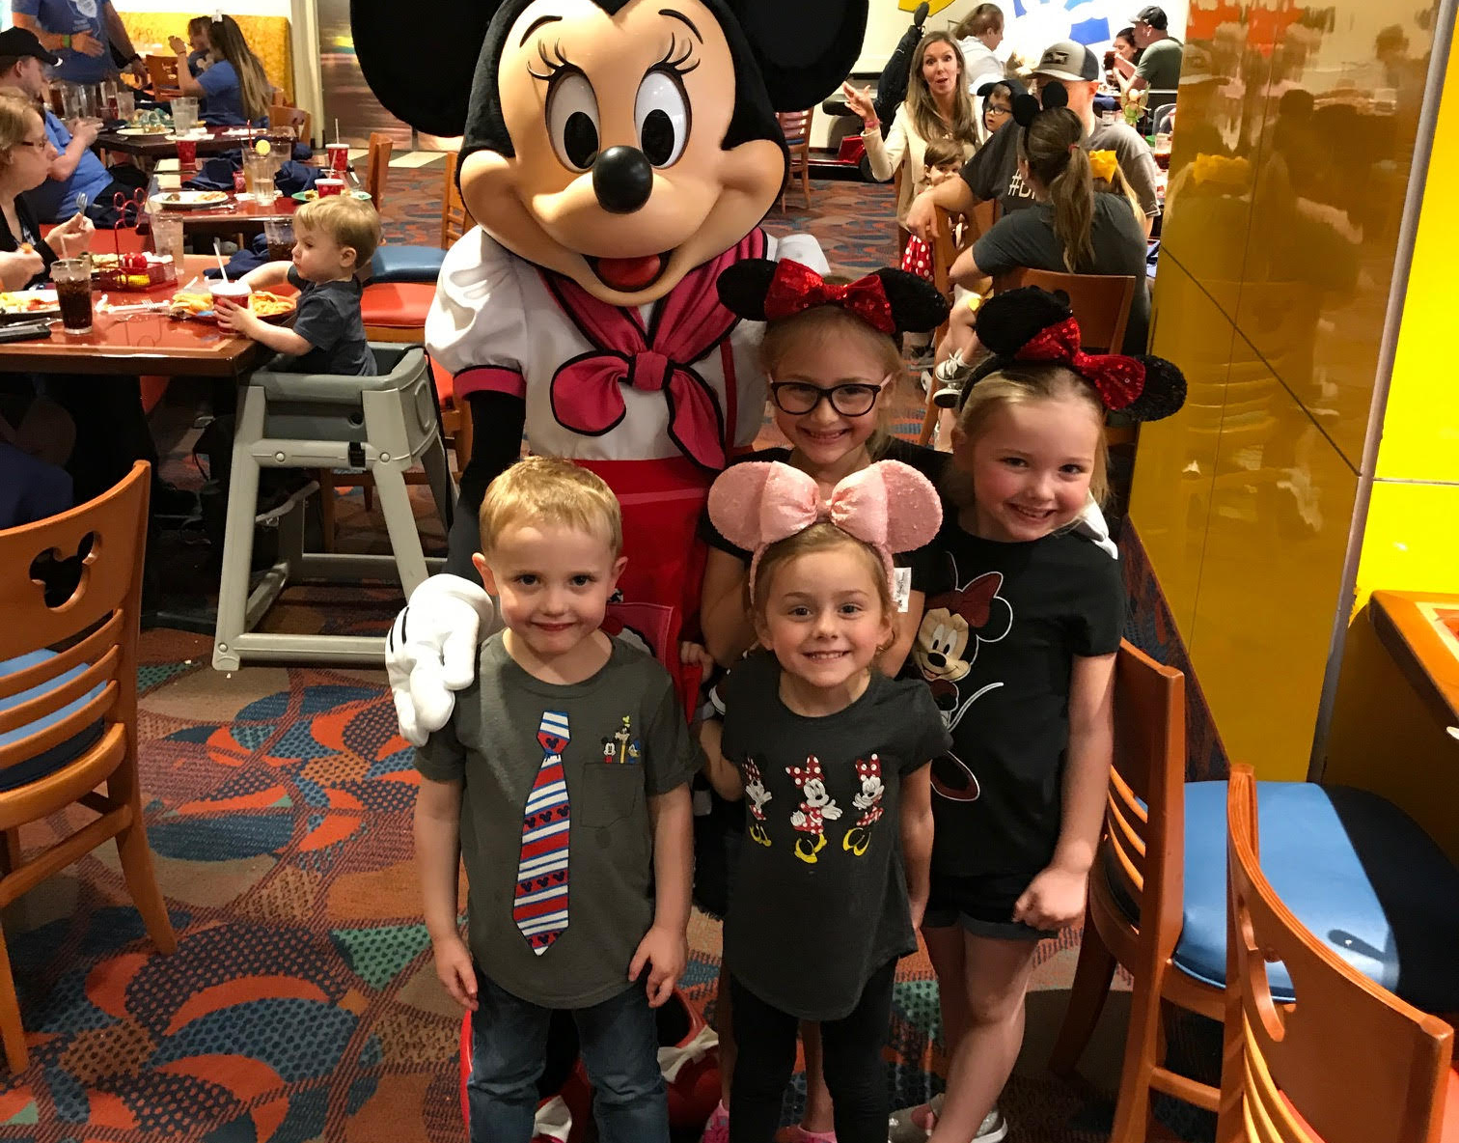
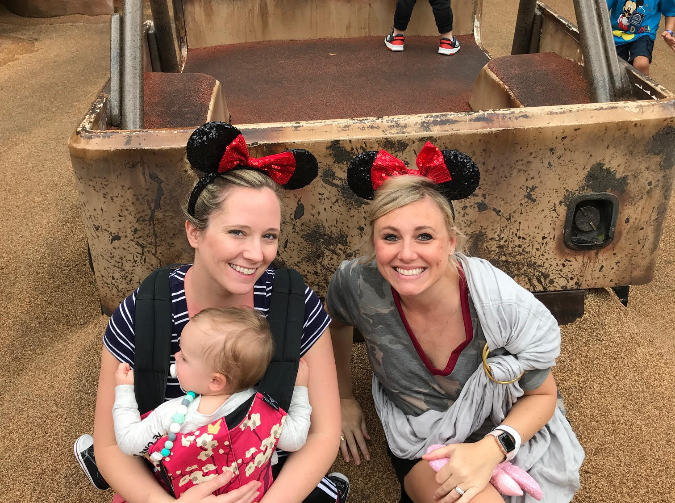

Slide 10
Luke 14:1-6
¹⁴ One Sabbath, when he went to dine at the house of a ruler of the Pharisees, they were watching him carefully. ² And behold, there was a man before him who had dropsy. ³ And Jesus responded to the lawyers and Pharisees, saying, “Is it lawful to heal on the Sabbath, or not?” ⁴ But they remained silent. Then he took him and healed him and sent him away. ⁵ And he said to them, “Which of you, having a son^{[a]} or an ox that has fallen into a well on a Sabbath day, will not immediately pull him out?” ⁶ And they could not reply to these things.

Slide 11
Luke 14:7-11
⁷ Now he told a parable to those who were invited, when he noticed how they chose the places of honor, saying to them, ⁸ “When you are invited by someone to a wedding feast, do not sit down in a place of honor, lest someone more distinguished than you be invited by him, ⁹ and he who invited you both will come and say to you, ‘Give your place to this person,’ and then you will begin with shame to take the lowest place. ¹⁰ But when you are invited, go and sit in the lowest place, so that when your host comes he may say to you, ‘Friend, move up higher.’ Then you will be honored in the presence of all who sit at table with you.¹¹ For everyone who exalts himself will be humbled, and he who humbles himself will be exalted.”

Slide 12
Luke 14:7-11
⁷ Now he told a parable to those who were invited, when he noticed how they chose the places of honor, saying to them, ⁸ “When you are invited by someone to a wedding feast, do not sit down in a place of honor, lest someone more distinguished than you be invited by him, ⁹ and he who invited you both will come and say to you, ‘Give your place to this person,’ and then you will begin with shame to take the lowest place. ¹⁰ But when you are invited, go and sit in the lowest place, so that when your host comes he may say to you, ‘Friend, move up higher.’ Then you will be honored in the presence of all who sit at table with you.¹¹ For everyone who exalts himself will be humbled, and he who humbles himself will be exalted.”

Slide 13
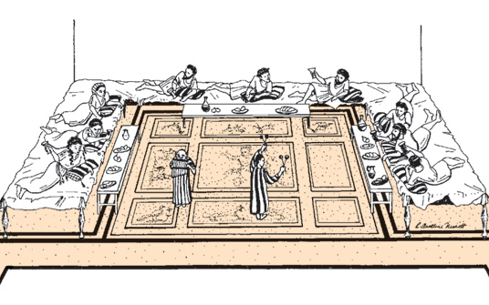
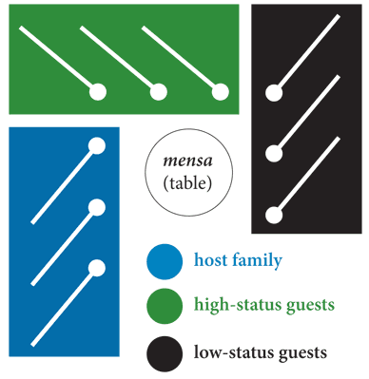
The Host’s Table

Slide 14
Luke 14:7-11
⁷ Now he told a parable to those who were invited, when he noticed how they chose the places of honor, saying to them, ⁸ “When you are invited by someone to a wedding feast, do not sit down in a place of honor, lest someone more distinguished than you be invited by him, ⁹ and he who invited you both will come and say to you, ‘Give your place to this person,’ and then you will begin with shame to take the lowest place. ¹⁰ But when you are invited, go and sit in the lowest place, so that when your host comes he may say to you, ‘Friend, move up higher.’ Then you will be honored in the presence of all who sit at table with you.¹¹ For everyone who exalts himself will be humbled, and he who humbles himself will be exalted.”

Slide 15
Luke 14:12-14
¹² He said also to the man who had invited him, “When you give a dinner or a banquet, do not invite your friends or your brothers^{[b]} or your relatives or rich neighbors, lest they also invite you in return and you be repaid. ¹³ But when you give a feast, invite the poor, the crippled, the lame, the blind, ¹⁴ and you will be blessed, because they cannot repay you. For you will be repaid at the resurrection of the just.”

Slide 16
Luke 14:15-24
¹⁵ When one of those who reclined at table with him heard these things, he said to him, “Blessed is everyone who will eat bread in the kingdom of God!” ¹⁶ But he said to him, “A man once gave a great banquet and invited many. ¹⁷ And at the time for the banquet he sent his servant^{[c]} to say to those who had been invited, ‘Come, for everything is now ready.’ ¹⁸ But they all alike began to make excuses. The first said to him, ‘I have bought a field, and I must go out and see it. Please have me excused.’ ¹⁹ And another said, ‘I have bought five yoke of oxen, and I go to examine them. Please have me excused.’ ²⁰ And another said, ‘I have married a wife, and therefore I cannot come.’

Slide 17
Luke 14:15-24
¹⁵ When one of those who reclined at table with him heard these things, he said to him, “Blessed is everyone who will eat bread in the kingdom of God!” ¹⁶ But he said to him, “A man once gave a great banquet and invited many. ¹⁷ And at the time for the banquet he sent his servant^{[c]} to say to those who had been invited, ‘Come, for everything is now ready.’ ¹⁸ But they all alike began to make excuses. The first said to him, ‘I have bought a field, and I must go out and see it. Please have me excused.’ ¹⁹ And another said, ‘I have bought five yoke of oxen, and I go to examine them. Please have me excused.’ ²⁰ And another said, ‘I have married a wife, and therefore I cannot come.’

Slide 18
Luke 14:15-24
¹⁵ When one of those who reclined at table with him heard these things, he said to him, “Blessed is everyone who will eat bread in the kingdom of God!” ¹⁶ But he said to him, “A man once gave a great banquet and invited many. ¹⁷ And at the time for the banquet he sent his servant^{[c]} to say to those who had been invited, ‘Come, for everything is now ready.’ ¹⁸ But they all alike began to make excuses. The first said to him, ‘I have bought a field, and I must go out and see it. Please have me excused.’ ¹⁹ And another said, ‘I have bought five yoke of oxen, and I go to examine them. Please have me excused.’ ²⁰ And another said, ‘I have married a wife, and therefore I cannot come.’

Slide 19
Luke 14:15-24 (continued)
²¹ So the servant came and reported these things to his master. Then the master of the house became angry and said to his servant, ‘Go out quickly to the streets and lanes of the city, and bring in the poor and crippled and blind and lame.’ ²² And the servant said, ‘Sir, what you commanded has been done, and still there is room.’ ²³ And the master said to the servant, ‘Go out to the highways and hedges and compel people to come in, that my house may be filled. ²⁴ For I tell you,^{[d]} none of those men who were invited shall taste my banquet.’”

Slide 20
Luke 14:15-24 (continued)
²¹ So the servant came and reported these things to his master. Then the master of the house became angry and said to his servant, ‘Go out quickly to the streets and lanes of the city, and bring in the poor and crippled and blind and lame.’ ²² And the servant said, ‘Sir, what you commanded has been done, and still there is room.’ ²³ And the master said to the servant, ‘Go out to the highways and hedges and compel people to come in, that my house may be filled. ²⁴ For I tell you,^{[d]} none of those men who were invited shall taste my banquet.’”

Slide 21
Application

Slide 22
Application
Consider the claims of Christ

Slide 23
Application
Consider the claims of Christ
Identify your strangers

Slide 24
Application
Consider the claims of Christ
Identify your strangers
Increase your bandwidth

Slide 25
Application
Consider the claims of Christ
Identify your strangers
Increase your bandwidth
Offer dignity to your strangers

Slide 26
Matthew 25:34-40
³⁴ Then the King will say to those on his right, ‘Come, you who are blessed by my Father, inherit the kingdom prepared for you from the foundation of the world. ³⁵ For I was hungry and you gave me food, I was thirsty and you gave me drink, I was a stranger and you welcomed me, ³⁶ I was naked and you clothed me, I was sick and you visited me, I was in prison and you came to me.’ ³⁷ Then the righteous will answer him, saying, ‘Lord, when did we see you hungry and feed you, or thirsty and give you drink? ³⁸ And when did we see you a stranger and welcome you, or naked and clothe you? ³⁹ And when did we see you sick or in prison and visit you?’ ⁴⁰ And the King will answer them, ‘Truly, I say to you, as you did it to one of the least of these my brothers,^{[a]} you did it to me.’

Slide 27
Matthew 25:34-40
³⁴ Then the King will say to those on his right, ‘Come, you who are blessed by my Father, inherit the kingdom prepared for you from the foundation of the world. ³⁵ For I was hungry and you gave me food, I was thirsty and you gave me drink, I was a stranger and you welcomed me, ³⁶ I was naked and you clothed me, I was sick and you visited me, I was in prison and you came to me.’ ³⁷ Then the righteous will answer him, saying, ‘Lord, when did we see you hungry and feed you, or thirsty and give you drink? ³⁸ And when did we see you a stranger and welcome you, or naked and clothe you? ³⁹ And when did we see you sick or in prison and visit you?’ ⁴⁰ And the King will answer them, ‘Truly, I say to you, as you did it to one of the least of these my brothers,^{[a]} you did it to me.’

Slide 28
Matthew 25:34-40
³⁴ Then the King will say to those on his right, ‘Come, you who are blessed by my Father, inherit the kingdom prepared for you from the foundation of the world. ³⁵ For I was hungry and you gave me food, I was thirsty and you gave me drink, I was a stranger and you welcomed me, ³⁶ I was naked and you clothed me, I was sick and you visited me, I was in prison and you came to me.’ ³⁷ Then the righteous will answer him, saying, ‘Lord, when did we see you hungry and feed you, or thirsty and give you drink? ³⁸ And when did we see you a stranger and welcome you, or naked and clothe you? ³⁹ And when did we see you sick or in prison and visit you?’ ⁴⁰ And the King will answer them, ‘Truly, I say to you, as you did it to one of the least of these my brothers,^{[a]} you did it to me.’

Slide 29
ApplicationS
Consider the claims of Christ
Identify your strangers
Increase your bandwidth
Offer dignity to your strangers
Decide on a next step now

Slide 30
Making Room: Recovering Hospitality as a Christian Tradition
“Because eating is something every person must do, meal time has a profound egalitarian dimension. As one woman from the Catholic Worker commented, no matter what our backgrounds or assets, we are all eaters and drinkers. “It’s the great leveler.” Meal-time, when people sit down together, is the clearest time of being with others, rather than doing for others. It is the time when hospitality looks least like social services.”

Slide 31
Questions, Comments, Testimonies
What are your Next steps?

