Slide 2
UPSIDE-DOWN RELATIONSHIPS

Slide 3
reclaiming neighboring
Because God first loved us, we exist to love God and to love our Neighbors

Slide 4
reclaiming neighboring
Introduction:
Neighboring: a lost art?
Are Christians Committed to Neighboring Expertise?

Slide 5
UPSIDE-DOWN RELATIONSHIPS
Tonight:
Evaluating Our Relationship Priorities
Answering: Who are our Neighbors?

Slide 6
Luke 5:27-32
²⁷ After this he went out and saw a tax collector named Levi, sitting at the tax booth. And he said to him, “Follow me.” ²⁸ And leaving everything, he rose and followed him.

Slide 8
Luke 5:27-32
²⁷ After this he went out and saw a tax collector named Levi, sitting at the tax booth. And he said to him, “Follow me.” ²⁸ And leaving everything, he rose and followed him.
²⁹ And Levi made him a great feast in his house, and there was a large company of tax collectors and others reclining at table with them. ³⁰ And the Pharisees and their scribes grumbled at his disciples, saying, “Why do you eat and drink with tax collectors and sinners?”

Slide 9
Luke 5:27-32
³¹ And Jesus answered them, “Those who are well have no need of a physician, but those who are sick. ³² I have not come to call the righteous but sinners to repentance.”

Slide 10
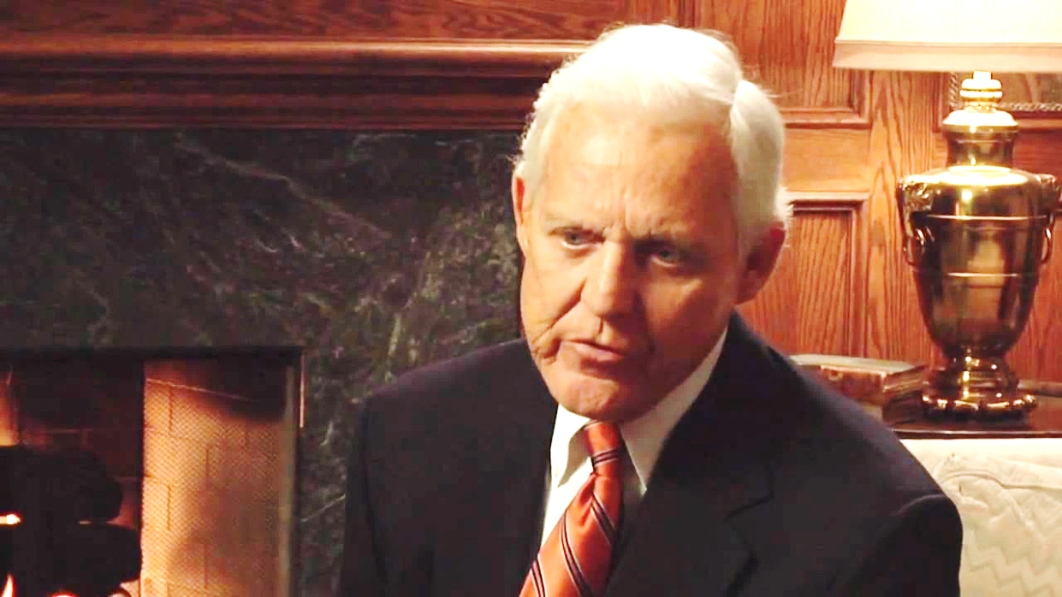
The Church is all too Often an irrelevant island of piety surrounded by an ocean of need
Quote by Bill Banowsky,
Lay Christian Leader
Former president
Pepperdine University (1967-77)
University of Oklahoma (1978-85)

Slide 11
Evaluating our relationship priorities
Loving oneself includes having meaningful Christian community.

Slide 12
Evaluating our relationship priorities
Loving Self includes having meaningful Christian Community.
Loving our Neighbor requires relationship with those outside of Christian faith.
I have not come to call the righteous but sinners to repentance.

Slide 13
Evaluating our relationship priorities
Loving Self includes having meaningful Christian Community.
Loving our Neighbor requires relationship with those outside of Christian faith.
Loving our Neighbor requires we balance loving self with loving others.

Slide 14
Evaluating our relationship priorities
Loving Self includes having meaningful Christian Community.
Loving our Neighbor requires relationship with those outside of Christian faith.
Loving our Neighbor requires we balance loving self with loving others.
Am I spending quality time with non-believers to earn the right to share the Gospel with them?

Slide 15
Luke 10:25-37
²⁵And behold, a lawyer stood up to put him to the test, saying, “Teacher, what shall I do to inherit eternal life?” ²⁶ He said to him, “What is written in the Law? How do you read it?: ²⁷And he answered, “You shall love the Lord your God with all your heart and all your soul and with all your strength and with all your mind, and your neighbor as yourself.” ²⁸And he said to him, “You have answered correctly; do this, and you will live.”

Slide 16
Luke 10:25-37
²⁹ But he, desiring to justify himself, said to Jesus, “And who is my neighbor? ³⁰ Jesus replied, “A certain man was going down from Jerusalem to Jericho, and he fell among robbers, who stripped him and beat him and departed, leaving him half dead. ³¹ Now by chance a priest was going down that road, and when he saw him he passed by on the other side. ³² So likewise a Levite, when he came to the place and saw him, passed by on the other side.

Slide 17
Luke 10:25-37
³³ But a Samaritan, as he journeyed, came to where he was, and when he saw him, he had compassion. ³⁴He went to him and bound up his wounds, pouring on oil and wine. Then he set him on his own animal and brought him to an inn and took care of him. ³⁵And the next day he took out two denarii and gave them to the innkeeper, saying, ‘Take care of him, and whatever more you spend, I will repay you when I come back.

Slide 18
Luke 10:25-37
³⁶Which of these three, do you think, proved to be a neighbor to the man who fell among the robbers?” ³⁷He said, “The one who showed him mercy.” And Jesus said to him, You go and do likewise.”

Slide 19
Answering: Who Is Our Neighbor?
Jesus Relationship Test: “Which of these . . . proved to be a neighbor to the robber?
Answer: The One Who Showed Mercy.
Jesus’ Response: “You go and do likewise.”

Slide 20
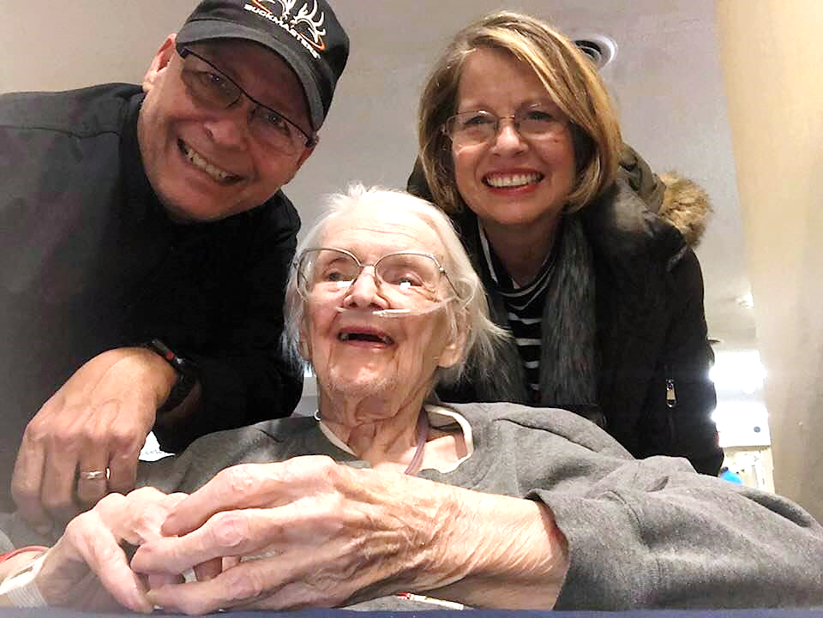
Answering: Who Is Our Neighbor?
Love the Close-By Neighbor – on your block, at work, school, etc.

Slide 21
Answering: Who Is Our Neighbor?
Love the Close-By Neighbor – on your block, at work, school, etc.
Loving those God brings across our path with needs for mercy, love and the gospel?

Slide 22
Answering: Who Is Our Neighbor?
Love the Close-By Neighbor – on your block, at work, school, etc.
Loving those God brings across our path with needs for mercy, love and the gospel?
Partnering with others locally to love a targeted group with need. Examples: H.I.S., Life Choice, Homestead . . . Engaging in foster care, adoption

Slide 23
Answering: Who Is Our Neighbor?
Love the Close-By Neighbor – on your block, at work, school, etc.
Loving those God brings across our path with needs for mercy, love and the gospel?
Partnering with others locally to love a targeted group with need. Examples: H.I.S., Life Choice, Homestead, Engaging in foster care, adoption.
Together as the Body of Christ, participating in ministries impacting the world-wide community.

Slide 24
Examples from Tallgrass members
Maris Deaver is on Staff with Global Scholars
Working on the Development of the
Society of Christian Scholars
Do you sense God’s call to be “salt and light” in higher education? Do you want your professional development to include being a Christian scholar?
Join the Society of Christian Scholars and be equipped to fulfil your calling.

Slide 25
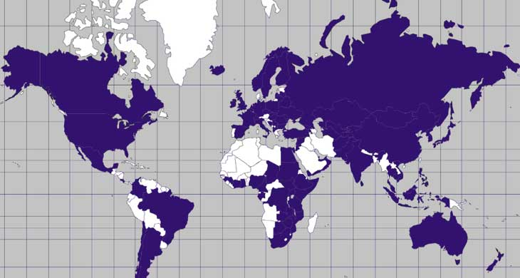
Examples from Tallgrass members
The vision is simple:
To change a nation, teach its leaders.
To teach its leaders, influence its universities.

Slide 26
Examples from tallgrass members
Global Scholars is Influencing the Nations through Higher Education

Slide 27
Examples from Tallgrass members
Ricky Greeve is on the Board for
Grace Bible Church Pakistan

Slide 28
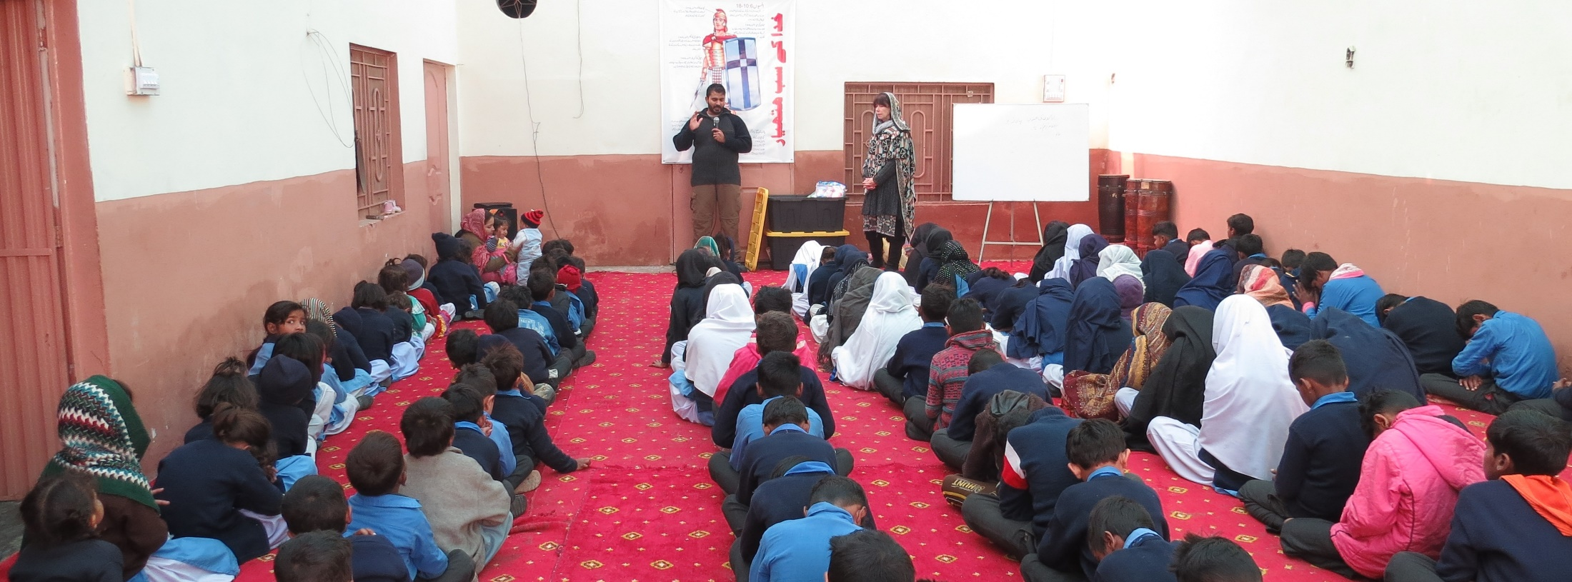
Examples from Tallgrass members
Children in Prayer during teaching on “Putting on the Armor of God” from Ephesians 6

Slide 29
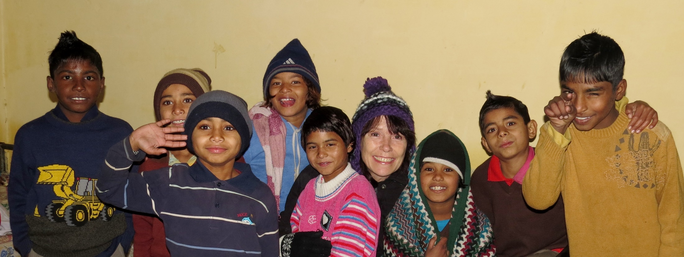
Examples from Tallgrass members
Ricky Greeve is on the Board for
Grace Bible Church Pakistan

Slide 30
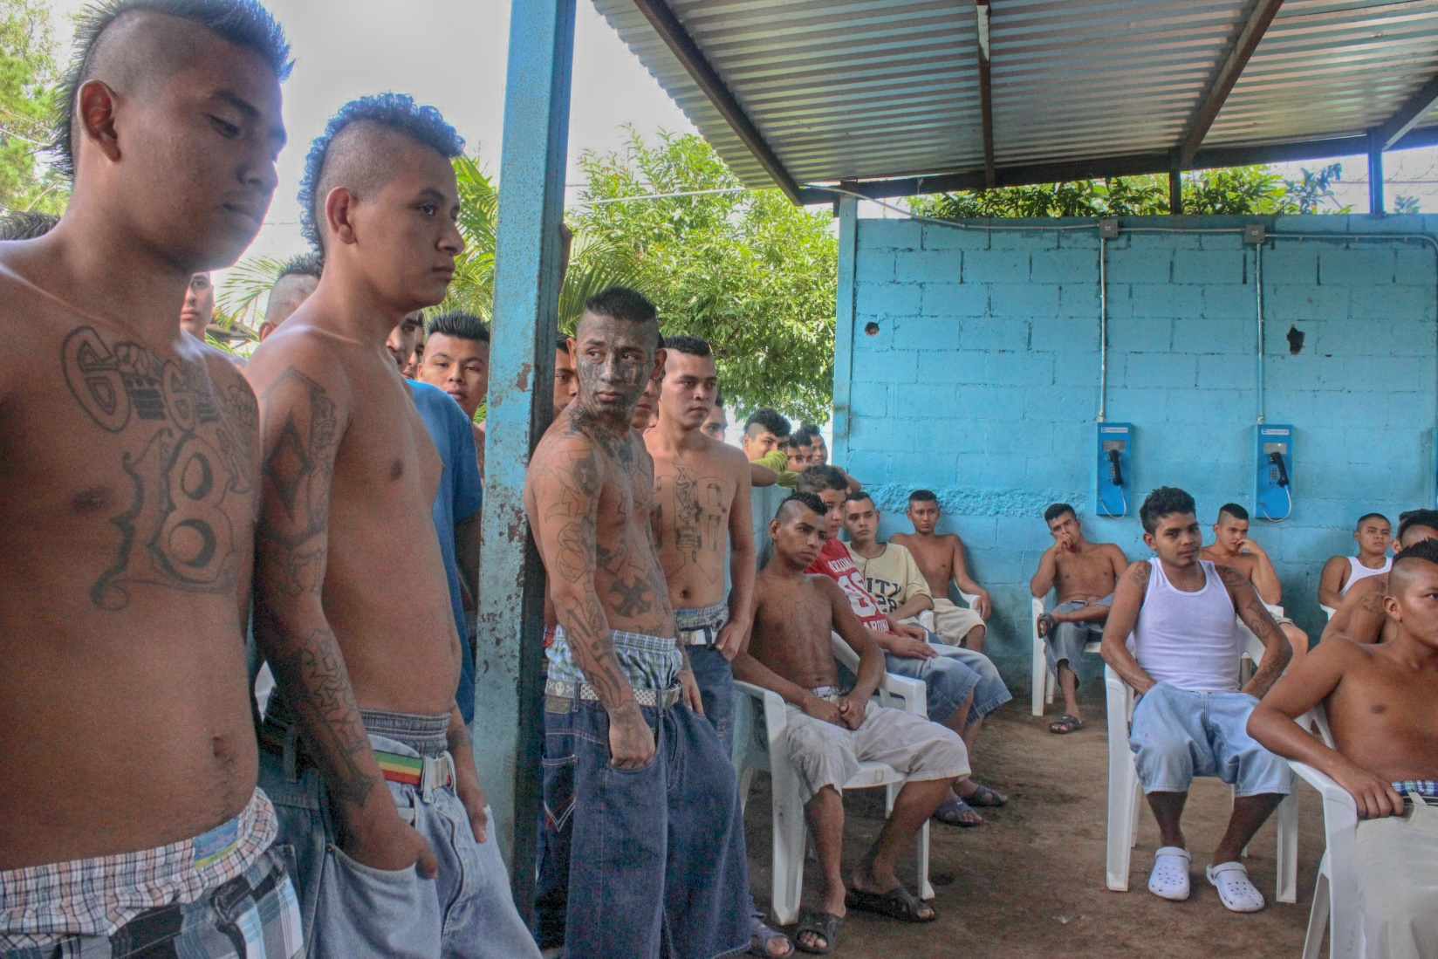
Examples from Tallgrass members
I have the privilege of being on staff with Orphan Helpers, ministering to youth in juvenile protection and detention centers in Central America.

Slide 31
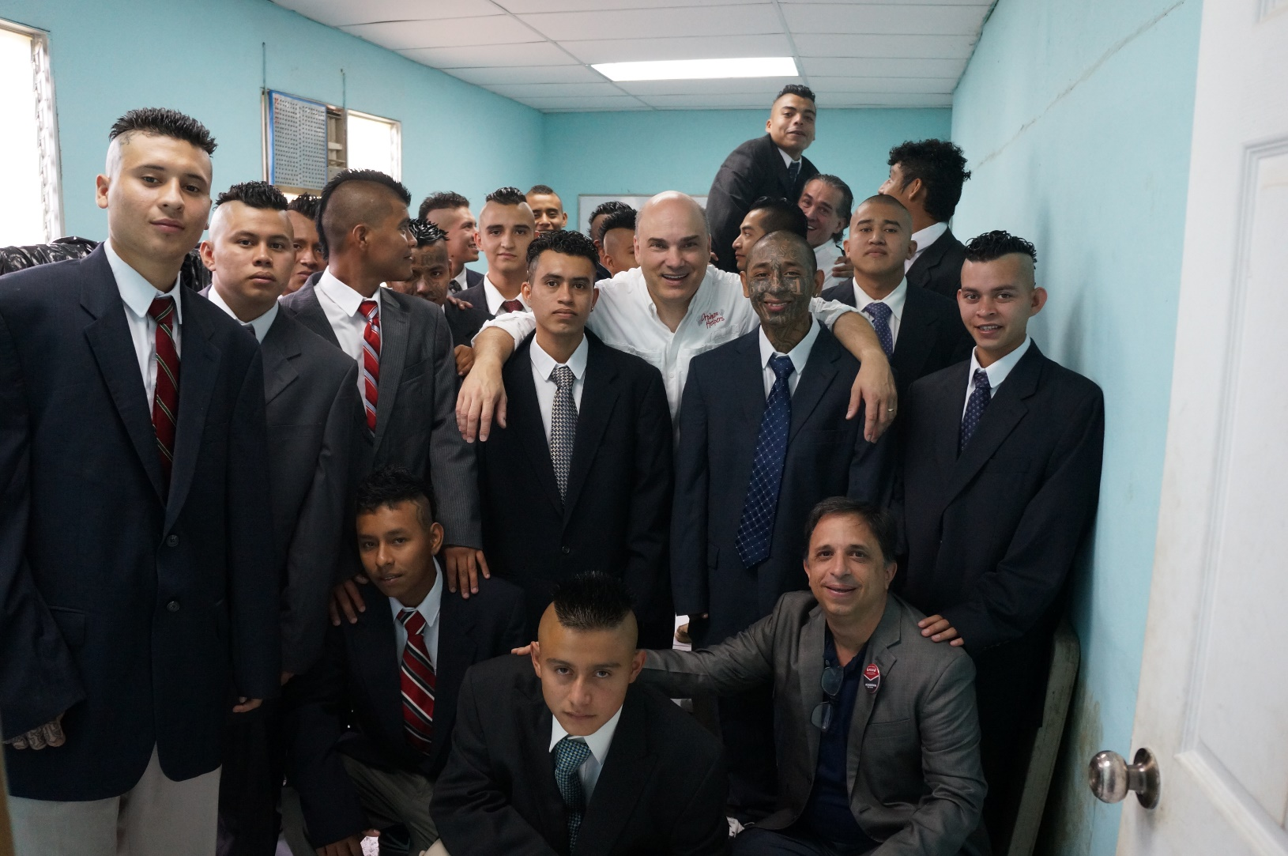
Examples from Tallgrass members
These youth from a Central American gang have completed our Success Academy studying New Life in Christ and Life-Skills

Slide 32
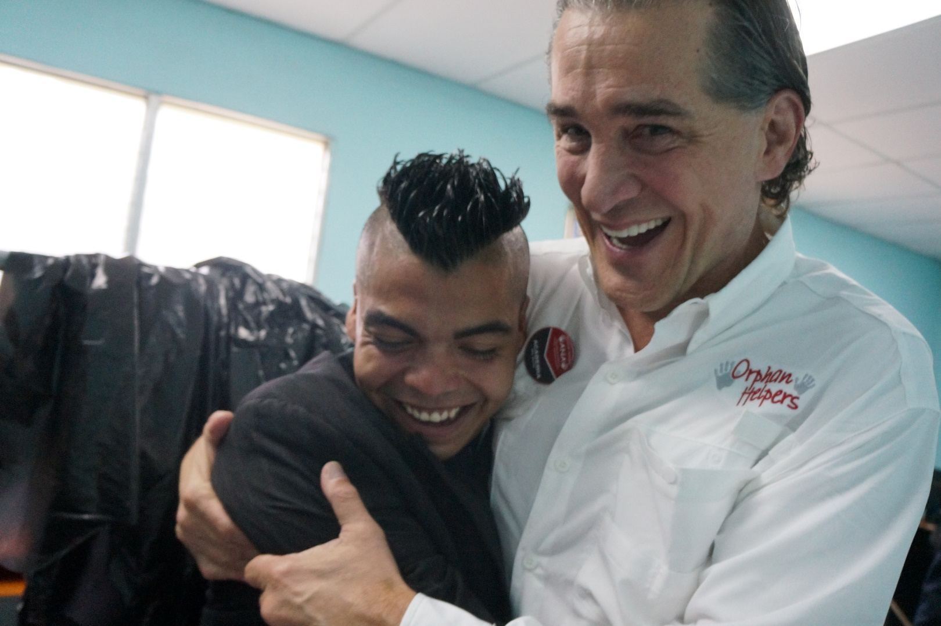
Examples from Tallgrass members
Greg Garrett, our mission founder – a real estate broker – had the vision for reaching youth no one else cared about!

