Slide 4
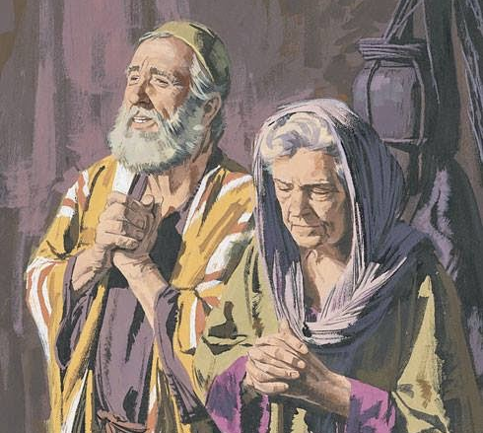

Slide 5
Luke 1:18-20
¹⁸ And Zechariah said to the angel, “How shall I know this? For I am an old man, and my wife is advanced in years.” ¹⁹ And the angel answered him, “I am Gabriel. I stand in the presence of God, and I was sent to speak to you and to bring you this good news. ²⁰ And behold, you will be silent and unable to speak until the day that these things take place, because you did not believe my words, which will be fulfilled in their time.”

Slide 6
Luke 1:21-23
²¹ And the people were waiting for Zechariah, and they were wondering at his delay in the temple. ²² And when he came out, he was unable to speak to them, and they realized that he had seen a vision in the temple. And he kept making signs to them and remained mute.²³ And when his time of service was ended, he went to his home.

Slide 7
Luke 1:21-25
²¹ And the people were waiting for Zechariah, and they were wondering at his delay in the temple. ²² And when he came out, he was unable to speak to them, and they realized that he had seen a vision in the temple. And he kept making signs to them and remained mute.²³ And when his time of service was ended, he went to his home.
²⁴ After these days his wife Eliz- abeth conceived, and for five months she kept herself hidden, saying, ²⁵ “Thus the Lord has done for me in the days when he looked on me, to take away my reproach among people.”

Slide 8
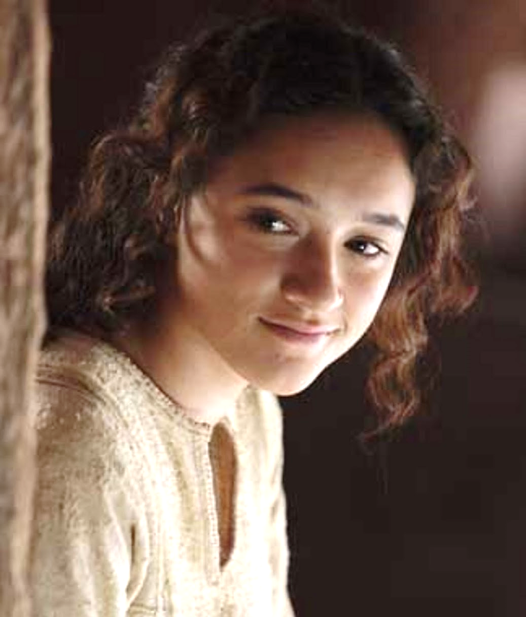
Luke 1:26-33
²⁶ In the sixth month the angel Gabriel was sent from God to a city of Galilee named Nazareth, ²⁷ to a virgin betrothed to a man whose name was Joseph, of the house of David. And the virgin's name was Mary. ²⁸ And he came to her and said, “Greetings, O favored one, the Lord is with you!” ²⁹ But she was greatly troubled at the saying, and tried to discern what sort of greeting this might be. ³⁰ And the angel said to her, “Do not be afraid, Mary, for you have found favor with God. ³¹ And behold, you will conceive in your womb and bear a son, and you shall call his name Jesus. ³² He will be great and will be called the Son of the Most High. And the Lord God will give to him the throne of his father David, ³³ and he will reign over the house of Jacob forever, and of his kingdom there will be no end.”

Slide 9
Luke 1:34
³⁴ And Mary said to the angel, “How will this be, since I am a virgin?”

Slide 10
Luke 1:34-37
³⁴ And Mary said to the angel, “How will this be, since I am a virgin?” ³⁵ And the angel answered her, “The Holy Spirit will come upon you, and the power of the Most High will overshadow you; therefore the child to be born will be called holy—the Son of God. ³⁶ And behold, your relative Elizabeth in her old age has also conceived a son, and this is the sixth month with her who was called barren. ³⁷ For nothing will be impossible with God.”

Slide 11
Luke 1:34-38
³⁴ And Mary said to the angel, “How will this be, since I am a virgin?” ³⁵ And the angel answered her, “The Holy Spirit will come upon you, and the power of the Most High will overshadow you; therefore the child to be born will be called holy—the Son of God. ³⁶ And behold, your relative Elizabeth in her old age has also conceived a son, and this is the sixth month with her who was called barren. ³⁷ For nothing will be impossible with God.” ³⁸ And Mary said, “Behold, I am the servant of the Lord; let it be to me according to your word.” And the angel departed from her.

Slide 12
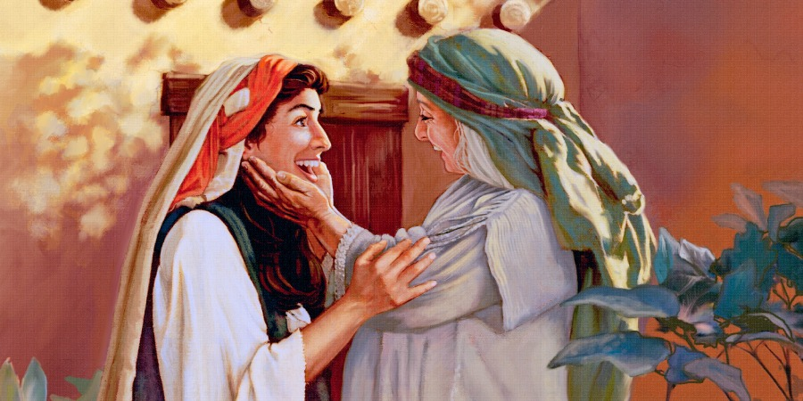
Luke 1:39-47
³⁹ In those days Mary arose and went with haste into the hill country, to a town in Judah, ⁴⁰ and she entered the house of Zechariah and greeted Elizabeth. ⁴¹ And when Elizabeth heard the greeting of Mary, the baby leaped in her womb. And Elizabeth was filled with the Holy Spirit, ⁴² and she exclaimed with a loud cry, “Blessed are you among women, and blessed is the fruit of your womb! ⁴³ And why is this granted to me that the mother of my Lord should come to me? ⁴⁴ For behold, when the sound of your greeting came to my ears, the baby in my womb leaped for joy. ⁴⁵ And blessed is she who believed that there would be a fulfillment of what was spoken to her from the Lord.”
⁴⁶ And Mary said, “My soul magnifies the Lord, ⁴⁷ and my spirit rejoices in God my Savior…”

Slide 14
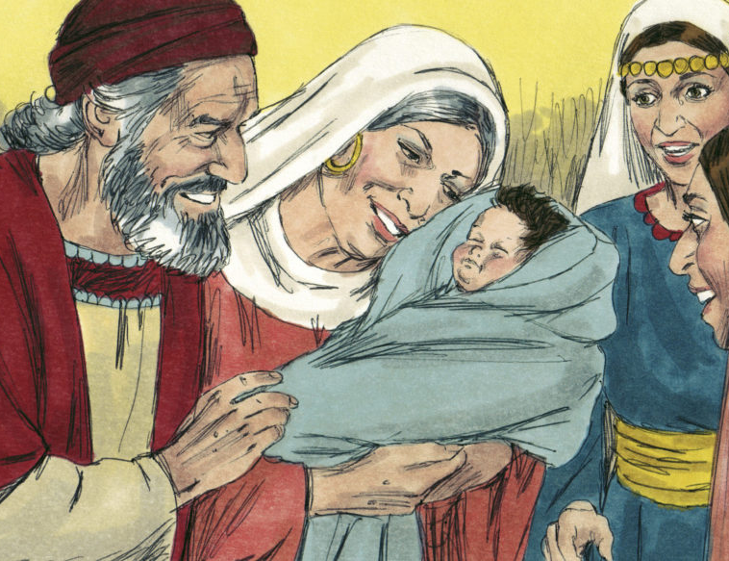
Luke 1:57-63
⁵⁷ Now the time came for Elizabeth to give birth, and she bore a son. ⁵⁸ And her neighbors and relatives heard that the Lord had shown great mercy to her, and they rejoiced with her. ⁵⁹ And on the eighth day they came to circumcise the child. And they would have called him Zechariah after his father, ⁶⁰ but his mother answered, “No; he shall be called John.” ⁶¹ And they said to her, “None of your relatives is called by this name.” ⁶² And they made signs to his father, inquiring what he wanted him to be called. ⁶³ And he asked for a writing tablet and wrote, “His name is John.” And they all wondered.

Slide 15
Luke 1:57-64, 67-68
⁵⁷ Now the time came for Elizabeth to give birth, and she bore a son. ⁵⁸ And her neighbors and relatives heard that the Lord had shown great mercy to her, and they rejoiced with her. ⁵⁹ And on the eighth day they came to circumcise the child. And they would have called him Zechariah after his father, ⁶⁰ but his mother answered, “No; he shall be called John.” ⁶¹ And they said to her, “None of your relatives is called by this name.” ⁶² And they made signs to his father, inquiring what he wanted him to be called. ⁶³ And he asked for a writing tablet and wrote, “His name is John.” And they all wondered. ⁶⁴ And immediately his mouth was opened and his tongue loosed, and he spoke, blessing God. … ⁶⁷ Zechariah was filled with the Holy Spirit and prophesied, saying, ⁶⁸ “Blessed be the Lord God of Israel for he has visited and redeem- ed his people…”

Slide 16
GOD POURS OUT HIS SPIRIT
Joel 2:28-29: “...I will pour out my Spirit on all flesh; your sons and your daughters shall prophesy, your old men shall dream dreams, and your young men shall see visions. Even on the male and female servants in those days I will pour out my Spirit.”

Slide 17
APPLICATIONS

Slide 18
APPLICATIONS
Respond to God’s Word

Slide 19
APPLICATIONS
Respond to God’s Word
Embrace Your 2nd Response

Slide 20
APPLICATIONS
Respond to God’s Word
Embrace Your 2nd Response
Prepare to Respond Well While You Are Waiting

