Slide 2
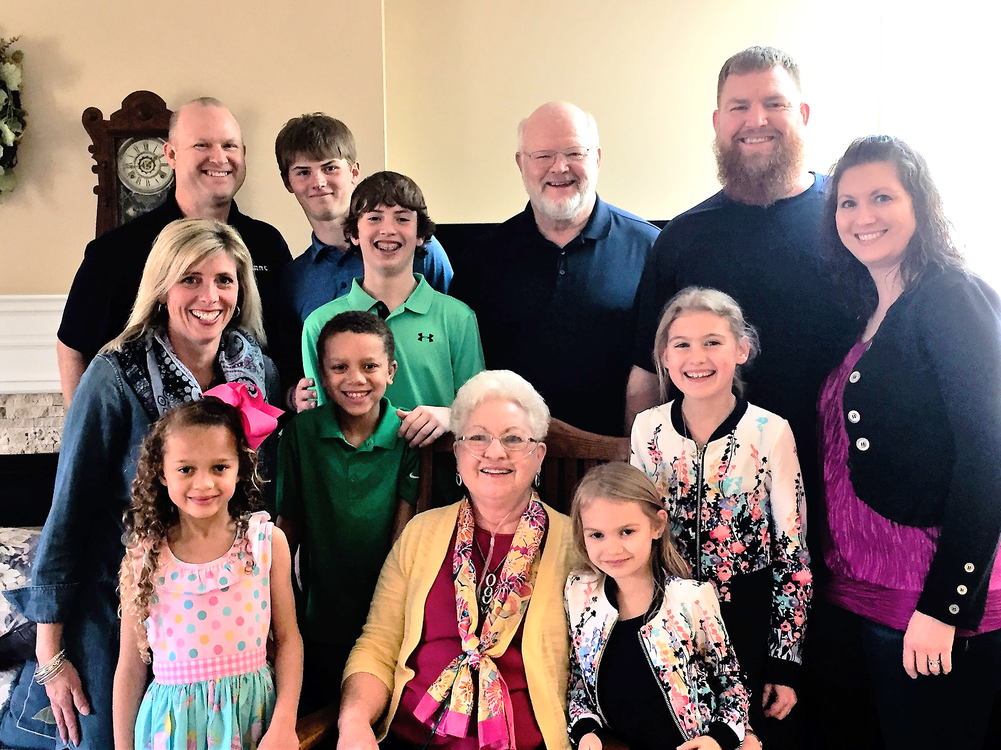

Slide 4
On youngness & oldness in the household of god
YOUNGNESS: The state or quality of being young; youthfulness, especially of character or appearance
YOUTH:
The Condition of being young!
The appearance, freshness, vigor, spirit, etc. characteristic of one who is young.
The time of being young, early life!
Any period of early development

Slide 5
On youngness & oldness in the household of god
OLDNESS: The opposite of youngness! ☺
Having lived or existed for a relatively long time
Made long ago; in existence for many years
Having or exhibiting the physical characteristics of age . . . and, of course the wisdom of age!!!!!!
Exhibiting the effects of long use; worn
Belonging to a remote or former period of history
Having become slower in flow and less vigorous
Synonyms: old, ancient¹, archaic, antediluvian, antique, antiquated

Slide 6
Paul’s relationship with timothy
1. Paul Has a Special Influence in Timothy’s Family
Most likely led Timothy’s mother Eunice and Grandmother Lois to become Jesus followers when preaching in Lystra and Derbe on his first missionary journey. (A.D. 46-48)
Acts 14:6,7 – “ . . .they . . fled to Lystra and Derbe, cities of Lycaonia, (modern country of Turkey) and to the surrounding country, and there they continued to preach the gospel.” (Also 14:8-23)

Slide 7
Paul’s relationship with timothy
1. Paul Has a Special Influence in Timothy’s Family
B. Returned on 2nd Missionary Journey (A.D. 49-52)
and found Timothy had become a strong believer.
Acts 16:1,2 – “Paul came also to Derbe and to Lystra. A disciple was there named Timothy, the son of a Jewish woman who was a believer, but his father was a Greek. He was well spoken of by the brothers at Lystra and Iconium.”
2 Timothy 1:5 “I am reminded of your sincere faith, a faith that dwelt first in your grandmother Eunice and now, I am sure, dwells in you as well.”

Slide 8
Paul’s relationship with timothy
2. Paul’s Affection for Timothy
I Cor. 4:17 – “That is why I sent you Timothy, my beloved and faithful child in the Lord, to remind you of my ways in Christ, as I teach them everywhere in every church.”
I Timothy 1:2 – “To Timothy, my true child in the faith.”
Note: Timothy’s Dad wasn’t a believer, so since he brought the gospel to Timothy’s family, he saw himself as his spiritual father.

Slide 9
PAUL’S RELATIONSHIP WITh timothy
3. Timothy Becomes Paul’s Assistant!
A. Took Timothy with him on Missionary Journey’s
2nd Journey: Acts 16:3 - 18:22
3rd Journey: Acts 18:23 – 21:16
Was there to support Paul when he was under house arrest in Rome. (Acts 27 – 28:16)

Slide 10
PAUL’S RELATIONSHIP WITH TIMOTHY
3. Timothy Becomes Paul’s Assistant!
B. Trusts Timothy with Challenging Assignments
When Paul was forced to leave the region of Thessalonica because of conflict caused by those opposed to the gospel, he later sent Timothy back to be with the Thessalonian believers to establish them and encourage them to maintain their faith. And Timothy later sent good reports on the strength of the believers there which encouraged Paul.
(I Thessalonians 3:1-9)

Slide 11
PAUL’S RELATIONSHIP WITH TIMOTHY
3. Timothy Becomes Paul’s Assistant!
B. Trusts Timothy with Challenging Assignments
Then on his 3rd Missionary Journey, he sent Timothy to Corinth to try and settle disputes and conflicts there (Acts 19:22).
And he sent Timothy to the Philippian believers to bring back word from this congregation and Paul commends Timothy for his great love for these believers. (Philippians 2:19-23)

Slide 12
PAUL’S RELATIONSHIP WITH TIMOTHY
3. Timothy Becomes Paul’s Assistant!
B. Trusts Timothy with Challenging Assignments
And according to I Timothy 1:3-7, we learn that Paul left him in Ephesus on the 3rd missionary journey to “charge certain persons not to teach any different doctrine . . .” and to do this in a spirit of love.

Slide 13
Paul’s relationship with timothy
3. Timothy Becomes Paul’s Assistant!
C. Each Had a Very Different Style!
These assignments show that although Paul and Timothy were very close as friends – even as father and son – they still were very different!
Paul was bold, spoke forcefully and courageously in the face of much conflict.
Timothy was more sensitive, relational and a peace-maker – these strengths were also in some ways his weakness!

Slide 14
Paul’s relationship with timothy
Timothy Struggled with Fear, Timidity and
Possibly Insecurity Related to His Youth
I Corinthians 16:10,11. Paul asks the church at Corinth to go easy on Timothy when he arrives – to put him at ease and not to despise him – and to help him in peace.
II Timothy 2:1. Paul urges Timothy to be strengthened in grace that is in Christ Jesus
II Timothy 2:22. Urges him to flee youthful passions and pursue righteousness, faith, love and peace

Slide 15
Paul’s relationship with timothy
Timothy Struggled with Fear, Timidity and
Possibly Insecurity Related to His Youth
II Timothy 1: “For this reason I remind you to fan into flame the gift of God, which in in you through the laying on of hands for God gave us a spirit not of fear but of power and love and self-control.”
I Timothy 5:23: Also struggled with stomach ailments and frequent illnesses. Paul encourages taking action for health!

Slide 16
APPLYING THE TEXT
THREE IMPORTANT LESSONS
1. The Power, Strength & Potential of Youth
2. Using our Gifts Fully
3. Intergenerational Love in the Household of God

Slide 17
1. The power, strength & POTENTIAL of youth
I Timothy 4:11,12: “11 Command and teach these things. 12Let no one despise you for your youth, but set the believers an example in speech, in conduct, in love, in faith, in purity.”
BEN DEAVER AND DAVID GELDART!
OUR YOUNG ADULTS AND PARENTS
OUR CHILDREN AND YOUTH

Slide 18
2. USING OUR GIFTS FULLY
I Timothy 4:13-16: “13 Until I come, devote yourself to the public reading of Scripture, to exhortation, to teaching. 14Do not neglect the gift you have, which was given you by prophecy when the council of elders laid their hands on you. 15Practice these things, immerse yourself in them, so that all may see your progress. 16Keep a close watch on yourself and on the teaching. Persist in this, for by so doing you will save both yourself and your hearers. . .
BEN DEAVER AND DAVID GELDART!
ALL OF US AS CO-MINISTERS OF THE GOSPEL

Slide 19
3. INTERGENERATIONAL LOVE IN THE HOUSEHOLD OF GOD
I Timothy 5:1,2 1Do not rebuke an older man but encourage him as you would a father, younger men as brothers, 2older women as mothers, younger women as sisters, in all purity.
ENCOURAGING, UNDERSTANDING & RESPECTING
INTENTIONALLY INTERACTING ACROSS AGE LINES
CREATING A TRUE FAMILY CHURCH COMMUNITY

Slide 20
Where to go from here?
Support our Pastors with prayer, encouragement, honest dialogue and shared ministry!

Slide 21
Where to go from here?
Support our Pastors with prayer, encouragement, honest dialogue and shared ministry!
Parents: Set example & engage your family in using gifts in meaningful ministry.

Slide 22
Where to go from here?
Support our Pastors with prayer, encouragement, honest dialogue and shared ministry!
Parents: Set example & engage your family in using gifts in meaningful ministry.
Children and Youth: Believe in yourselves and the strength you have to do important things ...

Slide 23
Where to go from here?
Support our Pastors with prayer, encouragement, honest dialogue and shared ministry!
Parents: Set example & engage your family in using gifts in meaningful ministry.
Children and Youth: Believe in yourselves and the strength you have to do important things ...
Intentionally include those different than you in LIFE Groups, activities, personal life, treating all as a father, mother, brother, sister you love.

Slide 24
WHO WE ARE!
OUR SHARED VISION FOR TALLGRASS:
A loving family sensitive to and caring for all. Continue to help our life groups flourish!
A serving church body making a difference in our neighborhoods and communities.
A community committed to children and youth … with so many volunteers that you have to wait for a chance to serve.

Slide 25
COMMISSIONING

