Slide 2
MINGLE QUESTION:
Are you a Costco member?
If so, what do you get there?
If not, why not?

Slide 3
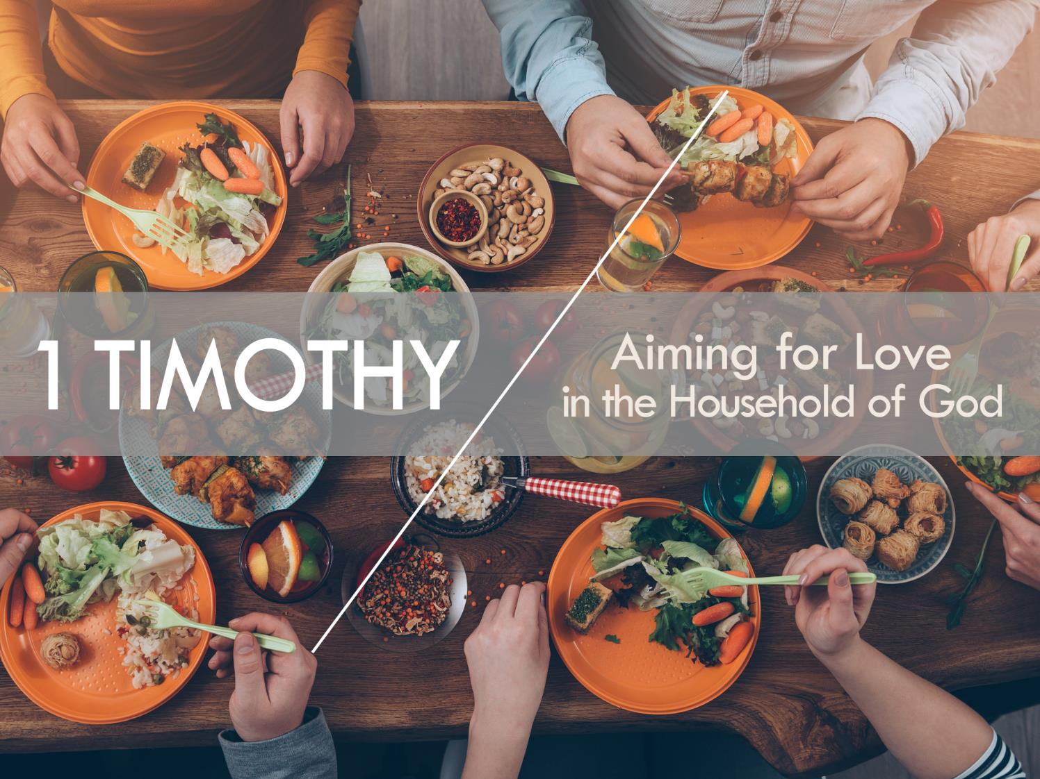

Slide 4
1 Timothy
Aiming for Love
in the Household of God
¹⁴ I hope to come to you soon, but I am writing these things to you so that, ¹⁵ if I delay, you may know how one ought to behave in the household of God, which is the church of the living God, a pillar and buttress of the truth.
¹⁶ Great indeed, we confess, is the mystery of godliness:
He was manifested in the flesh, vindicated by the Spirit, seen by angels, proclaimed among the nations, believed on in the world, taken up in glory.
1 Timothy 3:14-16

Slide 5
1 Timothy
Aiming for Love
in the Household of God
¹⁴ I hope to come to you soon, but I am writing these things to you so that, ¹⁵ if I delay, you may know how one ought to behave in the household of God, which is the church of the living God, a pillar and buttress of the truth.
¹⁶ Great indeed, we confess, is the mystery of godliness:
He was manifested in the flesh, vindicated by the Spirit, seen by angels, proclaimed among the nations, believed on in the world, taken up in glory.
1 Timothy 3:14-16
The aim of our charge is love that issues from a pure heart and a good conscience and a sincere faith. 1 Timothy 1:5

Slide 6
NT Pictures
of the Church
God’s Family—John 1:13; Matt. 23:8-10; Mark 3:32-35; 10:28-30; Gal. 6:10; 1 Tim. 3:15; 5:1-2; 1 Pet. 4:17; 210 verses from Acts to Revelation referring to Christians as “brothers” and “sisters”
The Body of Christ—John 2:19-22; Acts 9:5; Rom. 12:4-5; 1 Cor. 12:12-27
God’s Army—Matt. 16:18; Acts 15:36-38; Rom. 13:12; 1 Cor. 16:13; 2 Cor. 2:14-16; 6:7; 10:3-4; Eph. 6:10-18; Phil. 1:27-30; 2:25; Col. 2:5 (see also 2:15); 1 Thess. 5:8; 1 Tim. 6:12-14; 2 Tim. 2:3-4
God’s Building—1 Pet. 2:5; 1 Cor. 3:9b-17; Eph. 2:20-22
God’s Field—1 Cor. 3:6-9
Jesus’ Bride—Rev. 19:7-8; 2 Cor. 11:2-4; Eph. 5:25; James 4:4-5
God’s Flock—John 10:1-5
Checkout Members of One Another by Dennis McCallum

Slide 7
“Members”
in the NT
¹² For just as the body is one and has many members, and all the members of the body, though many, are one body, so it is with Christ.¹³ For in one Spirit we were all baptized into one body—Jews or Greeks, slaves or free—and all were made to drink of one Spirit. ¹⁴ For the body does not consist of one member but of many. ¹⁵ If the foot should say, “Because I am not a hand, I do not belong to the body,” that would not make it any less a part of the body. ¹⁶ And if the ear should say, “Because I am not an eye, I do not belong to the body,” that would not make it any less a part of the body. ¹⁷ If the whole body were an eye, where would be the sense of hearing? If the whole body were an ear, where would be the sense of smell? ¹⁸ But as it is, God arranged the members in the body, each one of them, as he chose.
1 Corinthians 12:12-18

Slide 8
“Members”
in the NT
¹⁹ If all were a single member, where would the body be? ²⁰ As it is, there are many parts, yet one body. ²¹ The eye cannot say to the hand, “I have no need of you,” nor again the head to the feet, “I have no need of you.” ²² On the contrary, the parts of the body that seem to be weaker are indispensable, ²³ and on those parts of the body that we think less honorable we bestow the greater honor, and our unpresentable parts are treated with greater modesty, ²⁴ which our more presentable parts do not require. But God has so composed the body, giving greater honor to the part that lacked it, ²⁵ that there may be no division in the body, but that the members may have the same care for one another. ²⁶ If one member suffers, all suffer together; if one member is honored, all rejoice together. ²⁷ Now you are the body of Christ and individually members of it.
1 Corinthians 12:19-27

Slide 9
“MEMBERS”
of the Church vs.
of Tallgrass Church 501(c)(3)
The Church | Tallgrass Church 501(c)(3)
Member by the blood of Christ | Member by the Bylaws
Eternal | Temporal
Invisible | Visible
Can’t resign membership | Can resign membership
Can be out of fellowship | Can’t be out of fellowship for long

Slide 10
Autonomy & affiliation
The Church is autonomous and maintains the right to govern its own affairs, independent of any denominational control. Recognizing, however, the benefits of cooperation with other churches in the fulfillment of its purposes, the Church may choose to voluntarily affiliate with organizations as fits our purpose and mission.
Section 5.01 Constitution/Bylaws

Slide 11
Qualifications
for membership
A Member shall have completed the Church’s membership class
Section 6.03 Constitution/Bylaws

Slide 12
Qualifications
for membership
A Member shall have completed the Church’s membership class
Section 6.03 Constitution/Bylaws
Welcome to Tallgrass Church Dinner
Sunday, October 14, 2018
6:30-8:00pm
in the Fellowship Hall

Slide 13
Qualifications
for membership
A Member shall have completed the Church’s membership class; and
A Member shall have made a written commitment to abide by our Church’s Membership Covenant.
Section 6.03 Constitution/Bylaws

Slide 14
Membership covenant
“Having received Christ as my Lord and Savior, and being in agreement with Tallgrass Church’s statements of belief, I now feel led by the Holy Spirit to unite with the Tallgrass Church family. In doing so, I commit myself to God and to the other members to do the following.”
Section 6.10 Constitution/Bylaws

Slide 15
Membership covenant
“Having received Christ as my Lord and Savior, and being in agreement with Tallgrass Church’s statements of belief, I now feel led by the Holy Spirit to unite with the Tallgrass Church family. In doing so, I commit myself to God and to the other members to do the following.”
Section 6.10 Constitution/Bylaws
Tallgrass Church’s Statements of Belief
Apostles Creed
Nicene Creed
1974 Lausanne Covenant
Statement on Marriage and Sexuality (Section 4.01)
1 Timothy 3:16
1 Corinthians 15:3b-7

Slide 16
1 Timothy
Aiming for Love
in the Household of God
¹⁴ I hope to come to you soon, but I am writing these things to you so that, ¹⁵ if I delay, you may know how one ought to behave in the household of God, which is the church of the living God, a pillar and buttress of the truth.
¹⁶ Great indeed, we confess, is the mystery of godliness:
He was manifested in the flesh, vindicated by the Spirit, seen by angels, proclaimed among the nations, believed on in the world, taken up in glory.
1 Timothy 3:14-16

Slide 17
apostles creed
I believe in God, the Father Almighty, Creator of heaven and earth.
I believe in Jesus Christ his only Son, our Lord.
He was conceived by the power of the Holy Spirit and born of the Virgin Mary.
He suffered under Pontius Pilate, was crucified, died and was buried.
He descended into hell (to the dead). On the third day he rose again.
He ascended into heaven, and is seated at the right hand of the Father.
Great indeed, we confess, is the mystery of godliness:
He was manifested
in the flesh, vindicated by the Spirit,
seen by angels, proclaimed
among the nations,
believed on
in the world,
taken up in glory.
1 Timothy 3:16

Slide 18
apostles creed
He will come again to judge the living and the dead.
I I believe in the Holy Spirit,
the holy catholic Church, the communion of saints,
the forgiveness of sins,
the resurrection of the body,
and life everlasting.
Amen.
Great indeed, we confess, is the mystery of godliness:
He was manifested
in the flesh, vindicated by the Spirit,
seen by angels, proclaimed
among the nations,
believed on
in the world,
taken up in glory.
1 Timothy 3:16

Slide 19
Membership covenant
1. I will protect the unity of my church by acting in love toward the other members, refusing to gossip, resolving conflicts, and by following the leaders. Ephesians 4:29; Hebrews 13:17
2. I will share in the responsibility of my church by praying for its growth, by inviting the unchurched to attend, and by warmly welcoming those who visit by coming alongside them wherever they are at on their spiritual journey. Ephesians 1:17-19
3. I will serve the ministry of my church by discovering my gifts and talents, by being equipped to serve by my leaders, and by developing a servant’s heart. Ephesians 4:11-12; Philippians 2:3-4, 7
4. I will support the testimony of my church by attending faithfully, by living a godly life, and by giving regularly. Hebrews 10:25; 1 Corinthians 16:2; Leviticus 27:30
Section 6.10 Constitution/Bylaws

Slide 20
Input rights
of membership
The Elder Team will solicit input from Church Membership through a process they deem best. This input period will be open for a minimum of two weeks on the following matters:
Acquisition of real property and incurring of indebtedness
Any business transaction beyond an approved budget and in excess of $10,000
The Annual Budget of the Church
Appointment of new Elders
Hiring of Staff
The Merger or Dissolution of the Church
Amendments to the Articles of Incorporation or Bylaws
Section 6.07 Constitution/Bylaws

Slide 21
APPLICATIONS
Get involved in the Tallgrass family

Slide 22
APPLICATIONS
Get involved in the Tallgrass family
Consider becoming a Member of the Tallgrass Church 501(c)(3)

Slide 23
APPLICATIONS
Get involved in the Tallgrass family
Consider becoming a Member of the Tallgrass Church 501(c)(3)
Worship Jesus Christ

Slide 24
APPLICATIONS
Get involved in the Tallgrass family
Consider becoming a Member of the Tallgrass Church 501(c)(3)
Worship Jesus Christ
Love one another

Slide 25
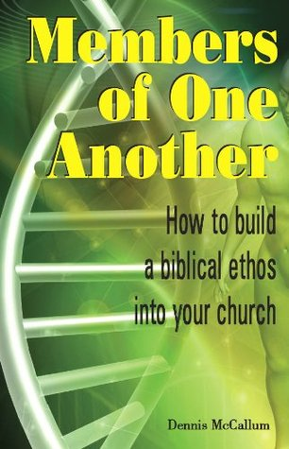
APPLICATIONS
Get involved in the Tallgrass family
Consider becoming a Member of the Tallgrass Church 501(c)(3)
Worship Jesus Christ
Love one another
Study the church more

Slide 27
LETTER
to the Church in Ephesus
¹ “To the angel of the church in Ephesus write: ‘The words of him who holds the seven stars in his right hand, who walks among the seven golden lampstands. ² “‘I know your works, your toil and your patient endurance, and how you cannot bear with those who are evil, but have tested those who call themselves apostles and are not, and found them to be false. ³ I know you are enduring patiently and bearing up for my name's sake, and you have not grown weary. ⁴ But I have this against you, that you have abandoned the love you had at first. ⁵ Remember therefore from where you have fallen; repent, and do the works you did at first. If not, I will come to you and remove your lampstand from its place, unless you repent. ⁶ Yet this you have: you hate the works of the Nicolaitans, which I also hate. ⁷ He who has an ear, let him hear what the Spirit says to the churches. To the one who conquers I will grant to eat of the tree of life, which is in the paradise of God.’” Revelation 2:1-7

