Slide 1
TALLGRASS
COMMUNITY CHURCH

Slide 3
1 Timothy 1:5-7
⁵ The aim of our charge is love that issues from a pure heart and a good conscience and a sincere faith. ⁶ Certain persons, by swerving from these, have wandered away into vain discussion, ⁷ desiring to be teachers of the law, without understanding either what they are saying or the things about which they make confident assertions.

Slide 4
What is the law?

Slide 5
What is the law?
Tells what’s right and wrong

Slide 6
What is the law?
Tells what’s right and wrong
How do we KNOW what’s right and wrong?

Slide 7
What is the law?
Tells what’s right and wrong
How do we KNOW what’s right and wrong?
Individuals

Slide 8
What is the law?
Tells what’s right and wrong
How do we KNOW what’s right and wrong?
Individuals
Groups / Societies

Slide 9
What is the law?
Tells what’s right and wrong
How do we KNOW what’s right and wrong?
Individuals
Groups / Societies
God

Slide 10
What is the law?
Tells what’s right and wrong
How do we KNOW what’s right and wrong?
Individuals
Groups / Societies
God
God’s Moral Law, revealed in the Old Testament

Slide 11
1 Timothy 1:8-11
⁸ Now we know that the law is good, if one uses it lawfully, ⁹understanding this, that the law is not laid down for the just but for the lawless and disobedient, for the ungodly and sinners, for the unholy and profane, for those who strike their fathers and mothers, for murderers,¹⁰ the sexually immoral, men who practice homosexuality, enslavers, liars, perjurers, and whatever else is contrary to sound doctrine, ¹¹ in accordance with the gospel of the glory of the blessed God with which I have been entrusted.

Slide 12
1 Timothy 1:8-11
⁸ Now we know that the law is good, if one uses it lawfully, ⁹understanding this, that the law is not laid down for the just but for the lawless and disobedient, for the ungodly and sinners, for the unholy and profane, for those who strike their fathers and mothers, for murderers,¹⁰ the sexually immoral, men who practice homosexuality, enslavers, liars, perjurers, and whatever else is contrary to sound doctrine, ¹¹ in accordance with the gospel of the glory of the blessed God with which I have been entrusted.

Slide 13
1 Timothy 1:8-11
⁸ Now we know that the law is good, if one uses it lawfully, ⁹understanding this, that the law is not laid down for the just but for the lawless and disobedient, for the ungodly and sinners, for the unholy and profane, for those who strike their fathers and mothers, for murderers,¹⁰ the sexually immoral, men who practice homosexuality, enslavers, liars, perjurers, and whatever else is contrary to sound doctrine, ¹¹ in accordance with the gospel of the glory of the blessed God with which I have been entrusted.

Slide 14
1 Timothy 1:8-11
⁸ Now we know that the law is good, if one uses it lawfully, ⁹understanding this, that the law is not laid down for the just but for the lawless and disobedient, for the ungodly and sinners, for the unholy and profane, for those who strike their fathers and mothers, for murderers,¹⁰ the sexually immoral, men who practice homosexuality, enslavers, liars, perjurers, and whatever else is contrary to sound doctrine, ¹¹ in accordance with the gospel of the glory of the blessed God with which I have been entrusted.

Slide 15
1 Timothy 1:8-11
⁸ Now we know that the law is good, if one uses it lawfully, ⁹understanding this, that the law is not laid down for the just but for the lawless and disobedient, for the ungodly and sinners, for the unholy and profane, for those who strike their fathers and mothers, for murderers,¹⁰ the sexually immoral, men who practice homosexuality, enslavers, liars, perjurers, and whatever else is contrary to sound doctrine, ¹¹ in accordance with the gospel of the glory of the blessed God with which I have been entrusted.
OBSERVATIONS

Slide 16
1 Timothy 1:8-11
⁸ Now we know that the law is good, if one uses it lawfully, ⁹understanding this, that the law is not laid down for the just but for the lawless and disobedient, for the ungodly and sinners, for the unholy and profane, for those who strike their fathers and mothers, for murderers,¹⁰ the sexually immoral, men who practice homosexuality, enslavers, liars, perjurers, and whatever else is contrary to sound doctrine, ¹¹ in accordance with the gospel of the glory of the blessed God with which I have been entrusted.
OBSERVATIONS
The Law is good
The Law can be used wrongly
The Law is not for the “just”
The Law is for “sinners”
The Law should be used in accordance with the Gospel

Slide 17
1 Timothy 1:8-11
⁸ Now we know that the law is good, if one uses it lawfully, ⁹understanding this, that the law is not laid down for the just but for the lawless and disobedient, for the ungodly and sinners, for the unholy and profane, for those who strike their fathers and mothers, for murderers,¹⁰ the sexually immoral, men who practice homosexuality, enslavers, liars, perjurers, and whatever else is contrary to sound doctrine, ¹¹ in accordance with the gospel of the glory of the blessed God with which I have been entrusted.
OBSERVATIONS
The Law is good
The Law can be used wrongly
The Law is not for the “just”
The Law is for “sinners”
The Law should be used in accordance with the Gospel

Slide 18
1 Timothy 1:8-11
⁸ Now we know that the law is good, if one uses it lawfully, ⁹understanding this, that the law is not laid down for the just but for the lawless and disobedient, for the ungodly and sinners, for the unholy and profane, for those who strike their fathers and mothers, for murderers,¹⁰ the sexually immoral, men who practice homosexuality, enslavers, liars, perjurers, and whatever else is contrary to sound doctrine, ¹¹ in accordance with the gospel of the glory of the blessed God with which I have been entrusted.
OBSERVATIONS
The Law is good
The Law can be used wrongly
The Law is not for the “just”
The Law is for “sinners”
The Law should be used in accordance with the Gospel

Slide 19
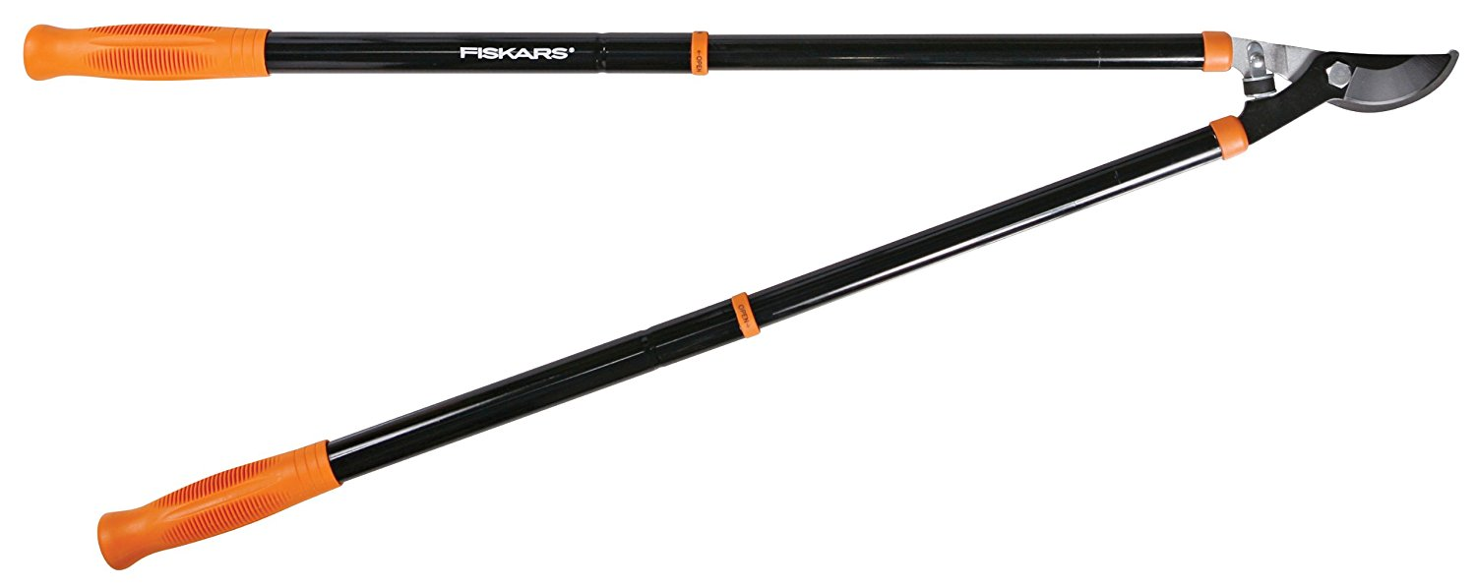
1 Timothy 1:8-11
⁸ Now we know that the law is good, if one uses it lawfully, ⁹understanding this, that the law is not laid down for the just but for the lawless and disobedient, for the ungodly and sinners, for the unholy and profane, for those who strike their fathers and mothers, for murderers,¹⁰ the sexually immoral, men who practice homosexuality, enslavers, liars, perjurers, and whatever else is contrary to sound doctrine, ¹¹ in accordance with the gospel of the glory of the blessed God with which I have been entrusted.
OBSERVATIONS
The Law is good
The Law can be used wrongly
The Law is not for the “just”
The Law is for “sinners”
The Law should be used in accordance with the Gospel

Slide 20
1 Timothy 1:8-11
⁸ Now we know that the law is good, if one uses it lawfully, ⁹understanding this, that the law is not laid down for the just but for the lawless and disobedient, for the ungodly and sinners, for the unholy and profane, for those who strike their fathers and mothers, for murderers,¹⁰ the sexually immoral, men who practice homosexuality, enslavers, liars, perjurers, and whatever else is contrary to sound doctrine, ¹¹ in accordance with the gospel of the glory of the blessed God with which I have been entrusted.
OBSERVATIONS
The Law is good
The Law can be used wrongly
The Law is not for the “just”
The Law is for “sinners”
The Law should be used in accordance with the Gospel

Slide 21
1 Timothy 1:8-11
⁸ Now we know that the law is good, if one uses it lawfully, ⁹understanding this, that the law is not laid down for the just but for the lawless and disobedient, for the ungodly and sinners, for the unholy and profane, for those who strike their fathers and mothers, for murderers,¹⁰ the sexually immoral, men who practice homosexuality, enslavers, liars, perjurers, and whatever else is contrary to sound doctrine, ¹¹ in accordance with the gospel of the glory of the blessed God with which I have been entrusted.
OBSERVATIONS
The Law is good
The Law can be used wrongly
The Law is not for the “just”
The Law is for “sinners”
The Law should be used in accordance with the Gospel

Slide 22
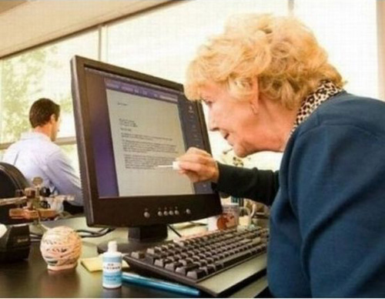
1 Timothy 1:8-11
⁸ Now we know that the law is good, if one uses it lawfully, ⁹understanding this, that the law is not laid down for the just but for the lawless and disobedient, for the ungodly and sinners, for the unholy and profane, for those who strike their fathers and mothers, for murderers,¹⁰ the sexually immoral, men who practice homosexuality, enslavers, liars, perjurers, and whatever else is contrary to sound doctrine, ¹¹ in accordance with the gospel of the glory of the blessed God with which I have been entrusted.
OBSERVATIONS
The Law is good
The Law can be used wrongly
The Law is not for the “just”
The Law is for “sinners”
The Law should be used in accordance with the Gospel

Slide 23
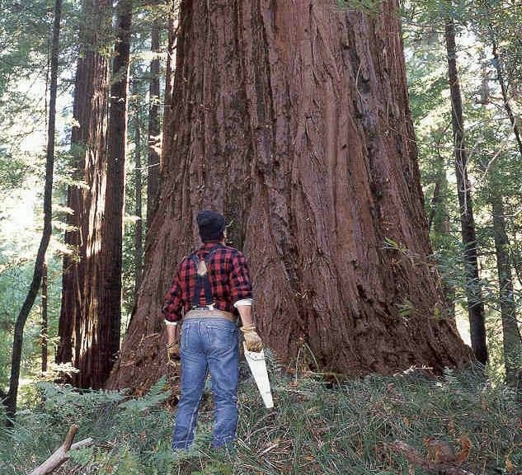
1 Timothy 1:8-11
⁸ Now we know that the law is good, if one uses it lawfully, ⁹understanding this, that the law is not laid down for the just but for the lawless and disobedient, for the ungodly and sinners, for the unholy and profane, for those who strike their fathers and mothers, for murderers,¹⁰ the sexually immoral, men who practice homosexuality, enslavers, liars, perjurers, and whatever else is contrary to sound doctrine, ¹¹ in accordance with the gospel of the glory of the blessed God with which I have been entrusted.
OBSERVATIONS
The Law is good
The Law can be used wrongly
The Law is not for the “just”
The Law is for “sinners”
The Law should be used in accordance with the Gospel

Slide 24
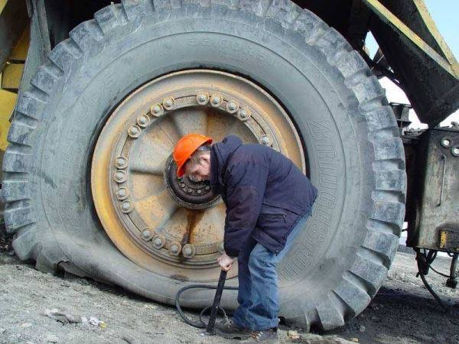
1 Timothy 1:8-11
⁸ Now we know that the law is good, if one uses it lawfully, ⁹understanding this, that the law is not laid down for the just but for the lawless and disobedient, for the ungodly and sinners, for the unholy and profane, for those who strike their fathers and mothers, for murderers,¹⁰ the sexually immoral, men who practice homosexuality, enslavers, liars, perjurers, and whatever else is contrary to sound doctrine, ¹¹ in accordance with the gospel of the glory of the blessed God with which I have been entrusted.
OBSERVATIONS
The Law is good
The Law can be used wrongly
The Law is not for the “just”
The Law is for “sinners”
The Law should be used in accordance with the Gospel

Slide 25
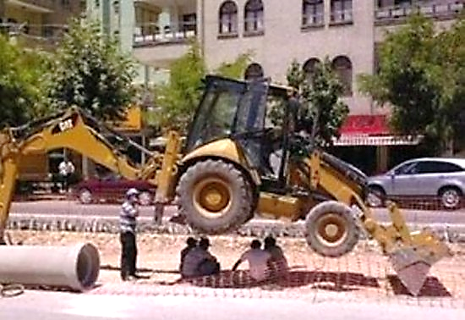
1 Timothy 1:8-11
⁸ Now we know that the law is good, if one uses it lawfully, ⁹understanding this, that the law is not laid down for the just but for the lawless and disobedient, for the ungodly and sinners, for the unholy and profane, for those who strike their fathers and mothers, for murderers,¹⁰ the sexually immoral, men who practice homosexuality, enslavers, liars, perjurers, and whatever else is contrary to sound doctrine, ¹¹ in accordance with the gospel of the glory of the blessed God with which I have been entrusted.
OBSERVATIONS
The Law is good
The Law can be used wrongly
The Law is not for the “just”
The Law is for “sinners”
The Law should be used in accordance with the Gospel

Slide 26
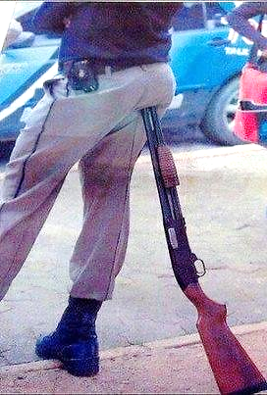
1 Timothy 1:8-11
⁸ Now we know that the law is good, if one uses it lawfully, ⁹understanding this, that the law is not laid down for the just but for the lawless and disobedient, for the ungodly and sinners, for the unholy and profane, for those who strike their fathers and mothers, for murderers,¹⁰ the sexually immoral, men who practice homosexuality, enslavers, liars, perjurers, and whatever else is contrary to sound doctrine, ¹¹ in accordance with the gospel of the glory of the blessed God with which I have been entrusted.
OBSERVATIONS
The Law is good
The Law can be used wrongly
The Law is not for the “just”
The Law is for “sinners”
The Law should be used in accordance with the Gospel

Slide 27
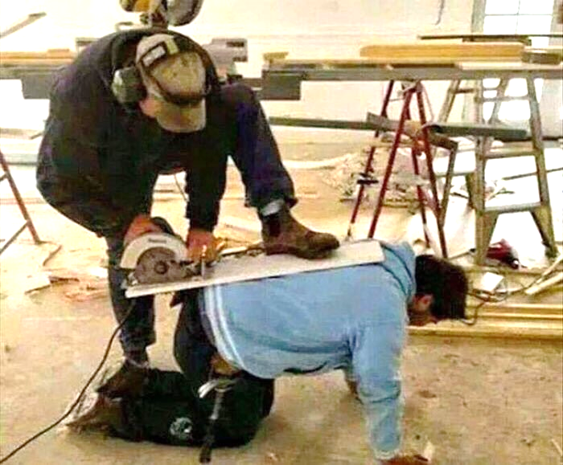
1 Timothy 1:8-11
⁸ Now we know that the law is good, if one uses it lawfully, ⁹understanding this, that the law is not laid down for the just but for the lawless and disobedient, for the ungodly and sinners, for the unholy and profane, for those who strike their fathers and mothers, for murderers,¹⁰ the sexually immoral, men who practice homosexuality, enslavers, liars, perjurers, and whatever else is contrary to sound doctrine, ¹¹ in accordance with the gospel of the glory of the blessed God with which I have been entrusted.
OBSERVATIONS
The Law is good
The Law can be used wrongly
The Law is not for the “just”
The Law is for “sinners”
The Law should be used in accordance with the Gospel

Slide 28
1 Timothy 1:8-11
⁸ Now we know that the law is good, if one uses it lawfully, ⁹understanding this, that the law is not laid down for the just but for the lawless and disobedient, for the ungodly and sinners, for the unholy and profane, for those who strike their fathers and mothers, for murderers,¹⁰ the sexually immoral, men who practice homosexuality, enslavers, liars, perjurers, and whatever else is contrary to sound doctrine, ¹¹ in accordance with the gospel of the glory of the blessed God with which I have been entrusted.
OBSERVATIONS
The Law is good
The Law can be used wrongly
The Law is not for the “just”
The Law is for “sinners”
The Law should be used in accordance with the Gospel

Slide 29
1 Timothy 1:8-11
⁸ Now we know that the law is good, if one uses it lawfully, ⁹understanding this, that the law is not laid down for the just but for the lawless and disobedient, for the ungodly and sinners, for the unholy and profane, for those who strike their fathers and mothers, for murderers,¹⁰ the sexually immoral, men who practice homosexuality, enslavers, liars, perjurers, and whatever else is contrary to sound doctrine, ¹¹ in accordance with the gospel of the glory of the blessed God with which I have been entrusted.
James 2:10 For whoever keeps the whole law but fails in one point has become guilty of all of it.
OBSERVATIONS
The Law is good
The Law can be used wrongly
The Law is not for the “just”
The Law is for “sinners”
The Law should be used in accordance with the Gospel

Slide 30
1 Timothy 1:8-11
⁸ Now we know that the law is good, if one uses it lawfully, ⁹understanding this, that the law is not laid down for the just but for the lawless and disobedient, for the ungodly and sinners, for the unholy and profane, for those who strike their fathers and mothers, for murderers,¹⁰ the sexually immoral, men who practice homosexuality, enslavers, liars, perjurers, and whatever else is contrary to sound doctrine, ¹¹ in accordance with the gospel of the glory of the blessed God with which I have been entrusted.
Romans 3:9 There is no one righteous, not even one.
OBSERVATIONS
The Law is good
The Law can be used wrongly
The Law is not for the “just”
The Law is for “sinners”
The Law should be used in accordance with the Gospel

Slide 31
1 Timothy 1:8-11
⁸ Now we know that the law is good, if one uses it lawfully, ⁹understanding this, that the law is not laid down for the just but for the lawless and disobedient, for the ungodly and sinners, for the unholy and profane, for those who strike their fathers and mothers, for murderers,¹⁰ the sexually immoral, men who practice homosexuality, enslavers, liars, perjurers, and whatever else is contrary to sound doctrine, ¹¹ in accordance with the gospel of the glory of the blessed God with which I have been entrusted.
Romans 3:21-22 ²¹ But now the righteousness of God has been manifested apart from the law, although the Law and the Prophets bear witness to it— ²² the righteousness of God through faith in Jesus Christ for all who believe.
OBSERVATIONS
The Law is good
The Law can be used wrongly
The Law is not for the “just”
The Law is for “sinners”
The Law should be used in accordance with the Gospel

Slide 32
1 Timothy 1:8-11
⁸ Now we know that the law is good, if one uses it lawfully, ⁹understanding this, that the law is not laid down for the just but for the lawless and disobedient, for the ungodly and sinners, for the unholy and profane, for those who strike their fathers and mothers, for murderers,¹⁰ the sexually immoral, men who practice homosexuality, enslavers, liars, perjurers, and whatever else is contrary to sound doctrine, ¹¹ in accordance with the gospel of the glory of the blessed God with which I have been entrusted.
2 Corinthians 5:21 For our sake he made him to be sin who knew no sin, so that in him we might become the righteousness of God.
OBSERVATIONS
The Law is good
The Law can be used wrongly
The Law is not for the “just”
The Law is for “sinners”
The Law should be used in accordance with the Gospel

Slide 33
1 Timothy 1:8-11
⁸ Now we know that the law is good, if one uses it lawfully, ⁹understanding this, that the law is not laid down for the just but for the lawless and disobedient, for the ungodly and sinners, for the unholy and profane, for those who strike their fathers and mothers, for murderers,¹⁰ the sexually immoral, men who practice homosexuality, enslavers, liars, perjurers, and whatever else is contrary to sound doctrine, ¹¹ in accordance with the gospel of the glory of the blessed God with which I have been entrusted.
OBSERVATIONS
The Law is good
The Law can be used wrongly
The Law is not for the “just”
The Law is for “sinners”
The Law should be used in accordance with the Gospel

Slide 34
1 Timothy 1:8-11
Romans 3:19-20 ¹⁹ Now we know that whatever the law says it speaks to those who are under the law, so that every mouth may be stopped, and the whole world may be held accountable to God. ²⁰ For by works of the law no human being will be justified in his sight, since through the law comes knowledge of sin.
⁸ Now we know that the law is good, if one uses it lawfully, ⁹understanding this, that the law is not laid down for the just but for the lawless and disobedient, for the ungodly and sinners, for the unholy and profane, for those who strike their fathers and mothers, for murderers,¹⁰ the sexually immoral, men who practice homosexuality, enslavers, liars, perjurers, and whatever else is contrary to sound doctrine, ¹¹ in accordance with the gospel of the glory of the blessed God with which I have been entrusted.
OBSERVATIONS
The Law is good
The Law can be used wrongly
The Law is not for the “just”
The Law is for “sinners”
The Law should be used in accordance with the Gospel

Slide 35
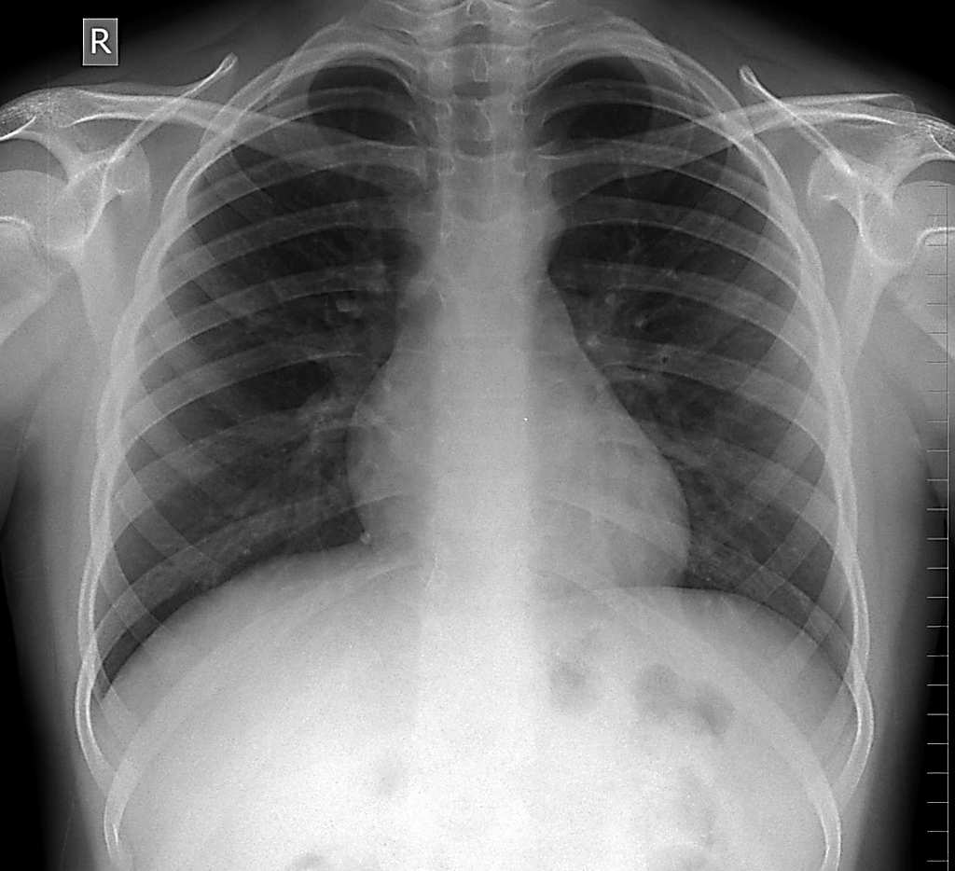
1 Timothy 1:8-11
⁸ Now we know that the law is good, if one uses it lawfully, ⁹understanding this, that the law is not laid down for the just but for the lawless and disobedient, for the ungodly and sinners, for the unholy and profane, for those who strike their fathers and mothers, for murderers,¹⁰ the sexually immoral, men who practice homosexuality, enslavers, liars, perjurers, and whatever else is contrary to sound doctrine, ¹¹ in accordance with the gospel of the glory of the blessed God with which I have been entrusted.
OBSERVATIONS
The Law is good
The Law can be used wrongly
The Law is not for the “just”
The Law is for “sinners”
The Law should be used in accordance with the Gospel

Slide 36
1 Timothy 1:8-11
⁸ Now we know that the law is good, if one uses it lawfully, ⁹understanding this, that the law is not laid down for the just but for the lawless and disobedient, for the ungodly and sinners, for the unholy and profane, for those who strike their fathers and mothers, for murderers,¹⁰ the sexually immoral, men who practice homosexuality, enslavers, liars, perjurers, and whatever else is contrary to sound doctrine, ¹¹ in accordance with the gospel of the glory of the blessed God with which I have been entrusted.
OBSERVATIONS
The Law is good
The Law can be used wrongly
The Law is not for the “just”
The Law is for “sinners”
The Law should be used in accordance with the Gospel

Slide 37
1 Timothy 1:8-11
⁸ Now we know that the law is good, if one uses it lawfully, ⁹understanding this, that the law is not laid down for the just but for the lawless and disobedient, for the ungodly and sinners, for the unholy and profane, for those who strike their fathers and mothers, for murderers,¹⁰ the sexually immoral, men who practice homosexuality, enslavers, liars, perjurers, and whatever else is contrary to sound doctrine, ¹¹ in accordance with the gospel of the glory of the blessed God with which I have been entrusted.
Romans 10:3-4 ³For [the Jews], being ignorant of the righteousness of God, and seeking to establish their own, they did not submit to God's righteousness. ⁴ For Christ is the end of the law for righteousness to everyone who believes.
OBSERVATIONS
The Law is good
The Law can be used wrongly
The Law is not for the “just”
The Law is for “sinners”
The Law should be used in accordance with the Gospel

Slide 38
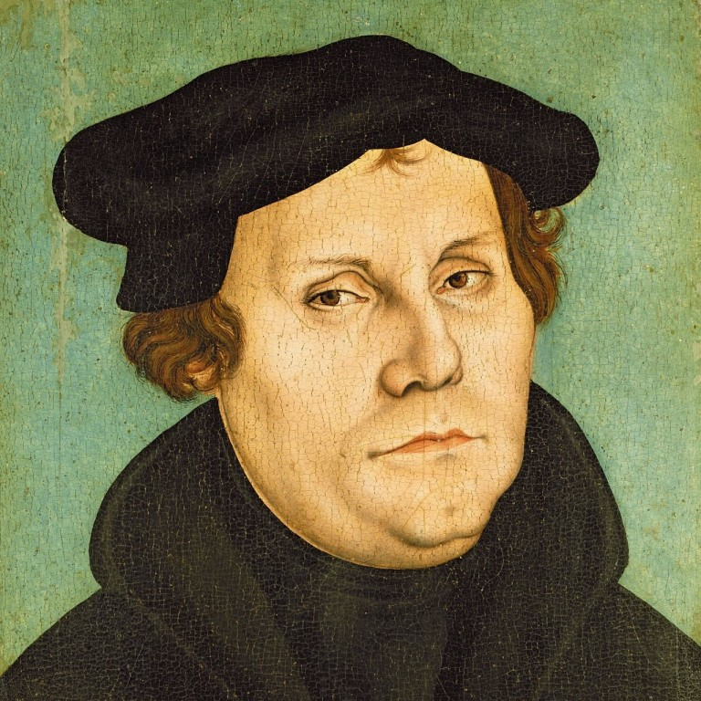
1 Timothy 1:8-11
⁸ Now we know that the law is good, if one uses it lawfully, ⁹understanding this, that the law is not laid down for the just but for the lawless and disobedient, for the ungodly and sinners, for the unholy and profane, for those who strike their fathers and mothers, for murderers,¹⁰ the sexually immoral, men who practice homosexuality, enslavers, liars, perjurers, and whatever else is contrary to sound doctrine, ¹¹ in accordance with the gospel of the glory of the blessed God with which I have been entrusted.
“The . . . principal purpose of the law (is to be) a mighty hammer to crush the self-righteousness of human beings. For it shows them their sin, so that by the recognition of sin they may be humbled . . . and so may long for grace and for (Christ).” – Martin Luther
OBSERVATIONS
The Law is good
The Law can be used wrongly
The Law is not for the “just”
The Law is for “sinners”
The Law should be used in accordance with the Gospel

Slide 39
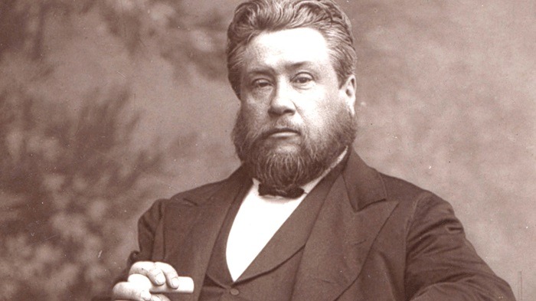
1 Timothy 1:8-11
⁸ Now we know that the law is good, if one uses it lawfully, ⁹understanding this, that the law is not laid down for the just but for the lawless and disobedient, for the ungodly and sinners, for the unholy and profane, for those who strike their fathers and mothers, for murderers,¹⁰ the sexually immoral, men who practice homosexuality, enslavers, liars, perjurers, and whatever else is contrary to sound doctrine, ¹¹ in accordance with the gospel of the glory of the blessed God with which I have been entrusted.
“I do not believe that any man can preach the gospel who does not preach the Law. The Law is the needle, and you cannot draw the silken thread of the gospel through a man’s heart unless you first send the needle of the Law to make way for it.” – Charles Spurgeon
OBSERVATIONS
The Law is good
The Law can be used wrongly
The Law is not for the “just”
The Law is for “sinners”
The Law should be used in accordance with the Gospel

Slide 40
1 Timothy 1:8-11
Galatians 3:23-26 ²³ Now before faith came, we were held captive under the law, imprisoned until the coming faith would be revealed. ²⁴ So then, the law was our guardian until Christ came, in order that we might be justified by faith. ²⁵ But now that faith has come, we are no longer under a guardian, ²⁶ for in Christ Jesus you are all sons of God, through faith.
⁸ Now we know that the law is good, if one uses it lawfully, ⁹understanding this, that the law is not laid down for the just but for the lawless and disobedient, for the ungodly and sinners, for the unholy and profane, for those who strike their fathers and mothers, for murderers,¹⁰ the sexually immoral, men who practice homosexuality, enslavers, liars, perjurers, and whatever else is contrary to sound doctrine, ¹¹ in accordance with the gospel of the glory of the blessed God with which I have been entrusted.
OBSERVATIONS
The Law is good
The Law can be used wrongly
The Law is not for the “just”
The Law is for “sinners”
The Law should be used in accordance with the Gospel

Slide 41
INCORRECT USES OF LAW

Slide 42
INCORRECT USES OF LAW
#1: For nonbelievers to earn their right standing with God.

Slide 43
INCORRECT USES OF LAW
#1: For nonbelievers to earn their right standing with God.
#2: For Christians to maintain their right standing with God.

Slide 44
INCORRECT USES OF LAW
#1: For nonbelievers to earn their right standing with God.
#2: For Christians to maintain their right standing with God.
Romans 7:6 But now we are released from the law, having died to that which held us captive, so that we serve in the new way of the Spirit and not in the old way of the written code.

Slide 45
INCORRECT USES OF LAW
#1: Nonbelievers need to keep the law to earn right standing w/ God
#2: Christians need to keep the law to maintain their right standing with God
Romans 6:1-2, 13-14 ¹What shall we say then? Are we to continue in sin that grace may abound? ² By no means! How can we who died to sin still live in it? … ¹³ Do not present your members to sin as instruments for unrighteousness, but present yourselves to God as those who have been brought from death to life, and your members to God as instruments for righteousness. ¹⁴ For sin will have no dominion over you, since you are not under law but under grace.

Slide 46
INCORRECT USES OF LAW
#1: For nonbelievers to earn their right standing with God.
#2: For Christians to maintain their right standing with God.
#3: For Christians to grow spiritually.*

Slide 47
INCORRECT USES OF LAW
#1: For nonbelievers to earn their right standing with God.
#2: For Christians to maintain their right standing with God.
#3: For Christians to grow spiritually.*
- LAW MOTIVATION vs GRACE MOTIVATION

Slide 48
INCORRECT USES OF LAW
#1: For nonbelievers to earn their right standing with God.
#2: For Christians to maintain their right standing with God.
#3: For Christians to grow spiritually.*
- LAW MOTIVATION vs GRACE MOTIVATION
Galatians 3:3 Are you so foolish? Having begun by the Spirit, are you now being perfected by the flesh?“

Slide 49
APPLICATIONS
Nonbeliever:
1) Look into the Law and run to Christ.

Slide 50
APPLICATIONS
Nonbeliever:
1) Look into the Law and run to Christ.
Christians:

Slide 51
APPLICATIONS
Nonbeliever:
1) Look into the Law and run to Christ.
Christians: 2) Quit trying to earn God’s favor.

Slide 52
APPLICATIONS
Nonbeliever:
1) Look into the Law and run to Christ.
Christians: 2) Quit trying to earn God’s favor.
3) Quit living in condemnation and shame when you fail.

Slide 53
APPLICATIONS
Nonbeliever:
1) Look into the Law and run to Christ.
Christians: 2) Quit trying to earn God’s favor.
3) Quit living in condemnation and shame when you fail.
4) Sit and simmer in God’s secure, unconditional love for you.

Slide 54
APPLICATIONS
Nonbeliever:
1) Look into the Law and run to Christ.
Christians: 2) Quit trying to earn God’s favor.
3) Quit living in condemnation and shame when you fail.
4) Sit and simmer in God’s secure, unconditional love for you.
5) Live and love in freedom.

Slide 55
Recommended resources
1) New Testament Books of Romans and Galatians
2) “Walking in Victory” by Dennis McCallum

Slide 57
How have you seen this play out in your life?
What might it be like for you to REALLY live this way? What might be different?

