Slide 1
TALLGRASS
COMMUNITY CHURCH

Slide 3
Tallgrass Church Mission Statement: Because God first loved us, we exist to love God and love our neighbors.

Slide 4
1. Why believe in God?
2. Why believe the Bible?
3. Why believe in Jesus?
4. What’s my next step?

Slide 5
1. Why believe in God?
2. Why believe the Bible?
3. Why believe in Jesus?
4. What’s my next step?

Slide 6
Clue 1: Origin of the Universe
Are you gonna put your faith in NOTHING or GOD?
Clue 2: Fine-Tuning of the Universe
Are you gonna put your faith in the MULTIVERSE or GOD?
Clue 3: Morality
Are you gonna put your faith in HUMANITY or GOD?
Clue #4: Love & Beauty
Does love and beauty come from EVOLUTION or GOD?

Slide 7
1. Why believe in God?
2. Why believe the Bible?
3. Why believe in Jesus?
4. What’s my next step?

Slide 8
Hasn’t the Bible been changed?
2. Isn’t the Bible filled with historical
inaccuracies and contradictions?
3. Isn’t the Bible just another holy
book?

Slide 9
1. Why believe in God?
2. Why believe the Bible?
3. Why believe in Jesus?
4. What’s my next step?

Slide 10
1. Jesus Died by Crucifixion
2. The Disciples’ Believed Jesus Rose and
Appeared to Them
3. Paul was Suddenly Changed
4. James was Suddenly Changed
5. The Tomb was Empty

Slide 11
1. Why believe in God?
2. Why believe the Bible?
3. Why believe in Jesus?
4. What’s my next step?

Slide 12
DOUBT…
duh, duh, duh!

Slide 13
Dealing with Doubt

Slide 14
Dealing with Doubt
Mark 9:24 “I believe; help my unbelief!”

Slide 15
Dealing with Doubt
Mark 9:24 “I believe; help my unbelief!”
Jude 22 “And have mercy on those who doubt…”

Slide 16
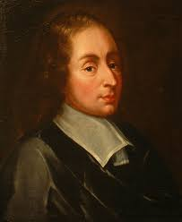
Dealing with Doubt
Mark 9:24 “I believe; help my unbelief!”
Jude 22 “And have mercy on those who doubt…”
“Seeing too much to deny and too little to be sure.”
—Blaise Pascal

Slide 17
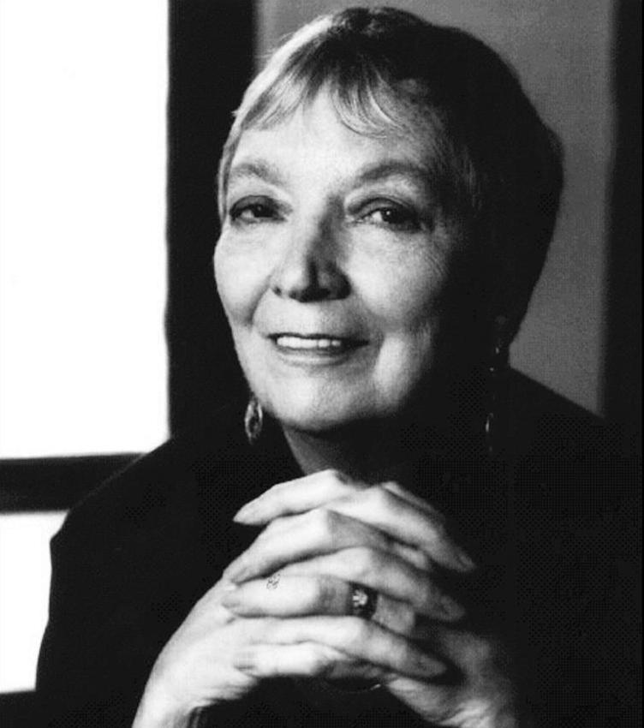
Dealing with Doubt
Mark 9:24 “I believe; help my unbelief!”
Jude 22 “And have mercy on those who doubt…”
“Those who believe they believe in God, but without passion in the heart, without anguish of mind, without uncertainty, without doubt, and even at times without despair, believe only in the idea of God, and not in God.”
—Madeleine L’Engle

Slide 18
Three Kinds of Doubt:
1. Factual Doubt
2. Emotional Doubt
3. Willful Doubt

Slide 19
Causes of Emotional Doubt:
psychological problems
medical problems
faulty view of God
childhood problems
old wounds
judging by feelings
need for attention
lack of sleep
peer pressure
identifying with fiction
Christian hypocrisy
concern about the unforgivable sin
anxiety about the future
judgment and Hell

Slide 20
Three Kinds of Doubt:
1. Factual Doubt
2. Emotional Doubt
3. Willful Doubt

Slide 21
Questions/Testimonies:
What questions remain?
2. How have you experienced
factual/emotional/willful doubt?
3. How have you engaged with your doubt?
4. How have you engaged with others’ doubts?

Slide 22
Scary Steps of Reasonable Faith: 1. Consider the evidence, risk commitment. 2. Gain confidence in your faith. 3. Grow in your ability to talk about this with others. 4. Consider how you need to more fully align your life with Jesus as Lord (then repent).

Slide 24
RESOURCES:
The Reason for God: Belief in an Age of Skepticism, Tim Keller ($10 on Resource Table)
Discovering God: Exploring the Possibilities of Faith, Dennis McCallum ($Free.99 on Welcome Table)
Evidence Unseen: Exposing the Myth of Blind Faith, James Rochford (www.evidenceunseen.com)
The Case for the Resurrection of Jesus, Gary Habermas & Mike Licona
The Case for Christ: A Journalist’s Personal Investigation of the Evidence for Jesus, Lee Strobel
The New Evidence that Demands a Verdict, Josh McDowell
Dealing with Doubt, Gary Habermas ($FREE.99 online)
The Myth of Certainty: The Reflective Christian & the Risk of Commitment, Daniel Taylor

Slide 26
Different Types of Doubters:
Thomas
Other Disciples
John the Baptist
Jewish Leaders
Father Abraham
King David
Paul
Brothers in Luke 16 story
Judas Iscariot
Humanity
Jesus

Slide 27
Different Types of Doubters:
Factual:
Thomas
Other Disciples
John the Baptist
Jewish Leaders
Brothers in Luke 16 story
Humanity
Emotional:
Father Abraham
King David
Paul
Humanity
Jesus
Volitional:
Jewish Leaders
Judas Iscariot
Brothers in Luke 16 story
Father Abraham
King David
Humanity

