Slide 2
TALLGRASS
COMMUNITY CHURCH

Slide 3
TALLGRASS
COMMUNITY CHURCH
DAVE GELDART | Associate Pastor

Slide 4
TALLGRASS
COMMUNITY CHURCH
SUNDAYS 5-6:15^{PM}

Slide 5
TALLGRASS
COMMUNITY CHURCH
WHERE TO TAKE KIDS

Slide 6
TALLGRASS
COMMUNITY CHURCH
WHERE TO TAKE FOOD

Slide 7
TALLGRASS
COMMUNITY CHURCH
WHERE TO GIVE DONATIONS

Slide 8
TALLGRASS
COMMUNITY CHURCH
HOW TO STAY IN TOUCH

Slide 9
TALLGRASS
COMMUNITY CHURCH
TALLGRASS.CHURCH

Slide 10
TALLGRASS
COMMUNITY CHURCH
INFO@TALLGRASS.CHURCH

Slide 11
TALLGRASS
COMMUNITY CHURCH
INFO@TALLGRASS.CHURCH

Slide 12
TALLGRASS
COMMUNITY CHURCH
RICKY GREEVE | Elder

Slide 13
TALLGRASS
COMMUNITY CHURCH
What brings you here?

Slide 14
TALLGRASS
COMMUNITY CHURCH
BEN DEAVER| Lead Pastor

Slide 15
RECLAIMING
neighboring

Slide 16
RECLAIMING
neighboring
APRIL 15| God first loved us.
APRIL 22| Love God.
APRIL 29| Love our neighbors.

Slide 17
FIRST TIMOTHY
paul’s letter to a young leader

Slide 18
FIRST TIMOTHY 3
paul’s letter to a young leader
¹⁴ I hope to come to you soon, but I am writing these things to you so that, ¹⁵ if I delay, you may know how one ought to behave in the household of God, which is the church of the living God, a pillar and buttress of the truth.

Slide 19
RECLAIMING
tallgrass

Slide 20
TALLGRASS
COMMUNITY CHURCH
Why are you here?

Slide 21
TALLGRASS
COMMUNITY CHURCH
WHY are you here?

Slide 22
TALLGRASS
COMMUNITY CHURCH
What are you bringing with you?

Slide 23
TALLGRASS
COMMUNITY CHURCH

Slide 24
RECLAIMING
tallgrass

Slide 25
TALLGRASS PRAIRIE
national park service
Where's the tall grass? Tallgrass prairie once covered 170 million acres of North America. Within a generation the vast majority was developed and plowed under. Today less than 4% remains, mostly here in the Kansas Flint Hills. The preserve protects a nationally significant remnant of the once vast tallgrass prairie and its cultural resources. Here the tallgrass prairie takes its last stand.

Slide 26
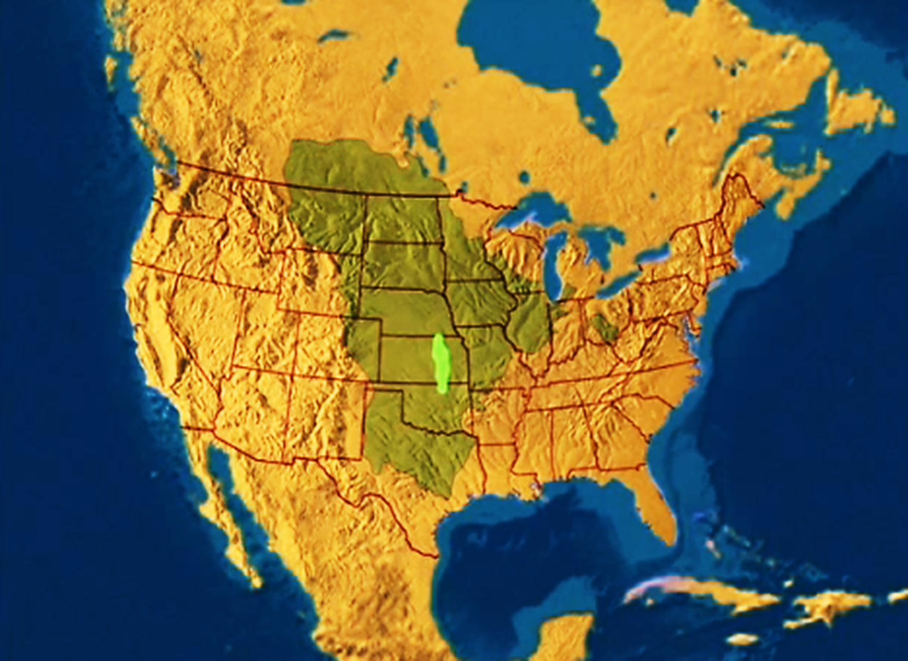
ORIGINAL vs. REMAINING PRAIRIE
Last Stand of the the Tallgrass Prairie (2001 documentary)

Slide 27
ISAIAH 61
future reality
^{10a} I will greatly rejoice in the Lord; my soul shall exult in my God… ¹¹ For as the earth brings forth its sprouts, and as a garden causes what is sown in it to sprout up, so the Lord God will cause righteousness and praise to sprout up before all the nations.

Slide 28
LUKE 4
jesus’ ministry
¹⁸ “The Spirit of the Lord is upon me, because he has anointed me to proclaim good news to the poor. He has sent me to proclaim
liberty to the captives and recovering of sight to the blind, to set at liberty those who are oppressed, ¹⁹ to proclaim the year of the Lord's favor.”

Slide 29
ISAIAH 61
jesus’ ministry
^{2b} …and the day of vengeance of our God; to comfort all who mourn; ³ to grant to those who mourn in Zion— to give them a beautiful headdress
instead of ashes, the oil of gladness instead of mourning, the garment of praise
instead of a faint spirit; that they may be called
oaks of righteousness, the planting of the Lord,
that he may be glorified.

Slide 30
ISAIAH 61
current reality
^{10a} I will greatly rejoice in the Lord; my soul shall exult in my God… ¹¹ For as the earth brings forth its sprouts, and as a garden causes what is sown in it to sprout up, so the Lord God will cause righteousness and praise to sprout up before all the nations.

Slide 31
1 CORINTHIANS 3
God gives the growth
⁴ For when one says, “I follow Paul,” and another, “I follow Apollos,” are you not being merely human? ⁵ What then is Apollos? What is Paul? Servants through whom you believed, as the Lord assigned to each. ⁶ I planted, Apollos watered, but
God gave the growth.

Slide 32
1 CORINTHIANS 15
first importance
¹ Now I would remind you, brothers and sisters, of the gospel I preached to you, which you received, in which you stand, ² and by which you are being saved, if you hold fast to the word I preached to you—unless you believed in vain.

Slide 33
1 CORINTHIANS 15
first importance
³ For I delivered to you as of first importance what I also received: that Christ died for our sins in accordance with the Scriptures, ⁴ that he was buried, that he was raised on the third day in accordance with the Scriptures, ⁵ and that he appeared to Cephas, then to the twelve.

Slide 34
1 CORINTHIANS 15
first importance
⁶ Then he appeared to more than five hundred brothers at one time, most of whom are still alive, though some have fallen asleep. ⁷ Then he appeared to James, then to all the apostles. ⁸ Last of all, as to one untimely born, he appeared also to me. ¹¹ Whether then it was I or they, so we preach and so you believed.

Slide 35
1 CORINTHIANS 3
you are God’s field
⁷ So neither he who plants nor he who waters is anything, but only God who gives the growth. ⁸ He who plants and he who waters are one, and each will receive his wages according to his labor. ⁹ For we are God's fellow workers. You are God's field,
God's building.

Slide 36
RECLAIMING
tallgrass

Slide 37
JOYS & SORROWS
testimonies

Slide 38
TAKE COURAGE
by Bethel

Slide 39
TAKE COURAGE
Slow down, take time
"Breathe in," He said
He'd reveal what's to come
The thoughts in His mind
Always higher than mine
He'll reveal all to come
[See Isaiah 55:8-9]
by Bethel

Slide 40
TAKE COURAGE
So take courage my heart
Stay steadfast my soul
He's in the waiting
He's in the waiting
And hold onto your hope
As your triumph unfolds
He's never failing
He's never failing
by Bethel

Slide 41
TAKE COURAGE
Sing praise my soul
Find strength in joy
Let His words lead you on
Do not forget
His great faithfulness
He'll finish all He's begun
[See Nehemiah 8:10]
by Bethel

Slide 42
TAKE COURAGE
So take courage my heart
Stay steadfast my soul
He's in the waiting
He's in the waiting
And hold onto your hope
As your triumph unfolds
He's never failing
He's never failing
by Bethel

Slide 43
TAKE COURAGE
And You who hold the stars
Who call them each by name
Will surely keep Your promise to me
That I will rise in Your victory!
by Bethel

Slide 44
TAKE COURAGE
So take courage my heart
Stay steadfast my soul
He's in the waiting
He's in the waiting
And hold onto your hope
As your triumph unfolds
He's never failing
He's never failing
by Bethel

Slide 45
JESUS PAID IT ALL
by Kristian Stanfill

Slide 46
JESUS PAID IT ALL
I hear the Savior say, “Thy strength indeed is small
Child of weakness, watch and pray
Find in me thine all in all”
by Kristian Stanfill

Slide 47
JESUS PAID IT ALL
Jesus paid it all
All to him I owe
Sin had left a crimson stain
He washed it white as snow
by Kristian Stanfill

Slide 48
JESUS PAID IT ALL
Lord, now indeed I find
Thy power and thine alone
can change the leper's spots
and melt the heart of stone
by Kristian Stanfill

Slide 49
JESUS PAID IT ALL
Jesus paid it all
All to him I owe
Sin had left a crimson stain
He washed it white as snow
by Kristian Stanfill

Slide 50
JESUS PAID IT ALL
When from my dying bed my ransomed soul shall rise
“Jesus died my soul to save”
shall rend the vaulted skies
by Kristian Stanfill

Slide 51
JESUS PAID IT ALL
Jesus paid it all
All to him I owe
Sin had left a crimson stain
He washed it white as snow
by Kristian Stanfill

Slide 52
JESUS PAID IT ALL
Oh praise the one who paid my debt
and raised this life up from the dead
by Kristian Stanfill

Slide 53
JESUS PAID IT ALL
And when before the throne
I stand in Him complete I’ll lay my trophies down
All down at Jesus’ feet
by Kristian Stanfill

Slide 54
JESUS PAID IT ALL
Jesus paid it all
All to him I owe
Sin had left a crimson stain
He washed it white as snow
by Kristian Stanfill

Slide 55
JOY OF THE LORD
by Rend Collective

Slide 56
JOY OF THE LORD
Though the tears may fall
My song will rise, my song will rise to You
Though my heart may fail
My song will rise, my song will rise to You
While there's breath in my lungs
I will praise You, Lord

Slide 57
JOY OF THE LORD
In the dead of night,
I'll lift my eyes, I'll lift my eyes to You
Though the waters rise,
I'll lift my eyes, I'll lift my eyes to You
While there's hope in this heart
I will praise You, Lord
by Rend Collective

Slide 58
JOY OF THE LORD
The joy of the Lord is my strength!
The joy of the Lord is my strength!
In the darkness I'll dance
In the shadows I'll sing
The joy of the Lord is my strength!
by Rend Collective

Slide 59
JOY OF THE LORD
When I cannot see You with my eyes
Let faith arise to You
When I cannot feel Your hand in mine
Let faith arise to You
God of mercy and love
I will praise You, Lord
by Rend Collective

Slide 60
JOY OF THE LORD
How You shine with glory, Lord of light
I feel alive with You
In Your presence now I come alive
I am alive with You
There is strength when I say:
“I will praise You, Lord”
by Rend Collective

Slide 61
JOY OF THE LORD
The joy of the Lord is my strength!
The joy of the Lord is my strength!
In the darkness I'll dance
In the shadows I'll sing
The joy of the Lord is my strength!
by Rend Collective

Slide 62
JOY OF THE LORD
When sorrow comes my way
You’re the shield around me
Always, You remain
My courage in the fight
I hear You call my name
Jesus, I am coming
Walking on the waves
Reaching for Your light!
by Rend Collective

Slide 63
JOY OF THE LORD
The joy of the Lord is my strength!
The joy of the Lord is my strength!
In the darkness I'll dance
In the shadows I'll sing
The joy of the Lord is my strength!
by Rend Collective

Slide 64
JOY
by Rend Collective

Slide 65
JOY
We're choosing celebration
Breaking into freedom
You're the song,
You're the song of our hearts
We cast aside our shadows
Trust You with our sorrows
You're the song,
You're the song of our hearts
by Rend Collective

Slide 66
JOY
We're dancing to the rhythm of Your heart
We're rising from the ashes to the stars
by Rend Collective

Slide 67
JOY
You're the joy, joy, joy lighting my soul
The joy, joy, joy making me whole
Though I'm broken, I am running
into Your arms of love
by Rend Collective

Slide 68
JOY
The pain will not define us
Joy will reignite us
You're the song,
You're the song of our hearts.
The dark is just a canvas
for Your grace and brightness
You're the song,
You're the song of our hearts
by Rend Collective

Slide 69
JOY
We're dancing to the rhythm of Your heart
We're rising from the ashes to the stars
by Rend Collective

Slide 70
JOY
You're the joy, joy, joy lighting my soul
The joy, joy, joy making me whole
Though I'm broken, I am running
into Your arms of love
by Rend Collective

Slide 71
JOY
In the shadows
In the sorrows
In the desert
When the pain hits
You are constant
Ever-present
You're the song of my heart
by Rend Collective

Slide 72
JOY
You're the joy, joy, joy lighting my soul
The joy, joy, joy making me whole
Though I'm broken, I am running
into Your arms of love
by Rend Collective

Slide 73
YES AND AMEN
by Housefires

Slide 74
YES AND AMEN
Father of kindness
You have poured out grace
You brought me out of darkness
You have filled me with peace
Giver of mercy You're my
help in time of need
Lord I can't help but sing:
by Housefires

Slide 75
YES AND AMEN
Faithful You are
Faithful forever You will be
Faithful You are
All Your promises are yes and Amen
All Your promises are yes and Amen
[See 2 Corinthians 1:20]
by Housefires

Slide 76
YES AND AMEN
Beautiful Savior
You have brought me near
You pulled me from the ashes
You have broken every curse
Blessed redeemer
You have set this captive free
Lord I can't help but sing:
by Housefires

Slide 77
YES AND AMEN
Faithful You are
Faithful forever You will be
Faithful You are
All Your promises are yes and Amen
All Your promises are yes and Amen
[See 2 Corinthians 1:20]
by Housefires

Slide 78
YES AND AMEN
I will rest in Your promises
My confidence is Your faithfulness
by Housefires

Slide 79
YES AND AMEN
Faithful You are
Faithful forever You will be
Faithful You are
All Your promises are yes and Amen
All Your promises are yes and Amen
[See 2 Corinthians 1:20]
by Housefires

Slide 80
TALLGRASS
COMMUNITY CHURCH

